Slide 1
National Institute of Technology Srinagar
“ERGONOMICS”
Seminar Presentation
7th Semester 2017
Pushpendra Singh
IT/49/13

Slide 2
Ergonomics :
According to International Labor Organization, ergonomics is the application of the human biological sciences in conjunction with engineering sciences to the worker and his working environment, so as to obtain maximum satisfaction for the worker and at the same time enhance productivity.
The term ergonomics was coined from the Greek words Ergon (meaning "work") and nomos (meaning "rules). So the literal meaning is "the rules of work," Ergonomics is the science of fitting the work-place conditions and job demands to the capabilities of the working population. The goal of ergonomics is to make the work place more comfortable and to improve both health and productivity.

Slide 3
WHY Ergonomics :
Due to poor ergonomics there are certain risk factors that lead to injuries and disorders.
Risk Factors :
Repetitive motion
Awkward posture
Long periods of repetitive activity (duration)
Lack of recovery time
Forceful movement
Stressful work organization

Slide 4
Applications of ergonomics :
Ergonomics at home
Ergonomics and computer user.
Ergonomics and driving
Ergonomics and the office.
Ergonomics and the automotive machines.

Slide 5
Ergonomics and computer user:
The personal computer is rapidly becoming a common household item and is now a necessary tool for all small businesses.
Machine Setup:
Chair
Keyboard
Mouse
Desk
Human Setup:
Posture
Eyes

Slide 6
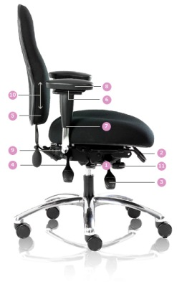
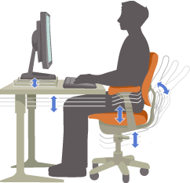
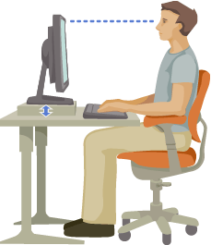
Chair Height System Alignment Distance From Screen

Slide 7
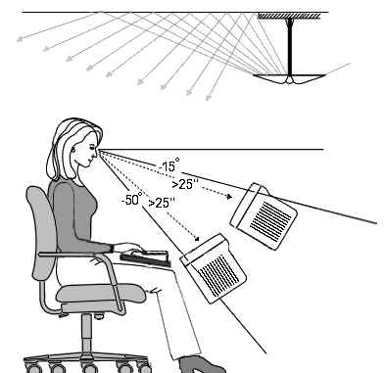
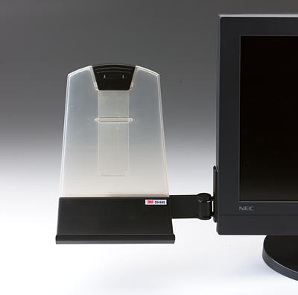
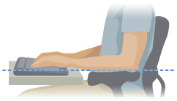
Lighting Document Holder Keyboard Setup

Slide 8
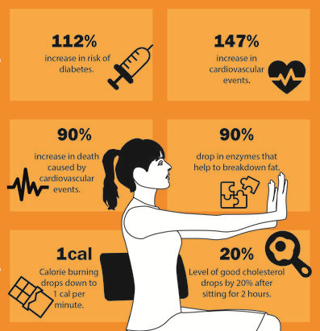
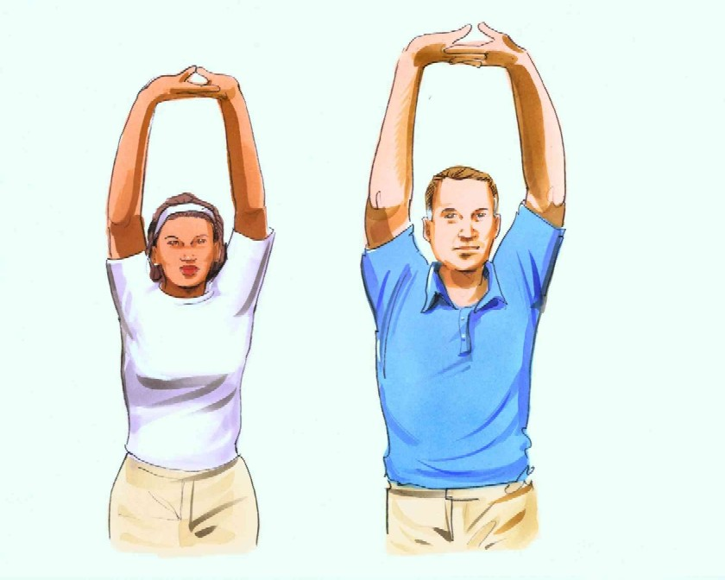
Take break and Relax more often

Slide 9
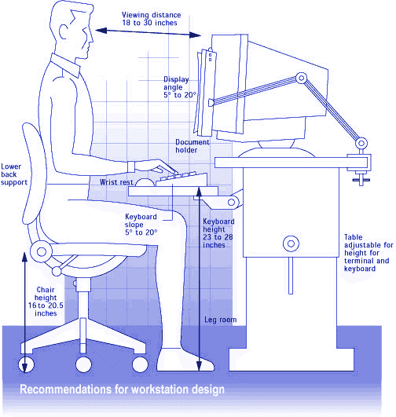
Complete Workstation Setup

Slide 10
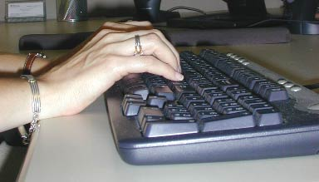
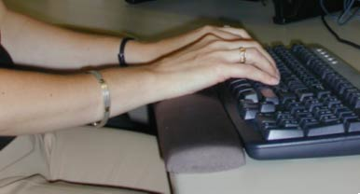
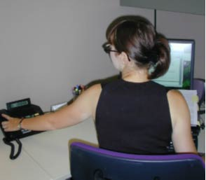
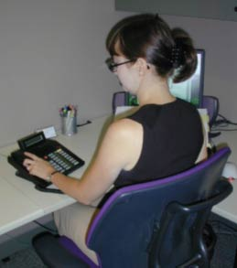
Real life Problems and Solutions

Slide 11
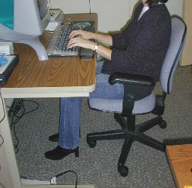
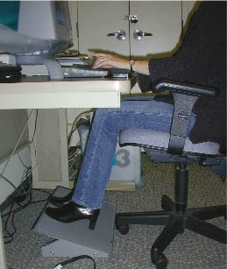
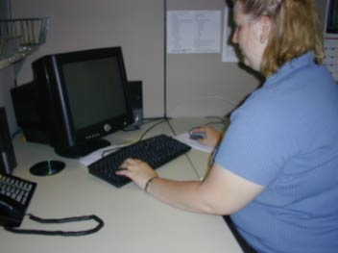
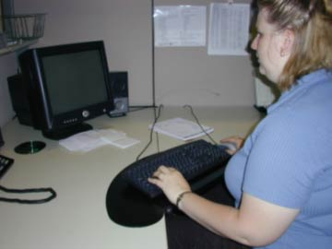

Slide 12
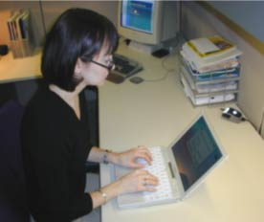
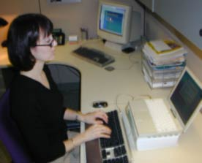

Slide 13
ergonomics IN daily life:
Sitting
Standing
Walking
Texting
Sleeping
Driving
Lifting

Slide 14
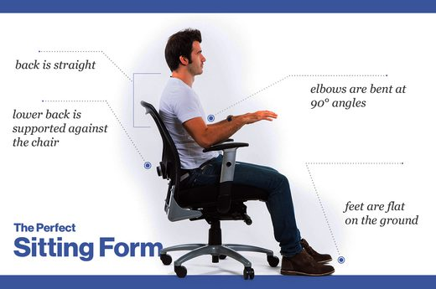

Slide 15
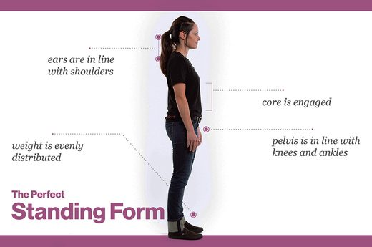

Slide 16
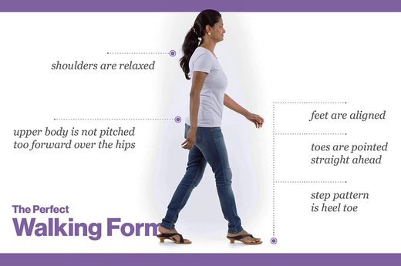

Slide 17
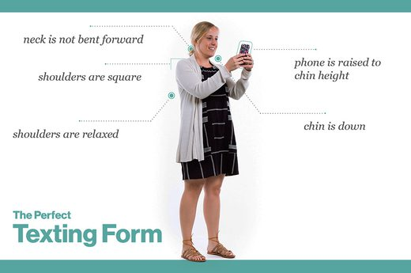

Slide 18
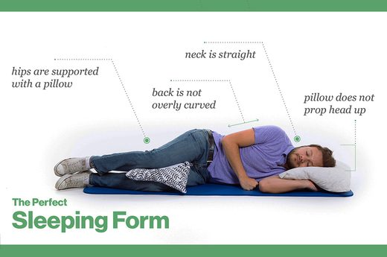

Slide 19
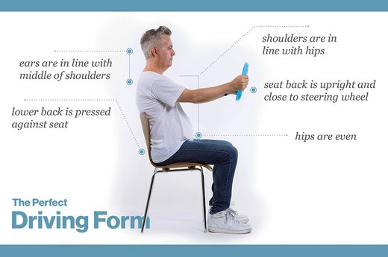

Slide 20
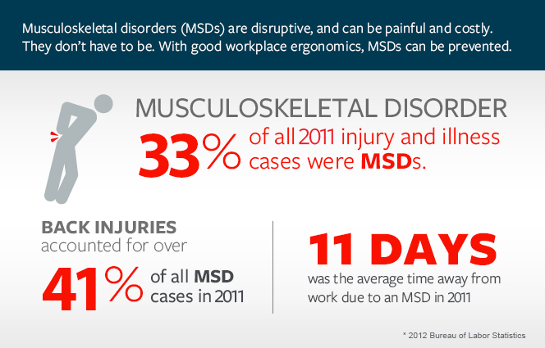
Affects of poor Ergonomics
MUSCULOSKELETAL DISORDERS (MSD)
It can range from general aches and pains to more serious problems. Medical practitioners do recommend that all the users who use computers regularly should report signs and symptoms
as early as possible to prevent serious injury or permanent damage

Slide 21
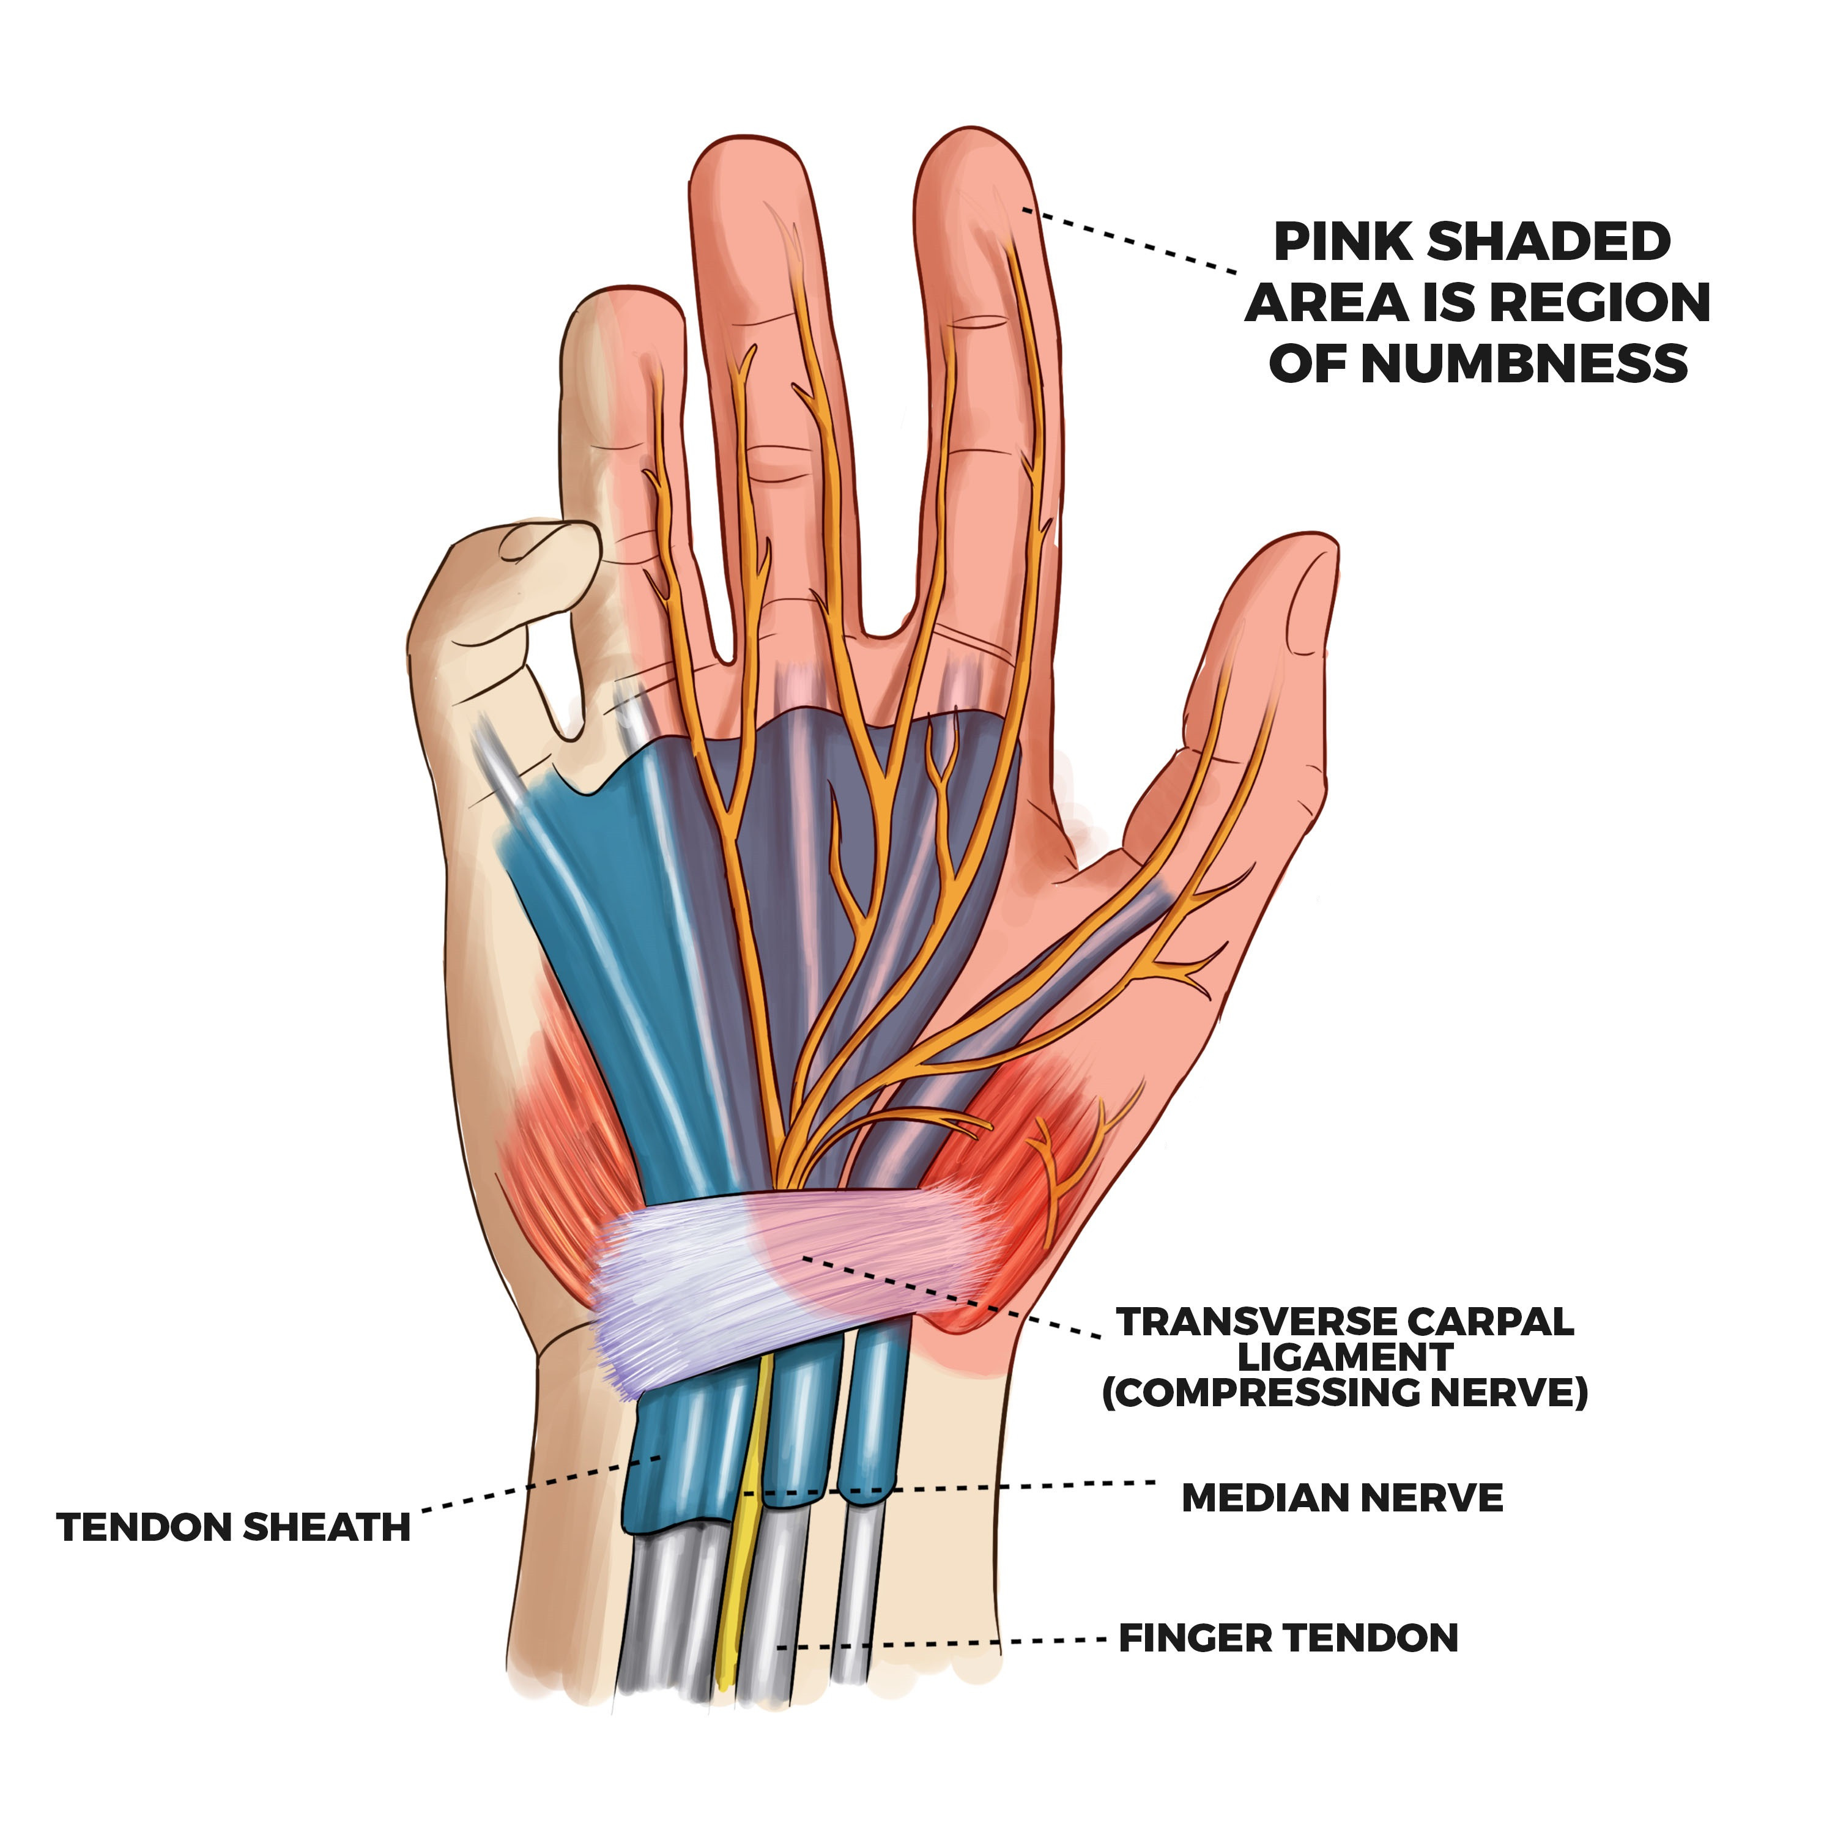
Affects of poor Ergonomics
Carpal Tunnel Syndrome (CTS)
CTS is a pinched nerve (called the Median nerve) in the wrist. When the protective lining of the tendons within the carpal tunnel inflamed and swell or when the ligament that forms the roof becomes thicker and broader leads to Carpal Tunnel Syndrome.
• Working with wrists that are bent;
• A high rate of repetition using the hands;
• A lack of rest for the hands and wrists; and
• Forceful hand motions.

Slide 22
prevention

Slide 23
THANK YOU !
I WILL TAKE YOUR QUESTIONS NOW
IF THERE ANY .

