Slide 1
Vacation Plan App
Agenda
Introduction
Problem Statement
Simple Use Case
Demo
Feedback
Design & Implementation Details

Slide 2
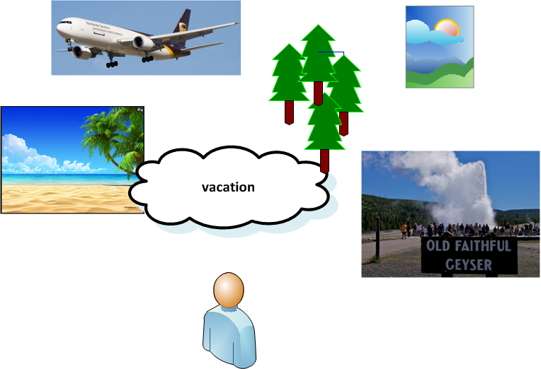
Planning a Vacation
Notes:
When the average person plans a vacation, they spend a lot of time considering the possibilities, … imagining themselves at far away locations, … seeing the sights, … relaxing ,…..

Slide 3
Software Engineer Planning a Vacation
Notes:
When engineers plan a vacation they imagine the calendar apps, .. spreadsheets, … and checklists , they get to create and use !!

Slide 4
Vacation Plan App
Problem Statement
Why do we carefully store the itineraries, reservation and confirmation numbers?
Where and how to store this?
Mike’s spreadsheet? (better bring the laptop along)
Notes:
We need ready access to this information before, during and after the vacation. Not having this information can literally end a vacation. But a laptop computer isn’t always practical, and the information only resides on the laptop, i.e. it is not shared.

Slide 5
Vacation Plan App
Solution Statement
A website may be the answer !
Remote access
Shared access is possible
Mobile Devices can access it
Notes:
List some advantages of the Website solution. Also point out that this Website design could be adapted for anything else needing a list - home repair projects , grocery shopping list.

Slide 6
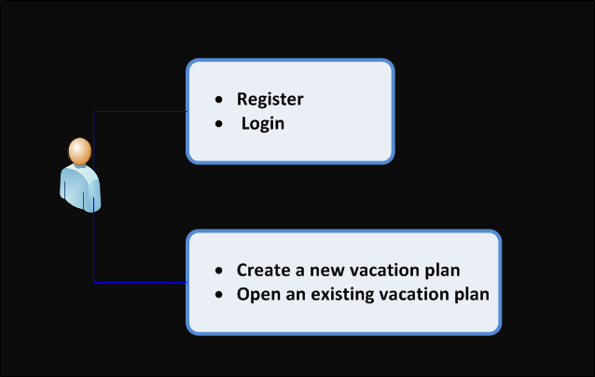
Happy Path Use Case Summary
Notes:
Lets introduce our website with the HAPPY PATH Use Case flow chart - page 1 In this slide and the next we only present a summary of the users view for the purpose of familiarizing the audience with the application. More details will come later.

Slide 7
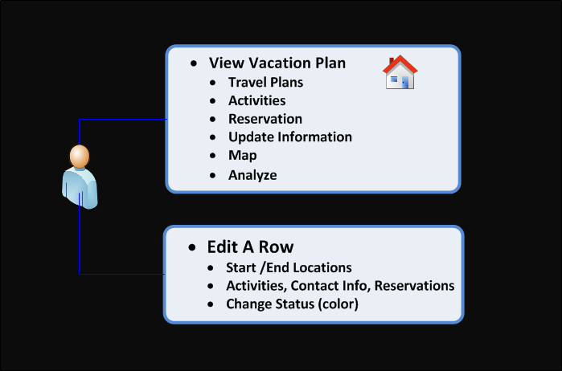
Happy Path Use Case Summary
Notes:
HAPPY PATH use case chart - page 2 In this slide and the previous one, we only present a summary of the users view for the purpose of familiarizing the audience with the application. More details will come later.

Slide 8
DEMO
Register
Create a vacation
Add at least 3 rows
In the last row ( to provide some feed back on the UI )
in morning activity – enter a positive comment
In afternoon activity – enter a negative comment
In evening activity – enter a suggestion
SAVE
Notes:
Near the end of the demo, we could ask them all to enter a new row, and put 1 positive statements in the morning activities box , 1 negative statements in the afternoon activities box, and 1 suggestion in the afternoon activities box. Then SAVE. This will give us some UI design feedback.

Slide 9
DEMO
IN THE DEMO YOU ASSISTED US WITH
UI evaluation
Focus group using & testing the UI
Load testing
Several concurrent users
Notes:
These important parts of the design process help ensure an intuitive and robust product. Thank you for your assistance.

Slide 10
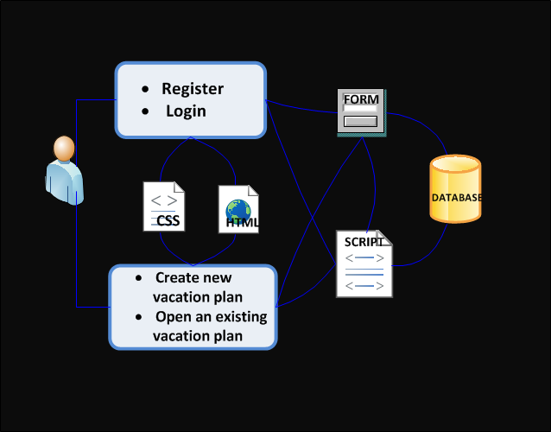
Technologies used
HTML5
CSS
Bootstrap
jQuery
Bootbox
Javascript
MySQL
Modal
Google Map API
Audio
Icons
Buttons
TextAreas
Inputs
Forms
Hidden attribute
Notes:
Here are some of the details.

Slide 11
Highlighted Technologies
Google Map API
Bootstrap
Had build in resizing, formatting, colored buttons,…
Bootbox
Modal message boxes built on bootstrap and jQuery
Query parameters ….
better security and special characters
Login using encryption and SALT for storing password.
Notes:
Here are a few technologies / code modules we would like to highlight

Slide 12
Technical Challenges
NetBeans IDE did not always show errors
Chrome Inspector was better at this
Bootstrap versions were not forward/backward compatible.
Javascript is very picky and not informative about errors

Slide 13
Software Development
Agile
Weekly iterations
Daily story / task assignments
Scope – realistic
Start small, make it work, expand on it
GIT worked great !

Slide 14
Progress against Plan
We accomplished most of what we set out to.

Slide 15
Proposal Key Features
Implemented All !!
Create User Account
User Login
Create New Vacation
Display Vacation
Update Existing Vacation
Delete Vacation
Store Core Information about Each Day
Notes:
Achieved all key Features

Slide 16
Proposal Bonus Features
Store Addition Advanced Information - some
Calculate Mileage Traveled Each Day - all
Provide a Map Showing Route - all
Provide Reports about Trips - all
Color Code Vacation to Alert to Areas of Concern - all
Security Measures Beyond Basic Login - some
Polished UI - some

Slide 17
Scope
Out of Scope items
Security audit / refactoring
Refactor to add accessibility
Review fonts, CSS, for consistency page-to-page
More UI testing
More performance and scale testing
Add captcha to register screen
Add Twilio notification reminders
Notes:
There are many things that would still need to be done for a commercial website

