Slide 1
Programming in jsPsych
Week 10: Online Integration
(saving data online; integration with SONA and Prolific)

Slide 2
Manipulating internal data vs writing to an external file
We have gone through how to add trial data and experiment data in previous weeks. (Internal data structure)
Writing the data to an external file is another matter.
Documentation: see https://www.jspsych.org/overview/data/
The simplest method: saving a .csv file of each participant’s data.

Slide 3
Create PHP file called write_data.php
<?php
$post_data = json_decode(file_get_contents('php://input'), true);
$name = "data/".$post_data['filename'].".csv"; $data = $post_data['filedata']; file_put_contents($name, $data);
?>

Slide 4
In your experiment code
function saveData(name, data){
var xhr = new XMLHttpRequest(); xhr.open('POST', 'write_data.php’); xhr.setRequestHeader('Content-Type', 'application/json’); xhr.send(JSON.stringify({filename: name, filedata: data}));
}

Slide 5
In your experiment code
saveData(id+".csv",jsPsych.data.get().csv()) needs to appear before the end of the experiment.
(id is the random identifier you have given your participants)

Slide 6
In your experiment code
var second_to_last_trial = {
type: jsPsychHtmlKeyboardResponse,
stimulus: "Please wait while your responses are transmitted to the server.",
choices: "NO_KEYS",
trial_duration: 5000,
on_load: function(){
saveData(id + "_interaction.csv", jsPsych.data.getInteractionData().csv());
saveData(id + ".csv", jsPsych.data.get().csv());
}
}

Slide 7
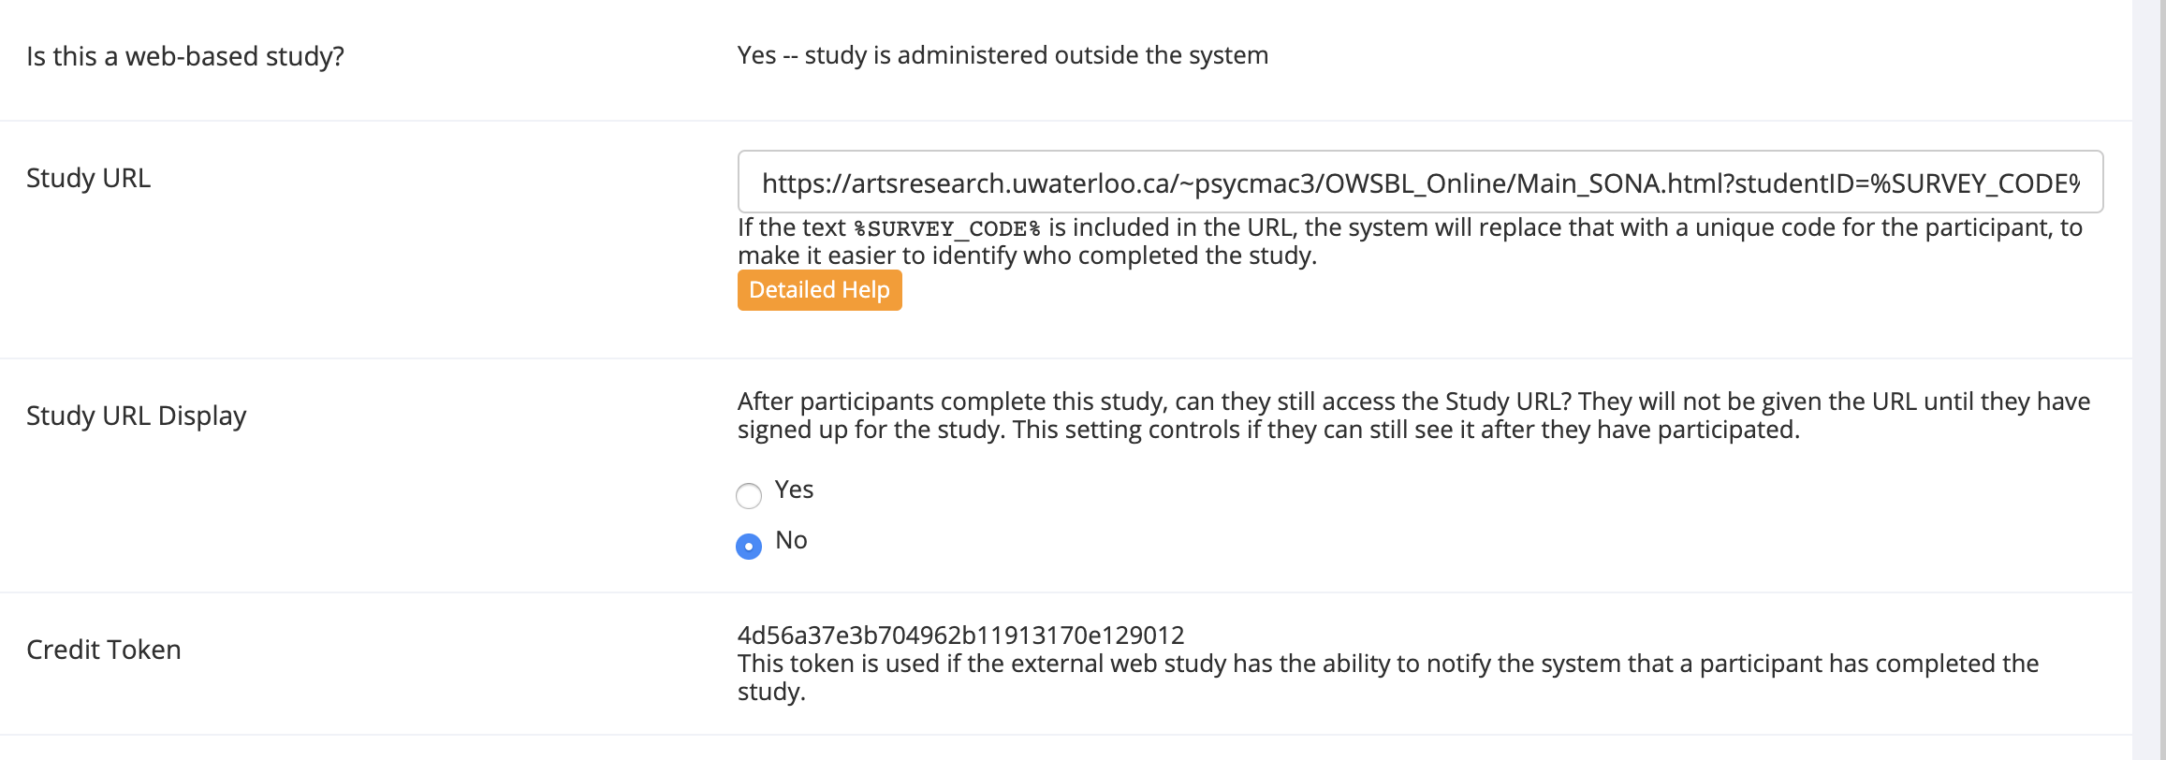
Integration with SONA

Slide 8
SONA URL with embedded ID code
Embed %SURVEY_CODE% at the end of your URL:
https://yourstudy.com/study.html?studentID=%SURVEY_CODE%
SONA will populate %SURVEY_CODE% with each student’s unique SONA ID.

Slide 9
In your experiment code
var sona_id = jsPsych.data.getURLVariable("studentID");

Slide 10
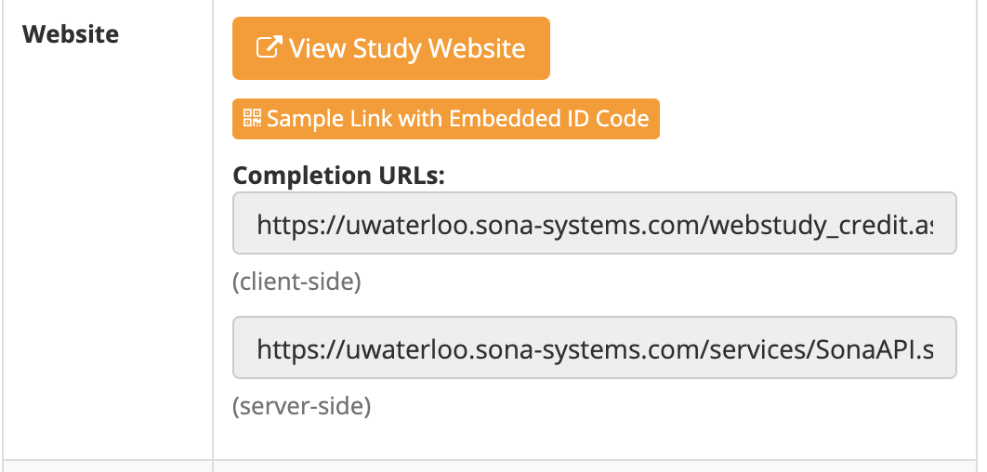
Completion URL:
https://uwaterloo.sona-systems.com/webstudy_credit.aspx?experiment_id= 4851&credit_token= 34ad9ee74a1e426eb2d212b83ca4d8e1&survey_code= XXXX

Slide 11
In your experiment code
var sona_id = jsPsych.data.getURLVariable("studentID");
var experimentID = 4851
var tokenID = "34ad9ee74a1e426eb2d212b83ca4d8e1"
var credit_url = `https://uwaterloo.sona-systems.com/webstudy_credit.aspx?experiment_id=${experimentID}&credit_token=${tokenID}&survey_code=${sona_id}`

Slide 12
In your experiment code
var sona_trial = {
type: jsPsychHtmlKeyboardResponse,
stimulus: function(){
return `<p>Thanks! You have completed the experiment.</p><p><a href='${credit_url}'><b>Please click here to return to SONA, and you will receive your credit right away!</b></a></p>.`
},
choices: "NO_KEYS",
}

Slide 13
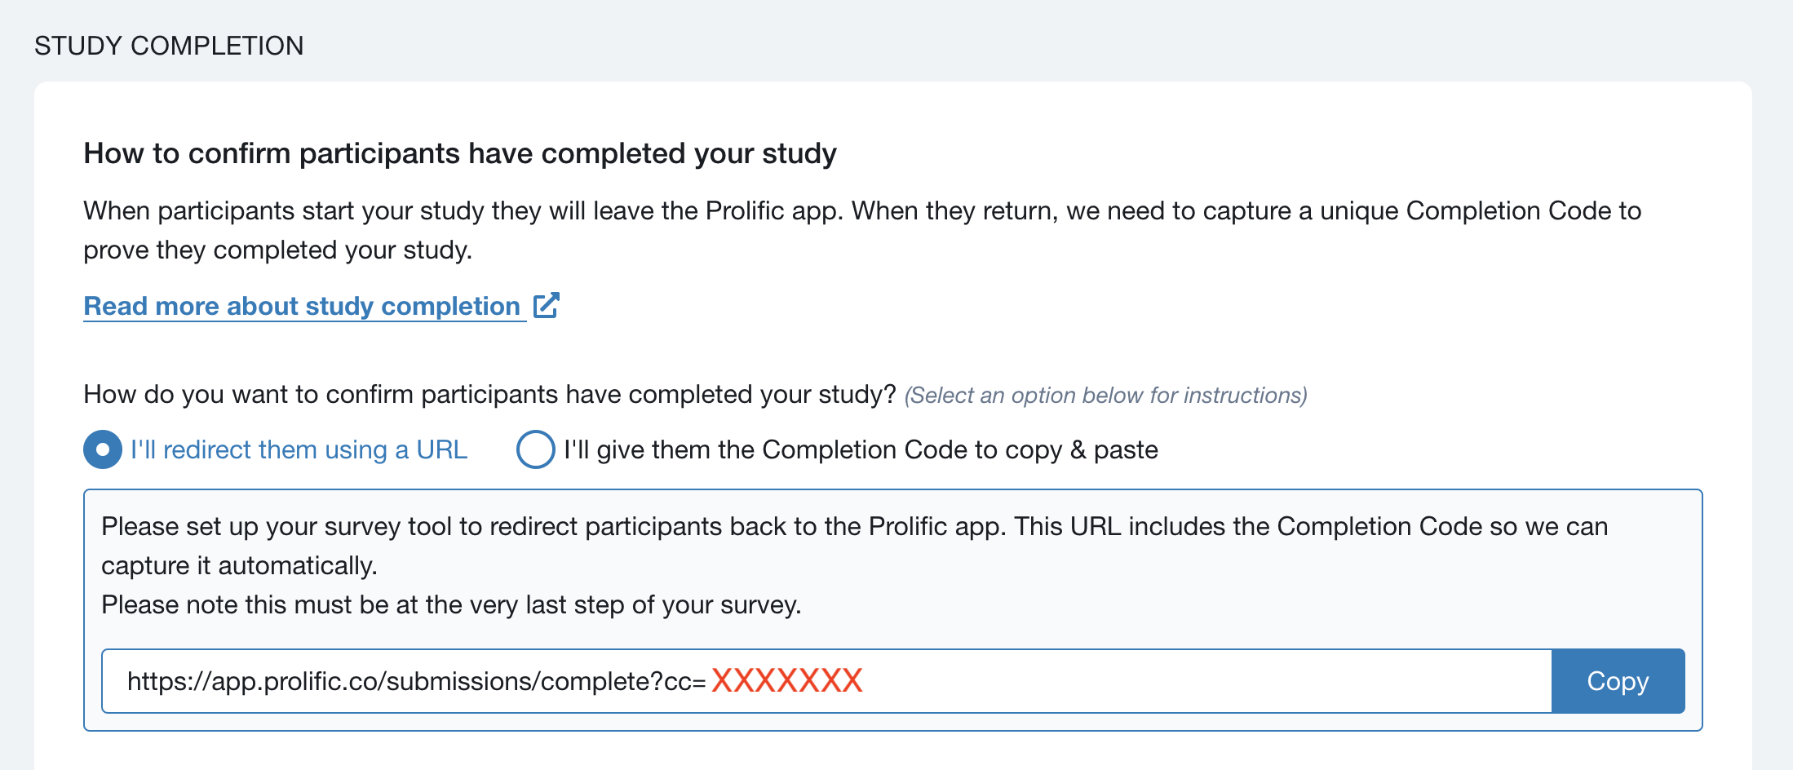
Integration with Prolific

Slide 14
In your experiment code
var participant_id = getQueryVariable("PROLIFIC_PID")
var tokenID = "XXXXXXXX"
var credit_url = `https://app.prolific.co/submissions/complete?cc=${tokenID}`

Slide 15
In your experiment code
var prolific_trial = {
type: jsPsychHtmlKeyboardResponse,
stimulus: function(){
return `<p>Thanks! You have completed the experiment.</p><p><a href='${credit_url}'><b>Please click here to return to Prolific and receive your completion code.</b></a></p>.`
},
choices: "NO_KEYS",
}

Slide 16
Resources
jsPsych forum: https://github.com/jspsych/jsPsych/discussions/
w3schools: https://www.w3schools.com/
js.info: https://javascript.info/
codecademy: https://www.codecademy.com/
https://stackoverflow.com/

