Slide 1
Programming in jsPsych
Week 10: Online Integration
(saving data online; integration with SONA and mTurk)

Slide 2
Manipulating internal data vs writing to an external file
We have gone through how to add trial data and experiment data in previous weeks. (Internal data structure)
Writing the data to an external file is another matter.
Documentation: see https://www.jspsych.org/overview/data/
The simplest method: saving a .csv file of each participant’s data.

Slide 3
Create PHP file called write_data.php
<?php
$post_data = json_decode(file_get_contents('php://input'), true);
$name = "data/".$post_data['filename'].".csv"; $data = $post_data['filedata']; file_put_contents($name, $data);
?>

Slide 4
In your experiment code
function saveData(name, data){
var xhr = new XMLHttpRequest(); xhr.open('POST', 'write_data.php’); xhr.setRequestHeader('Content-Type', 'application/json’); xhr.send(JSON.stringify({filename: name, filedata: data}));
}

Slide 5
In your experiment code
jsPsych.init({
timeline: etc…,
on_finish: function(){
saveData(id+".csv",jsPsych.data.get().csv());
}
})

Slide 6
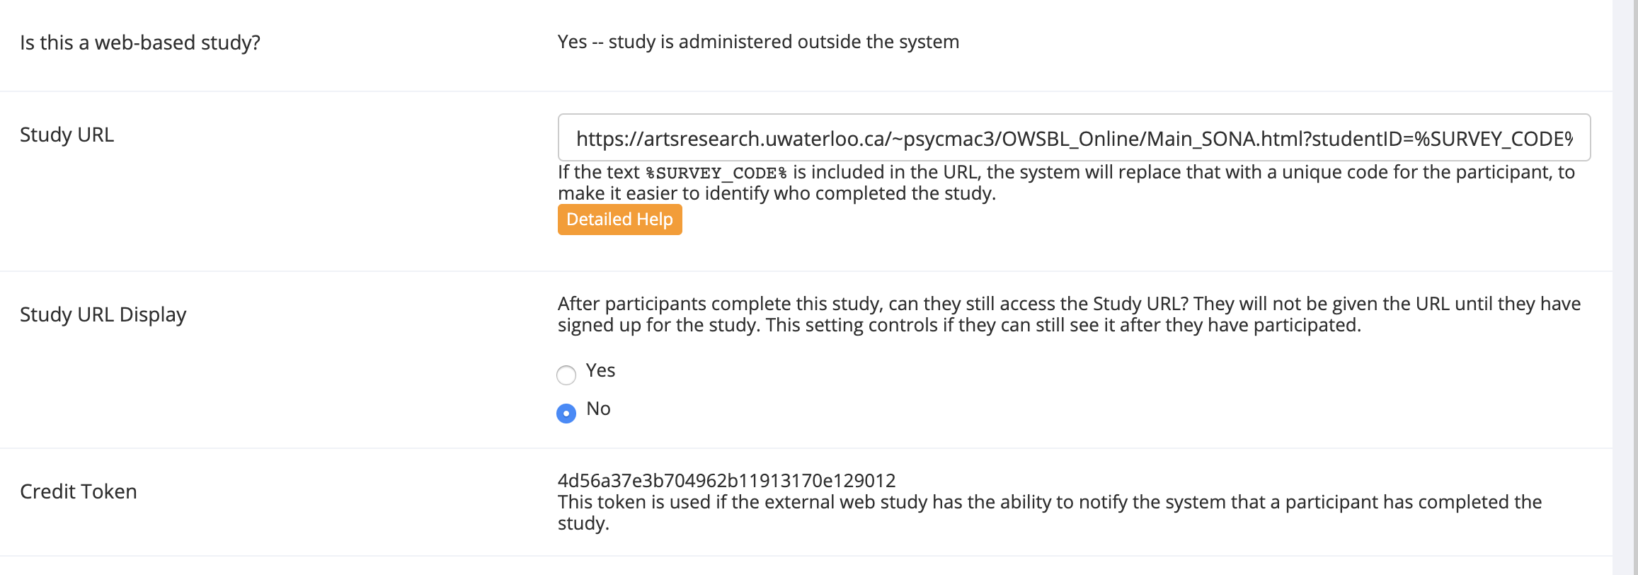
Integration with SONA

Slide 7
SONA URL with embedded ID code
Embed %SURVEY_CODE% to your URL:
https://yourstudy.com/study.html?studentID=%SURVEY_CODE%
SONA will populate %SURVEY_CODE% with each student’s unique SONA ID.

Slide 8
In your experiment code
var sona_id = jsPsych.data.getURLVariable("studentID");

Slide 9

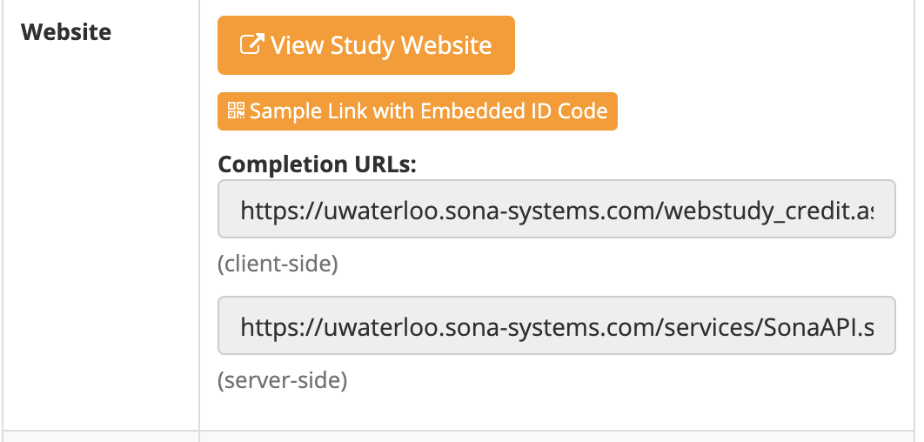
Completion URL:
https://uwaterloo.sona-systems.com/webstudy_credit.aspx?experiment_id= 4851&credit_token= 34ad9ee74a1e426eb2d212b83ca4d8e1&survey_code= XXXX

Slide 10
In your experiment code
var sona_id = jsPsych.data.getURLVariable("studentID");
var experimentID = 4851
var tokenID = "34ad9ee74a1e426eb2d212b83ca4d8e1"
var credit_url = "https://uwaterloo.sona-systems.com/webstudy_credit.aspx?experiment_id=" + experimentID + "&credit_token=" + tokenID + "&survey_code=" + sona_id

Slide 11
In your experiment code
jsPsych.init({
timeline: etc...,
on_finish: function () {
window.location.replace(credit_url);
}
});

Slide 12
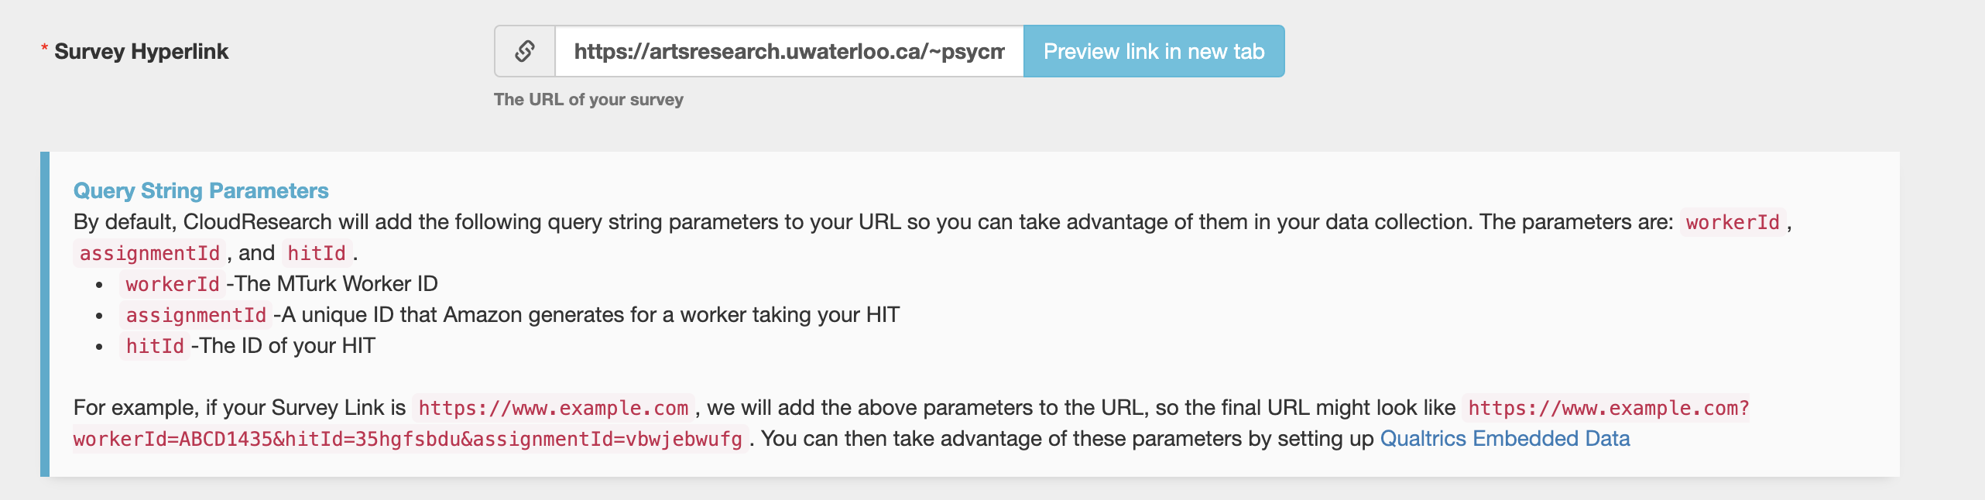
Integration with mTurk

Slide 13
In your experiment code
var mturk_id = getQueryVariable("workerId");
var assign_id = getQueryVariable("assignmentId");
var hit_id = getQueryVariable("hitID");

Slide 14
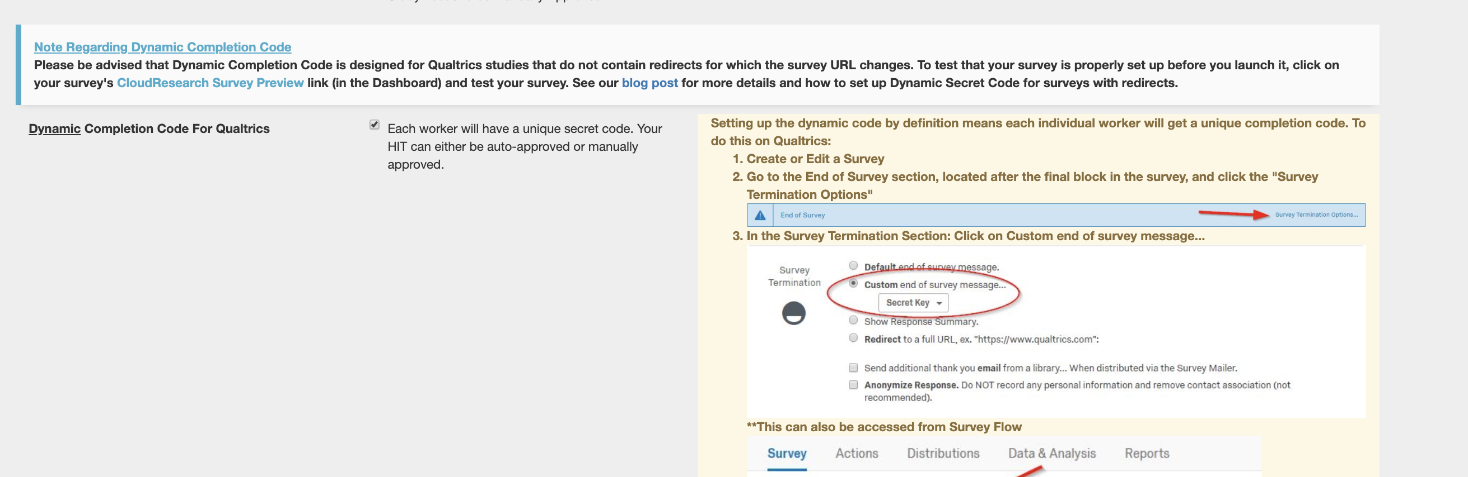
Crediting Workers

Slide 15
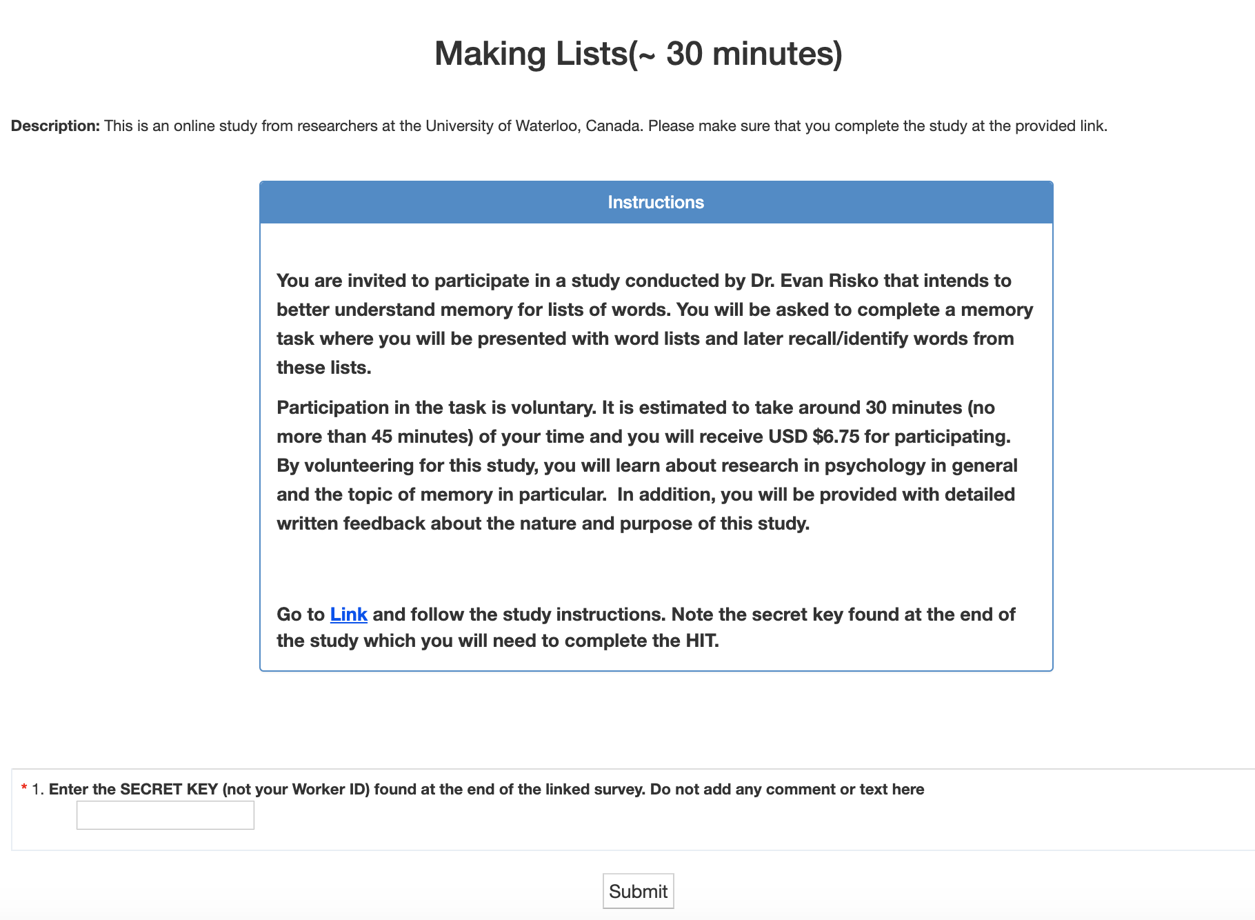

Slide 16
In your experiment code
var dynamic_code_trial = {
type: 'html-keyboard-response',
choices: jsPsych.NO_KEYS,
stimulus: '<iframe src="https://www.turkprime.com/TurkPrime/TakeLaunchedSurvey/DynamicKey" width="100%" height="200"></iframe>’ ',
on_load : function () { saveData(id + ".csv", jsPsych.data.get().csv()); }
}

Slide 17
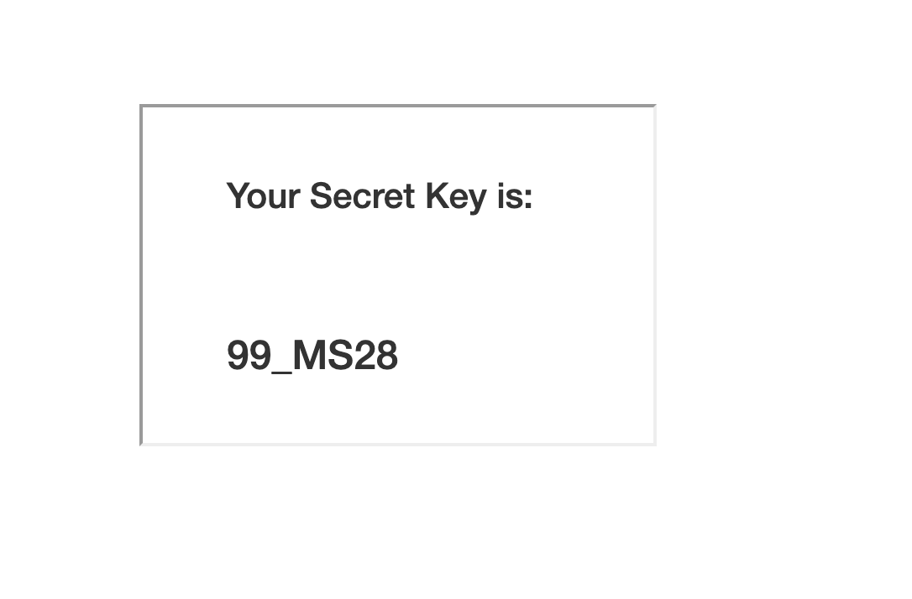
Final Screen
timeline.push(dynamic_code_trial)
* Note that we had to move the data saving to on_load because the trial never technically finishes (and neither does the study).

Slide 18
The End?

Slide 19
Resources
jsPsych forum: https://github.com/jspsych/jsPsych/discussions/
w3schools: https://www.w3schools.com/
js.info: https://javascript.info/
codecademy: https://www.codecademy.com/
https://stackoverflow.com/

