Slide 1

Data Warehouse
For Trading System
Zhuoran Yu
MET CS779 Term Project

Slide 2
OUTLINE
4. Summary and Expectations
Summarize some of the poiints learned throughout the project and the subsequent steps needed to improve the trading system.
1. Intro and Requirments
A brief introduction to trading systems and requirements for designing a data warehouse
Data Warehouse For Trading System
3. ETL, SQL, Visualization
Processing data and designing sql to query the results and finally presenting the visualizations
2. DataWarehouse Design
Designing a Data Warehouse to Meet the Data Needs of the Strategy

Slide 3
01
Intro and Requirments
A brief introduction to trading systems and requirements for designing a data warehouse

Slide 4

Intro and Requirments
What is a Trading System
Anwered by Claude2
A trading system refers to a structured, rules-based approach to buying and selling financial assets like stocks, options, futures, etc. in the financial markets.
The goal of most trading systems is to methodically outperform buy-and-hold approaches through a rules-based methodology for selecting and managing trades. Discipline in sticking to the rules is key to their success.

Slide 5
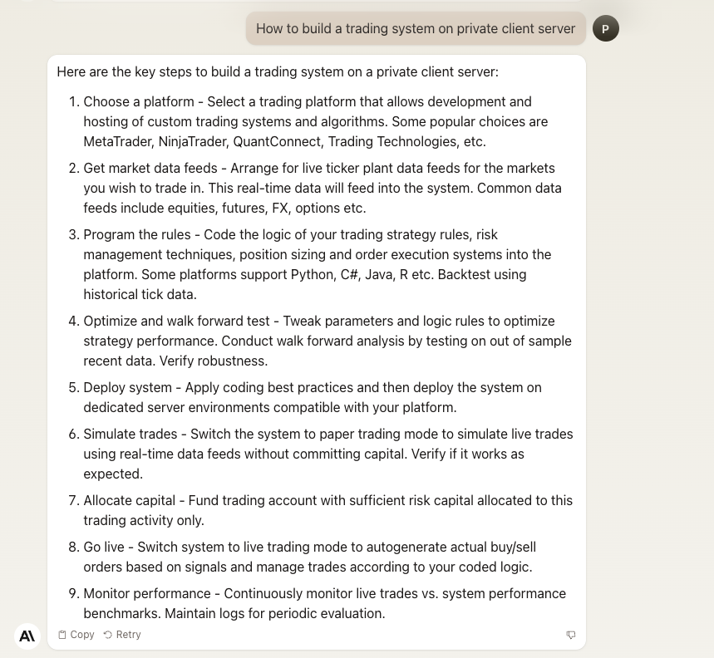
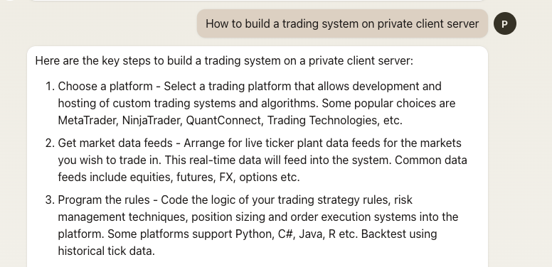
Intro and Requirments
How to build a trading system
Anwered by Claude2
Get market data feeds - Arrange for live ticker plant data feeds for the markets you wish to trade in. This real-time data will feed into the system. Common data feeds include equities, futures, FX, options etc.

Slide 6
Requirments for Datawarehouse
01
Req1 Data for all Instruments
Req 4 Company Earnings Data(US Market)
02
Minute and day stock data, including open, close, high, low, etc.
Earnings data released by the company each quarter, including PB, PE, etc.
Req 2 Company Basic Info
03
04
Req 3 Significant events occurring in the company(CN Market)
Basic information about the company including market capitalization, the company's industry, etc.
Significant events occurring in the company include asset reorganization, external guarantees, share pledges, asset acquisitions, etc.

Slide 7
02
DataWarehouse Design
Designing a Data Warehouse to Meet the Data Needs of the Strategy

Slide 8
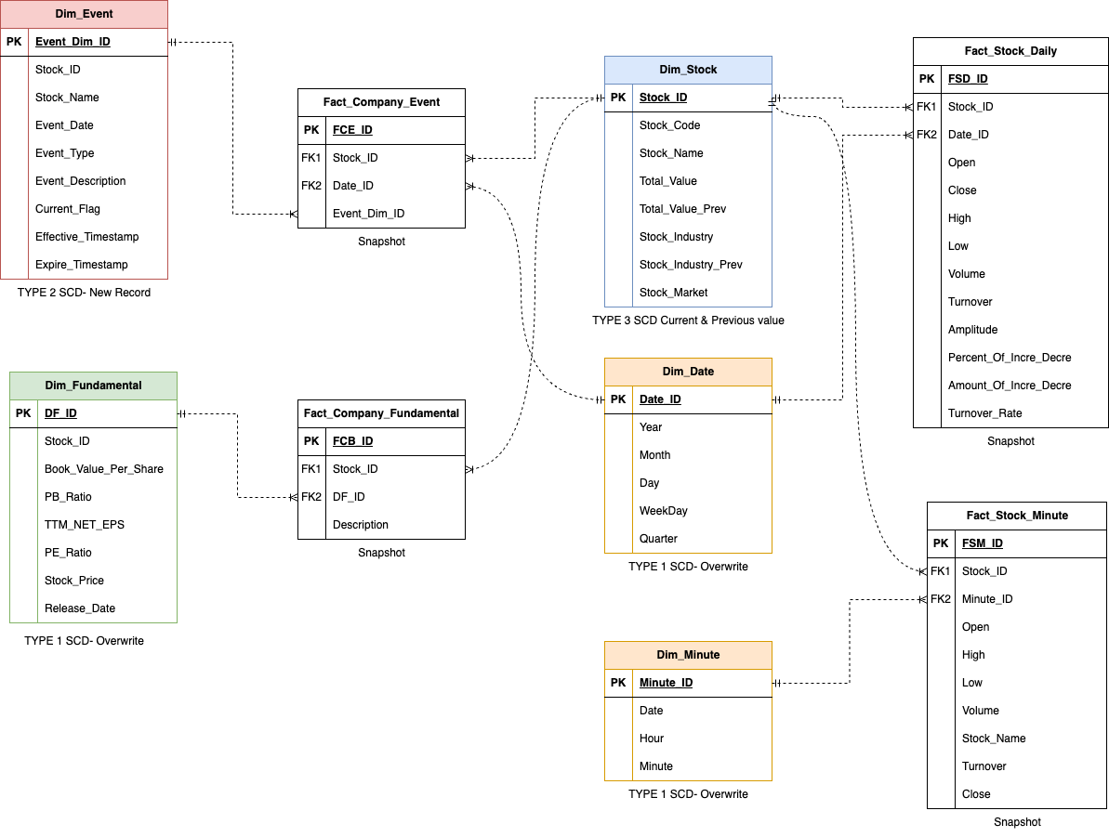
DataWarehouse Design

Slide 9
03
ETL, SQL, Visualization
Processing data and designing sql to query the results and finally presenting the visualizations

Slide 10

ETL Process
1. History Data Processing
2. Processing of daily updated data
（Jupyter Notebook)

Slide 11
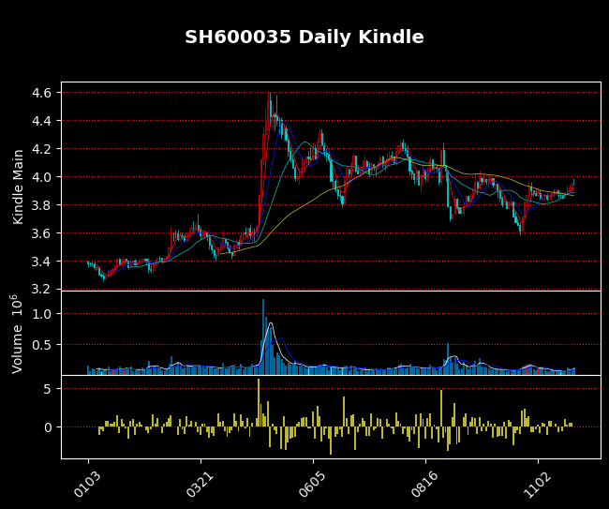
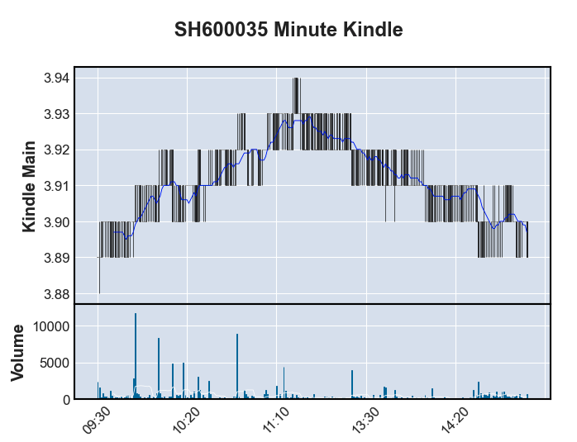
Data Visualization

Slide 12
Basic SQL Search Examples
Seq1
Seq4
select all stocks that rise over 9.9% on 2023-11-28
Store Procedure for SCD Type2 Dim_Event
Seq2
Seq3
select Minute Level Data from 2023-11-30 9:30 to 2023-11-30 9:40
where the company is in CN market and its Total_Value is in top 10
select Daily Situations for every Monday in November of company SZ300796;

Slide 13
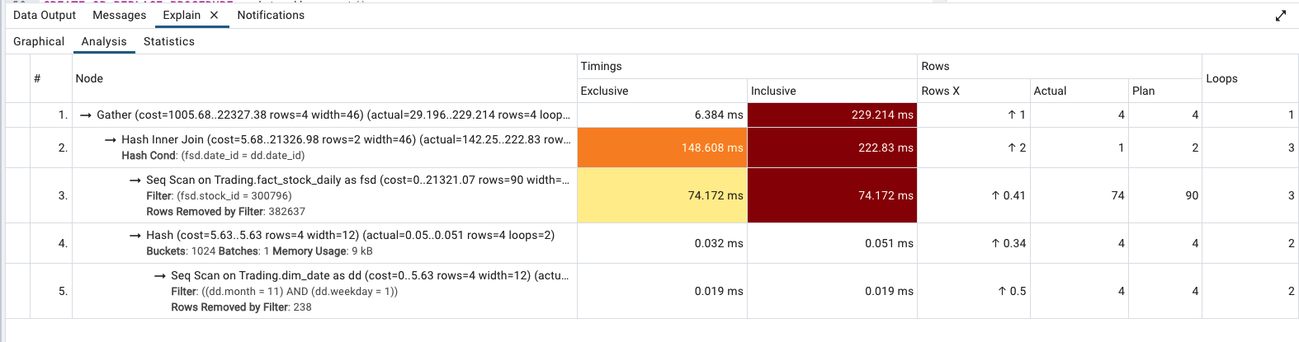
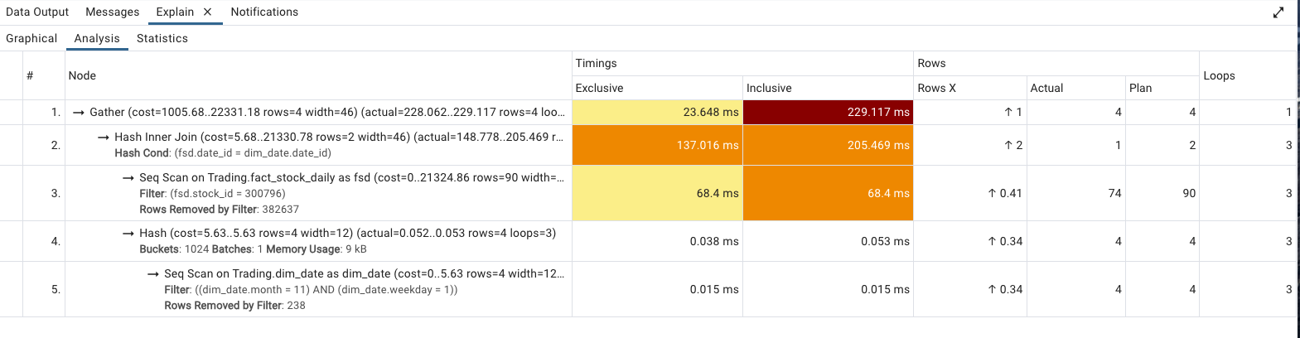
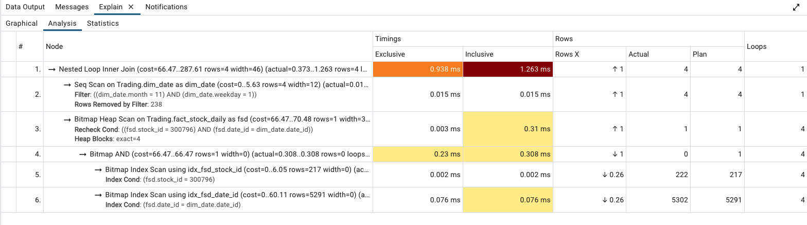
Performance Tuning for Seq3
--version1
SELECT dd.Month, dd.WeekDay, fsd.Stock_ID, fsd.Date_ID, fsd.Open,fsd.High,fsd.Low, fsd.Volume, fsd.Turnover
FROM "Trading".Fact_Stock_Daily fsd
JOIN "Trading".Dim_Date dd ON fsd.Date_ID = dd.Date_ID
WHERE dd.Month = 11 and dd.WeekDay=1 and fsd.Stock_ID = 300796;
--version2
SELECT dd.Month, dd.WeekDay, fsd.Stock_ID, fsd.Date_ID, fsd.Open,
fsd.High,fsd.Low, fsd.Volume, fsd.Turnover
FROM "Trading".Fact_Stock_Daily fsd
JOIN (SELECT Date_ID, Month, WeekDay FROM "Trading".Dim_Date
WHERE Month = 11 AND WeekDay = 1) dd ON fsd.Date_ID = dd.Date_ID
WHERE fsd.Stock_ID = 300796;
--version3
Add Index on FK

Slide 14
04
Summary and Expectations
Summarize some of the points learned throughout the project and the subsequent steps needed to improve the trading system.

Slide 15

Summary and Expectations
Takeaways from this project
1. Design the sql to help me get the data I need for the transaction process
2. Optimize the sql (Performance Tuning) to improve the efficiency of data acquisition.
Use store procedure to improve the efficiency of data updating.
3. Design a data warehouse to fulfill the historical data requirements of the trading system.
What’s Next:
1. For more time-critical data consider streaming data processing (e.g. kafka)
2. Continuing to refine my trading system (strategy part and backtesting system)

Slide 16
THANKS

