Slide 1

SSL协议
主讲人：裴士辉
e_mail: shihui_pei @sina.com
电话：13694302598

Slide 2
SSL
Secure Sockets Layer
  http://wp.netscape.com/eng/ssl3/
  Netscape Communication Corporation
  1994.11 SSL V2.0
  1996.3 SSL V3.0
IETF
  1999.1 TLS V1.0
  TLS V1.0是一个Internet标准，完全建立在SSL V3.0的基础上，又称为SSL V3.1
Notes:
互联网工程任务组—The Internet Engineering Task Force

Slide 3
SSL的特点
连接是保密的，对称加密用于加密数据
  例如：DES, RC4,RC2, 3DES, fortezza
实体的身份通过公钥加密得到验证
  例如：RSA, DSS
  SSL V3.0有三种验证模式：
    Client和Server都被验证
    只验证Server,不验证Client
    完全匿名
    模式2是目前Internet上应用最广泛的模式
连接是可靠的，带密钥的MAC用于保证消息的完整性
  例如：SHA, MD5等hash算法

Slide 4
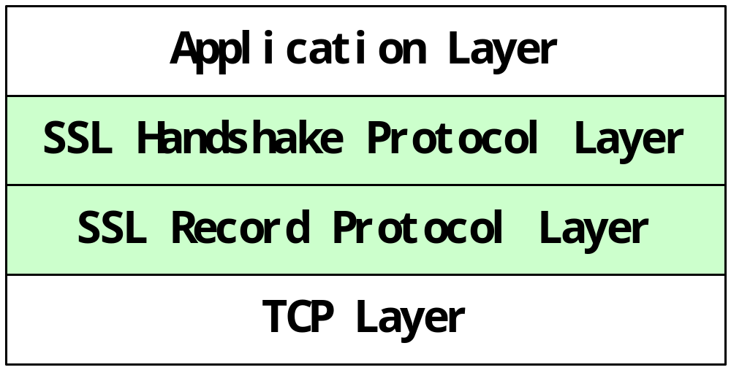
SSL V3.0的结构
握手层允许通信双方在应用协议传送数据之前相互验证、协商加密算法、生成密钥等，记录层封装各种高层协议，具体实施压缩/解压缩、加/解密、计算/验证、MAC等与安全有关的操作

Slide 5
会话状态
*Session identifier
会话标识符
*Peer certificate
server(和client)的X.509 v3格式的证书
*compression method
压缩算法，用于加密前对数据进行压缩
*cipher Spec
握手协议协商的一套加密参数，包括加密算法、MAC算法
*master secret

Slide 6
连接状态
*server and client random
*server write MAC secret
*client write MAC secret
*Server Write Key
*Client write key
*initialization vectors
*sequence numbers

Slide 7
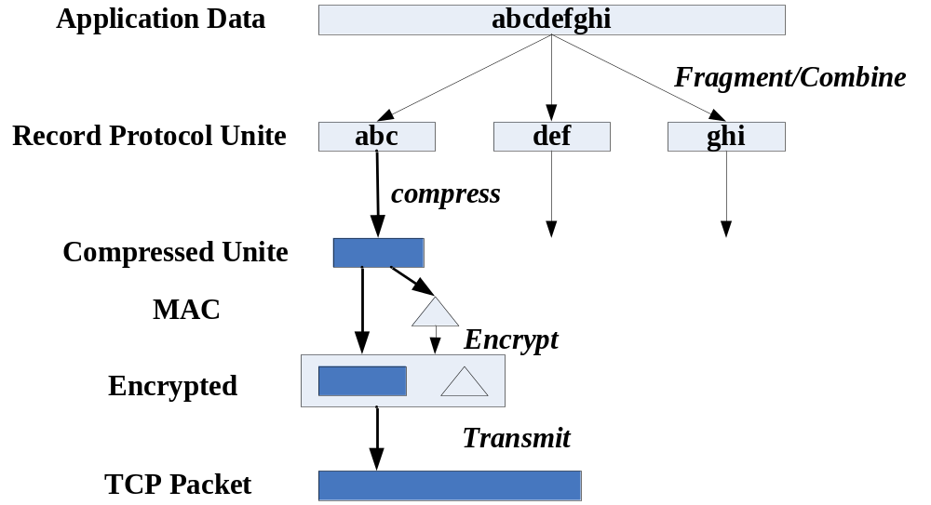
记录层

Slide 8
记录层
Fragmentation
compression or decompression
Protection

Slide 9
SSLPlaintext:
*Content Type
//(alert, handshake, application_data)
*ProtocolVersion
*length //<=2¹⁴
*fragment[length]

Slide 10
SSLCompressed:
*Content Type
*ProtocolVersion
*length //<==2¹⁴+1024
*fragment[length]

Slide 11
SSLCiphertext:
*Content Type
//(alert, handshake, application_date)
*ProtocolVersion
*length //<=2¹⁴+2048
*fragment[length]

Slide 12
密码输入由三部分组成：
content[SSLCompressed.length]
MAC[CipherSpec.hash.size]
padding

Slide 13
MAC：
Hash(
MAC_write_secret+pad_2+
Hash(MAC_write_secret+pad_1+seq_num+length+content)
）；

Slide 14
握手协议层
*agree on a protocol version
*select cryptographic algoritm
*authenticate each other
*use public_key encryption techniques to generates shared secrets

Slide 15
clidnt server
Client Hello
Server Hello
Certificate
Certificate Request
Server Key Exchange
Certificate
Client Key Exchange
Certificate Verif
Finished
Finished
Application Data Application data

Slide 16
实现举例
CipherSuite:
SSL_RSA_WITH_DES_CBC_SHA={0x00,0x07}

Slide 17
clidnt server
Client Hello Server Hello
Certificate
Certificate Request
Certificate
Client Key Exchange
Certificate Verif
Finished
Finished
Application Data Application data

Slide 18
ClientHello:
Struct{
ProtocolVersion;
ClientRandom; //time[2]+random_byte[28]
CipherSuits<0.. 2¹⁶ -1>; //{0x00,0x07}
CompressionMethods<0.. 2¹⁶-1>;
}ClientHello;

Slide 19
ServerHello:
Struct{
ProtocolVersion;
ServerRandom; //time[2]+random_byte[28]
CipherSuit[ 2]; //{0x00,0x07}
CompressionMethod[1];
}ServerHello;

Slide 20
Client key exchange message:
struct{
Public_key_encrypted PreMasterSecret;
}ClientKeyExchange;

Slide 21
Struct{
ProtocolVersion;
Random[46];
}PreMasterSecrect;

Slide 22
Certificat verify:
Struct{
Signature
}CertificateVerify;
SHA(
master_secret+pad2+
SHA(handshake_messages+master_secret+pad1)
);

Slide 23
Finished:
Enum {client(0x434c4e54), server(0x53525652)}Sender;
Struct{
md5_hash[16];
sha_hash[20];
}Finished;

Slide 24
md5_hash:
md5(
master_secret+pad2+
md5(handshake_messages+Sender+master_secret+pad1)
);
Sha_hash:
Sha(
master_secret+pad2+
sha(handshake_message+Sender+master_secret+pad1)
);

Slide 25
Master_secret:
Master_secret=
Md5(premaster_secret+sha(‘A’+pre_master_secret+
ClientHello.random+ServerHello.randm))+
Md5(premaster_secret+sha(‘BB’+pre_master_secret+
ClientHello.random+ServerHello.randm))+
Md5(premaster_secret+sha(‘CCC’+pre_master_secret+
ClientHello.random+ServerHello.randm))

Slide 26
Key_block= Md5(master_secret+sha(‘A’+_master_secret+
ClientHello.random+ServerHello.random))+
Md5(master_secret+sha(‘BB’+master_secret+
ClientHello.random+ServerHello.random))+
Md5(master_secret+sha(‘CCC’+master_secret+
ClientHello.random+ServerHello.random))+
Md5(master_secret+sha(‘DDDD’+master_secret+
ClientHello.random+ServerHello.random)

Slide 27
Client_write_MAC_secret[20]= key_block_{0..19}
Server_write_MAC_secret[20]= key_block_{20..39}
Client_write_Key[8]= key_block_{40..47}
Server_write_key[8]= key_block_{48..55}
Client_write_IV[8]
Server_write_IV[8]

Slide 28
基于SSL的应用
􀂙 https 443
􀂙 ssmtp 465
􀂙 snntp 563
􀂙 sldap 636
􀂙 spop3 995
􀂙 ftp-data 889
􀂙 ftps 990
􀂙 imaps 991
􀂙 telnets 992
􀂙 ircs 993

Slide 29
在线支付系统的SSL加密技术
采用基本的SSL协议，进行两端SSL加密。
首先要购买并安装数字认证证书。然后向在线支付服务提供商获得支付网关的服务内容和服务范围，选定信用卡交易方式和交易处理系统。
向VeriSign公司购买其数字认证证书
确定交易处理系统为ADC Direct Response。

Slide 30
在线支付系统的SSL加密技术
整个在线支付的过程会牵涉到多方协作，其中包括
  供货方也叫零售商(Merchant)
  商业服务提供者MSP
  （Merchant service Provider)
  客户
  支付处理者(Payment Processor)
  以及Authorize．Net(支付网关)

Slide 31
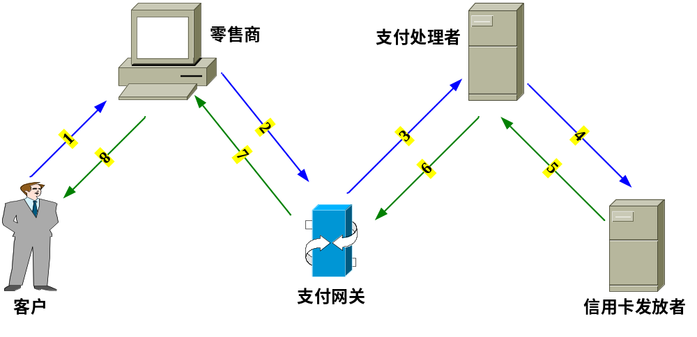
在线支付系统的SSL加密技术

Slide 32
import java.io.*;
import java.net.*;
import javax.net.*;
public class SSLSocketClient {
private static final String HOST = "127.0.0.1";
private static final int PORT = 5053;
public static void main(String[] args) throws Exception {
Socket s = new Socket(HOST,PORT);
OutputStream out = s.getOutputStream();
out.write(23);
out.write(45);
System.out.print("\nNumbers has sent.\n\n");
out.close();
s.close();
}
}

Slide 33
import java.io.*;
import java.net.*;
public class SSLSocketServer {
private static final int PORT = 5053;
public static void main (String[] args) throws Exception {
ServerSocket ss = new ServerSocket(PORT);
Socket s = ss.accept();
InputStream in = s.getInputStream();
int a=0;
int b=0;
a=in.read();
b=in.read();
System.out.print(" "+a+"+"+b+"="+(a+b));
in.close();
s.close();
}
}

Slide 34
简单的SSL连接
利用J2SDK提供的keytool工具进行创建证书
1.创建批处理文件
keytool -genkey -dname "CN=认证中心, OU=计算机科学与技术学院, O=吉林大学, L=长春, ST=吉林省, C=CN" -alias lf -keyalg RSA -keysize 1024 -keystore lfkeystore -keypass ififif -storepass ififif -validity 3500
2.在dos下执行该批处理文件

Slide 35
将数字证书导出到文件
keytool -export -alias lf -file lf.cer -keystore lfkeystore -storepass ififif
客户端将证数文件到入密钥库
keytool -import -alias lf -file lf.cer -keystore clientlfkeystore -storepass ififif

Slide 36
import java.net.*;
import java.io.*;
import javax.net.ssl.*;
public class MySSLServer{
public static void main(String args[ ]) throws Exception{
System.setProperty("javax.net.ssl.keyStore","lfkeystore");
System.setProperty("javax.net.ssl.keyStorePassword","ififif");
SSLServerSocketFactory ssf=
(SSLServerSocketFactory) SSLServerSocketFactory.getDefault( );
ServerSocket ss=ssf.createServerSocket(5432);
System.out.println("Waiting for connection...");
while(true){
Socket s=ss.accept( );
PrintStream out = new PrintStream(s.getOutputStream( ));
out.println("Hi");
out.close( );
s.close( );
}
}
}

Slide 37
import java.net.*;
import java.io.*;
import javax.net.ssl.*;
public class MySSLClient{
public static void main(String args[ ]) throws Exception {
System.setProperty("javax.net.ssl.trustStore", "clientlfkeystore");
SSLSocketFactory ssf=
(SSLSocketFactory) SSLSocketFactory.getDefault( );
Socket s = ssf.createSocket("127.0.0.1", 5432);
BufferedReader in
= new BufferedReader(new InputStreamReader(s.getInputStream( )));
String x=in.readLine( );
System.out.println(x);
in.close( );
}
}

Slide 38
import java.net.*;
import java.io.*;
import javax.net.ssl.*;
public class MyHTTPSServer {
public static void main(String args[ ]) {
int i=0;
try {
System.setProperty("javax.net.ssl.keyStore","lfkeystore");
System.setProperty("javax.net.ssl.keyStorePassword","ififif");
SSLServerSocketFactory
ssf= (SSLServerSocketFactory) SSLServerSocketFactory.getDefault( );
ServerSocket ss=ssf.createServerSocket(443);
System.out.println("Web Server OK ");
while(true){
Socket s=ss.accept( ); //等待请求
PrintStream out = new PrintStream(s.getOutputStream( ));
BufferedReader in = new BufferedReader(
new InputStreamReader(s.getInputStream( )));
String info=null;
while(( info=in.readLine())!=null){
System.out.println("now got "+info);
if(info.equals("")) break;
}

Slide 39
System.out.println("now go");
out.println("HTTP/1.0 200 OK");
out.println("MIME_version:1.0");
out.println("Content_Type:text/html");
i++;
String c="<html> <head></head><body> <h1> Hi, this is "
+i+"</h1></Body></html>";
out.println("Content_Length:"+c.length( ));
out.println("");
out.println(c);
out.close( );
s.close( );
in.close( );
}
} catch (IOException e) {
System.out.println(e);
}
}
}

Slide 40
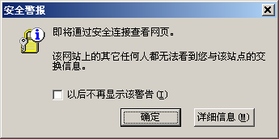

Slide 41
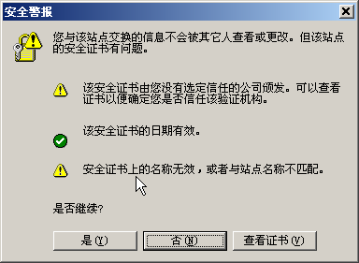

Slide 42
openssl
The OpenSSL Project is a collaborative effort to develop a robust, commercial-grade, full-featured, and Open Source toolkit implementing the Secure Sockets Layer (SSL v2/v3) and Transport Layer Security (TLS v1) protocols as well as a full-strength general purpose cryptography library. The project is managed by a worldwide community of volunteers that use the Internet to communicate, plan, and develop the OpenSSL toolkit and its related documentation.
OpenSSL is based on the excellent SSLeay library developed by Eric A. Young and Tim J. Hudson.

Slide 43
下此课内容
SSH协议

Slide 44
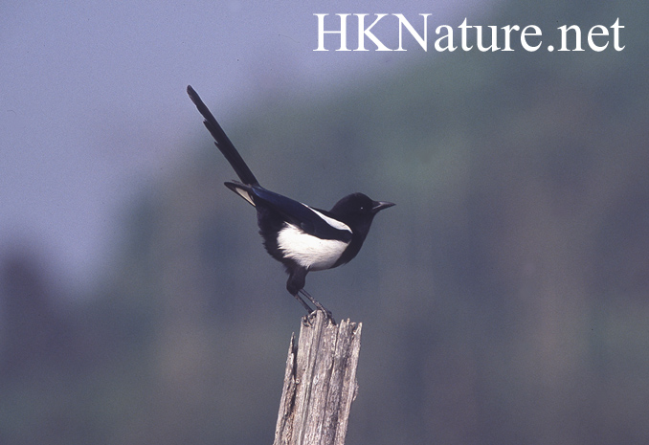
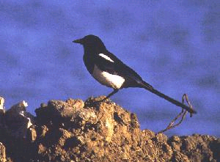
下次课再见！

