Slide 1
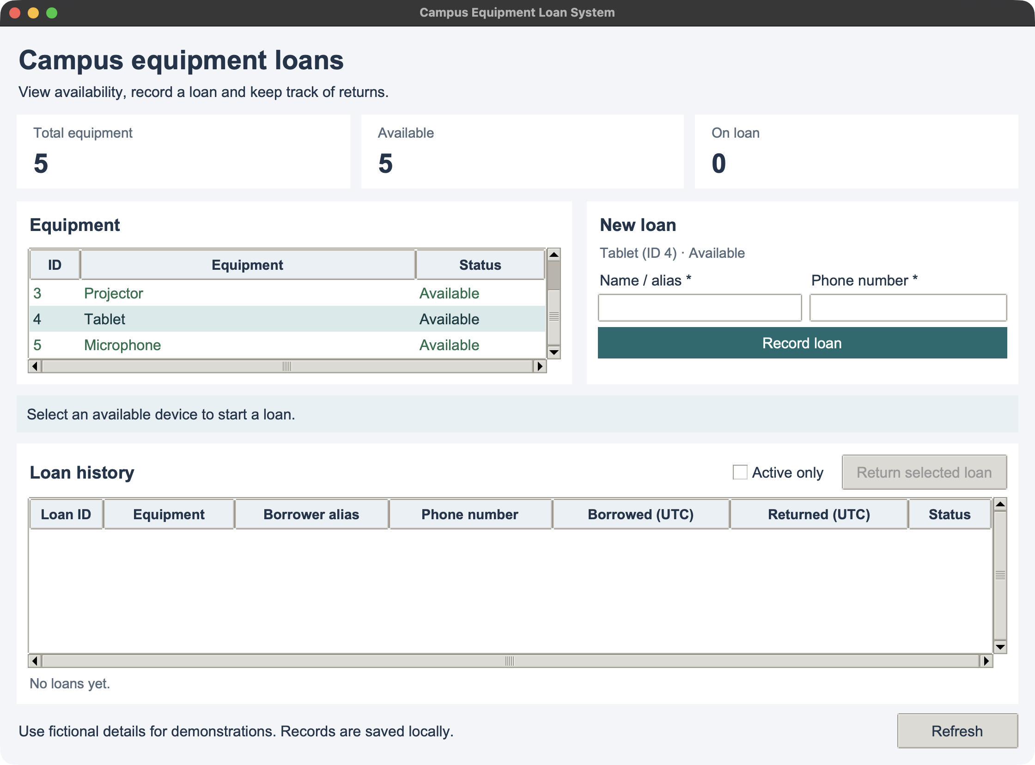
MSE800 / ASSESSMENT 2
Campus Equipment
Loan System
A local desktop application
for a campus equipment desk
Xuerui Huang
Bin Wang
Yonghui Dai
Requirements · Design and demo · Evidence and reflection
Xuerui Huang | 00:00–00:30
01 / 12
Notes:
SLIDE 1 | Xuerui Huang | 00:00–00:30 (30 seconds)
ENGLISH SCRIPT
Good morning. We are Xuerui Huang, Bin Wang and Yonghui Dai. Our project is the Campus Equipment Loan System. It is a desktop application for a campus equipment desk. I will explain the requirements and planning. Bin will explain the design and demonstrate the product. Yonghui will discuss testing, cultural considerations and reflection.
操作提示（不朗读）
封面；介绍姓名和分工。30 秒时换第 2 页。
Sources: current selected Project Report (sections 3–5, 8–10 and appendices), Reflection Report and Python source at GitHub source commit d61c66ca11d2fd69c2bd40c005d3e4b53f65b100. Repository: https://github.com/dreamgithub0920/Campus_Equipment_Loan_System. Technical checks recorded 24 October 2026 on macOS; not a Windows execution or student activity record. Screenshots were captured from the current application on 25 October 2026 NZDT using an isolated in-memory database and fictional details.

Slide 2
MSE800 / ASSESSMENT 2
Equipment desk workflow
Check availability
ID | Equipment
1 | Laptop
2 | Camera
3 | Projector
4 | Tablet
5 | Microphone
Find an available device by its ID and name.
Record a loan
Enter a borrower name or alias and a phone.
Register a return
Keep the completed loan in the history.
Python + Tkinter + SQLite
One local database per workstation
Xuerui Huang | 00:30–01:30
02 / 12
Notes:
SLIDE 2 | Xuerui Huang | 00:30–01:30 (60 seconds)
ENGLISH SCRIPT
The operator needs to answer a simple question: which device can someone borrow now? The system manages five devices: a laptop, camera, projector, tablet and microphone. The operator checks availability, records a loan, and later registers a return.
Each new loan includes a borrower name or alias and a phone contact. When the item comes back, the system keeps the record instead of deleting it. This helps the operator review both current and earlier borrowing.
The application runs locally with SQLite storage. It does not need a server or internet connection for normal use. Different computers keep separate records. We use fictional names and phone numbers in the demonstration.
操作提示（不朗读）
指向设备清单和借还流程。此页结束时累计 1 分 30 秒。
Sources: current selected Project Report (sections 3–5, 8–10 and appendices), Reflection Report and Python source at GitHub source commit d61c66ca11d2fd69c2bd40c005d3e4b53f65b100. Repository: https://github.com/dreamgithub0920/Campus_Equipment_Loan_System. Technical checks recorded 24 October 2026 on macOS; not a Windows execution or student activity record. Screenshots were captured from the current application on 25 October 2026 NZDT using an isolated in-memory database and fictional details.

Slide 3
MSE800 / ASSESSMENT 2
Requirements and priorities
Story | Observable requirement | Priority
US01 | View equipment availability | Must
US02 | Borrow with name and phone | Must
US03 | Return an active loan | Must
US04 | Review loan history | Should
US05 | Preserve records after restart | Must
US06 | Preserve Unicode names | Must
Phone format: 7–15 digits, up to 30 formatted characters.
Spaces, hyphens, parentheses and one leading + are allowed.
Xuerui Huang | 01:30–03:00
03 / 12
Notes:
SLIDE 3 | Xuerui Huang | 01:30–03:00 (90 seconds)
ENGLISH SCRIPT
We organise the requirements into six user stories. The first is viewing equipment and its availability. The second is borrowing an available item with a name and phone. The third is returning an active loan. The fourth is reviewing history. The fifth is preserving records after a restart. The sixth is preserving Unicode characters in names, including macrons.
The core workflow and data preservation are Must requirements. History is a Should requirement, and the current product includes it. Each story has an observable acceptance criterion. For example, a duplicate borrowing request must leave the number of loans unchanged.
The phone is required for new loans. Its format allows seven to fifteen digits, with spaces, hyphens, parentheses and one leading plus. This checks the format only. It cannot confirm that a phone exists or belongs to the borrower. Online booking, accounts and payments remain outside the current scope.
操作提示（不朗读）
不必逐字读表；重点解释 Must/Should 和电话规则。累计 3 分钟。
Sources: current selected Project Report (sections 3–5, 8–10 and appendices), Reflection Report and Python source at GitHub source commit d61c66ca11d2fd69c2bd40c005d3e4b53f65b100. Repository: https://github.com/dreamgithub0920/Campus_Equipment_Loan_System. Technical checks recorded 24 October 2026 on macOS; not a Windows execution or student activity record. Screenshots were captured from the current application on 25 October 2026 NZDT using an isolated in-memory database and fictional details.

Slide 4
MSE800 / ASSESSMENT 2
Team, sprints and estimate
Proposed responsibilities
Planning allowance | Hours
Sprint 1 example | 23
Sprint 2 example | 31
Release adaptation | 12
Total estimate | 66
Xuerui Huang
Requirements, coordination and interface
Bin Wang
Domain objects, business rules and integration
NZD 2,211
Yonghui Dai
Persistence, testing and evidence
Labour 1,980 + resources 30
+ 10% contingency 201
Planning examples and estimates; no claim of completed student hours or meetings.
Xuerui Huang | 03:00–05:00
04 / 12
Notes:
SLIDE 4 | Xuerui Huang | 03:00–05:00 (120 seconds)
ENGLISH SCRIPT
The proposed division of work follows the main parts of the system. My role covers requirements, coordination and the interface. Bin's role covers domain objects, business rules and integration. Yonghui's role covers persistence, testing and evidence. Everyone should also review another component so that understanding does not depend on one person.
The report describes a baseline classroom case with two sprints. Sprint one focuses on inventory, borrowing and the storage foundation. Sprint two focuses on returns, history, integration and acceptance. Their estimates are twenty-three and thirty-one hours, giving fifty-four hours in total. These are written planning examples, rather than records of completed student meetings.
The later requests add the desktop interface, Windows startup support, two devices and a required phone contact. We keep those changes separate from the earlier case. The revised planning model adds twelve hours, suggested as four hours per member for adaptation and review. The current estimate is therefore sixty-six hours.
At thirty New Zealand dollars per hour, labour is one thousand nine hundred and eighty dollars. Adding thirty dollars for resources and a ten-percent contingency gives two thousand two hundred and eleven dollars. This is an estimate, not a record of payments or actual student hours. Bin will now explain the design and demonstrate the application.
操作提示（不朗读）
保留估算和示例状态，不把计划说成已完成经历。可在 4:45 左右结束并交接；5:00 由 Bin 接手。
Sources: current selected Project Report (sections 3–5, 8–10 and appendices), Reflection Report and Python source at GitHub source commit d61c66ca11d2fd69c2bd40c005d3e4b53f65b100. Repository: https://github.com/dreamgithub0920/Campus_Equipment_Loan_System. Technical checks recorded 24 October 2026 on macOS; not a Windows execution or student activity record. Screenshots were captured from the current application on 25 October 2026 NZDT using an isolated in-memory database and fictional details.

Slide 5
MSE800 / ASSESSMENT 2
Object-oriented structure
Responsibility | Objects / entry points | Purpose
Interface | LoanApp / app.py | GUI and terminal inputs
Business rules | LoanService | Validate borrowing and returns
Storage | EquipmentRepository | Read, write and migrate SQLite
Domain data | Equipment / Loan | Carry equipment and loan data
Both interfaces use one LoanService.
Composition: the service receives a repository object in its constructor.
Bin Wang | 05:00–06:30
05 / 12
Notes:
SLIDE 5 | Bin Wang | 05:00–06:30 (90 seconds)
ENGLISH SCRIPT
Thank you. The design separates presentation, business rules and storage. LoanApp in gui.py displays the desktop interface. The original app.py provides a terminal interface. Both use the same LoanService, so changing the interface does not create a second set of borrowing rules.
LoanService receives an EquipmentRepository object through its constructor. This is composition. The service checks requests, while the repository handles SQLite queries and saved records. Equipment and Loan are data classes that carry information between these components.
For borrowing, the service checks the name and phone, finds the equipment and rejects an item that is already on loan. A database index also prevents two active loans for the same device. The service provides a readable message, and the database protects the stored rule. Tablet and Microphone use the existing Equipment model because they follow the same borrowing behaviour as the other devices.
操作提示（不朗读）
讲清两个界面共用服务、组合关系、服务校验和数据库约束。累计 6:30。
Sources: current selected Project Report (sections 3–5, 8–10 and appendices), Reflection Report and Python source at GitHub source commit d61c66ca11d2fd69c2bd40c005d3e4b53f65b100. Repository: https://github.com/dreamgithub0920/Campus_Equipment_Loan_System. Technical checks recorded 24 October 2026 on macOS; not a Windows execution or student activity record. Screenshots were captured from the current application on 25 October 2026 NZDT using an isolated in-memory database and fictional details.

Slide 6
MSE800 / ASSESSMENT 2
Phone storage and older records
Field / behaviour | New loan | Earlier loan after migration
Phone | Required and validated | Not recorded if missing
Existing identifiers | New loan ID | Preserved
Earlier name and times | Not applicable | Preserved
History | Retained on return | Retained
Add borrower_phone without deleting earlier loans.
Missing historical information stays visible; the program does not invent contacts.
Bin Wang | 06:30–07:15
06 / 12
Notes:
SLIDE 6 | Bin Wang | 06:30–07:15 (45 seconds)
ENGLISH SCRIPT
The phone change reaches every layer: input, validation, the Loan object, database storage and displayed history. New loans require a phone contact.
Older databases need a different treatment. The repository adds the borrower_phone column automatically. Existing identifiers, names and timestamps remain unchanged. A historical record without a phone shows Not recorded. The program keeps that gap visible instead of creating information that the borrower never supplied. I will now show the workflow in the GUI.
操作提示（不朗读）
解释旧记录升级，不清空数据库，不编造历史电话。累计 7:15，切到演示。
Sources: current selected Project Report (sections 3–5, 8–10 and appendices), Reflection Report and Python source at GitHub source commit d61c66ca11d2fd69c2bd40c005d3e4b53f65b100. Repository: https://github.com/dreamgithub0920/Campus_Equipment_Loan_System. Technical checks recorded 24 October 2026 on macOS; not a Windows execution or student activity record. Screenshots were captured from the current application on 25 October 2026 NZDT using an isolated in-memory database and fictional details.

Slide 7
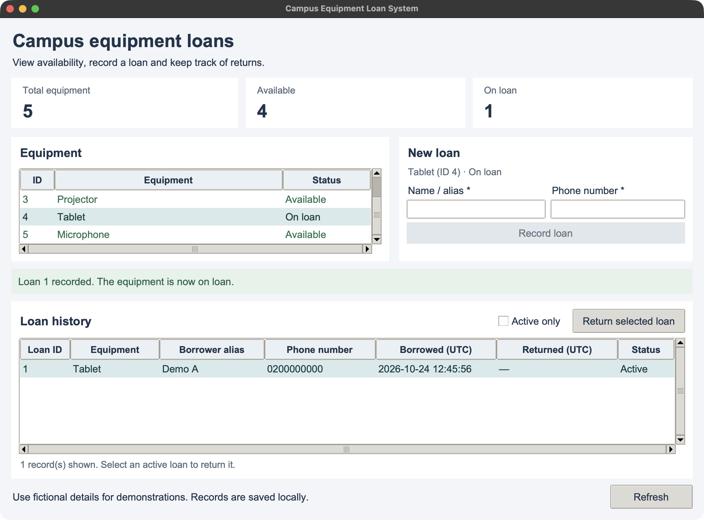
MSE800 / ASSESSMENT 2
Live GUI demonstration
2 min 15 sec
1 Select Tablet
2 Check required phone
3 Borrow and return
4 Reopen the database
Fictional demo details
Demo A / 0200000000
Bin Wang | 07:15–09:30
07 / 12
Notes:
SLIDE 7 | Bin Wang | 07:15–09:30 (135 seconds)
ENGLISH SCRIPT
This is a separate demonstration database. The inventory contains five devices. I am scrolling to Tablet and Microphone, then selecting Tablet.
I enter Demo A and first leave the phone empty. The program rejects the request. Now I enter the fictional contact zero two zero, followed by seven zeros, and record the loan.
The history shows a Loan ID, the name and the phone. The tablet now shows On loan, and its borrowing button is disabled.
I select that active loan and return it. The tablet becomes available again. The returned record and phone stay in history.
I will close the window and reopen the same database. The saved record remains. Returns use the loan record, because a loan ID can differ from the equipment ID.
操作提示（不朗读）
本页 2 分 15 秒包含鼠标操作和重启时间。0–15 秒：选 Tablet；15–35 秒：空电话被拒并填写 0200000000；35–55 秒：借用并展示记录；55–80 秒：归还；80–115 秒：关闭并用同一命令重开；115–135 秒：确认历史。保持演示数据库一致。累计 9:30，返回 PPT。
Sources: current selected Project Report (sections 3–5, 8–10 and appendices), Reflection Report and Python source at GitHub source commit d61c66ca11d2fd69c2bd40c005d3e4b53f65b100. Repository: https://github.com/dreamgithub0920/Campus_Equipment_Loan_System. Technical checks recorded 24 October 2026 on macOS; not a Windows execution or student activity record. Screenshots were captured from the current application on 25 October 2026 NZDT using an isolated in-memory database and fictional details.

Slide 8
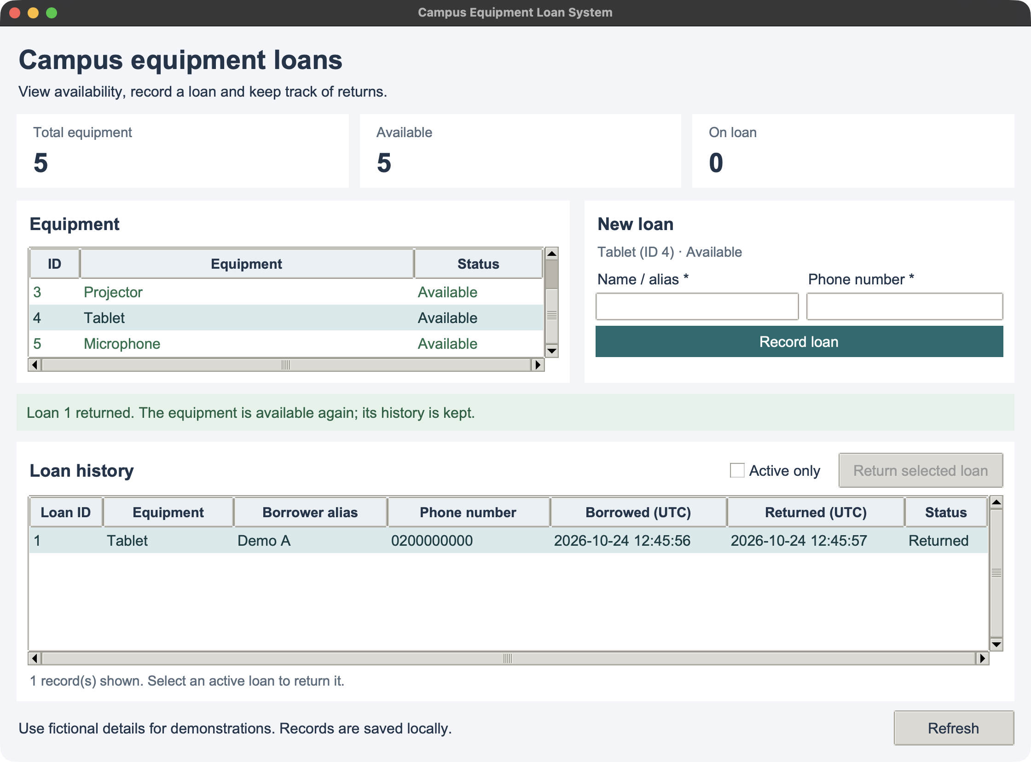
MSE800 / ASSESSMENT 2
Design choices and limits
Shared rules in GUI and CLI
Return a loan without losing its history.
Current boundary: one workstation, no server, login or database encryption.
Actual returned record with fictional borrower details
Bin Wang | 09:30–10:00
08 / 12
Notes:
SLIDE 8 | Bin Wang | 09:30–10:00 (30 seconds)
ENGLISH SCRIPT
These choices keep the project small enough to explain and test. Both interfaces share the same rules, and returns preserve history. The current product supports one workstation. It has no shared server, login or database encryption. Real campus use would need further controls and review. Yonghui will now explain our technical evidence and the remaining work.
操作提示（不朗读）
30 秒总结并交接。10:00 由 Yonghui 接手。
Sources: current selected Project Report (sections 3–5, 8–10 and appendices), Reflection Report and Python source at GitHub source commit d61c66ca11d2fd69c2bd40c005d3e4b53f65b100. Repository: https://github.com/dreamgithub0920/Campus_Equipment_Loan_System. Technical checks recorded 24 October 2026 on macOS; not a Windows execution or student activity record. Screenshots were captured from the current application on 25 October 2026 NZDT using an isolated in-memory database and fictional details.

Slide 9
MSE800 / ASSESSMENT 2
Technical verification
20
12
unittest checks passed
acceptance checks passed
12 business and storage
8 GUI checks with real Tk widgets
Borrow, reject, return, restart,
Unicode, new devices and phone
macOS execution recorded on 24 October 2026
Windows launcher included; a real Windows run is still required.
Technical verification does not establish client acceptance.
Yonghui Dai | 10:00–11:30
09 / 12
Notes:
SLIDE 9 | Yonghui Dai | 10:00–11:30 (90 seconds)
ENGLISH SCRIPT
Thank you. The current technical verification includes twelve business and storage checks, eight GUI checks, and twelve acceptance checks. All passed in the recorded assistant execution on macOS on the twenty-fourth of October. The GUI checks create real Tk widgets rather than checking only the business service.
The checks cover availability, borrowing, invalid input, duplicate protection, return, filtering, restart and Unicode names. They also exercise the required phone and the two additional devices. Migration checks compare older records before and after upgrading, including their identifiers and timestamps.
These observations support the tested software version. They do not establish that the three students personally ran the checks, or that a client accepted the product. Windows startup support is included, but a real Windows run is still needed. If the environment skips GUI checks because Tkinter or a desktop display is missing, that does not verify the interface on that computer.
操作提示（不朗读）
区分 20 项 unittest（12 业务＋8 GUI）与另 12 项验收；不要说已在 Windows 实测。累计 11:30。
Sources: current selected Project Report (sections 3–5, 8–10 and appendices), Reflection Report and Python source at GitHub source commit d61c66ca11d2fd69c2bd40c005d3e4b53f65b100. Repository: https://github.com/dreamgithub0920/Campus_Equipment_Loan_System. Technical checks recorded 24 October 2026 on macOS; not a Windows execution or student activity record. Screenshots were captured from the current application on 25 October 2026 NZDT using an isolated in-memory database and fictional details.

Slide 10
MSE800 / ASSESSMENT 2
Cultural considerations and Te Tiriti
Partnership
Seek appropriate guidance before settling cultural decisions.
Participation
Invite relevant people to influence requirements and review.
Protection
Review why phone data is needed, access and retention.
Kaiārahi consultation: OPEN
Unicode support is implemented; cultural suitability needs appropriate review.
Yonghui Dai | 11:30–13:00
10 / 12
Notes:
SLIDE 10 | Yonghui Dai | 11:30–13:00 (90 seconds)
ENGLISH SCRIPT
The report considers partnership, participation and protection. Partnership means seeking appropriate guidance before treating cultural decisions as settled. Participation means allowing relevant people to influence the requirements and review the interface. Protection includes examining what information the project collects and how it keeps that information.
The new phone requirement makes that discussion more specific. The prototype stores contacts locally without login or encryption. Before real use, the team needs agreement on why a contact is necessary, who can access it, and how long it should remain. Our demonstration uses fictional details.
The software preserves Unicode names, including macrons. That is a useful technical property, but it cannot establish cultural suitability. No actual Kaiārahi consultation or community approval is claimed. The prepared briefing asks about participation, language, contact collection and acceptance criteria. Those review questions remain open until the appropriate people contribute.
操作提示（不朗读）
用具体电话字段说明 protection；说明咨询仍待开展。累计 13:00。
Sources: current selected Project Report (sections 3–5, 8–10 and appendices), Reflection Report and Python source at GitHub source commit d61c66ca11d2fd69c2bd40c005d3e4b53f65b100. Repository: https://github.com/dreamgithub0920/Campus_Equipment_Loan_System. Technical checks recorded 24 October 2026 on macOS; not a Windows execution or student activity record. Screenshots were captured from the current application on 25 October 2026 NZDT using an isolated in-memory database and fictional details.

Slide 11
MSE800 / ASSESSMENT 2
Reflection and next review
A phone field affects every layer
Connect requirements to the interface, rules, model, storage and tests.
Migration must preserve earlier records
Compare saved values and reopen the database to verify the result.
Team roles need a cross-check
Review another component; base personal reflection on actual contributions.
Yonghui Dai | 13:00–14:30
11 / 12
Notes:
SLIDE 11 | Yonghui Dai | 13:00–14:30 (90 seconds)
ENGLISH SCRIPT
The case and current implementation give us several points to examine. A small change, such as requiring a phone, affects the screen, service, data model, database and tests. A requirement therefore needs to connect to each affected component and to an observable result.
Migration provides another example. A new column should not damage earlier loans or make missing contacts appear complete. Tests need to compare stored values and reopen the database, rather than rely only on a success message.
For teamwork, assigned roles and equal estimated hours are only a starting point. Each member should explain another component, review a complete borrowing path and record any unresolved question. Personal reflections should use actual contributions and learning rather than repeat the written scenario as an experience.
The next technical step is checking the extracted release on the presentation computer. The next participation steps are confirming the tutor's client arrangement and the appropriate advisory route, then recording how that input affects the project.
操作提示（不朗读）
反思使用分析语气，不声称未做过的团队活动。累计 14:30。
Sources: current selected Project Report (sections 3–5, 8–10 and appendices), Reflection Report and Python source at GitHub source commit d61c66ca11d2fd69c2bd40c005d3e4b53f65b100. Repository: https://github.com/dreamgithub0920/Campus_Equipment_Loan_System. Technical checks recorded 24 October 2026 on macOS; not a Windows execution or student activity record. Screenshots were captured from the current application on 25 October 2026 NZDT using an isolated in-memory database and fictional details.

Slide 12
MSE800 / ASSESSMENT 2
Current release and next steps
Current release
Five devices · Required phone · Borrow and return · Saved history
Next: Windows verification, participant review and consultation.
Thank you
github.com/dreamgithub0920/
Campus_Equipment_Loan_System
Yonghui Dai | 14:30–15:00
12 / 12
Notes:
SLIDE 12 | Yonghui Dai | 14:30–15:00 (30 seconds)
ENGLISH SCRIPT
To finish, the current release demonstrates five devices, required phone contacts, borrowing, returns and saved history through a desktop interface. The code and documents are available in the project repository. The remaining work includes Windows verification, participant review and the appropriate consultation. Thank you for listening. We are ready for your questions.
操作提示（不朗读）
15:00 结束。若老师把问答计入 15 分钟，请相应缩短正文；当前安排不额外包含问答。
Sources: current selected Project Report (sections 3–5, 8–10 and appendices), Reflection Report and Python source at GitHub source commit d61c66ca11d2fd69c2bd40c005d3e4b53f65b100. Repository: https://github.com/dreamgithub0920/Campus_Equipment_Loan_System. Technical checks recorded 24 October 2026 on macOS; not a Windows execution or student activity record. Screenshots were captured from the current application on 25 October 2026 NZDT using an isolated in-memory database and fictional details.

