Slide 1
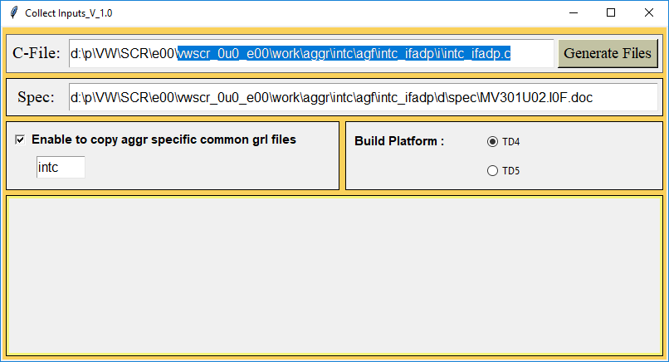
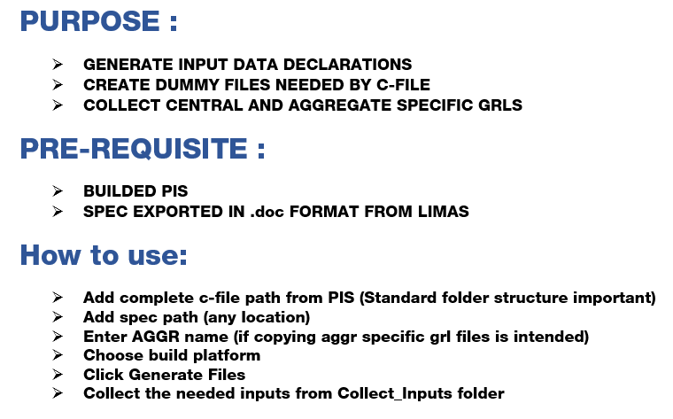
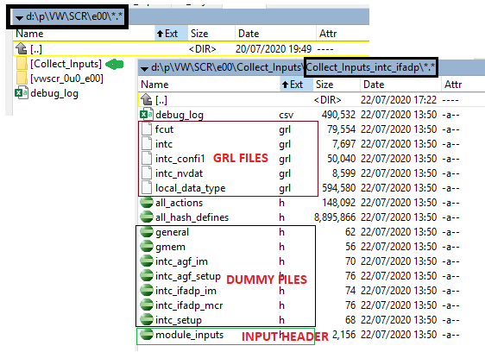

NEW FEATURE WITH TOOLS : Collect Inputs
EMS2MCR manual coding build environment

