Slide 1
Informatics in society: Big Data
INFO20002: Foundations of Informatics
11th May 2015

Slide 2
Informatics in Society
Big Data
Health Informatics
Security
  (No workshop)

Slide 3

Big Data
Every Second on the Internet…
  http://onesecond.designly.com
Big Data = Data

Slide 4

Buzzwords Everywhere…
Beware the marketeers…
Big Problems:
  Volume without judgement or inference (cleverness)
  Concentrate on handling rather than representative sample sizes
    Similar to issues of badly-designed clinical trials…

Slide 5
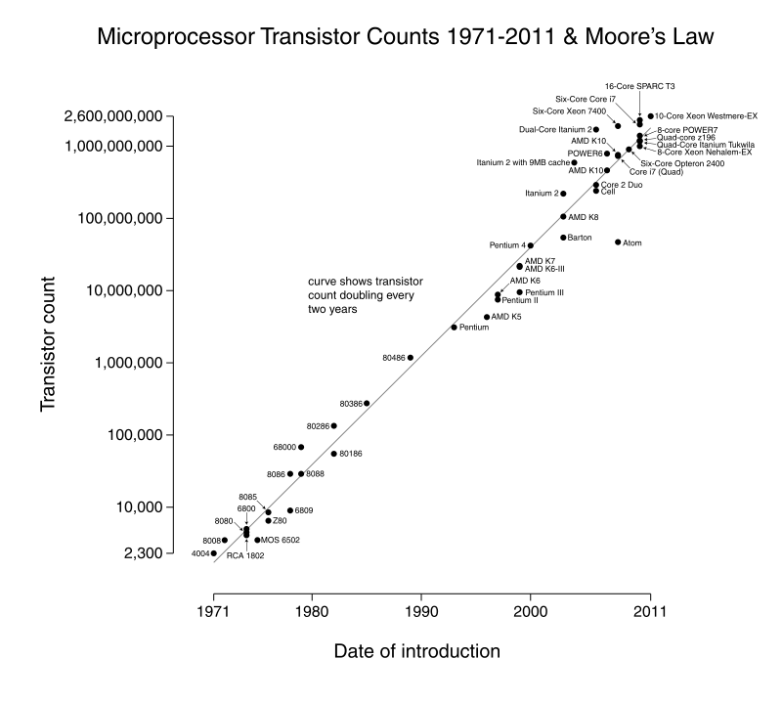
Context in Informatics
Technology that has led us to this “digital age”:
  Moore’s Law
  “Number of transisters in an integrated circuit doubles approximately every two years”
Leads to increased capabilities in:
  Storage
  Execution

Slide 6
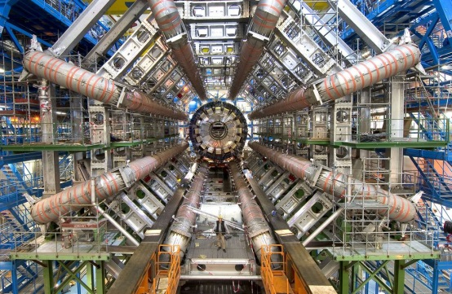
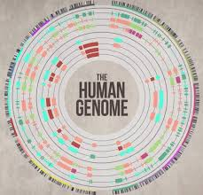
Scientific Computing
Particle physics
  Large Hadron Collider generating ~25 Petabytes per year
  http://en.wikipedia.org/wiki/Worldwide_LHC_Computing_Grid
Bioinformatics
  One person’s genome: ~ 100 Gigabytes
  A million genomes: 100 Petabytes
  http://www.forbes.com/sites/sap/2012/04/16/how-cloud-and-big-data-are-impacting-the-human-genome-touching-7-billion-lives/

Slide 7

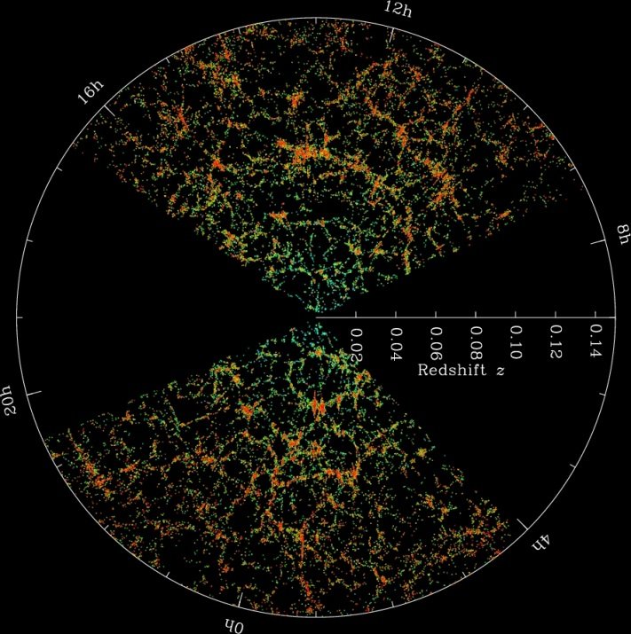
“e-Science”
“Computationally-intensive science that uses immense data-sets”
First coined by Director General of UK Office of Science and Technology
Large Hadron Collider
Sloan Digital Sky Survey

Slide 8
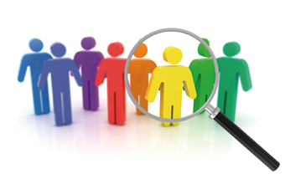
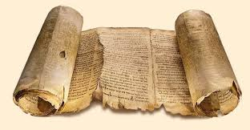

“e-Research”
Social sciences
  Population health studies
Humanities
  Analysis of ancient texts and language processing
Population sentiment analysis
  Twitter
“e-Dance” (All-hands meeting keynote speech, Oxford 2010)
  Practice-led dancing supported by Grid Computing

Slide 9

Science vs Commerce
For many scientific problems, distributed capacity was over-subscribed (e.g. at 110% of available nodes)
  Therefore, there is always a queue
  And every node is getting hammered
Commercial vendors would balk at this prospect:
  Constant wear on assets
  No room for profit mark-ups
    They want you to pay more for under-utilised subscriptions

Slide 10
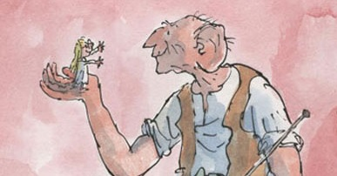
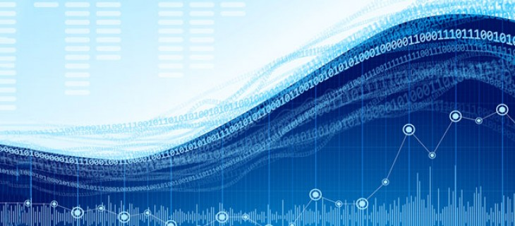
The birth of “Big Data”
But there was a growing realisation that data volumes on these scales weren’t just limited to science:
  Surveillance
  Politics and public policy
  Marketing
  Population health
  Etc.
Previously known as the “data tsunami”
  And other pejorative terms…
Marketeers needed something friendlier…
  “Big” is friendly

Slide 11
Seriously, we’re on slide 11 – what is Big Data?
“Data sets so large or complex that traditional data processing applications are inadequate.” (Wikipedia)

Slide 12
Big Detail – the V’s
Volume
  How big is the data?
Velocity
  How fast is the data generated?
Variability
  How regular or varied is the data?
Veracity
  What is the quality/consistency of the data?

Slide 13
Data Consistency
When you’re analysing from many different sources, you need to know that what you’re using is current. If it changes then in what way is it likely to change?
  Is the data returned in the right order and up to date?
  What is the provenance of the data?
  What are the latest, benchmarked versions of this data?

Slide 14
Information Standardisation
Do you create one big “data dictionary” that everyone must adhere to?
  A global schema
  For instance, Health-Level 7 (a health information encoding)
Or do you work on the glue in-between?
  Accept that each node has it’s own version of the data format and work on the mapping between these…
  For instance, ontologies / semantic web

Slide 15
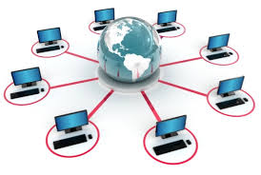
Big Infrastructure
Cluster Computing (90’s and earlier)
  Set of computers that work together and can be viewed as a single system
Grid Computing (00’s)
  Collection of computer resources to achieve common goal
  Modelled on the electricity grid
  Process grids / Information grids
  SETI@home was one of the original concepts
Cloud Computing (10’s)
  Infrastructure as a service (IAAS)
  Platform as a service (PAAS)
  Software as a service (SAAS)

Slide 16
Bandwidth and managing latency
Despite increasing processor speeds, the bottleneck is always in taking the data to these redundant computers…
So we have a trade-off between speed gained from the individual node speeds and the time taken to get the data there:
Network speeds vary massively due to many factors:
  underlying infrastructure speeds, throttling, VPN versus leased lines, net neutrality, etc

Slide 17
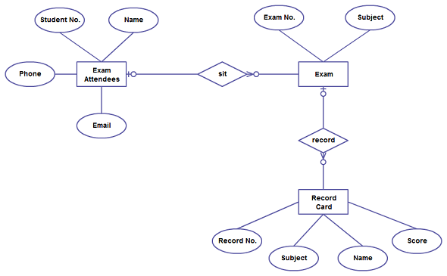
Size vs Structure
We can have a structured database organised into tables:
  Query using SQL (Standard Query Language)
  Organisation allows optimisation of speed to “finding useful stuff”
Or we can have a patterned repository that follows a syntax and service very large data-sets (what Big Data is all about)…

Slide 18

Big Data Applications: CouchDB
Coming into fashion at the same time as Big Data:
  NoSQL databases
Large-scale data repositories
  Structure is JSON syntax
  The emphasis is on scale of storage
  Does not perform well with random access
  Best with regularly structured data, accessed through stream

Slide 19

Big Data Applications: CouchBase
CouchBase is an integration of CouchDB and Membase (formerly “memcached” – memory management that supports Facebook)
Provides a NoSQL database that has structure (metadata to help organise) and speed to combine this with high volume
  But the speed is gained through the baseline hardware requirements…

Slide 20

Corporate Big Data: Facebook
Facebook understands the “social network” like no other
  Who are you friends with?
  What are you doing (and who with)?
  What’s your status (nice car, fancy job, etc)
Like well-targeted advertising, we are happy to divulge this information for the (social) rewards…
But now Facebook can recognise your face to a 97.25% accuracy (which is as good as humans):
  http://www.smh.com.au/digital-life/digital-life-news/facebook-facial-recognition-takes-a-giant-scary-leap-forward-20140320-3547d.html
Facebook can figure out your age, race and sexual orientation just from your “likes”:
  http://www.itworld.com/article/2713345/it-management/facebook-knows-you-re-gay-before-your-mother-does.html

Slide 21
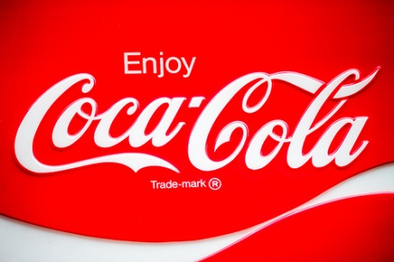
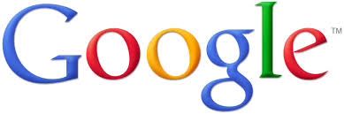
Corporate Big Data: Google
Google understands human curiosity like no other:
  “How do I…?”
  “What/where is…?”
Both Facebook and Google can harvest all the information that we’ve touched on in this course:
  User’s browser setup, Cookies, Geo-location, timestamps
To build up a targeted behavioural pattern of their users:
  Then advertise at you…

Slide 22
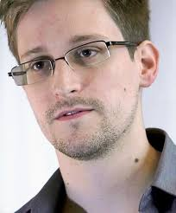
Government Big Data: NSA / PRISM
Capabilities of the National Security Agency (NSA) revealed in mid-2013 (ongoing)
INTERNET
Google
ISP
ISP

Slide 23
Government Big Data: NSA / PRISM
But what if the controllers of Big Data wanted more than to advertise at you…
In the post-9/11 world, nearly every government has pushed the technological capabilities of Big Data as a means of counter-terrorism
  By profiling your “data footprint” you could be put on a no-fly list
  Have your credit or assets frozen
  Be detained at a government’s pleasure
  Etc
They capture the “metadata”:
  Who you talked to/ what time/ where / etc.

Slide 24
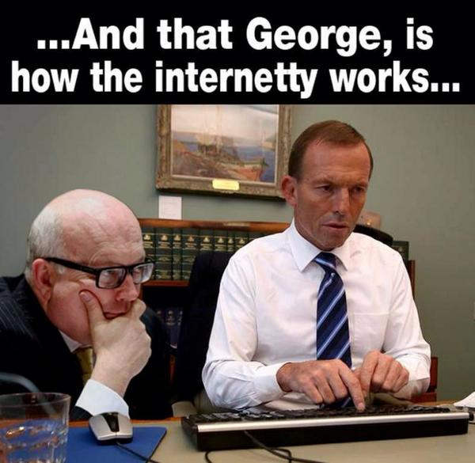
Privacy?
Ever noticed that no matter how left-leaning the government is, no party will ever try to scale back their capabilities of digital monitoring?
  It’s just way too useful…
Australia’s data retention laws
  http://www.aph.gov.au/Parliamentary_Business/Bills_Legislation/Bills_Search_Results/Result?bId=r5375
  Passed in March 2015
  Telco’s retain all data and will allow security agencies to see it if required
  George Brandis (attorney-general) apparently doesn’t know what “metadata” is…
Privacy advocacy reading:
  Electronic Frontier Foundation (EFF) - www.eff.org
  Ross Anderson - www.lightbluetouchpaper.org/

Slide 25
Summary
Big Data has come about from scientific computing and improving computing technology
Big Data uses distributed computing paradigms (cloud, grid, etc)
  But be aware of people conflating data and data-handling
Big Data technical detail is about transporting data, consistency, standardisation, volume
Example applications use database technology such as NoSQL (CouchDB, CouchBase, etc)
Big Data examples in society include corporate (Facebook, Google) and government (NSA). All have privacy ramifications on your life

