Slide 1
Making sense of data - 2
INFO20002: Foundations of Informatics

Slide 2
Bivariate = Two Variables
Searching for a relationship between two variables (if one exists)
Simplest type of statistics
  Apart from univariate (= one variable!)
Covering the basic principles and characteristics of this analysis

Slide 3

Independent / Dependent variables
In any experiment you have (at least):
  one independent variable
  one dependent variable
  everything else controlled
For instance, to establish the effect of temperature on the rate of plant growth:
  Temperature is the independent variable
  Growth is the dependent variable
    Which could be height, weight, number of fruits, etc

Slide 4
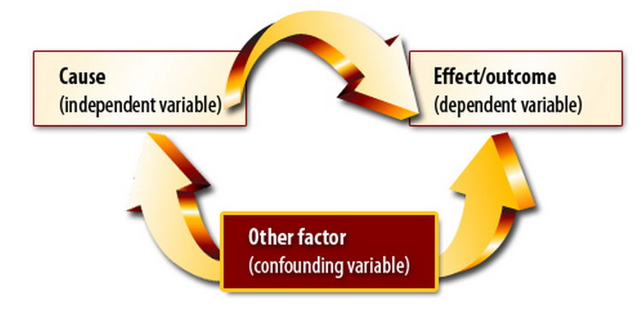
Confounding variables
A confounding variable is one that the researcher has failed to control but which mediates the relationship between independent and dependent.
For example:
  Are people that drink heavily more likely to die younger?
  Over a population sample, the answer is yes.
  But what if people that drink heavily are more likely to smoke/ eat junk food / not exercise?

Slide 5
Analysing discrete variables: contingency tables
Summarise information about discrete variables using contingency tables:
  “A matrix that shows the frequency distribution of the two variables being correlated”
  Also known as a “cross tabulation”
  Shows the number of observations for each combination of discrete values from two categorical variables.
  Categorical values can be ordinal or nominal
  Continuous values must be made discrete (categorised)

Slide 6
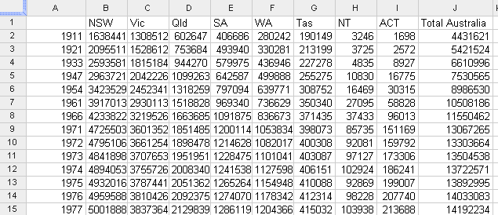
Contingency table example: population count
YEAR VS STATE
cells are count of resident (total population)

Slide 7
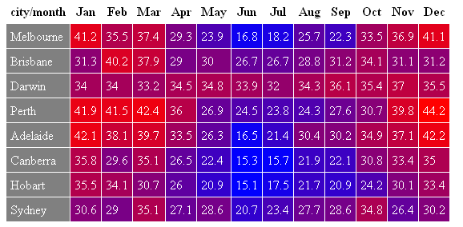
Pivot tables: visualisation of the contingencies
CITY VS MONTH
cells are average of mean max temperature

Slide 8
Pivot tables
Pivot tables allow quick creation of contingencies
Can change the order of variables and see the changes (hence “pivot” due to the rotation of the variables)
Automatically sorts, totals or averages counts within a (tabulated) data-set
Relevant to phase 3 project

Slide 9
Analysing discrete variables: rank correlation
Rank correlation
  Calculates similarities between ranks
“If a university has a higher-ranked football team, then is it likely to have a higher-ranked basketball team?”
Football ranking | University team
1 | Melbourne
2 | Monash
3 | Sydney
4 | New South Wales
5 | Adelaide
6 | Perth
Basketball ranking | University team
1 | Sydney
2 | Melbourne
3 | Monash
4 | New South Wales
5 | Perth
6 | Adelaide

Slide 10
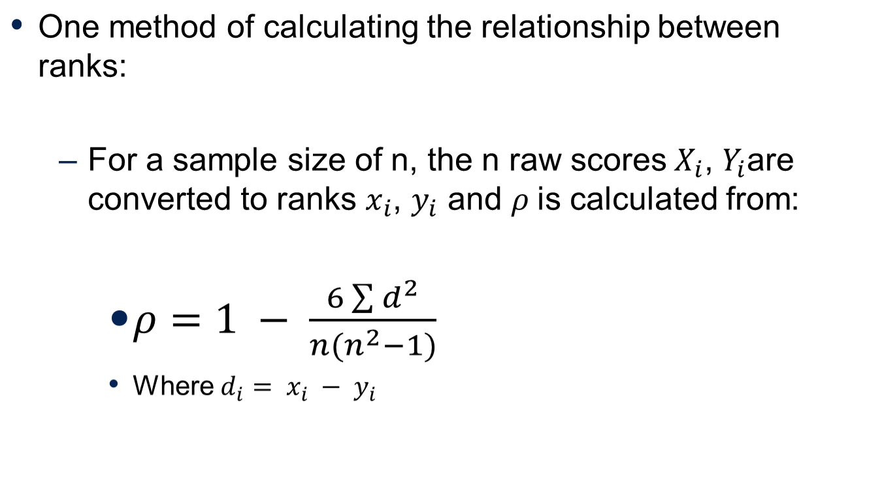
Spearman’s Rank Correlation

Slide 11
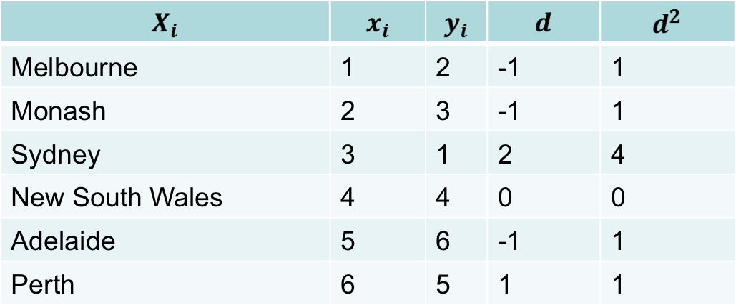
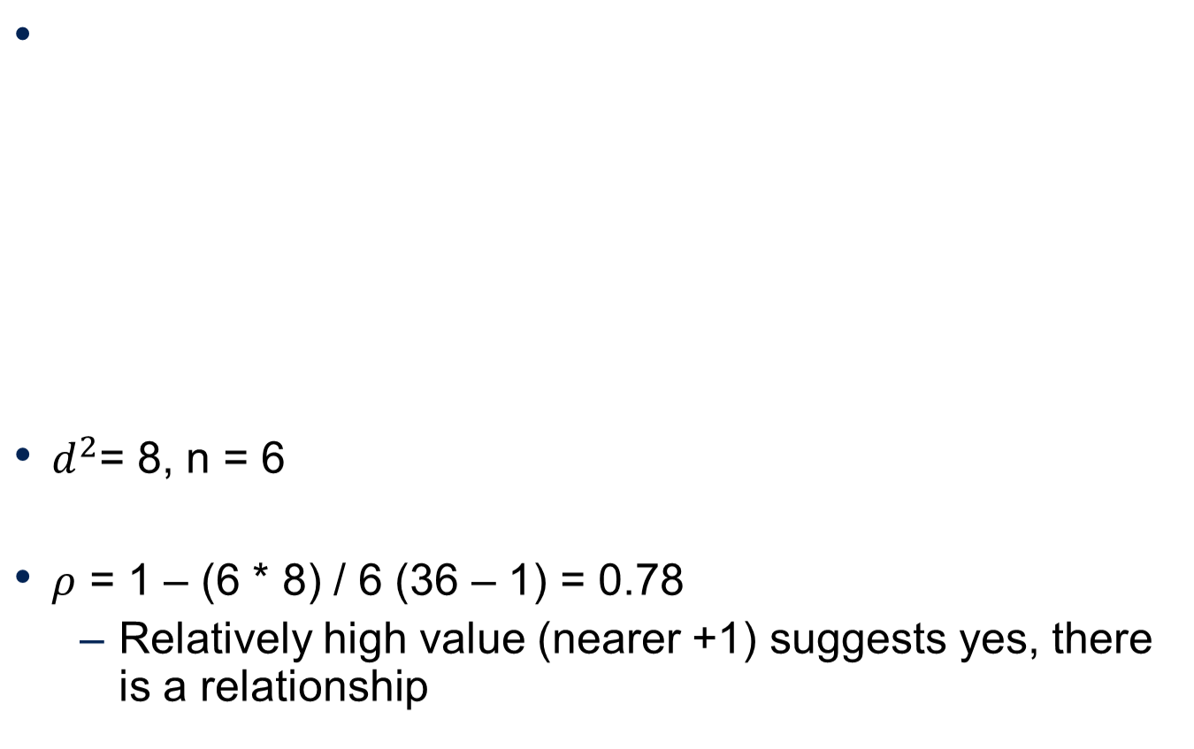
Example: Spearman’s Rank Correlation

Slide 12
Analysing continuous variables
Regression
  The concept that in the long-term, extreme measurements of a continuous variable will converge on a single “average” relationship
Correlation co-efficients
  The degree of relationship between two continuous variables
  From observation to mathematical model, this can be derived

Slide 13
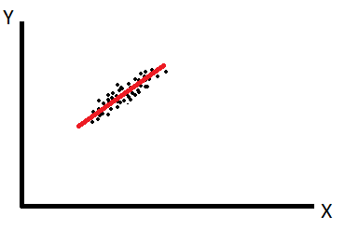
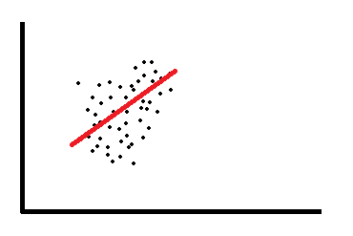

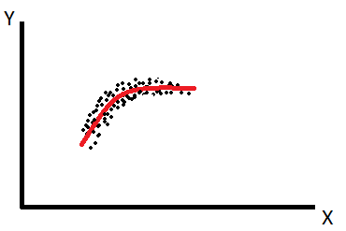
Regression to the mean
The idea is that there is a defined meaning of “normal” of this data-set, and in a good model the data points are never very far from “normal”
  i.e. they “regress to the mean”…

Slide 14
Correlation co-efficients
For instance, the rate of plant growth is the relationship between the independent and dependent variables:
  Growth = [some number] * Temperature
  Where [some number] is the correlation co-efficient
Growth
Rate of growth
Rate of growth
Temperature

Slide 15
Data mining - descriptive
Descriptive = grouping things together to get a view of the “data landscape”
Association rule
  Generate rules based on observations of the data-set
Clustering
  Groups data into sets of observations or clusters

Slide 16
Descriptive example – Association Rules
IF a patient is over 70
  AND they have history of liver problems
  AND they have low socio-economic status
    THEN they are 70% likely to be diabetic
Rule is easy to apply to other data points
Rule can be generated by analysing the data-set
Advantages:
  Easy to understand, actionable, good for large data
Disadvantages:
  Categorical only, time-consuming to generate, many rules means priority to be worked out

Slide 17
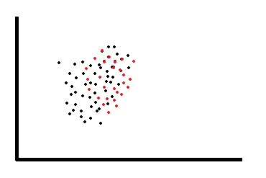
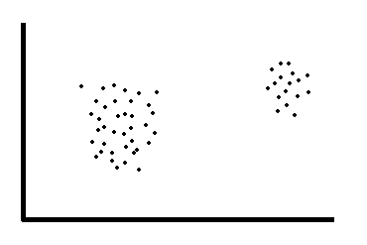
Descriptive example - Clustering
Advantages:
  Flexible, hierarchical approach possible
Disadvantages:
  Subjective interpretations, slow, size limits

Slide 18
Data mining - prescriptive
Prescriptive = using historical patterns to predict what will happen next…
Classification
  Allows observations to be assigned to different categories
Regression
  Mathematical model to predict a continuous response variable

Slide 19
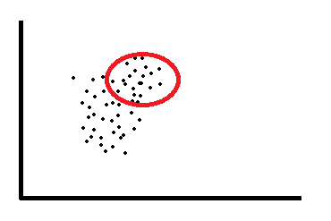
Prescriptive example - Classification
Build the model to predict which category the next data-point is going to fall into…
Assess the quality of a model using a contingency table:
TP = true positive
FN = false negative
FP = false positive
TN = true negative
Actual / Predicted | Positive (1) | Negative (0)
True (1) | TP | FN
False (0) | FP | TN

Slide 20
Sensitivity and Specificity
Sensitivity = how well the model is able to predict ‘true’ values:
  Sensitivity =
Specificity = how well the model is able to predict ‘false’ values:
  Specificity =
In real life, there is usually a trade-off between these two:
  e.g. airport scanners set to trigger on low-risk items like keys or belts (low specificity) so that they never miss the big things like bomb components…
TP
TP + FN
TN
FP + TN

Slide 21
Prescriptive example - Regression
The idea is that there is a defined meaning of “normal” of this data-set, and in a good model the data points are never very far from “normal”
  i.e. they “regress to the mean”…

Slide 22
Summary
Analysis is the critical skill that interfaces your knowledge of obscure data to the real world
There are five broad steps to successful analysis:
  Sourcing, understanding, cleaning, transformation, feature selection
  Know what each of these steps entails
Know your hypothesis/research question before analysis
Feature extraction / data mining
  Broadly two types (with examples):
    Descriptive = association rules, clustering
    Prescriptive = classification, regression to the mean

Slide 23


© Copyright The University of Melbourne 2009

