Slide 1
Making sense of data - 1
INFO20002: Foundations of Informatics

Slide 2
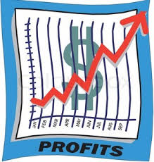
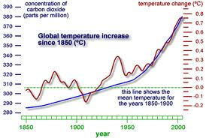
Context
The actual answers that the data gives us:
  This is the bit that the rest of the world want access to
    Scientists, policy-makers, journalists, general public…
How do we get to that?
Analysis

Slide 3
Analytics
Analytics
  Discovery and communication of meaningful patterns in data
This lecture gives the broad concepts of analysing data and some examples of grouping and prediction
  Tomorrow we’ll look at the specific, but very common, case of bivariate analysis (two variables)
  Later in the semester, we’ll look more deeply into the use of these analysis “tools” and touch on more advanced techniques (statistical analyses, machine learning)

Slide 4
Data in the rest of the (non-tech) world
Usually we’re presented with tables and tables of data…
  Comma-Separated Values (.csv)
  Spreadsheets
  Databases
The general Internet community seems to be happiest dealing with spreadsheets...
  So this is where the valuable data lies
  But spreadsheets and tables are terrible tools for communication…

Slide 5
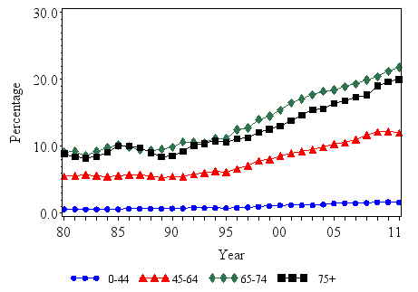
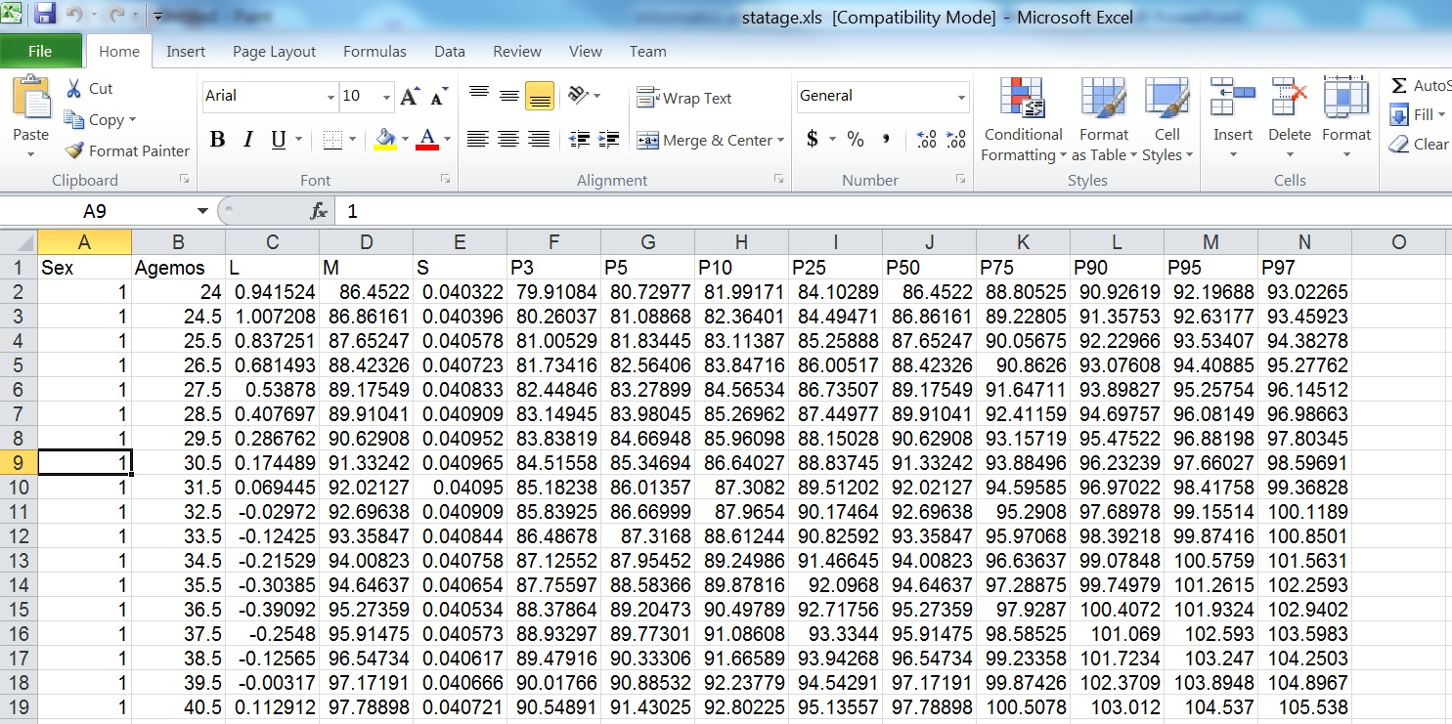
Example - health: CDC charts for diabetes
http://www.cdc.gov/diabetes/statistics/prev/national/figbyage.htm

Slide 6


Example - tech: what would Google do?
They have a massive data store under their control, facilitated by their product (online search):
  The original business driver was to match pages to users
  To improve this, Google need to know pages/documents are most relevent to their users’ search patterns
Google Analytics
  They can harvest all the information that we’ve been dealing with in the mechanics of the Internet:
    Browser setup, cookies, geo-location, timestamps, etc
And build up a targeted behavioural pattern and then advertise at you…

Slide 7


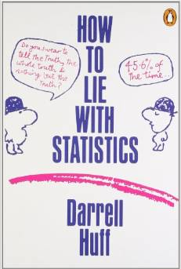
And if you’re in the business of “spin”…
How to lie with data visualisation:
  http://data.heapanalytics.com/how-to-lie-with-data-visualization/
How to lie with statistics, Darrell Huff

Slide 8
Data analysis – the steps
1. Sourcing
  Find your data…
2. Understanding
  What do the columns and values represent?
  Figure out what story is buried in that data…
3. Cleaning
  Are there errors and is the data valid?
  What was the original data collection purpose?
4. Transformation
  Turn the data into something presentable
5. Feature selection
  Pull out the relevant bits to address your hypothesis

Slide 9

Finding a hypothesis
A “chicken and egg” problem…
You need to look at the data to figure out a question…
Then you need to answer that question using the data…

Slide 10
Step 1: sourcing data
Data-set types:
  Surveys or polls, Experiments, Observational and other studies
Repository types:
  Operational databases, Data warehouses, Historical databases, Purchased data
Data types:
  Any kind of persistent file storage (SQL, CSV, XML, JSON, …)

Slide 11
Step 2: understanding the data
Tables
  Data about “things”
  Column is a variable, row is an observation
  Raw or derivative

Slide 12
Discrete vs Continuous
Continuous = numbers or anything that can have a range
  Also called “numerical”
Discrete = anything else
  Also called “categorical”
  But note: numbers can be discrete too

Slide 13
Examples of continuous variables
Numerical measurements:
  Temperature
  Velocity
  Time
  Etc
Anything that can be set down as a range…
1
2
3
4
5
6

Slide 14
Examples of discrete variables
Anything that isn’t a number (“nominal”):
  Colours
  Political party
  Favourite food
  Car models
  Age (as commonly used in polls – e.g. 21-35)
  Etc
But numbers can also be discrete (“ordinal”):
  A set of options (e.g. choose either “1”, “2”, or “3”)

Slide 15
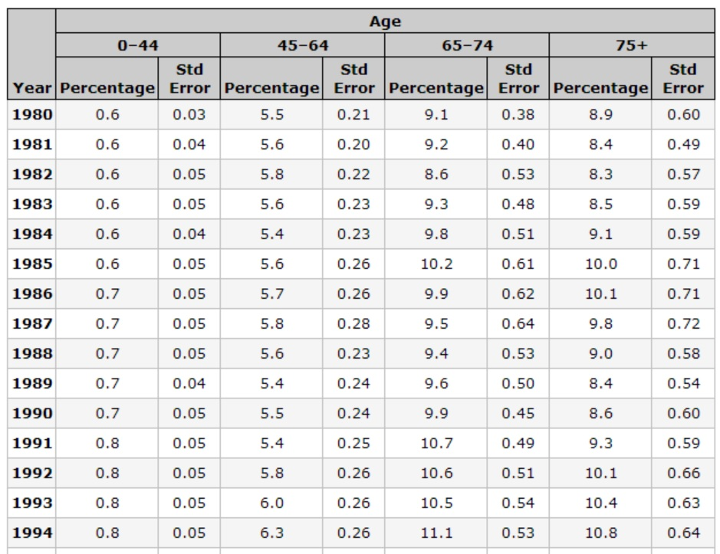
Example – CDC diabetes tables

Slide 16
Step 2: understanding the data
Frequency distribution
  Define categories and plot them along the x-axis
If the variable is already categorical:
  … just use those
If it is numerical:
  … count the instances and put them into the categories (called a histogram)

Slide 17
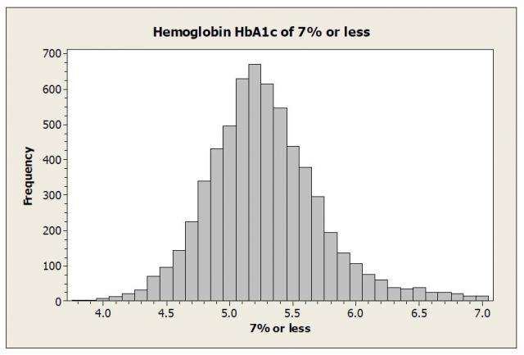
Example – CDC diabetes

Slide 18
Transforming continuous to discrete
The basic idea:
  Divide the range into intervals that have well-defined boundaries
  Commonly called “binning” into a histogram

Slide 19
Transforming continuous to discrete
There are several strategies for defining what these intervals should be:
  Equal interval
    Intuitively easiest: split up the range equally and see how the data falls into them (previous example)
  Quantile
    Instead of splitting up the range, look at the data and break up the categories so that each one has equal member numbers
  Jenks (Natural Breaks)
    Look at the data and see where the “natural” intervals lie (by measuring the distance from the mean)

Slide 20
Quantile intervals
Seen this in phase 1 of the project:
  “Five key numbers”
Quartile is the most commonly used version of quantile splitting:
  Split into four evenly-populated sections (Q1 – Q4)
  Names are a bit confusing
Quartile name | Alternative name / reference
First quartile (Q1) | Lower Quartile (25th percentile)
Second quartile (Q2) | Median (50th percentile)
Third quartile (Q3) | Upper Quartile (75th percentile)
Interquartile range (IQR) | Q3 – Q1 (difference between upper and lower quartiles)

Slide 21
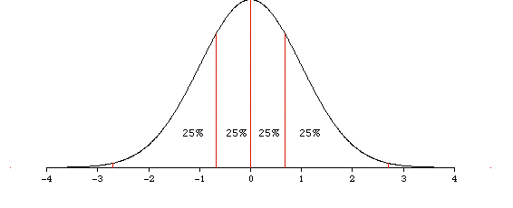
Quartile graph (normal distribution)

Slide 22
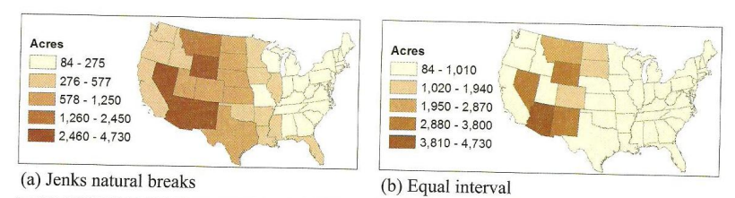
Jenks (natural break)
Jenks natural breaks classification
Cluster a set of values into different classes by reducing the variance within classes and maximizing the variance between classes.

Slide 23
Jenks (natural break)
equal interval (two classes)
jenks natural breaks (two classes)

Slide 24

Step 3: cleaning the data
Validation and tidying of the data
Semantic similarities:
  “General Electric Company”
  “General Elec Co.”
  “GE”
  “Gen. Electric Company”
Range problems (or maybe wrong units…)
  Age = 150 years
  Blood pressure = 250 mmHg

Slide 25
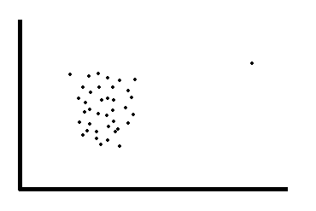
Removing variables
When we say remove variables we mean:
  “Removing an entire category because it contributes nothing of interest or relevance to the analysis”
We do NOT mean:
  “Removing a single data point because it makes the graph look bad”
In this case, these data points are called outliers and entire statistics courses look at how to deal with them…

Slide 26
Step 4: Transformation
Normalization
  Scale numerical columns so that they can be compared fairly
  e.g. converting absolute numbers to percentages, then scaling
Value mapping
  Convert text data (nominal) to numbers
  e.g. low = 0, medium = 1, high = 2
Discretization
  Convert numerical variables into categorical ones
Aggregation
  Derive a variable that isn’t present from two (or more) that are…

Slide 27

Step 5: Feature Extraction
If your data is way too big… then there will probably be some redundancy
  e.g. measurements in metres and feet
Feature extraction is an algorithm to pull only the information of relevance => Data Mining
This is yet another branch of mathematics in itself…
  Principal component analysis, Non-linear dimensionality reduction, etc.

Slide 28


© Copyright The University of Melbourne 2009

