Slide 1

Spreadsheet 2
INFO20002:
Foundation of Informatics
Dept of Computing and Information Systems

Slide 2
Filtering and Sorting
=UNIQUE(sourceArray)
Returns only the unique rows in the source array, discarding duplicates, in the order in which those rows first appears.
=FILTER(sourceArray, arrayCondition_1, arrayCondition_2, ..., arrayCondition_30)
Returns a filtered version of the given source array, where only certain rows (columns) have been included. Each condition should be a column (row) of boolean values. Only the rows (columns) from the source array corresponding to the true values of the condition array will be returned. If there are multiple conditions, then all must be true for the corresponding values in the source array to be returned.
=SORT(data, keyColumn_1, ascOrDesc_1, keyColumn_2, ascOrDesc_2, ..., keyColumn_30, ascOrDesc_30)
Returns the rows in the given data range (or array), sorted according to the given key columns. The key column may be part of the data range, or as another column outside the range. If the key column is within the data range, give its index within the range: 1 is the first column of the range, 2 is the second column, etc. You can also specify another column outside the range. Each key column must also be marked to sort either ascending or descending, by adding either TRUE or FALSE after that specifying that key column.

Slide 3
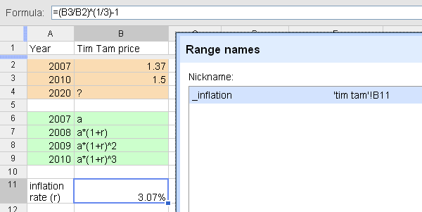
The Basics: Named Range
Define a symbolic name for a particular cell or range of cells
Do not use names that have a potential of conflict with cell references, e.g. A1, ABC123 X
Use underscore to avoid conflict: inflation_

Slide 4
The Basics: Lookup
=VLOOKUP(key_value, range, index, sort_order)
Finds key_value in the first column of range and
returns the value in the matching row and column-index.
key_value: the exact value searched for in the first column of the range.
range: the reference to lookup table, which must include at least two columns.
index: the number of the column in the range that contains the value to be
returned. The first column has the number 1.
sort_order (optional): TRUE or FALSE to indicate whether the first column in the range
is sorted in ascending order. (default=TRUE)

Slide 5

Example: when do you want to retire?

Slide 6
Let’s ask the data ...
How has our demographics structure changed?
How can we approximate our living cost in the future?
How much money we must save for our retirement age?

Slide 7
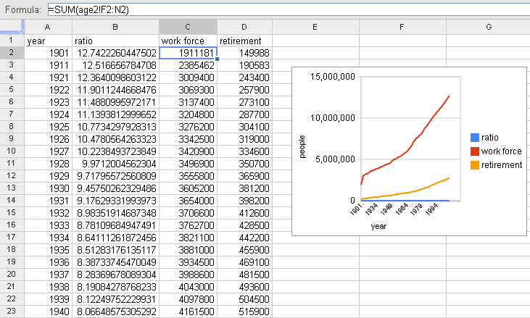
How our demographics structure has changed?

Slide 8

The Cost of Living: Inflation Rate
The rate of increase of a price index, or the percentage of change in price over time
What you can buy with $1 now is different to what you would be able to buy with the same amount of money 10 years from now

Slide 9
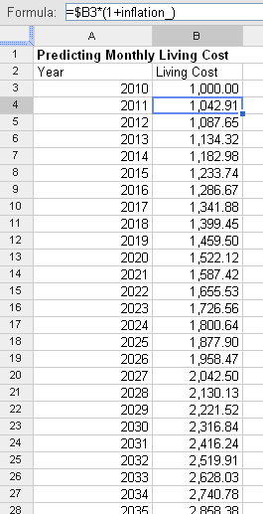
Extrapolating trend

Slide 10
What You Earn Is What You Save (WYEIWYS)
Annuity: a series of uniform payments paid at regular intervals
Future Value / Present Value
Present Value
In Retirement
Future Value
In Employment
SAVING REGULARLY
DRAWING REGULARLY

Slide 11
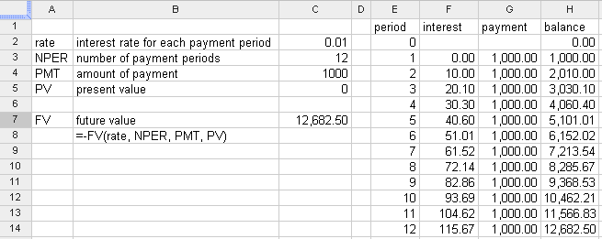
Iterative Calculations

Slide 12

Financial Formulas
PV(rate, NPER, PMT, FV) - Present value
Returns the present value of an investment resulting from a series of regular payments.
FV(rate, NPER, PMT, PV) - Future Value
Returns the future value of an investment based on periodic, constant payments and a constant interest rate.
PMT(rate, NPER, PV, FV) - Periodic payment
Returns the periodic payment for an annuity with constant interest rates.

Slide 13
Financial Parameters
Rate defines the interest rate per period.
NPER is the total number of payment periods.
PMT is the regular payment made per period.
FV defines the future value remaining/desired at the end of the periodic payments
PV (optional) is the present cash value of an investment.

Slide 14
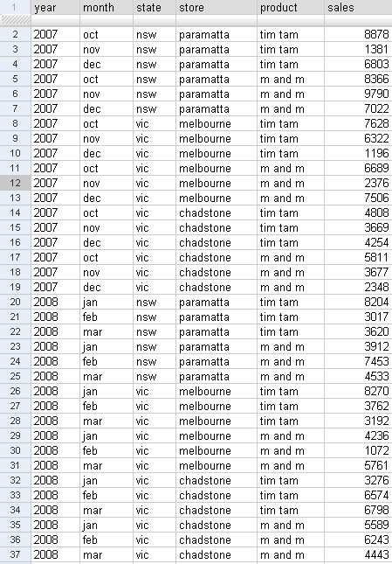
Pivot Table
Almost all data contain more than two dimensions
Hyperdimensions (Hypercube)
Dimensions (Categories) and Measurements
Some dimensions are hierarchical

Slide 15
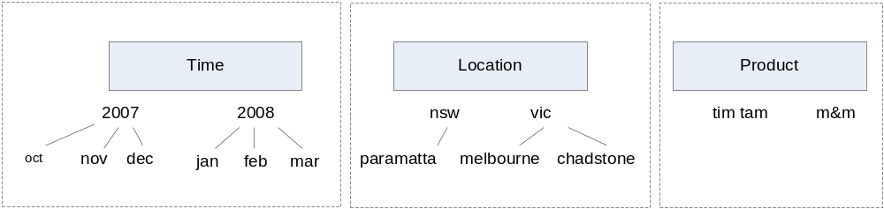
Pivot Table
Dimensions
Measurements: Sales

Slide 16
Pivot Table
Crosstab/Pivot Table/OLAP Cube
Provides data summarization (aggregation) over selected dimensions (typically subset of all dimensions)
Provide sorting and ranking function

Slide 17
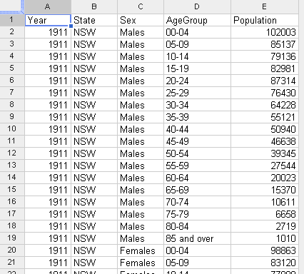
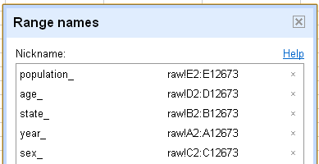
Pivot Table: Example
Australian Demographics Data (from ABS)
Dimensions:
  State: NSW, Vic, Qld, SA, WA, Tas, NT, ACT
  Year: 1911-2007
  18 Age categories: from 0-4 to 85 over
  Sex: Males and Females
Measurements:
Number of Population

Slide 18
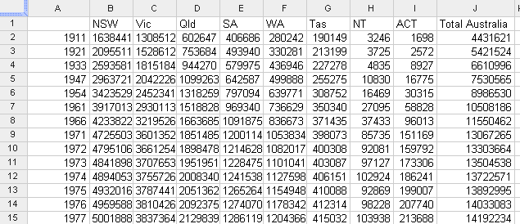
Year vs State
=TRANSPOSE(UNIQUE(state_))
=UNIQUE(year_)
=SUM(B2:I2)
=SUM(FILTER(population_,year_=$A2,state_=B$1))

Slide 19
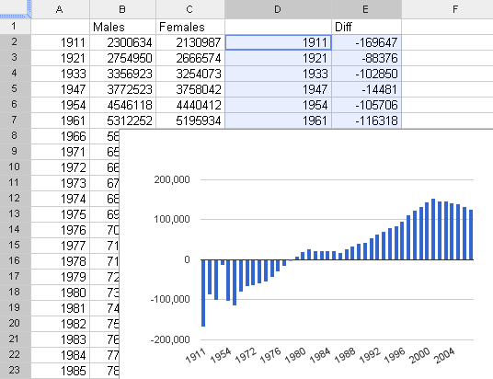
Year vs Sex

Slide 20
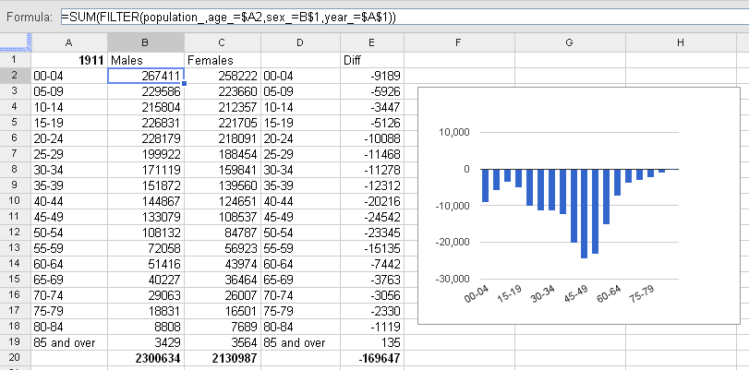
Age vs Sex
"There are three kinds of lies: lies, damned lies, and statistics."
"DRILLING DOWN"

