Slide 1
Tools of Analysis
INFO20002: Foundations of Informatics

Slide 2
Data mining
Data mining, machine learning, statistical learning
Learning from data
Unsupervised (Descriptive) vs
Supervised (Unsupervised)
Supervised Learning: some prior knowledge about what you want to find out (target variable)
Exploratory vs Explanatory

Slide 3
Data mining - unsupervised
Provide broader view to get the “data landscape” or “interesting recurrent pattern”
Association rule
  Generate rules based on observations of the data-set
Clustering
  Groups data into sets of observations or clusters

Slide 4
Association
IF a patient is over 70
  AND they have history of liver problems
  AND they have low socio-economic status
    THEN they are 70% likely to be diabetic
Rule is easy to apply to other data points
Rule can be generated by analysing the data-set
Advantages:
  Easy to understand, actionable, good for large data
Disadvantages:
  Categorical only, time-consuming to generate, many rules means priority to be worked out

Slide 5
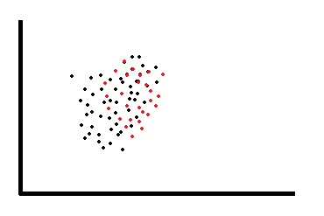
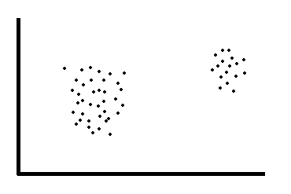
Clustering
K-Means Clustering
Advantages: flexible, hierarchical approach possible
Disadvantages: setting initial cluster number, can be slow, size limits

Slide 6
Data mining - supervised
Supervised = using historical patterns to predict what will happen next…
Class = f(v1, v2, v3)
Regression
  Mathematical model to predict a continuous response variable
Classification
  Allows observations to be assigned to different categories

Slide 7
Classification
Build the model to predict which category the next data-point is going to fall into…
A classifier: a model that contains some parameters
K-nearest neighbour classifier, Naïve Bayes Classifier, Support Vector Machine, Decision Tree
You have a “training data set” for a classifier to learn from (i.e. use the data to find the parameters).
You test the performance using “test data set“

Slide 8
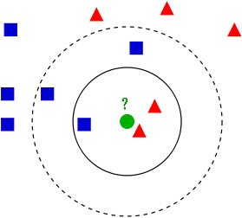
KNN Classification
The class of an unknown instance is the majority of k closest sample/training data.
Lazy method, the classifier model is the whole dataset.

Slide 9
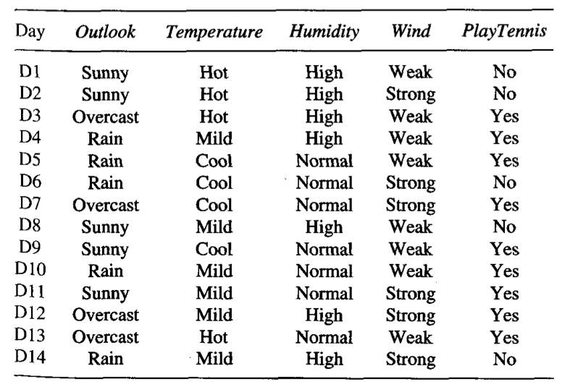
Decision Tree
Classification on discrete values
Classifier is modelled as a tree. Decision tree grows from the root downwards by selecting the next best attribute at each decision level.

Slide 10
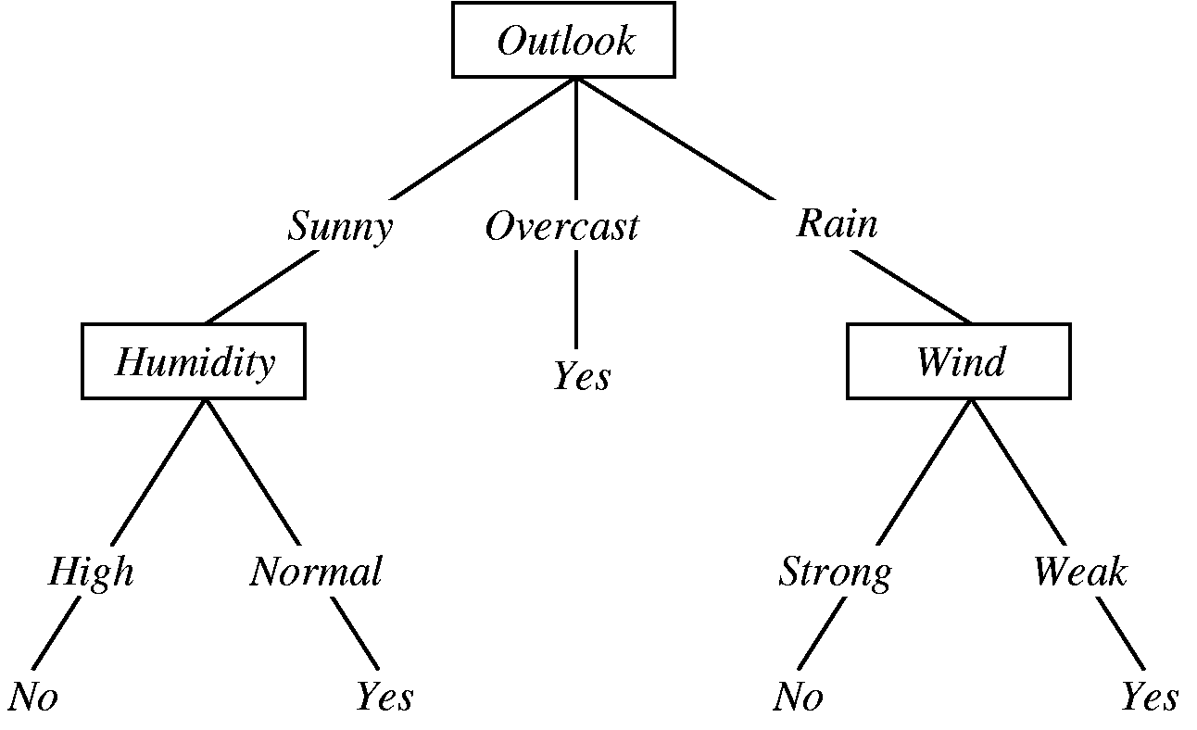
Decision Tree
IF Outlook = Overcast THEN Play = Yes
ELSE IF Outlook = Rain THEN
  IF Wind = Strong THEN Play = No
  ELSE IF Wind = Weak THEN Play = Yes
  ...
Play = (Outlook = Sunny AND Humidity = Normal)
OR (Outlook = Overcast)
OR (Outlook = Rain AND Wind = Weak)

Slide 11
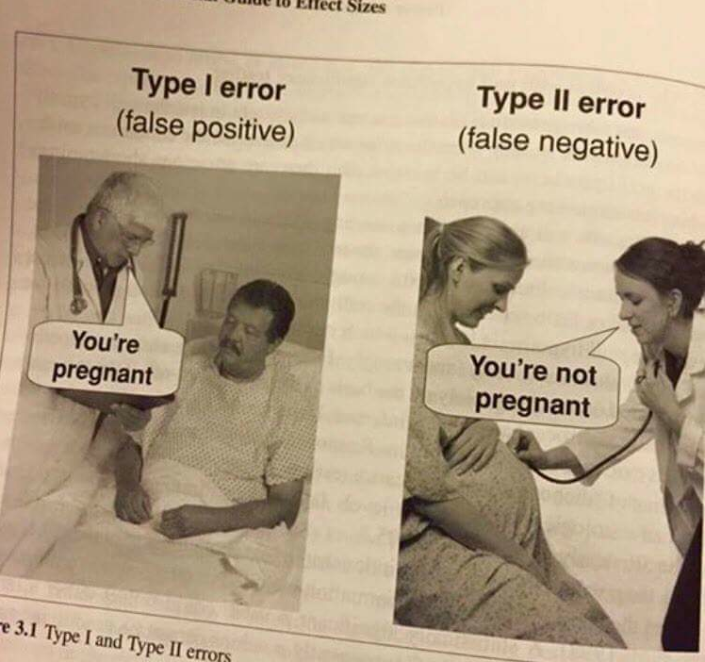
Assessing Binary Classifier

Slide 12
Assessing Binary Classifier
Assess the quality of a model using a confusion matrix (contingency table):
TP = true positive
FN = false negative
FP = false positive
TN = true negative
Actual / Predicted | Positive (1) | Negative (0)
True (1) | TP | FN
False (0) | FP | TN

Slide 13
Sensitivity and Specificity
Sensitivity = how well the model is able to predict ‘true’ values:
  Sensitivity =
Specificity = how well the model is able to predict ‘false’ values:
  Specificity =
In real life, there is usually a trade-off between these two:
  e.g. airport scanners set to trigger on low-risk items like keys or belts (low specificity) so that they never miss the big things like bomb components…
TP
TP + FN
TN
FP + TN

Slide 14


© Copyright The University of Melbourne 2009

