Slide 1

Spreadsheet 1
INFO20002:
Foundation of Informatics
Dept of Computing and Information Systems

Slide 2
Spreadsheets
What do you all use spreadsheets for?
What other things can you use spreadsheets for?
Answer: anything that can be modelled in a table

Slide 3

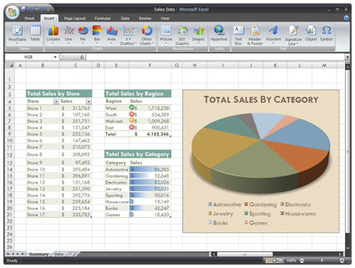
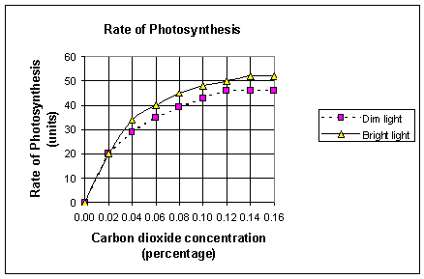
Examples

Slide 4

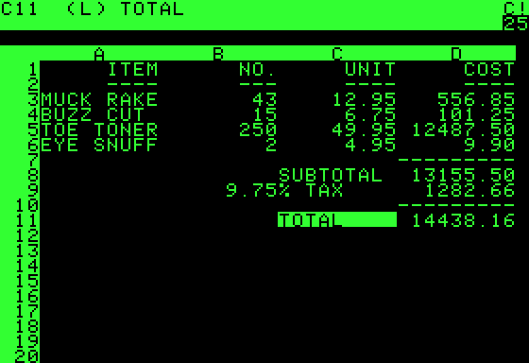
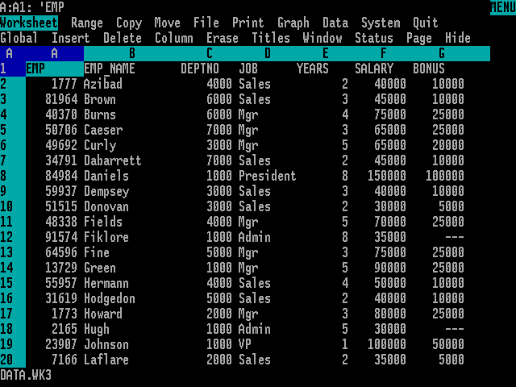

History
Taken from paper-accounting worksheets
VisiCalc (1979)
  First “killer app” for the Apple 2
Lotus-1-2-3 (1981)
  MS DOS on the IBM (also a “killer app”)
Excel (1985)
  The Microsoft Office suite

Slide 5
Data tells a story ...
Narrative over time
Describe relationship between various measurements

Slide 6

Example: when do you want to retire?

Slide 7

What do you want your retirement to be like?
http://www.theage.com.au/news/national/seniors-strip-in-pension-protest/2008/05/16/1210765127184.html

Slide 8
Let’s ask the data ...
How has our demographics structure changed?
How can we approximate our living cost in the future?
How much money we must save for our retirement age?

Slide 9
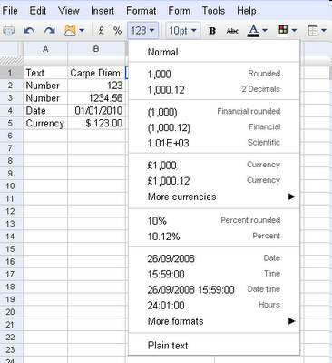
Google Spreadsheet
Sheets, Rows, and Columns
Cell references:
A1, A1:C3, A3:A, B:B
Sheet1!A1:C3
Static data (literals)
and formulas
A formula is constructed from literals, operators, functions, and cell references
literals

Slide 10
The Basics: Formulas
A formula is constructed from literals, operators, functions, and cell references
Starts with = (equal sign)
Examples:
=1+2*3
=A1+2
=SUM(1,2,3)
=SUM(A1:A10)
=ImportHtml("http://www.unimelb.edu.au/freebies.html","table",2)
=Transpose(A1:C3)

Slide 11
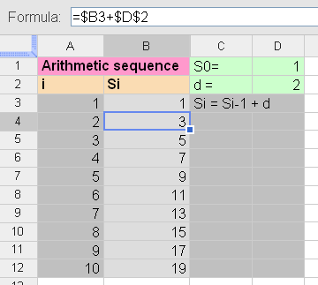
The Basics: Cell Reference
Absolute Cell Reference:$A$1
Relative Cell Reference: A1
Mixed: $A1
When copying a formula that contains column and/or row relative references to another cell, the references in the copied formula will be offset by the distance between source and target cells.
Named ranges

Slide 12
Aggregate Functions
http://docs.google.com/support/bin/answer.py?answer=82712
=SUM(number_1, number_2, ... number_30)
Adds all the numbers in the arguments (up to 30 arguments). You can also enter a range using cell references.
=AVERAGE(number_1, number_2, ... number_30)
Returns the average of the arguments. Arguments can be numerical values or ranges. Text is ignored.
=MAX(number_1, number_2, ... number_30)
Returns the maximum value in a list of arguments. Arguments can be numerical values or ranges.
=MIN(number_1, number_2, ... number_30)
Returns the minimum value in a list of arguments. Arguments can be numerical values or ranges.
=COUNT(value_1, value_2, ... value_30)
Counts how many numbers are in the list of arguments. Text entries are ignored. Values could also be ranges.
=COUNTA(value_1, value_2, ... value_30)
Counts how many values are in the list of arguments. Text entries are also counted, even when they contain an empty string of length 0.

Slide 13
Conditionals
=IF(test, then_value, otherwise_value)
Returns values based on a logical test. Test is any value or logical expression that can be TRUE or FALSE. Then_value (optional) is the value that is returned if the logical test is TRUE. Otherwise_value (optional) is the value that is returned if the logical test is FALSE.
marks > 85
=IF(B11>85,"H1","Not H1")
False
Condition/
Logical test
True
"H1"
"Not H1"

Slide 14
Conditionals
Use + as logical OR operator
Use * as logical AND operator
=IF((year>=1970)*(year<=1979),"Seventies","Oldies or Babies")
=IF((year<1970)+(year>1979),"Kids and Seniors","Adult")

Slide 15
Conditional & Aggregation
=COUNTIF(range, criteria)
Returns the number of elements that meet certain criteria within a cell range. Range is the range to which the criteria are to be applied. Criteria is a number or a text used for the search criteria.
=SUMIF(range, criteria, sum_range)
Adds the cells specified by a given criteria. Range is the range to which the criteria are to be applied. Criteria is a number or a text used for the search criteria. Sum_range is the range from which values are summed.

Slide 16
Index and Offset
=INDEX(reference, row, column)
Returns the content of a cell, specified by row and column offset
=OFFSET(cell_reference, offset_rows, offset_columns, [height], [width])
Returns a range reference shifted a specified number of rows and columns from a starting cell reference

Slide 17
Array Formula
In a formula wrapped inside an =ARRAYFORMULA function, you can pass arrays (ranges) to functions and operators that typically only take non-array arguments. Those functions and operators will be applied to each member of the arrays one at a time. There results of these operation will be presented as a new array.
http://docs.google.com/support/bin/answer.py?hl=en&answer=71291
=ARRAYFORMULA( + )

Slide 18
Filtering and Sorting
=UNIQUE(sourceArray)
Returns only the unique rows in the source array, discarding duplicates, in the order in which those rows first appears.
=FILTER(sourceArray, arrayCondition_1, arrayCondition_2, ..., arrayCondition_30)
Returns a filtered version of the given source array, where only certain rows (columns) have been included. Each condition should be a column (row) of boolean values. Only the rows (columns) from the source array corresponding to the true values of the condition array will be returned. If there are multiple conditions, then all must be true for the corresponding values in the source array to be returned.
=SORT(data, keyColumn_1, ascOrDesc_1, keyColumn_2, ascOrDesc_2, ..., keyColumn_30, ascOrDesc_30)
Returns the rows in the given data range (or array), sorted according to the given key columns. The key column may be part of the data range, or as another column outside the range. If the key column is within the data range, give its index within the range: 1 is the first column of the range, 2 is the second column, etc. You can also specify another column outside the range. Each key column must also be marked to sort either ascending or descending, by adding either TRUE or FALSE after that specifying that key column.

