Slide 1
Spreadsheets
INFO20002: Foundations of Informatics
28th March 2017

Slide 2
Spreadsheets
Motivation/history/examples of spreadsheets
Basics: cell references, formulae, aggregation
Advanced: conditionals, aggregation, index/offset
Advanced: filtering/sorting, array-formula, vlookup, named range
Pivot tables

Slide 3
Spreadsheets
Motivation/history/examples of spreadsheets
Basics: cell references, formulae, aggregation
Advanced: conditionals, aggregation, index/offset
Advanced: filtering/sorting, array-formula, vlookup, named range
Pivot tables

Slide 4
Spreadsheets
What do you all use spreadsheets for?
What other things can you use spreadsheets for?
Answer: any information that can be modelled in a table

Slide 5
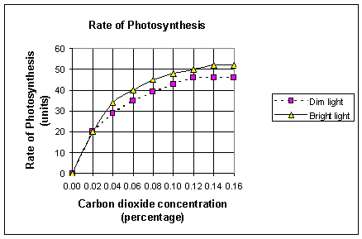
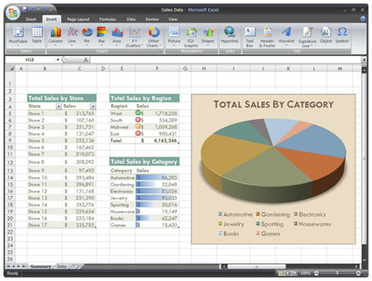

Examples

Slide 6
Storing data
XML and JSON are methods of representing data
Can they be used for storage?
In what formats can data be stored?
CSV, text files, databases, …
All persistent data can be used as navigable storage
Spreadsheets are a tool to navigate/manipulate that (stored) data

Slide 7

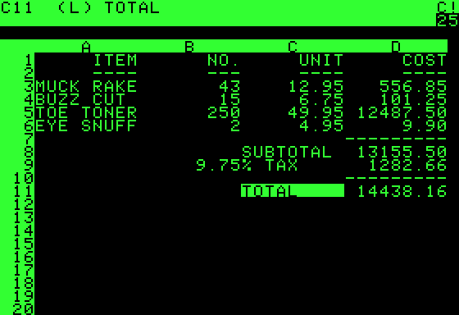
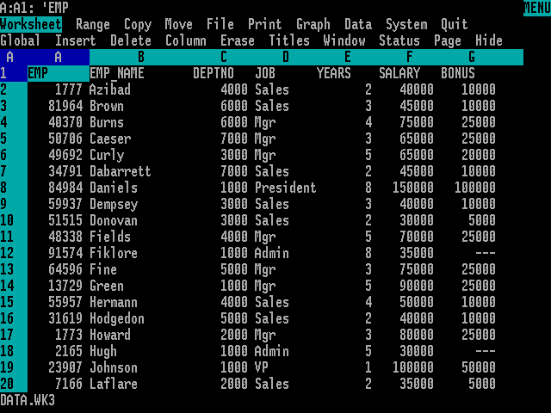

History
Taken from paper-accounting worksheets
VisiCalc (1979)
  First “killer app” for the Apple 2
Lotus-1-2-3 (1981)
  MS DOS on the IBM (also a “killer app”)
Excel (1985)
  The Microsoft Office suite
Google Spreadsheets (2006)

Slide 8
Spreadsheets
Motivation/history/examples of spreadsheets
Basics: cell references, formulae, aggregation
Advanced: conditionals, aggregation, index/offset
Advanced: filtering/sorting, array-formula, vlookup, named range
Pivot tables

Slide 9
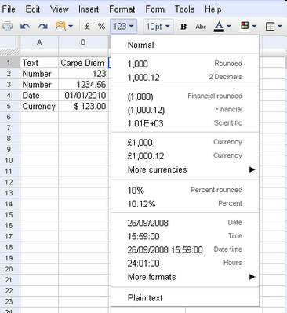
Google Spreadsheets
Sheets, Rows, and Columns
Cell references:
A1, A1:C3, A3:A, B:B
Sheet1!A1:C3
Static data (literals)
and formulas
A formula is constructed from literals, operators, functions, and cell references
literals

Slide 10
The basics: formulas
A formula is constructed from literals, operators, functions, and cell references
Starts with = (equal sign)
Examples:
=1+2*3
=A1+2
=SUM(1,2,3)
=SUM(A1:A10)
=ImportHtml("http://www.unimelb.edu.au/freebies.html","table",2)
=Transpose(A1:C3)

Slide 11
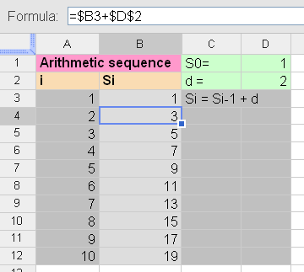
The basics: cell references
Absolute Cell Reference:$A$1
Relative Cell Reference: A1
Mixed: $A1
When copying a formula that contains column and/or row relative references to another cell, the references in the copied formula will be offset by the distance between source and target cells.
Named ranges

Slide 12
Aggregate functions
=SUM(number_1, number_2, ... number_30)
Adds all the numbers in the arguments (up to 30 arguments). You can also enter a range using cell references.
=AVERAGE(number_1, number_2, ... number_30)
Returns the average of the arguments. Arguments can be numerical values or ranges. Text is ignored.
=MAX(number_1, number_2, ... number_30)
Returns the maximum value in a list of arguments. Arguments can be numerical values or ranges.
=MIN(number_1, number_2, ... number_30)
Returns the minimum value in a list of arguments. Arguments can be numerical values or ranges.
=COUNT(value_1, value_2, ... value_30)
Counts how many numbers are in the list of arguments. Text entries are ignored. Values could also be ranges.
=COUNTA(value_1, value_2, ... value_30)
Counts how many values are in the list of arguments. Text entries are also counted, even when they contain an empty string of length 0.

Slide 13
Spreadsheets
Motivation/history/examples of spreadsheets
Basics: cell references, formulae, aggregation
Advanced: conditionals, aggregation, index/offset
Advanced: filtering/sorting, array-formula, vlookup, named range
Pivot tables

Slide 14
Conditionals
=IF(test, then_value, otherwise_value)
Returns values based on a logical test. Test is any value or logical expression that can be TRUE or FALSE. Then_value (optional) is the value that is returned if the logical test is TRUE. Otherwise_value (optional) is the value that is returned if the logical test is FALSE.
marks > 85
False
=IF(B11>85,"H1","Not H1")
True
"H1"
"Not H1"

Slide 15
Conditionals
Use + as logical OR operator
Use * as logical AND operator
=IF((year>=1970)*(year<=1979),"Seventies","Oldies or Babies")
=IF((year<1970)+(year>1979),"Kids and Seniors","Adult")

Slide 16
Conditional & Aggregation
=COUNTIF(range, criteria)
Returns the number of elements that meet certain criteria within a cell range. Range is the range to which the criteria are to be applied. Criteria is a number or a text used for the search criteria.
=SUMIF(range, criteria, sum_range)
Adds the cells specified by a given criteria. Range is the range to which the criteria are to be applied. Criteria is a number or a text used for the search criteria. Sum_range is the range from which values are summed.

Slide 17
Index and Offset
=INDEX(reference, row, column)
Returns the content of a cell, specified by row and column offset
=OFFSET(cell_reference, offset_rows, offset_columns, [height], [width])
Returns a range reference shifted a specified number of rows and columns from a starting cell reference

Slide 18
Spreadsheets
Motivation/history/examples of spreadsheets
Basics: cell references, formulae, aggregation
Advanced: conditionals, aggregation, index/offset
Advanced: filtering/sorting, array-formula, vlookup, named range
Pivot tables

Slide 19
Filtering and Sorting
=UNIQUE(sourceArray)
Returns only the unique rows in the source array, discarding duplicates, in the order in which those rows first appears.
=FILTER(sourceArray, arrayCondition_1, arrayCondition_2, ..., arrayCondition_30)
Returns a filtered version of the given source array, where only certain rows (columns) have been included.
Each condition should be a column (row) of boolean values. Only the rows (columns) from the source array corresponding to the true values of the condition array will be returned. If there are multiple conditions, then all must be true for the corresponding values in the source array to be returned.
=SORT(data, keyColumn_1, ascOrDesc_1, keyColumn_2, ascOrDesc_2, ..., keyColumn_30, ascOrDesc_30)
Returns the rows in the given data range (or array), sorted according to the given key columns.
The key column may be part of the data range, or as another column outside the range. If the key column is within the data range, give its index within the range: 1 is the first column of the range, 2 is the second column, etc. You can also specify another column outside the range. Each key column must also be marked to sort either ascending or descending, by adding either TRUE or FALSE after that specifying that key column.

Slide 20
Array Formula
In a formula wrapped inside an =ARRAYFORMULA function, you can pass arrays (ranges) to functions and operators that typically only take non-array arguments. Those functions and operators will be applied to each member of the arrays one at a time. There results of these operation will be presented as a new array.
http://docs.google.com/support/bin/answer.py?hl=en&answer=71291
=ARRAYFORMULA( + )

Slide 21
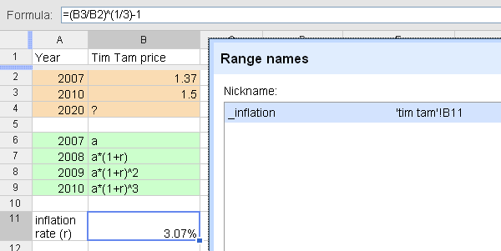
The basics: named range
Define a symbolic name for a particular cell or range of cells
Do not use names that have a potential of conflict with cell references, e.g. A1, ABC123 X
Use underscore to avoid conflict: inflation_

Slide 22
The basics: lookup
=VLOOKUP(key_value, range, index, sort_order)
Finds key_value in the first column of range and
returns the value in the matching row and column-index.
key_value:the exact value searched for in the first column of the range.
range: the reference to lookup table, which must include at least two columns.
index: the number of the column in the range that contains the value to be returned. The first column has the number 1.
sort_order (optional): TRUE or FALSE to indicate whether the first column in the range is sorted in ascending order. (default=TRUE)

Slide 23
Spreadsheets
Motivation/history/examples of spreadsheets
Basics: cell references, formulae, aggregation
Advanced: conditionals, aggregation, index/offset
Advanced: filtering/sorting, array-formula, vlookup, named range
Pivot tables

Slide 24
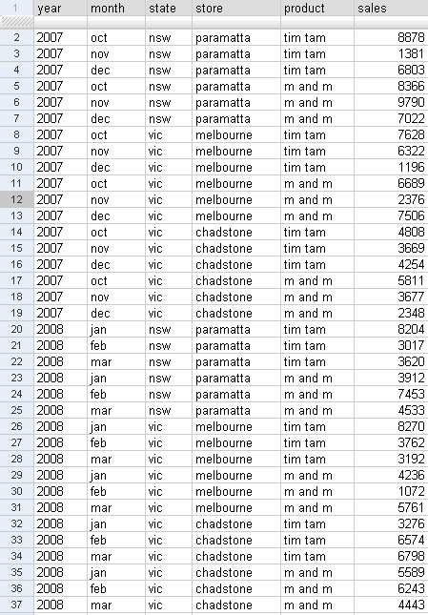
Pivot table
Almost all data contain more than two dimensions
Hyperdimensions (Hypercube)
Dimensions (Categories) and Measurements
Some dimensions are hierarchical

Slide 25
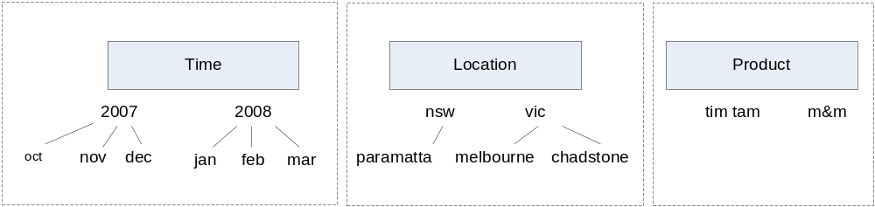
Pivot table
Dimensions
Measurements: Sales

Slide 26
Pivot table
Crosstab/Pivot Table/OLAP Cube
Provides data summarization (aggregation) over selected dimensions (typically subset of all dimensions)
Provide sorting and ranking function

Slide 27
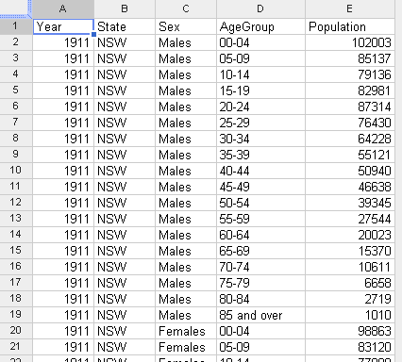
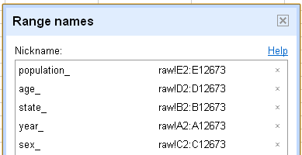
Pivot table: example
Australian Demographics Data (from ABS)
Dimensions:
  State: NSW, Vic, Qld, SA, WA, Tas, NT, ACT
  Year: 1911-2007
  18 Age categories: from 0-4 to 85 over
  Sex: Males and Females
Measurements:
Number of Population

Slide 28
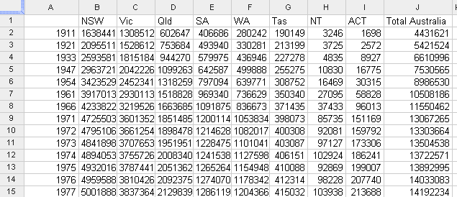
Year vs State
=TRANSPOSE(UNIQUE(state_))
=SUM(B2:I2)
=UNIQUE(year_)
=SUM(FILTER(population_,year_=$A2,state_=B$1))

Slide 29
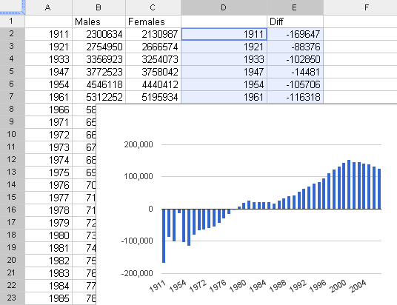
Year vs Sex

Slide 30
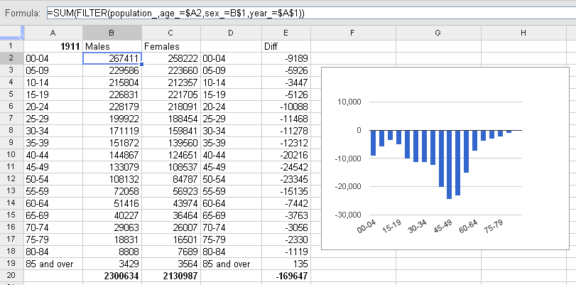
Age vs Sex
"DRILLING DOWN"

Slide 31


© Copyright The University of Melbourne 2014

