Slide 1

HTML/CSS workshop
INFO20002: Foundations of Informatics
Week 5

Slide 2
CSS to make the data beautiful
Client
Data
Markup layer
From server,
database,
JSON,
whatever…
Style reference
Notes:
HTML
Then we told you how it became XML
Then we told you that this developed into JSON
Now we’re back to HTML again (with a difference)
These progressions generally (not exactly) mirror the development of information organisation as the Internet has matured…

Slide 3

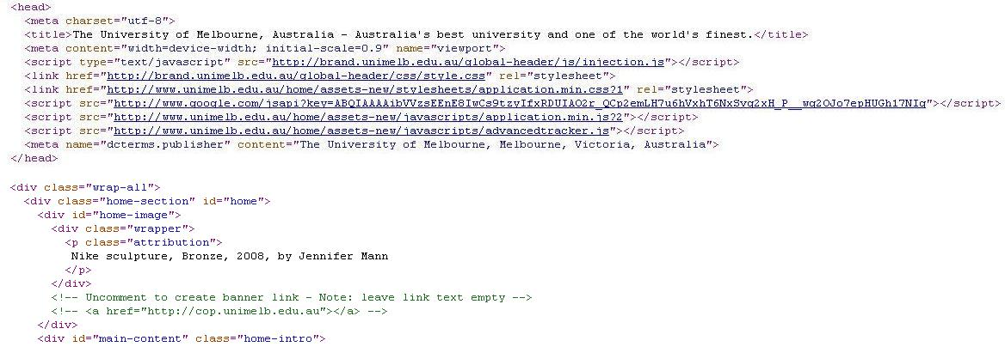
(X)HTML: today (sort of)

Slide 4
Markup – 3 types (for any ML)
Structural markup
  Provides the structure of the doc
    <p>, <h1>, <h2>, etc
    <div> and <span> (XHTML)
Stylistic markup
  Changes how the text appears
    <em>, <strong>, etc
Semantic markup
  Gives meaning to markup content but doesn’t change doc
    <name>Anthony Stell</name>
    <email>astell@unimelb.edu.au</email>

Slide 5
HTML vs XML (XHTML)
XHTML
  ... is an XML document
  ... has stronger structural support
  ... separates content and presentation
  ... allows easier content management
  ... allows easier search engine optimisation
  ... can be validated

Slide 6
Typical XHTML document
XML declaration (optional)
<?xml version="1.0" encoding="UTF-8"?>
<!DOCTYPE html
PUBLIC "-//W3C//DTD XHTML 1.0 Transitional//EN"
"http://www.w3.org/TR/xhtml1/DTD/xhtml1-transitional.dtd">
<html xmlns="http://www.w3.org/1999/xhtml" xml:lang="en-au">
<head>
<title>My first XHTML page</title>
<meta name="description" content="Sample XHTML page" />
<meta name="keywords" content="xhtml, web page" />
<meta name="author" content="John Doe" />
<link rel="stylesheet" href="my_styles.css" type="text/css" />
</head>
<body>
<p>Content of the page.</p>
</body>
</html>
DOCTYPE (DTD)
namespace
metadata
Link to other
documents (style sheet)

Slide 7
Basic Operation
Styles are specified
And they are passed down (“cascaded”)
    selector {
    style-attribute : value;
    }

Slide 8
Simple example
    h1 {
    text-align : center;
    }

Slide 9
Selectors: id and class
id
  identifies a unique element in a document
  defined in CSS with # (hash)
    #c100 {styles}
    <p id="c100"> . . . </p>
class
  identifies several elements belonging to the same group or class
  defined in CSS with . (dot)
    .city {styles} OR p.city {styles}
    <p class="city"> . . . </p>
If element name is not included, style is applied to all elements that use that class

Slide 10
Selector types
general
Universal selector: all elements
*{color: black}
Tag selector: HTML elements e.g. <h1>
h1 {color:black}
Class selector: elements with the specified class
e.g. <h1 class="aClass">
.aClass {color:black}
h1.aClass {color:black}
id selector: Single/Unique element identified by an id
e.g. <div id="pageTitle">
#pageTitle {color:black}
specific

Slide 11
Pseudo class
Syntax
  selector:pseudo-class {property: value}
Anchor pseudo-class (“a”)
  a:link {color: #ff0000} /* unvisited link */
  a:visited {color: #00ff00} /* visited link */
  a:hover {color: #ff00ff} /* mouse over link */
  a:active {color: #0000ff} /* selected link */
Class and Pseudo-class
  a.red:visited {color: #ff0000}
  <a class="red" href="css_syntax.asp">CSS Syntax</a>

Slide 12
Advanced selectors
Descendant selector (space in between selectors):
  div#bigContainer .aClass {property: value}
Child selector (>):
  div.mainText > .aClass {property: value}
Adjacent sibling (+):
  p + div#bigContainer {property: value}
First-child pseudo-sibling
  div > p:first-child {property: value}

Slide 13

© Copyright The University of Melbourne 2009

