Slide 1
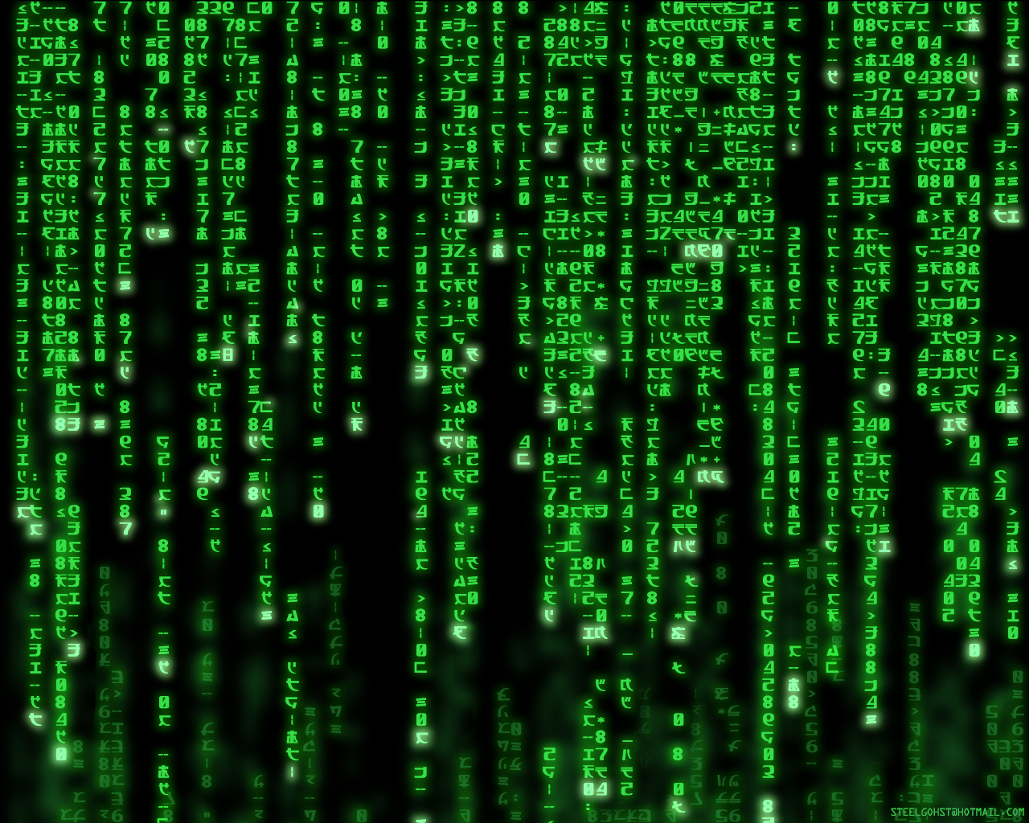
The Matrix

Slide 2
The Internet
IE / Windows
Client 1
HTTP Request
Server
HTTP Response
Client 2
HTTP Request
HTTP Response
Safari / OSX
Apache / Linux

Slide 3
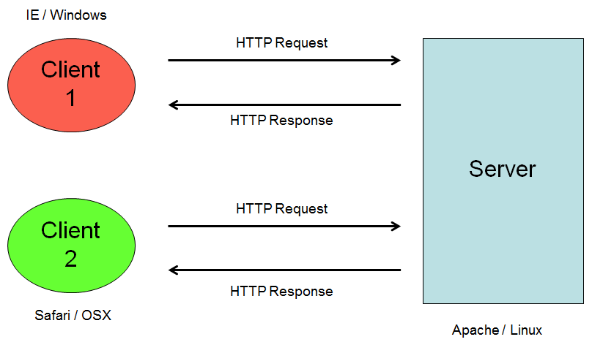
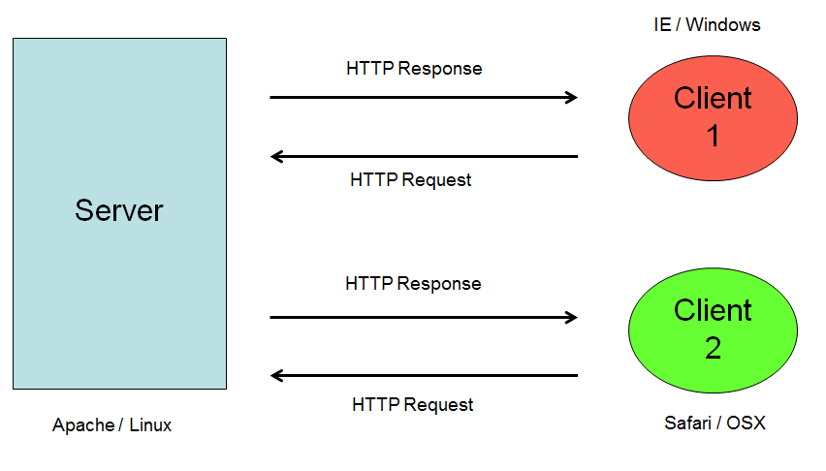
Clients and Servers = The Internet
Server
Client 1
Client 1

Slide 4
How do servers process the data?
IE / Windows
CGI
Client 1
HTTP Request
Server
11000110
00111001
HTTP Response
Client 2
HTTP Request
11000110
00111001
HTTP Response
Safari / OSX
Apache / Linux

Slide 5
Many servers processing much data…
Server
Client 1
Client 1

Slide 6
Processing code in the client…
IE / Windows
Javascript
HTTP Request
Client 1
Server
11000110
00111001
HTTP Response
Client 2
HTTP Request
11000110
00111001
HTTP Response
Safari / OSX
Apache / Linux

Slide 7
Processing data one way…
IE / Windows
Client 1
HTTP Request
Server
11000110
00111001
HTTP Response
Client 2
HTTP Request
11000110
00111001
HTTP Response
Safari / OSX
Apache / Linux

Slide 8
And processing it another way…
IE / Windows
Client 1
HTTP Request
Server
11000110
00111001
HTTP Response
JSON
Client 2
HTTP Request
11000110
00111001
HTTP Response
Safari / OSX
Apache / Linux

Slide 9
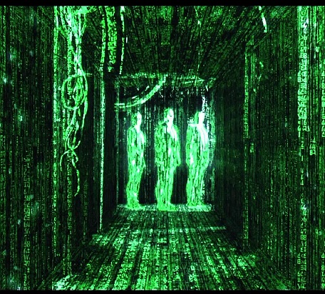
The Matrix: Reloaded

Slide 10
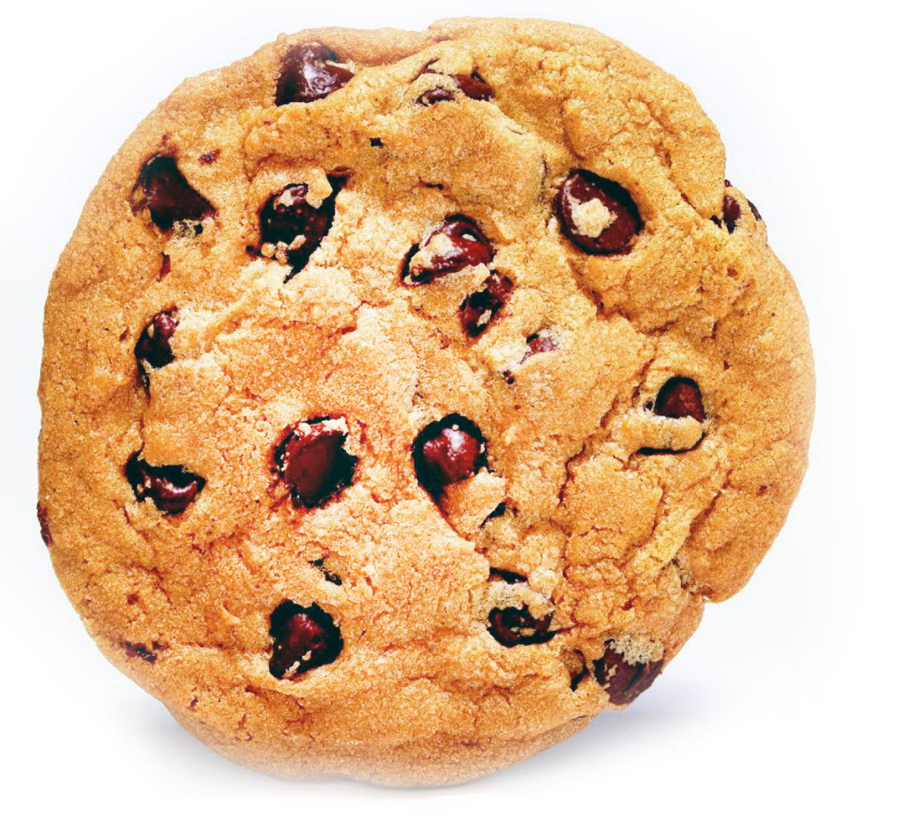
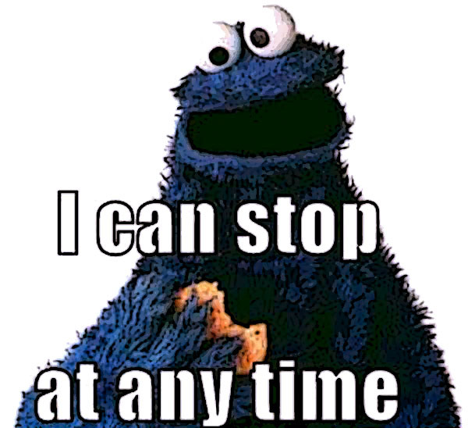
Example: Cookies

Slide 11
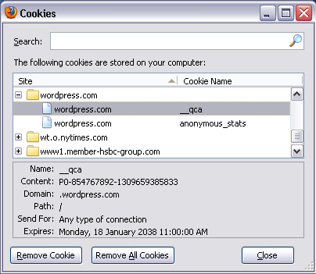
Cookies

Slide 12
Man in the middle attack
Server
Hi server!
Hi, I’m the server
Hi, I’m the client
Client
Hi client!

Slide 13

Encryption: sharing secrets
Prove it: do you have the secret I sent you earlier?
Do you have the secret I sent you earlier?
Yes, I do: here it is
Server
Well then, go away…
Um… no?
Hi, I’m the server
Client
Secret key

Slide 14

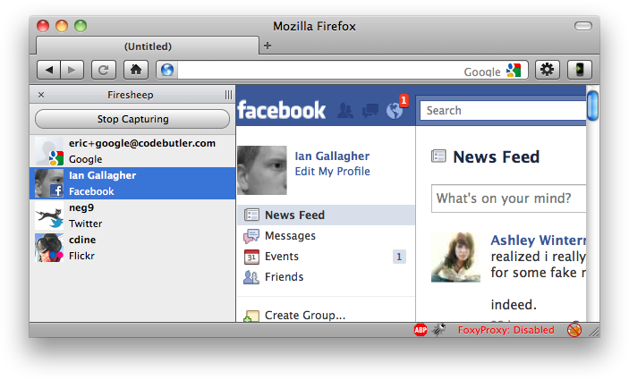
Internet Insecurity
Cookie hijacking
  without encryption, cookies can be intercepted and replaced
Firesheep
  Turned these methods into an easy plugin:

