Slide 1
Interacting with data #1: JavaScript
INFO20002: Foundations of Informatics
4th May 2015

Slide 2
Introduction
The best sites on the Internet these days are:
  Visually-appealing, “rich”, interactive
Nearly all of the best ones are powered largely by JavaScript
W3schools says that for good web development you need to know “at least”:
  HTML for structure
  CSS for style
  JavaScript for browser control
    I would also argue a server-side scripting language should be known too such as python, JSP, PHP, etc

Slide 3
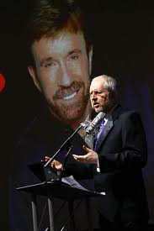
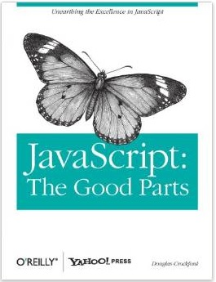

Resources
w3schools
“JavaScript: the good parts”
  Douglas Crockford

Slide 4


A brief history of JavaScript
“Lightweight” client-side programming language
Originally developed by Netscape
  to compete with Microsoft Visual Basic…
  and to complement Java…
Originally called LiveScript, renamed in Netscape browser 2.0B3 (mid 90’s)
  Suspected to attempt to follow on Java’s popularity
  Very confusing…

Slide 5
Running the code in the client’s browser…
IE / Windows
Client 1
HTTP Request
Server
11000110
00111001
HTTP Response
Client 2
HTTP Request
11000110
00111001
HTTP Response
Safari / OSX
Apache / Linux

Slide 6
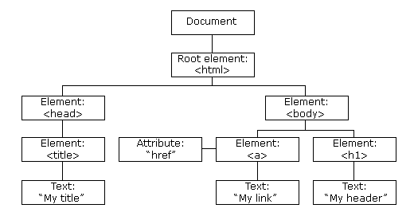
Document Object Model (DOM)
Collection of elements to describe page/document
  Can be expressed as HTML, XML, CSS, and other core components
The HTML DOM of a page looks like this:

Slide 7
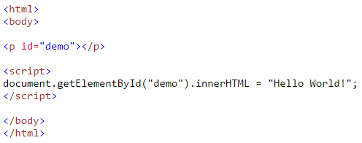
Manipulating the DOM
You can dynamically manipulate the elements within a page DOM using JavaScript:
  Can change HTML elements, attributes, and CSS styles
  Remove/add HTML elements and attributes
  React to existing HTML “events” within a page
  Create new HTML “events” within a page

Slide 8
Event-driven programming
Instead of performing a program in a set procedure, you can identify events and code a function that responds to those events:
  onclick
  onmouseover
  onmousedown
  onblur
  onfocus
  etc…
http://www.w3schools.com/js/js_events_examples.asp

Slide 9
JavaScript – how to get running…
The basic unit of declaring JavaScript is within script tags:
<script>
Code goes here…
</script>
You can declare JavaScript functions, variables or external scripts in the page header, and refer to them later in the body…
… or you can reference them as you go through the body

Slide 10
JavaScript – basic debugging
Developer tools (Firefox, Chrome, Safari, IE8)
  Seen already in HTML/CSS
  This is a user-friendly view of the browser console
console.log()
window.alert()
document.write()
innerHTML
<script>
document.getElementById(“demo”).innerHTML=‘test’;
</script>

Slide 11
JavaScript – some grammar
Whitespace
  var that = this;
    The space between var and that is significant
Names
  Some reserved words that you can’t use (boolean, char, etc)
  Annoyingly, these do NOT include undefined and NaN
Numbers
  A single number type (so, for example, 1 and 1.0 are the same value)
Strings
  A string literal can be wrapped in single or double quotes and can have zero or more characters
  JavaScript does not have a char type (string with one character = char)

Slide 12
JavaScript - Objects
JavaScript is “weakly typed”:
  var that = this;
  The variable type of that does not need to be declared
    The browser will figure that out at run-time (insecure)
Basic types that the variable could be are:
  Number, string, boolean, null and undefined
  Everything else is an Object

Slide 13
JavaScript – Object examples
var empty_object = { };
var stooge = {
  “first-name”: “Jerome”,
  “last-name”: “Howard”
}
var flight = {
airline: “Oceanic”,
number: 815,
departure: {
IATA: “SYD”
time: “2004-09-22 14:55”,
city: “Sydney”
}
}

Slide 14
JavaScript – Object methods
Retrieval
  stooge[“first-name”] // “Jerome”
  flight.departure.IATA // “SYD”
  stooge[“middle-name”] // undefined
Reflection
  typeof flight.number // ‘number’
  typeof flight.airline // ‘string’
  typeof flight.manifest // ‘undefined’
Enumeration
  A loop construct will give you back all property names, but there is no guarantee of ordering

Slide 15
JavaScript Object Notation (JSON) - example
{
"firstName": “David",
"lastName": “Lynn",
"isAlive": true,
"age": 25,
"height_cm": 167.6,
"address": {
"streetAddress": "211 Fox Street",
"city": “Greenville",
"state": "NH",
"postalCode": “80021“
},

Slide 16
JavaScript - Functions
In JavaScript, Functions are Objects
  Can be used like any other value:
    Stored in variables, passed as arguments, can have methods, etc
  The special thing about Functions is that they can be invoked
Function objects are created with function literals with four parts:
  function reserved word
  name
  parameters
  statements

Slide 17
Function example
//Create a variable called ‘add’ and store a function in it that adds two numbers
var add = function (a, b) {
  return a + b;
}

Slide 18
Invocation - method
Two (primary) ways to invoke a function:
  As a function (simplest)
  As a method
As a function:
  var sum = add(3, 4);
As a method:
  myObject.add(3, 4);
    Where add had been defined as a property of myObject earlier

Slide 19
Scope
JavaScript does not have ‘block scope’ even though the syntax suggests it does, but it does have ‘function scope’ so parameters/variables declared in a function are visible inside, but not outside, that function
Recommended for JavaScript that variables are declared at the top of a function
More on the perils of JavaScript ‘scope’ tomorrow…

Slide 20
JavaScript - Arrays
  var empty = [ ];
  var numbers = [
    ‘zero’,’one’,’two’,’three’
  ];
empty[1] // undefined
numbers[1] // ‘one’
empty.length // 0
numbers.length // 4

Slide 21
Confusion between objects and arrays
Arrays are very like Objects but have more methods available for faster access and storage
When deciding what to use:
  When property names are small sequential integers, use an array. Otherwise use an object
Confusingly:
  JavaScript returns ‘object’ when asked what the typeof value of an Array is

Slide 22
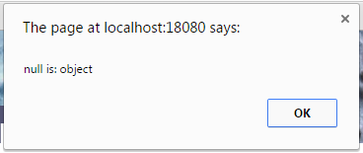
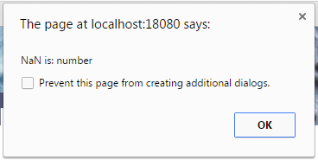
JavaScript is… weird
Null is an object
  window.alert(“null is: ” + (typeof null));
NaN is a number
  window.alert(“NaN is: “ + (typeof NaN));

Slide 23
Summary
Interactive websites use JavaScript
  If you have any thoughts about being a (good) web developer, then learn it
JavaScript is a client-side scripting language
JavaScript allows you to manipulate a web page’s DOM
JavaScript is largely event-driven (‘onclick’, etc)
JavaScript is invoked using <script> tags and has four main ways of getting debug output
To work properly with JavaScript you should understand how it processes:
  basic grammar, objects (JSON), functions, inheritance, arrays

Slide 24


© Copyright The University of Melbourne 2009

