Slide 1
Informatics in society: Data Privacy and Security
INFO20002: Foundations of Informatics
12th May 2016

Slide 2
Big Data – Recap #1
Large amounts of data (Big Data) exists in all fields of society:
  These large data-sets can give you unique insights
  But they are also difficult to handle (store, communicate, etc)
The analysis that gives you unique insights is just like the analysis that we’ve shown in previous lectures…
  … and that you are doing for phase 3.
  This is the real value that you want to extract from Big Data

Slide 3
Big Data – Recap #2
But when a company or a technology claim to be doing Big Data, they are almost always referring to the handling of that data...
  e.g. “we store this Big Data in a special database therefore we can tell you insightful things about that data”
The issues when handling Big Data are:
  Data consistency (data from different sources)
  Network issues
  Storage (previously called this “Size vs Structure”)

Slide 4


Big Data – Recap #3
CouchDB is a classic example of a “big bucket of JSON”
It is marketed as a “Big Data” database
But it’s difficult to find what you’re looking for in a big bucket…
  … as a result the application was very slow when handling large amounts of data
CouchBase was the next version, and was supposed to solve the speed problem…
… and it did, NOT because of cleverness in the code…
… but because they demanded it run on faster machines.
Disclaimer: my opinion, happy to debate it, etc

Slide 5
Data Privacy and Security
This week’s workshop – thoughts?
“Once data is on the Internet, it is there FOREVER”
Attitudes towards data privacy and security…

Slide 6

Corporate Big Data: Facebook
Facebook understands the “social network” like no other
  Who are you friends with?
  What are you doing (and who with)?
  What’s your status (nice car, fancy job, etc)
We are happy to divulge this information for the (social) rewards and well-targeted advertising…
But now Facebook can recognise your face to a 97.25% accuracy (which is as good as humans):
  http://www.smh.com.au/digital-life/digital-life-news/facebook-facial-recognition-takes-a-giant-scary-leap-forward-20140320-3547d.html
Facebook can figure out your age, race and sexual orientation just from your “likes”:
  “Facebook knows you’re gay before your mother does”:
    http://www.itworld.com/article/2713345/it-management/facebook-knows-you-re-gay-before-your-mother-does.html

Slide 7

Corporate Big Data: Google
Google understands human curiosity like no other:
  “How do I…?”
  “What/where is…?”
Both Facebook and Google can harvest all the information that we’ve touched on in this course:
  User’s browser setup, Cookies, Geo-location, timestamps
To build up a targeted behavioural pattern of their users:
  Then advertise at you…

Slide 8
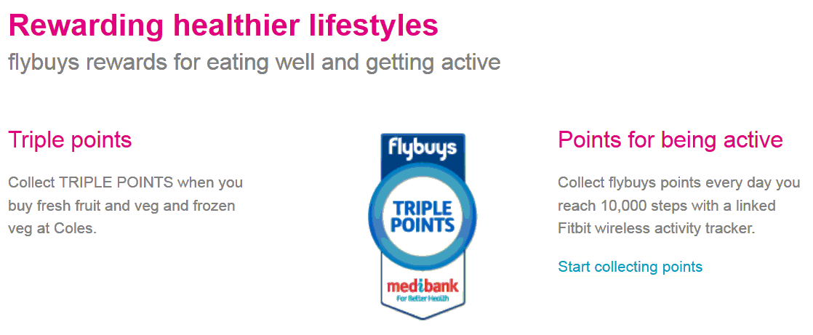

Corporate Big Data: Health
Health insurers: monitoring technology
“Husband learns wife is pregnant from her Fitbit data”
  http://mashable.com/2016/02/10/fitbit-pregnant/#atE5iqPGtkqc

Slide 9
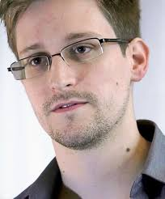
Government Big Data
Capabilities of the National Security Agency (NSA) revealed in mid-2013
Now in political asylum in Russia
Still an advocate for exposing surveillance
  Skype presentation, South Wharf, 22nd May

Slide 10







PRISM
DNS, “backbone”, etc

Slide 11
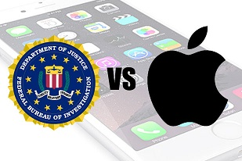
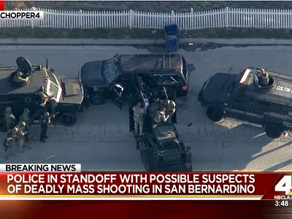
FBI vs Apple
In the wake of the San Bernardino shooting, one of the suspect’s iPhones was recovered
The FBI wanted to access what was on it and asked Apple to create a way to let them in
  This is the fabled “back door”
But by doing this Apple would allow access to this iPhone, but ALL iPhones…

Slide 12
What can I do about it?
As the data subject:
  Minimise your “data footprint”
  www.privacytools.io
As the data custodians:
  Protect the identities of your subjects
  Seek ethical clearance (medical)
  Make sure your data storage and implementation is as secure as possible (not like ex. 3 in workshop!)
  Have a “security philosophy”

Slide 13
A philosophy of security
Prevention (gates, locks, etc)
  Username / passwords
Detection (alarms)
  Audit trails
Reaction (prosecution, payback, etc)
  Auditing and Attribution
Least effective
Most effective

Slide 14
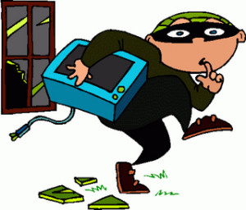
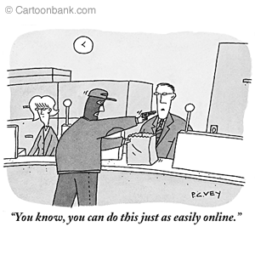
Examples
Breaking into a house…
Breaking into an online bank account…

Slide 15
Security Layers
Data
How much can be identified?
Application
Sanitised user inputs
(e.g. checking ASCII text-fields)
Infrastructure
Patched Operating Systems
Physical
Servers behind locked doors

Slide 16
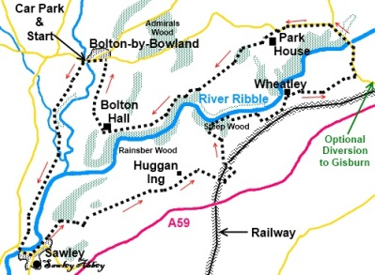
Data security
De-identify the data:
  No names, addresses
Watermark the data with false records
  These will always be unique and help with attribution and auditing in the event that the worst happens…
Ordnance Survey (maps)

Slide 17
Application security: an example
To secure any online application, you need:
  A way to establish a perimeter
    This is known as a “gated” community (with only one gate)
  A way of sharing secrets between those within that perimeter

Slide 18
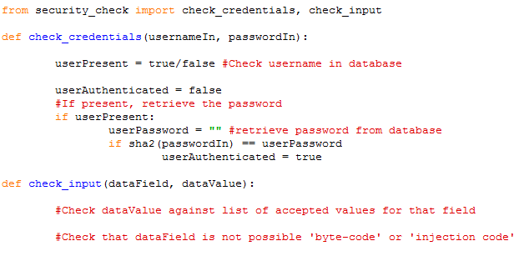
Example in Python

Slide 19
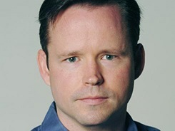
“The Internet of Things”
“I will be concerned when people start dying because of the insecurity of the Internet”
  Brian Krebs,
    Tech security journalist, formerly Washington Post
    www.krebsonsecurity.com
CBS 60 Minutes
  Car hacking (brake-control removed by remote exploit)
  http://www.cbsnews.com/news/car-hacked-on-60-minutes/

Slide 20
Summary
Corporate and Government Big Data has serious consequences in terms of privacy
There are some things you can do:
  As a data subject: minimise your “digital footprint”
  As a data custodian: keep your data secure
One security philosophy is “Prevention, Detection, Reaction”
You can design your application security to create a “gated” online space

Slide 21

Security resources
Electronic Frontier Foundation (EFF) - www.eff.org
Ross Anderson - www.lightbluetouchpaper.org/
Security Now (Steve Gibson)
  www.grc.com/securitynow

Slide 22
Example Exam Question
The harvesting of personal information for Big Data projects has ramifications for the privacy of an individual. Describe an example where information is gathered on an individual through social media. What is the potential impact if this social information was linked to their electronic medical record? What steps could the curators of the social information and the medical records take to minimise this impact?

Slide 23


© Copyright The University of Melbourne 2009

