Slide 1
Representing data: JSON
INFO20002: Foundations of Informatics
17th March 2015

Slide 2
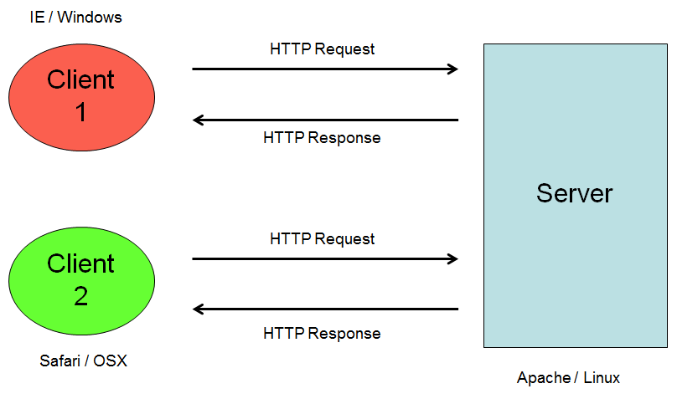
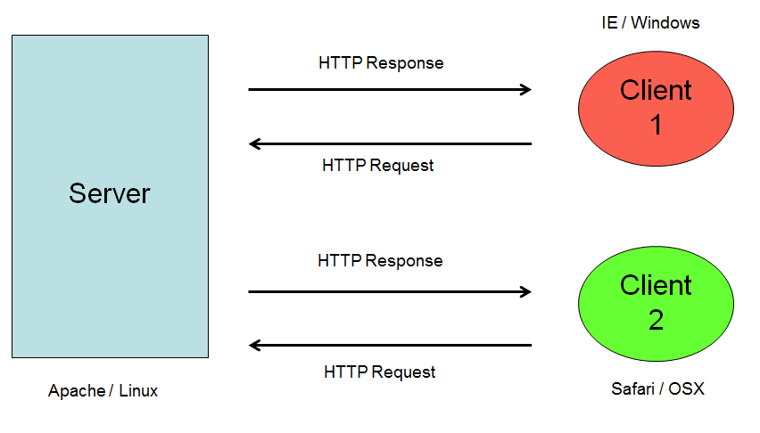
Connecting the Internet…
HTTP (carrying an XML payload…)
Server
<?xml version="1.0"?>
<catalog>
<book isbn="1-23456-789-0">
<title>Beyond the Clouds</title>
<author>
<firstname>Rebecca</firstname>
<surname>Skye</surname>
<picture source="rebecca.jpg" />
</author>
</book>
</catalog>
Client 1
Client 1

Slide 3


A brief history of Javascript
“Lightweight” client-side programming language
Originally developed by Netscape
  to compete with Microsoft Visual Basic…
  and to complement Java…
Originally called LiveScript, renamed in Netscape browser 2.0B3 (mid 90’s)
  Suspected to attempt to follow on Java’s popularity
  Very confusing…

Slide 4
Running the code in the client’s browser…
IE / Windows
Client 1
HTTP Request
Server
11000110
00111001
HTTP Response
Client 2
HTTP Request
11000110
00111001
HTTP Response
Safari / OSX
Apache / Linux

Slide 5
Browsers and Servers
When running code in the client, an issue that quickly develops is the lack of speed when the server needs to be contacted…
In the early 2000’s, developers tried to solve this by pre-compiling code and sending that to the client browser (Flash or Java applets)…
  This approach lacked flexibility
AJAX (Asynchronous Javascript And XML) and other projects started to use clever caching methods to bring info from the server when needed, but hold it at the client for a certain time…

Slide 6
Real-time browser-server interaction
IE / Windows
Client 1
HTTP Request
Server
11000110
00111001
HTTP Response
Client 2
HTTP Request
11000110
00111001
HTTP Response
Safari / OSX
Apache / Linux

Slide 7
Real-time browser-server interaction
IE / Windows
Client 1
HTTP Request
Server
11000110
00111001
HTTP Response
Client 2
HTTP Request
11000110
00111001
HTTP Response
Safari / OSX
Apache / Linux

Slide 8
Demonstration
Demonstration of asynchronous browser-server interactions
  Using AJAX (but try not to let that confuse you)

Slide 9
A slimline information passage…
So we have a situation where information is passing along HTTP connections…
  Quickly (the data is sort of local)
  Flexibly (the connection is cleverly guessing what info you’re likely to want next)
We need a way to represent data that isn’t as cumbersome as formats such as XML…
And can be easily integrated into the executable environment (which is Javascript…)

Slide 10
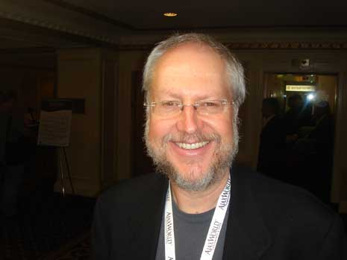
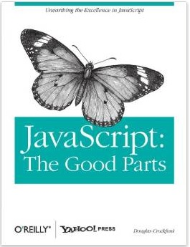
JavaScript Object Notation (JSON)
JSON (www.json.org)
Douglas Crockford (pretty much alone)
  c.f the development of XML by committee
“Javascript: the good parts”
  O’ Reilly, Yahoo Press
Notes:
Jason pic
Chuck Norris pic

Slide 11
Data Example
Customer
Customer
Name: Adservices
Name: Mrs Jean Kaufman
Customer
Name: Mr David Lynn
CustID: Cust201
Type: home
Address: 211 Fox Street
Greenville, NH 80021
Phone: (315) 555-1812
E-mail: dlynn@nhs.net

Slide 12
JSON Example
{
"firstName": “David",
"lastName": “Lynn",
"isAlive": true,
"age": 25,
"height_cm": 167.6,
"address": {
"streetAddress": "211 Fox Street",
"city": “Greenville",
"state": "NH",
"postalCode": “80021“
},

Slide 13
JSON Example
"phoneNumbers": [
{
"type": "home",
"number": “315 555-1812“
},
{
"type": "office",
"number": "646 555-4567“
}
],
“email”: dlynn@nhs.net
}

Slide 14
Diagram of a JSON object
person
firstName
address
city
postalCode
state
phone
age
etc

Slide 15
XML Representation
<?xml version=“1.0”?>
<customers>
<customer>
<name>David Lynn</name>
<address>211 Fox Street Greenville, NH 80021</address>
<phone>(315) 555-1812</phone>
<email>dlynn@nhs.net</email>
</customer>
</customers>

Slide 16
JSON syntax rules
Data is in name/value pairs
  "firstName":"John“
JSON values
  A number (integer or floating point)
  A string (in double quotes)
  A Boolean (true or false)
  An array (in square brackets)
  An object (in curly braces)
  null

Slide 17
JSON syntax rules
JSON Objects
  {"firstName":"John", "lastName":"Doe"}
JSON Arrays
  "employees":[
  {"firstName":"John", "lastName":"Doe"},
  {"firstName":"Anna", "lastName":"Smith"},
  {"firstName":"Peter", "lastName":"Jones"}
  ]
These objects repeat recursively down a hierarchy as needed.
In terms of syntax that’s pretty much it!

Slide 18
Using JSON (Python)
import json
json.loads(
  '["foo",
    {"bar":
      ["baz", null, 1.0, 2]
    }
  ]')
json.dumps(
  ['foo',
    {'bar':
      ('baz', None, 1.0, 2)
    }
  ]
)
Note: white space and indentation
Is for display purposes only!

Slide 19
JSON vs XML
XML has the concept of a schema concept
  allows formal validation
  makes you consider the data design more closely
  JSON schema does exist but is not formalised
JSON is more streamlined, lightweight and compressed
  Which appeals to programmers looking for speed and efficiency
  Compare slide 16 and slide 13 of this lecture to see difference in verbosity

Slide 20


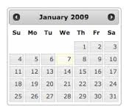
Applications - JQuery
JQuery
  A very useful Javascript library
    Creates beautiful, rich UI features (and much more)
  Contains a JSON parser

Slide 21

Applications - CouchDB
Document repository
Serves as a large-scale database
  Part of the “Big Data” movement
The documents lots and lots of JSON objects appended to each other
The lightweight, streamlined nature of JSON is what makes this work

Slide 22
Big Data: document storage
NoSQL
  Alternatives to the traditional SQL databases
    MySQL, PostgreSQL, Oracle, MS SQL Server
With SQL you have a structure that has been optimised for navigation
  Structure and organisation is high
  Speed of query is low
With NoSQL the optimisation is for storage
  Speed is high (as long as data is ordered and regular)
  Structure is low

Slide 23
Big Data: document storage
Big Data is about high volume and high speed
  So many of the “Big Data” databases use JSON
However, remember: speed is high when the ordering of access doesn’t matter. When it does or access is random, the speed slows significantly
  Big Data databases are good for highly regular and predictable data patterns
XML databases follow a similar paradigm
  But XML is old and Big Data is nothing if not fashionable

Slide 24
Hierarchy vs Relational
Both XML and JSON have this issue…
person
order
firstName
address
item
city
postalCode
person
state
name
address
phone

Slide 25
Using JSON (Javascript)
  var p = json.parse(json_data);
JSON is native Javascript
  Therefore it can be fed into a Javascript program and executed
  Very tempting to do this as a shortcut to mixing program code and data
  Some programmers see this as an advantage

Slide 26
Using JSON (Javascript)
You can define this variable:
  var evil_json_code = { innocent_file: “evilserver/nothingtoseehere.js”}
All that is required is to feed this JSON code, as an external input, into a line of Javascript (which remember, runs on your client machine):
  var q = json.eval(evil_json_code);
This executability is unique to JSON as a data exchange format

Slide 27
Other exchange formats: YAML
YAML Ain’t Markup Language (YAML)
firstName: David,
lastName: Lynn,
address:
- streetAddress: 211 Fox Street
- city: Greenville
- state: NH
Very similar to JSON
  Some parsers can cope with both interchangeably

Slide 28
Other exchange formats: CSV
Comma Separated Values (CSV)
firstName, lastName, address,
david, lynn, 211 Fox Street, Greenville, NH
Very intuitive
  Many people are familiar with spreadsheets and data in “two dimensions”
Quite inflexible
  No hierarchy or relational information (strictly rows and columns)

Slide 29


© Copyright The University of Melbourne 2014

