Slide 1
Interacting with data #2: JavaScript, JQuery, AJAX
INFO20002: Foundations of Informatics

Slide 2
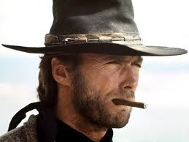
JavaScript: The Good, the Bad and the Ugly
The good:
  Object literals and array literals (inspiration for JSON)
The bad:
  Global variables
  Scope (no block)
The ugly:
  == and ===

Slide 3
Good: JavaScript Object Notation (JSON)
{
"firstName": “David",
"lastName": “Lynn",
"isAlive": true,
"age": 25,
"height_cm": 167.6,
"address": {
"streetAddress": "211 Fox Street",
"city": “Greenville",
"state": "NH",
"postalCode": “80021“
},

Slide 4
Bad: Scope and Global Variables
JavaScript has a terrible habit of declaring variables with a default scope of “global” (which is bad)
It also doesn’t necessarily have “block scope” on it’s variables, even though the code syntax looks like it has
Demonstration on IVLE
  Python vs JavaScript

Slide 5
Ugly: =, == and ===
= is assignment
    var this = that;
== means that something is equal in value but performs type conversion
  A string (“1”) and number (1) of same value would return true
    if(this == that){
      … code
=== means that something is equal in value and type (‘exactly equals’)
    if(this === that){
      … code

Slide 6
Interactivity – context recap
Interactivity is driven by JavaScript applications because:
  The “action” is happening at the client-side, not server, so is much faster
  The web-page is being immediately changed using the DOM, rather than being built “from scratch” by CGI
  The changes are being triggered by many events built into that page, rather than the restricted HTTP controls

Slide 7
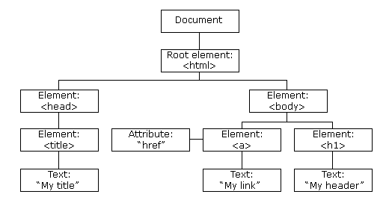
Document Object Model (DOM) - recap
The HTML DOM of a page looks like this:

Slide 8
Event-driven programming - recap
Instead of performing a program in a set procedure, you can identify events and code a function that responds to those events:
  onclick
  onmouseover
  onmousedown
  onblur
  onfocus
  etc…
http://www.w3schools.com/js/js_events_examples.asp

Slide 9



Building on JavaScript – libraries/frameworks
JavaScript is a very “raw” and untamed language so has many projects built on top (to try to tame it…)
  Twitter Bootstrap
  D3.js
  AngularJS
  Google Web Toolkit
  Many, many others…
    https://en.wikipedia.org/wiki/Comparison_of_JavaScript_frameworks
    https://en.wikipedia.org/wiki/List_of_JavaScript_libraries
CoffeeScript
  A language that “transcompiles” into JavaScript

Slide 10

JQuery
JQuery is one of the most popular JavaScript libraries
  designed to make the business of navigation, selection, response, event-handling by JavaScript so much easier…
At it’s core it is a DOM manipulation library
Several advantages:
  Extensible
  Cross-browser compatibility
  Separation of JavaScript and HTML

Slide 11
JQuery – Usage
Simply download the library and include it:
  <script src="jquery.js"></script>
Or you can source it from a content distribution network (CDN):
  <script src="//code.jquery.com/jquery-1.11.1.min.js"></script>
Use Google’s version if you’re running your application over https:
<script src="/ajax.googleapis.com/ajax/libs/jquery/1.11.1/jquery.min.js">
</script>

Slide 12
JQuery – Usage
You can either use the $ function:
  Which operates and add/removes information to an object directly
Or you can use the $. function:
  Known as a “utility function”, it uses the defined methods but does not add/remove information to that object
ready() is a general containing function for event handlers
Typically, you would start at:
  <script type="text/javascript">
    $(document).ready(function(){
      // jQuery code, event handling callbacks here
    });
  </script>

Slide 13
JQuery – Example #1
JQuery UI example: datepicker
In the page header:
  <script>
    $(function() {
      $( "#datepicker" ).datepicker();
    });
  </script>
And in the page body:
  <input type="text" id="datepicker">

Slide 14
JQuery – Examples #2
“Draggable” elements
In the page head:
  <style>
    #draggable { width: 150px; height: 150px; padding: 0.5em; }
  </style>
  <script>
    $(function() {
      $( "#draggable" ).draggable();
    });
  </script>
And in the page body:
  <div id="draggable" class="ui-widget-content">
    <p>Drag me around</p>
  </div>

Slide 15
JQuery – Examples #2
“Droppable” elements
In the page head:
  <script>
  $(function() {
    $( "#draggable" ).draggable();
    $( "#droppable" ).droppable({
      drop: function( event, ui ) {
        $( this )
        .addClass( "ui-state-highlight" )
        .find( "p" )
        .html( "Dropped!" );
      }
    });
  });
  </script>

Slide 16
JQuery – Example of chaining
Latter was an example of “chaining”
  $( this )
    .addClass( "ui-state-highlight" )
      .find( "p" )
        .html( "Dropped!" );
And also:
  $(this)[0] === this
‘this’ refers to the element being coded
Use the $() notation when using JQuery to do “DOM things”

Slide 17

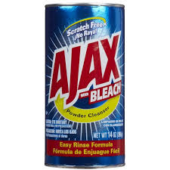
Asynchronous Javascript and XML (AJAX)
AJAX is a group of technologies used to communicate between client and server without interfering with display or behaviour of a page:
  HTML/CSS for presentation
  DOM for dynamic display
  XML for data interchange
  XMLHttpRequest object (asynchronous)
  JavaScript to tie all the technologies together

Slide 18
AJAX example (JavaScript)
var xmlhttp;
//Check if the XMLHttpRequest object already exists and respond according to browser type
if (window.XMLHttpRequest){
// code for IE7+, Firefox, Chrome, Opera, Safari
xmlhttp=new XMLHttpRequest();
}else{
// code for IE6, IE5
xmlhttp=new ActiveXObject("Microsoft.XMLHTTP");
}
//Define a function that does something with the response text when the “ready state” of xmlhttp changes
xmlhttp.onreadystatechange=function(){
if (xmlhttp.readyState==4 && xmlhttp.status==200){
document.getElementById("center_info").innerHTML=xmlhttp.responseText;
}
}
//Define the script to run and wait for the response
var script_url = server_root + "/scripts/getcenterinfo.jsp?centerid="+str;
xmlhttp.open("POST",script_url,true);
xmlhttp.send();

Slide 19
XMLHttpRequest
XMLHttpRequest (XHR) is an API that browsers support that allows you to send information over HTTP (sort of like a “container”)
  AJAX cannot function without this
onreadystatechange() is an event listener
send(), sends the information along the HTTP request

Slide 20
AJAX example (JQuery)
http://www.w3schools.com/jquery/ajax_ajax.asp
http://www.w3schools.com/jquery/demo_test.txt
$(document).ready(function(){
$("button").click(function(){
$.ajax({url: "demo_test.txt", success: function(result){
$("#div1").html(result);
}});
});
});

Slide 21

HighCharts
JavaScript charting framework
Provides easy-to-use interactive charts for websites
Builds on JavaScript and JQuery
http://www.highcharts.com/

Slide 22
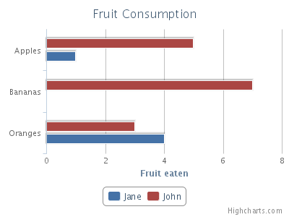
HighCharts – Example code
http://www.highcharts.com/docs/getting-started/your-first-chart
The key parts are the function declarations at the top:
$(function () {
  $('#container').highcharts({
    chart: { type: 'bar' },
    title: { text: 'Fruit Consumption' },
And the id declaration in the body:
<div id="container" style="width:100%; height:400px;"></div>

Slide 23
Example question (type/structure)
What is the Document Object Model (DOM) of a web page? Describe it using common examples of tags, elements and attributes.
What aspects of JavaScript make it ideally suited to building interactive web-sites?
Given the following code snippet:
  [code]
  Write some code (or pseudo-code) that will replace the text in the [something] tags
    Using JavaScript
    Using JQuery

Slide 24
Summary
JavaScript has good, bad and ugly features
  Familiarise yourself with these to make your coding experience easier
JavaScript is important for interactivity due to it’s ability to manipulate web-page DOMs and event-driven paradigm
JavaScript is raw and untamed => many libraries exist
JQuery is the most popular of these
AJAX asynchronously allows communication between client and server in the background
HighCharts is a leading interactive charting framework using JavaScript
Think about all these technologies for your project

Slide 25


© Copyright The University of Melbourne 2009

