Slide 1
Introduction
INFO20002: Foundations of Informatics
28th February 2017

Slide 2
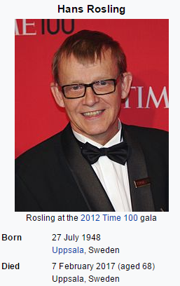
Hans Rosling
https://www.ted.com/playlists/474/the_best_hans_rosling_talks_yo

Slide 3
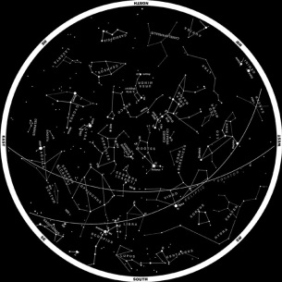
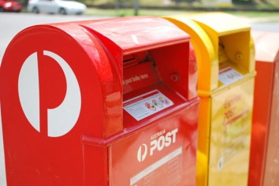

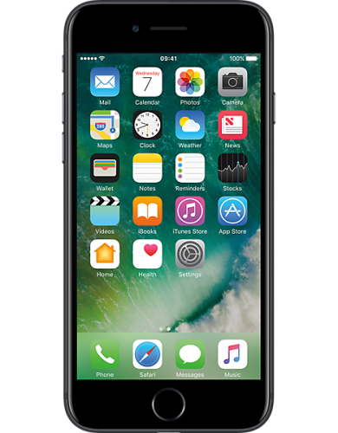
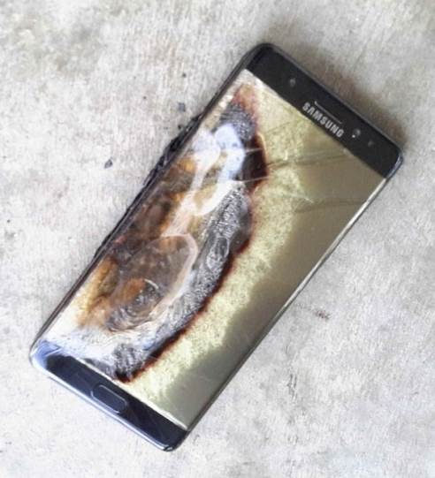
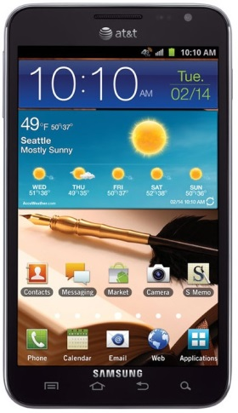

Data through the years…
20 years ago: star-charts and post-codes in individual databases (~megabytes)
10 years ago: medical databases (gigabytes) and genetic information (petabytes)
NOW (2017): more data than we know what to do with

Slide 4
Put this into Google…
“Cambridge Analytica Donald Trump”

Slide 5
We’ll teach you the basics of two things:
How to analyse data
How to communicate that analysis (online)

Slide 6

If you’re not stressed…
https://giphy.com/gifs/l3q2IJJia5vPhsK0U/html5

Slide 7


© Copyright The University of Melbourne 2014

