Slide 1

HTTP and WebApp
INFO20002: Foundations of Informatics

Slide 2
Overview
Hyper-Text Transfer Protocol (HTTP)
  How computers talk to each other…
HyperText Markup Language (HTML)
  How this information gets displayed…
Flask Web Application Framework
  How computers process the information…

Slide 3

Resources
Putty
  http://www.chiark.greenend.org.uk/~sgtatham/putty/
Telnet
  http://www.telnet.org
cURL
  http://curl.haxx.se
WireShark
  https://www.wireshark.org
“The Cuckoo’s Egg” by Cliff Stoll

Slide 4

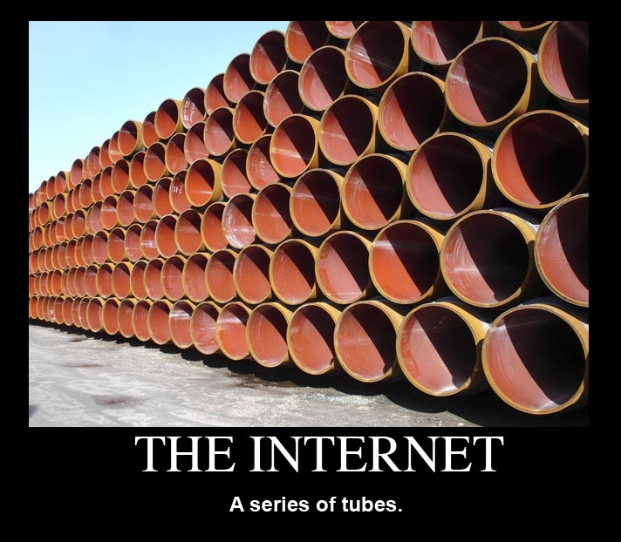
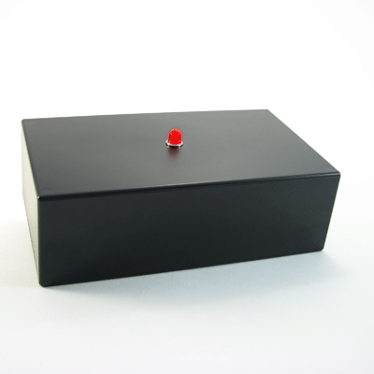
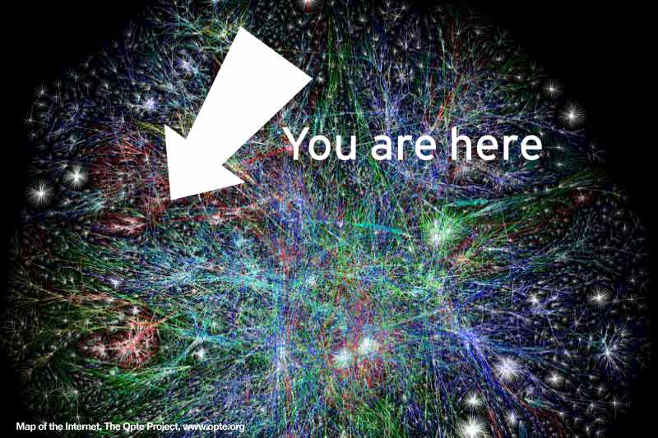
What is The Internet?
“A global system of interconnected computer networks…”
A network of networks…

Slide 5
A (very) brief history…
Began as the ARPANet in the early 60’s
  A product of the Cold War
Early 1980’s:
  TCP/IP was developed (a protocol)
  National Science Foundation funded expanded access to ARPANet
Considered (approximately) to indicate the beginning of “The Internet” as we know it today…

Slide 6
HyperText Transfer Protocol
One of many protocols for the transfer of data on the Internet
Emerged in the early 1990s, and has gone through some revisions
Version 1.1 is the most popular version in use today
Originally intended for transmission of “hypertext” documents (text with links)
Now used for a wide variety of media (video, audio, web apps)

Slide 7
Client-Server Architecture
IE / Windows
Client 1
HTTP Request
Server
HTTP Response
Client 2
HTTP Request
HTTP Response
Safari / OSX
Apache / Linux

Slide 8
HTTP using “telnet”
telnet www.theage.com.au 80
Trying 203.26.51.71...
Connected to theage.com.au.
Escape character is '^]'.
GET /index.html HTTP/1.0
HTTP/1.1 302 Found
Date: Sat, 06 Sep 2008 04:35:48 GMT
Server: Apache
Location: http://www.fairfax.com.au
Content-Length: 209
Connection: close
Content-Type: text/html; charset=iso-8859-1
<!DOCTYPE HTML PUBLIC "-//IETF//DTD HTML 2.0//EN">
<html><head>
<title>302 Found</title>
</head><body>
<h1>Found</h1>
<p>The document has moved <a href="http://www.fairfax.com.au">here</a>.</p>
</body></html>
Connection closed by foreign host.
Connect to port 80 on server
Request a document from the server using HTTP version 1.0
Status code (302 = redirect)
MIME type – tells client what kind of entity appears in the response
Response header
Response body
Request and response terminated by blank lines

Slide 9
HTTP is very simple…
GET - retrieve an entity (document) from the server.
POST - submit data to the server (usually via an HTML form) for processing.
PUT - send an entity to be stored on the server.
DELETE - request the removal of an entity from the server.
OPTIONS - ask the server to reveal its capabilities.
HEAD - same as GET but only return HTTP headers and not the document.
http://www.ietf.org/rfc/rfc2616.txt

Slide 10
Clients and Servers
IE / Windows
Client 1
HTTP Request
Server
HTTP Response
Client 2
HTTP Request
HTTP Response
Safari / OSX
Apache / Linux

Slide 11
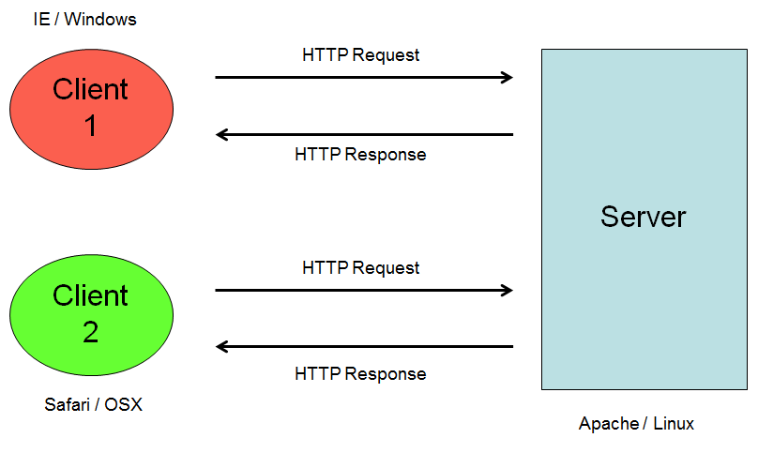
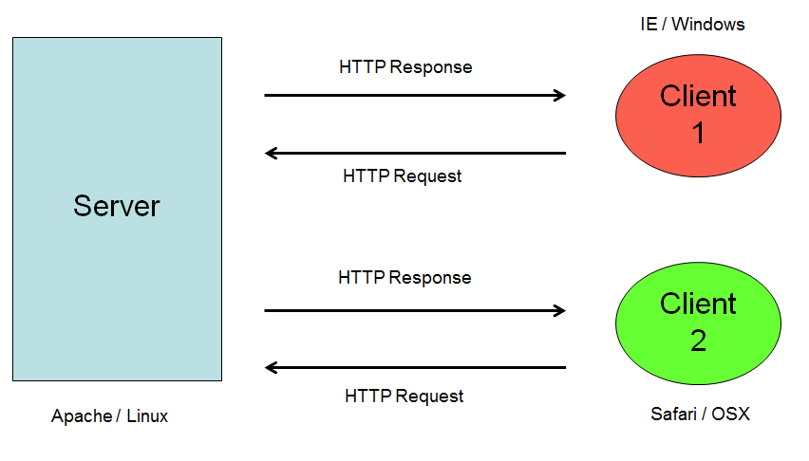
Clients and Servers
Server
Client 1
Client 1

Slide 12
HyperText Markup Language (HTML)
HyperText Markup Language (HTML)

Slide 13
A very simple HTML form
<html>
<head>
<title>A simple form</title>
</head>
<body>
<h1>A simple form</h1>
<form method="post“ action="http://localhost/env.py">
<input type="text" name="foo" />
<input type="submit" />
</form>
</body>
</html>

Slide 14
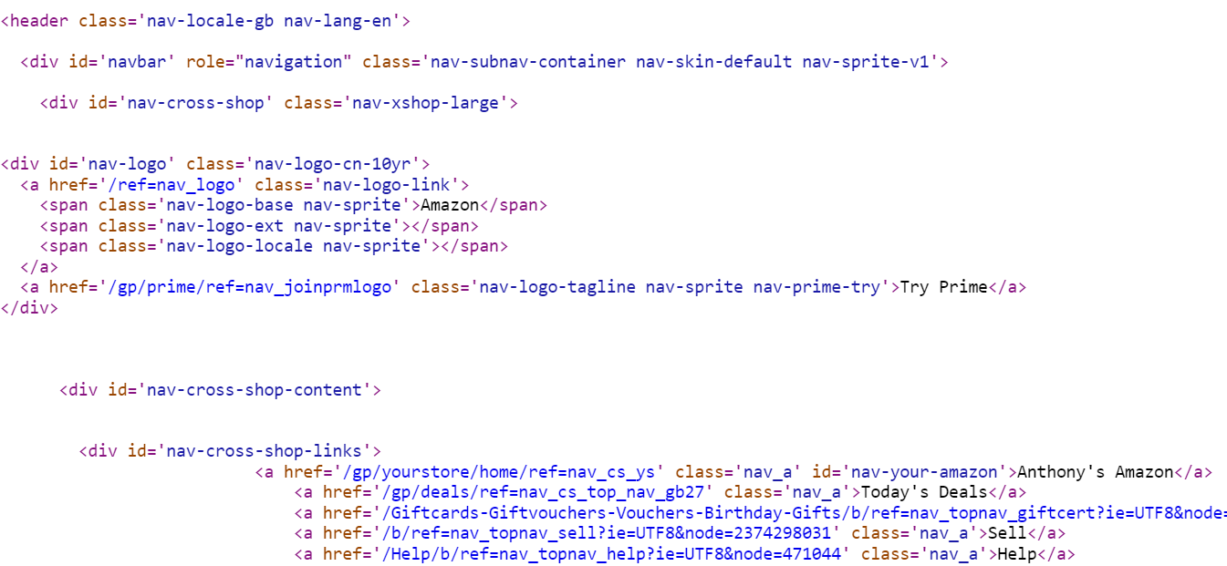
A more complicated HTML example

Slide 15
Web Application Framework (Flask)
Web Application Framework (Flask)

Slide 16
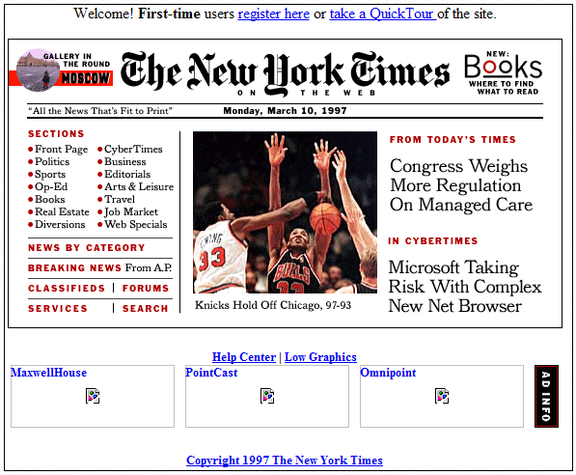
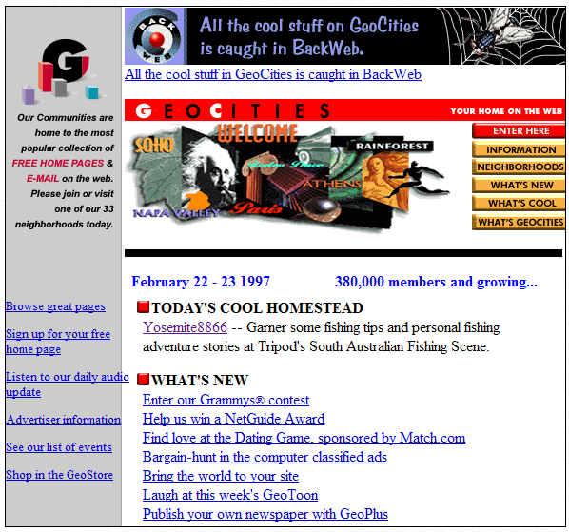
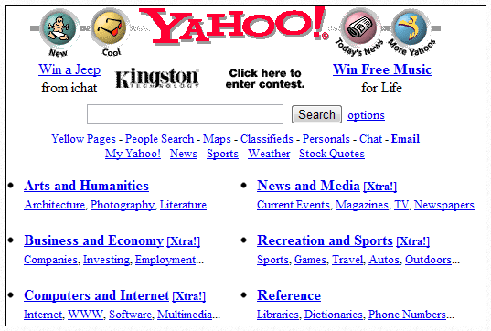
Old (static) websites (~15 years ago)
http://www.makeuseof.com/tag/time-10-big-websites-looked-15-years/

Slide 17
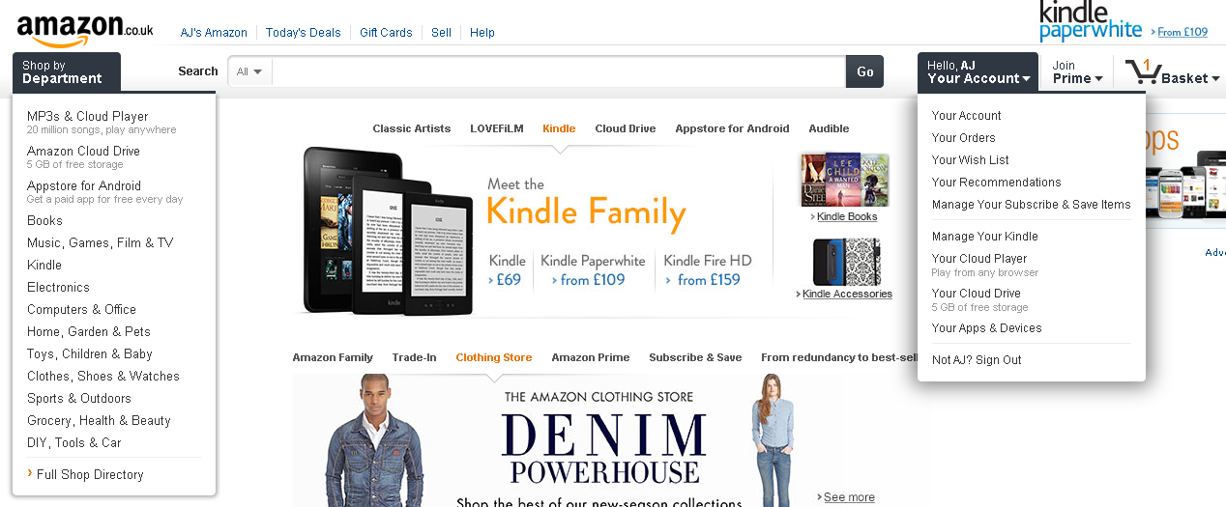
Dynamic websites

Slide 18
How do servers process the data?
IE / Windows
Client 1
HTTP Request
Server
11000110
00111001
HTTP Response
Client 2
HTTP Request
11000110
00111001
HTTP Response
Safari / OSX
Apache / Linux

Slide 19
The Common Gateway Interface (CGI) – Old Way
A standard method – allows the server to construct a web page using information from a client
The (dynamic) content is created by a program running on the server called a CGI script
The URI for the requested content identifies the name of the CGI script to use
The server locates the CGI script, executes it, and sends the output of the script back to the client
The script can be implemented in any programming language (even compiled ones)

Slide 20
Flask – Web Framework
Encapsulate low-level information passing between browser and application (Python’s server side code)
Provide routing of the URL
  e.g /handler -> taken care by a specific Python code
Provide templating or abstraction for HTML

Slide 21
Flask Hello World (hello.py)
from flask import Flask
# just serve all the static files under root
app = Flask(__name__, static_folder='.', static_url_path='’)
# for / root, return Hello Word
@app.route("/")
def root():
return 'Hello World!'
# start listening
if __name__ == "__main__":
app.run(debug=True)

Slide 22
CGI Environment Variables on IVLE
To launch:
  python hello.py
  This will set up a web server that runs on port 5000
  http://localhost:5000/
In debug mode, changes on the source code will refresh the web application server

Slide 23
Reading user input
form.html
<!doctype html>
<html>
<body>
<form method="get" action="handler">
<p>
Your name: <input type="text" name="name"/>
<input type="submit" />
</p>
</form>
</body>
</html>

Slide 24
Reading user input
handler.py
from flask import Flask, request
…
@app.route('/handler', methods=['POST', 'GET'])
def handler():
if request.method == 'POST':
name = request.form['name']
else: # GET request method
name = request.args.get('name’)

Slide 25

© Copyright The University of Melbourne 2009

