Slide 1
Presentation on the web: CSS
INFO20002: Foundations of Informatics
24th March 2015

Slide 2
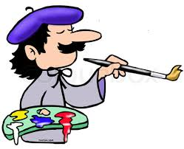
Web development as “art”...
Think of this as instruction on your canvas and paintbrush...
Presentation
  Important for any career...
  Extra important in web development...
“Designer” vs “Developer”

Slide 3

Cascading Style Sheets (CSS)

Slide 4
CSS to make the data beautiful
Client
Data
Markup layer
From server,
database,
JSON,
whatever…
Style reference
Notes:
HTML
Then we told you how it became XML
Then we told you that this developed into JSON
Now we’re back to HTML again (with a difference)
These progressions generally (not exactly) mirror the development of information organisation as the Internet has matured…

Slide 5
History of CSS
Style sheets have existed in some form since the inception of the Internet
  CSS was closely related to the development timeline of HTML
Limited and patchy adoption has led to inconsistencies between browser support
  Which still exists today
CSS “hacks”:
  <!--[if IE 6]>
  <p>You are using Internet Explorer 6.</p>
  <![endif]-->
  <!--[if !IE]>
  <p>You are not using Internet Explorer.</p>
  <!--<![endif]-->

Slide 6
Advantages of CSS
Separates content and structure
  De-couple each part of the site to what it does best
Makes sites “maintainable”
  Change one tag and all in the document are changed
Bandwidth
  Load the style reference into the cache once only
Accessibility
  Aids the ease of useful semantic structure in a site

Slide 7
Basic Operation
Styles are specified
And they are passed down (“cascaded”)
    selector {
    style-attribute : value;
    }

Slide 8
Simple example
    h1 {
    text-align : center;
    }

Slide 9
Selectors: id and class
id
  identifies a unique element in a document
  defined in CSS with # (hash)
    #c100 {styles}
    <p id="c100"> . . . </p>
class
  identifies several elements belonging to the same group or class
  defined in CSS with . (dot)
    .city {styles} OR p.city {styles}
    <p class="city"> . . . </p>
If element name is not included, style is applied to all elements that use that class

Slide 10
Selector types
general
Universal selector: all elements
*{color: black}
Tag selector: HTML elements e.g. <h1>
h1 {color:black}
Class selector: elements with the specified class
e.g. <h1 class="aClass">
.aClass {color:black}
h1.aClass {color:black}
id selector: Single/Unique element identified by an id
e.g. <div id="pageTitle">
#pageTitle {color:black}
specific

Slide 11
Pseudo class
Syntax
  selector:pseudo-class {property: value}
Anchor pseudo-class (“a”)
  a:link {color: #ff0000} /* unvisited link */
  a:visited {color: #00ff00} /* visited link */
  a:hover {color: #ff00ff} /* mouse over link */
  a:active {color: #0000ff} /* selected link */
Class and Pseudo-class
  a.red:visited {color: #ff0000}
  <a class="red" href="css_syntax.asp">CSS Syntax</a>

Slide 12
Advanced selectors
Descendant selector (space in between selectors):
  div#bigContainer .aClass {property: value}
Child selector (>):
  div.mainText > .aClass {property: value}
Adjacent sibling (+):
  p + div#bigContainer {property: value}
First-child pseudo-sibling
  div > p:first-child {property: value}

Slide 13
Demonstration
Selectors and pseudo-classes

Slide 14
Adding style to XHTML (3 methods)
Inline:
  <h1 style="text-align: center">Page Title</h1>
Embedded:
  <head>
  <style>
  h1 {text-align: center}
  </style>
  </head>
  <body>
  <h1>Page Title</h1>
  </body>
Imported:
  <link type="text/css" href="my_styles.css" rel="stylesheet"> OR…
  @import url(mystyles.css)

Slide 15
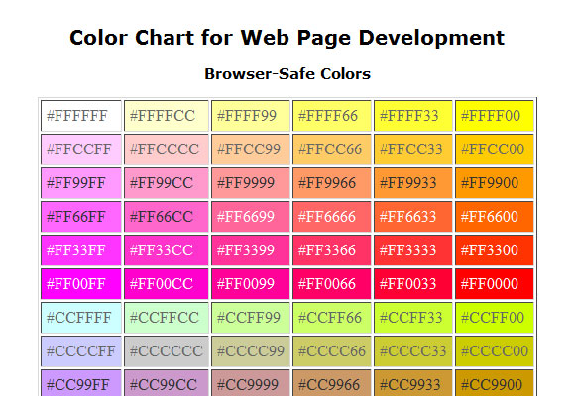
Colour
Expressing Color
  standard CSS colors
    red, blue, black, purple …
  rgb decimal
    rgb (255, 0, 0) is ‘red’
    rgb (0, 128, 128) is ‘teal’
  rgb hexidecimal
    #ff0000 is ‘red’
    #008080 is ‘teal’
    #fffff0 is ‘ivory’
Color wheels/charts readily available…
  Online
  Photoshop Elements

Slide 16
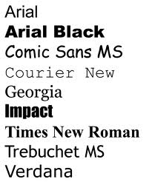
Fonts
font-family:
  Generic fonts
    serif, sans-serif, monospace, cursive, fantasy,...
  Specific fonts
    Arial, Helvetica, Times, Garamond,...
Generic fonts allows the OS to chose the best match, but may not render as you expect
Specific fonts provide a more accurate idea of the display, but the OS may not have the font
It is common to specify more than one font, from specific to generic – to cover your bases…

Slide 17
Positioning, Border, Size
Positioning
  absolute/relative: absolute position within block/relative from default location
  float: allow text to wrap round element
  clear: do not allow text wrapping (e.g. {clear: right;})
Border
  borders, margins, padding
  e.g. All have variants with ‘top’, ‘bottom’, ‘right’, ‘left’:
    {padding-left:10pt}
    {margin-bottom:5px}
Size (width and height)
  Absolute: px (smallest display element), cm/mm/in/... etc
  Relative:
    % (percent of parent)
    em (width M in default font)
    ex (height x in default font)

Slide 18
Demonstration
Colours, fonts and positioning

Slide 19
Media
Specify CSS for audio:
  @import url("voice.css") aural;
Larger font for print:
  @media print {
body { font-size: 12pt }}
Smaller font for screen:
  @media screen {
  body { font-size: 10pt }}
And the HTML looks like:
  <link rel="stylesheet" type="text/css" media="print, handheld" href="foo.css">

Slide 20
Inheritance
An xhtml element that lies within another xhtml element inherits some of the styles of its parent
Example:
    <body>
    <p>This is <strong>very</strong> important</p>
    </body>
Some styles allocated to <body> are inherited by <p> and <strong>
Applicable to styles like color and font.

Slide 21
Developer Tools
Mozilla Firefox
    → Developer → Style Editor
Google Chrome
    → More Tools → Developer Tools
Useful for many web development issues
  e.g. Javascript debugging

Slide 22
Demonstration
Unpick the selector over-riding using the developer tools

Slide 23
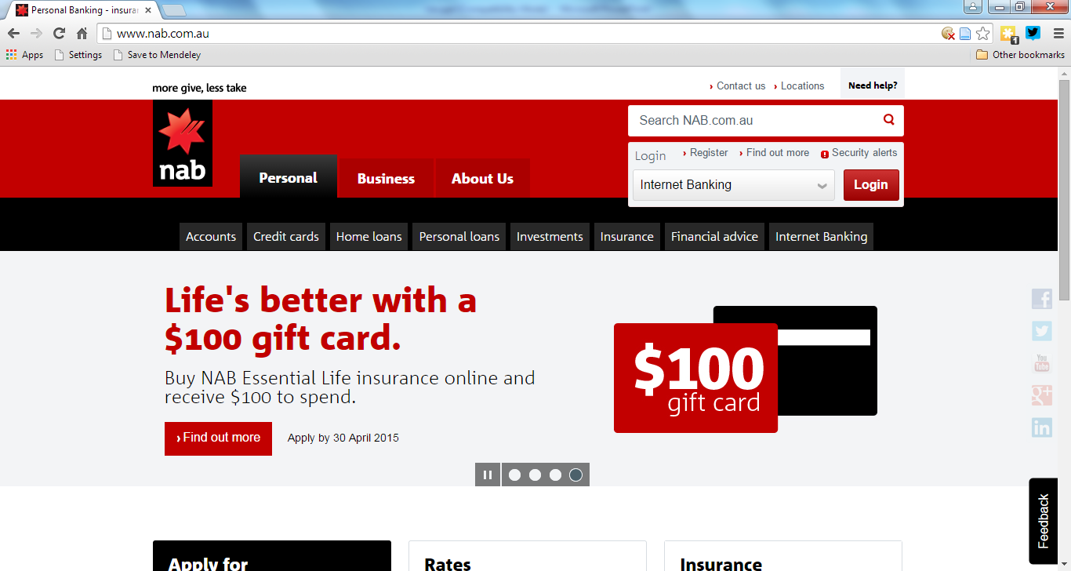

Device-aware styles

Slide 24
Detecting and selecting…
Do this with a combination of Javascript and CSS (the user agent is the key variable):
  var isMobile = {
  function() {
  return navigator.userAgent.match(‘browser_name’); }
  };
  var cssFile = “specific_browser_name.css”;
  if(isMobile){
  cssFile = “mobile_browser_name.css”
  }
  <link rel=“stylesheet” href=“<%cssFile%>” type=“text/css”>

Slide 25





Know your browser...
IE, Firefox, Chrome, Safari
Various pitfalls...
  Predominantly IE usage (default Windows installations)
One store introduced an “IE tax”...

Slide 26
Conditional comments
  <!--[if IE 6]>
  <p>You are using Internet Explorer 6.</p>
  <![endif]-->
  <!--[if !IE]>
  <p>You are not using Internet Explorer.</p>
  <!--<![endif]-->

Slide 27
Limitations of CSS
Can’t target specific text without markup tags
  With the exception of the :first-letter pseudo-element
Can’t name rules
No expressions
Very easy to overwrite other rules in a complex CSS file

Slide 28

Twitter Bootstrap
Example of framework that does a lot of styling work for you
  Combines HTML, CSS and Javascript
Disadvantage is that it has a particular and recognisable style now…
Demonstration

Slide 29
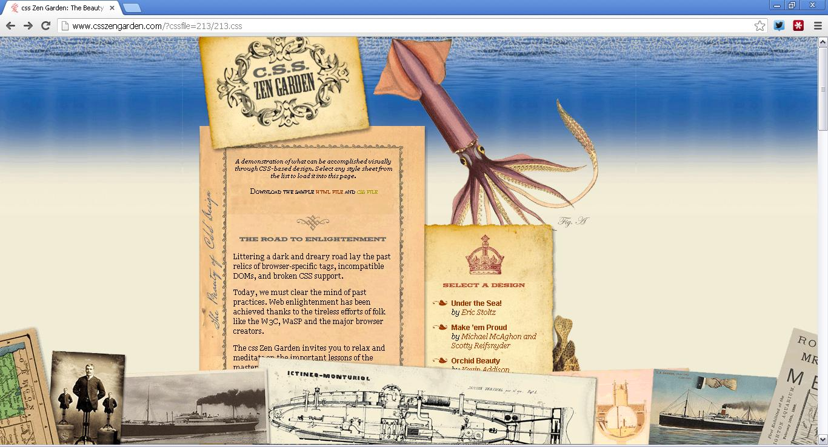
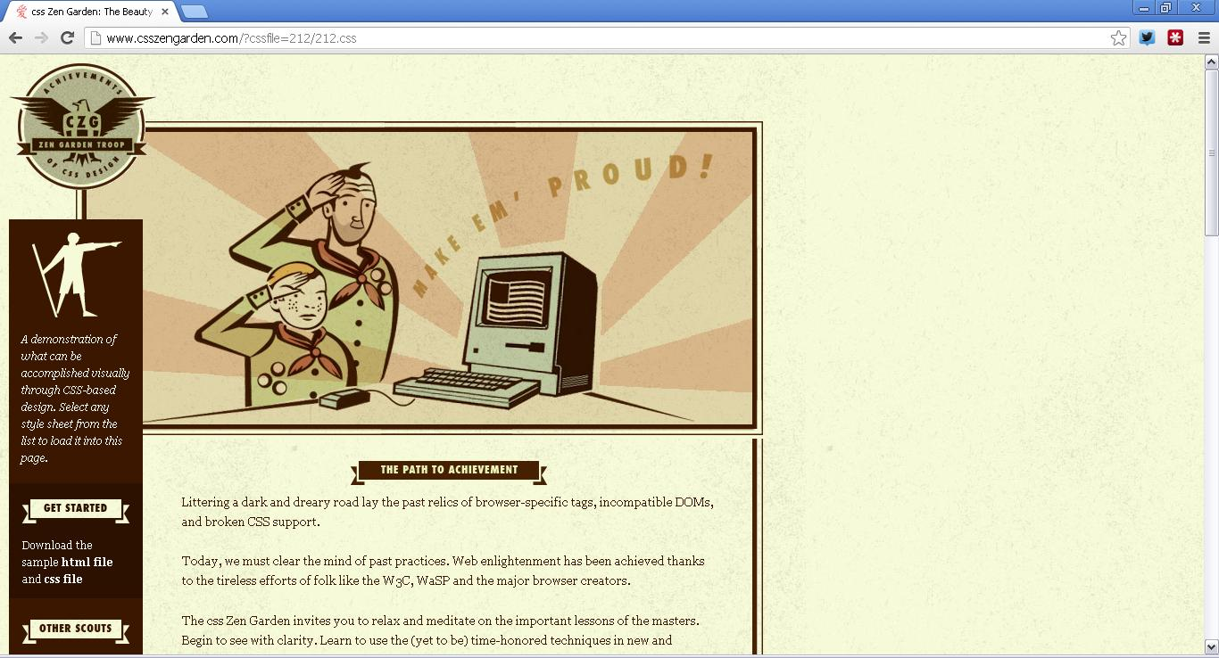
CSS Zen Garden (csszengarden.com)

Slide 30


Resources
sitepoint.com
  Books
  Tutorials
  Podcast (discontinued)
  Invaluable – and specific - expertise
w3schools.com
  API References

Slide 31
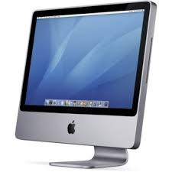
You are now an artist!

Slide 32


© Copyright The University of Melbourne 2014

