Slide 1
Presentation on the web: HTML
INFO20002: Foundations of Informatics
23rd March 2015

Slide 2
Connecting the Internet…
IE / Windows
Client 1
HTTP Request
Server
11000110
00111001
HTTP Response
Client 2
HTTP Request
11000110
00111001
HTTP Response
Safari / OSX
Apache / Linux

Slide 3
HTML to render the data
Client
Data
Markup layer
From server,
database,
JSON,
whatever…
This shift in use of HTML reflects the progression of data
transfer as the Internet has matured…
Notes:
HTML
Then we told you how it became XML
Then we told you that this developed into JSON
Now we’re back to HTML again (with a difference)
These progressions generally (not exactly) mirror the development of information organisation as the Internet has matured…

Slide 4
HyperText
“Three-dimensional” text
  structured and linked to other nodes
One of the keys to this is the anchor tag:
  <a href=“somepage.html”>Text</a>

Slide 5
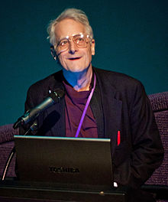
HyperText
Ted Nelson coined the term “Hypertext” (1965)
  His original vision was the simplest possible interface
  HTML doesn’t cut it (according to him):
    “Ever-breaking links, no version management, quotes you can’t follow to their origin, no rights management, links going outward only”
“Most people are fools,
most authority is malignant,
God does not exist,
and everything is wrong"

Slide 6
html: from past to the future
HTML 4.0
HTML 4.01
(1998,1999)
HTML 2.0
(1995)
HTML 3.2
(1997)
XHTML 1.0
(2000)
HTML5
(2008)
The original HTML, mostly structural markup (<h1>,<h2>,<p>), not intended for formatting a document (no <font> tag).
Stylistic markup like <font> and color attributes were added.
Mix of content and presentation:
content chaos,
the era of colorful but messy web pages.
Formatting is removed from the document and stored in a separate style sheet (CSS).
Presentation is separated from the document structure.
Structure is enforced even further.
Stricter and cleaner document.
HTML as XML document.
New elements and attributes for modern Web sites.
New semantic markup <nav> (website navigation) and <footer>.
Multimedia <audio> and <video>.
higher level of abstraction
Notes:
People too plain
http://www.w3.org/History/19921103-hypertext/hypertext/WWW/TheProject.html
http://havenworks.com/
http://www.dokimos.org/ajff/
http://www.angelfire.com/super/badwebs/

Slide 7
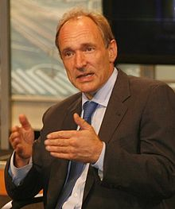
The World-Wide Web (www)
World Wide Web (WWW) – program/system to access interlinked hypertext documents using a web browser
  Tim Berners-Lee, 1989, CERN (Nuclear research, Geneva)

Slide 8
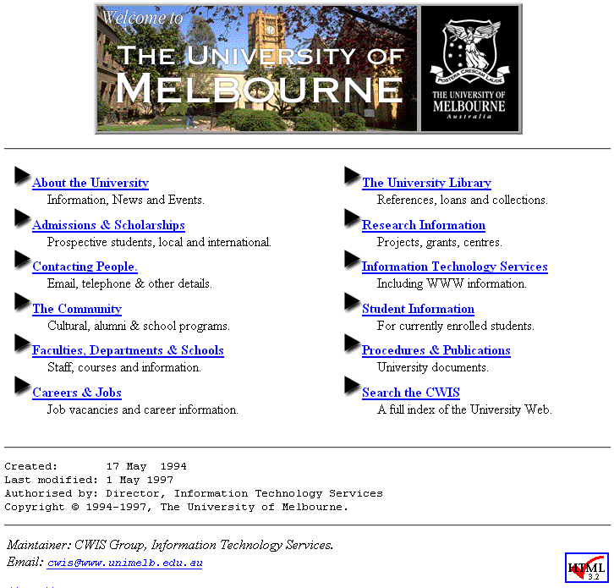
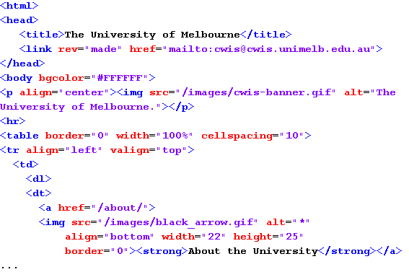
HTML: ~ 10 years ago

Slide 9
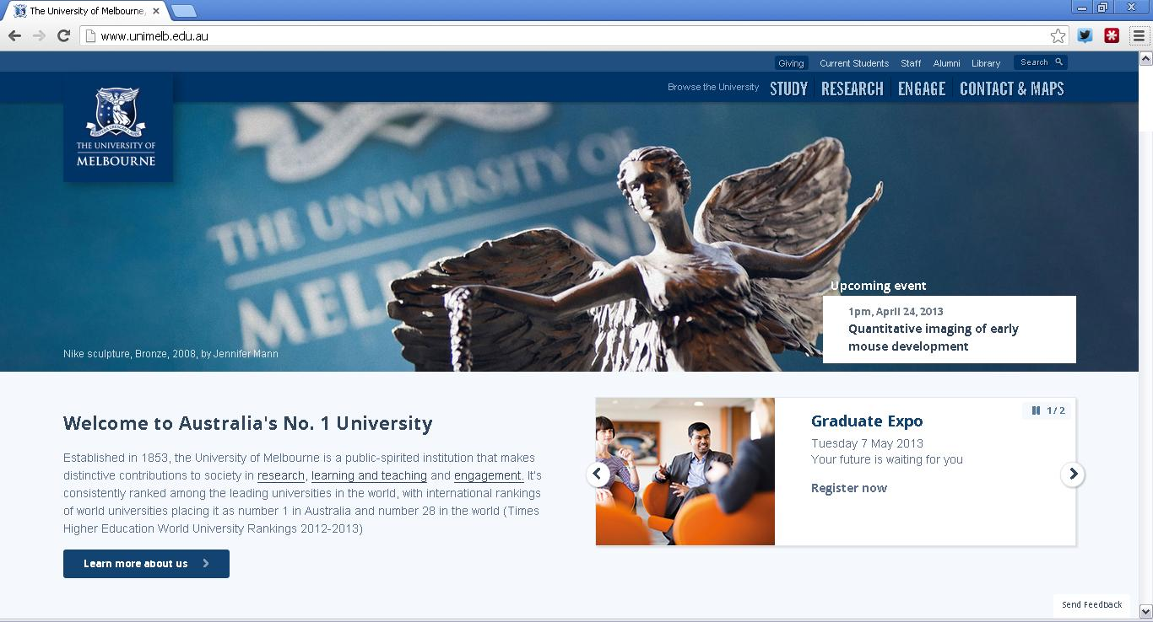
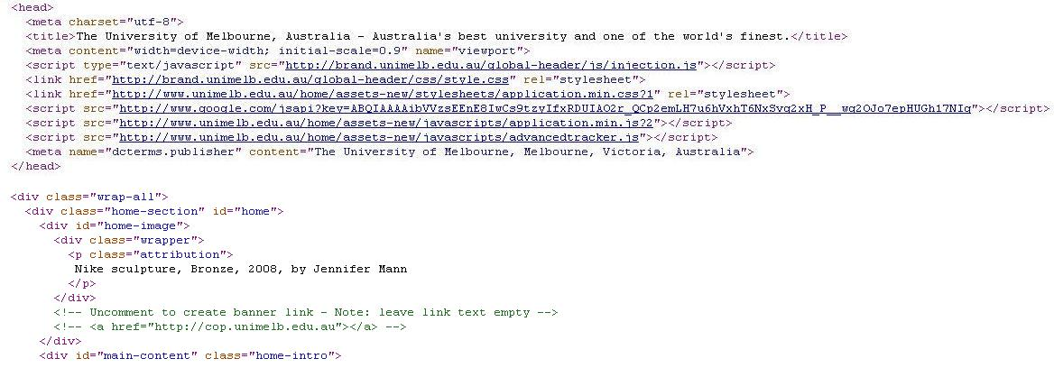
(X)HTML: today

Slide 10

HTML5
The latest version is HTML5
  As of October 2014
It updates the standard to reflect modern usage of the web, with emphasis on audio and video embedding
Compared to multimedia support such as Flash
  But it is a different thing: an open standard
Generally these updates are A Good Thing
  But many idiosyncratic tags were thrown in, so beware of relying on it’s stranger side too heavily…

Slide 11
Markup
Structural markup
  Provides the structure of the doc
    <p>, <h1>, <h2>, etc
    <div> and <span> (XHTML)
Stylistic markup
  Changes how the text appears
    <em>, <strong>, etc
Semantic markup
  Gives meaning to markup content but doesn’t change doc
    <name>Anthony Stell</name>
    <email>astell@unimelb.edu.au</email>

Slide 12
HTML vs XML (XHTML)
XHTML
  ... is an XML document
  ... has stronger structural support
  ... separates content and presentation*
  ... allows easier content management
  ... allows easier search engine optimisation
  ... can be validated
* but so does HTML 4...

Slide 13
Well-formed XML
Elements must be properly closed with an end tag
  X <p>This is a para.<p>This is another para.
  √ <p>This is a para.</p><p>This is another para.</p>
Empty elements must also be properly closed
  X <br> √ <br />
  √ <br /> <hr /> <img src="an_image.jpg" />
Correct ordering of nested elements
  X <em><strong>Something is wrong</em></strong>
  √ <em><strong>Something is good</strong></em>

Slide 14
Well-formed XML (contd.)
All attribute values must be properly quoted
  X <td colspan=3>
  √ <td colspan="3">
Attribute minimization is not allowed
  X <select multiple>…</select>
  √ <select multiple="multiple">… </select>
Use appropriate entities
  X <title>Hansel & Gretal</title>
  √ <title>Hansel &amp; Gretal</title>
  √ <a href="page.php?id=about&amp;style=5">About Us</a>

Slide 15
Typical XHTML document
XML declaration (optional)
<?xml version="1.0" encoding="UTF-8"?>
<!DOCTYPE html
PUBLIC "-//W3C//DTD XHTML 1.0 Transitional//EN"
"http://www.w3.org/TR/xhtml1/DTD/xhtml1-transitional.dtd">
<html xmlns="http://www.w3.org/1999/xhtml" xml:lang="en-au">
<head>
<title>My first XHTML page</title>
<meta name="description" content="Sample XHTML page" />
<meta name="keywords" content="xhtml, web page" />
<meta name="author" content="John Doe" />
<link rel="stylesheet" href="my_styles.css" type="text/css" />
</head>
<body>
<p>Content of the page.</p>
</body>
</html>
DOCTYPE (DTD)
namespace
metadata
Link to other
documents (style sheet)

Slide 16
XHTML 1.0 – 3 flavours
XHTML 1.0 Strict
  Clean structural mark-up, no style tags
  http://www.w3.org/TR/xhtml1/DTD/xhtml1-strict.dtd
XHTML 1.0 Transitional
  XHTML but accessible to older browsers
  http://www.w3.org/TR/xhtml1/DTD/xhtml1-transitional.dtd
XHTML 1.0 Frameset
  Use HTML Frames to partition windows
  http://www.w3.org/TR/xhtml1/DTD/xhtml1-frameset.dtd

Slide 17
Strict and Transitional
Presentational elements not allowed in Strict:
  <center>
  <font>
  <u>
Presentational attributes that are not allowed in Strict:
  align
  background
  bgcolor
http://www.w3schools.com/tags/default.asp

Slide 18
Block and Inline elements
Block elements expand naturally and naturally drop below other elements
Generally considered structural
Inline elements can be thought of as a “box that acts like text”
Flows with text and is generally considered presentational
Block can go inside block
Inline can go inside block
Block cannot go inside inline

Slide 19
<div> and <span>
<span> element is used for inline markup:
  <p>I am reading <span class="book">Harry Potter</span></p>
… and can only enclose inline elements:
  text and <img>
<div> element is used for block markup:
  <div class="sale_items">
  <p>This week's sale items are:</p>
  <ul>
  <li>Pink Lady apples</li>
  <li>Bananas</li>
  </ul>
  </div>
… and can enclose any inline or block elements:
  <p>, <blockquote>, <pre>, <h1>…<h6>, <div>

Slide 20
Interacting with HTML: a simple form
<html>
<head>
<title>A simple form</title>
</head>
<body>
<h1>A simple form</h1>
<form method="post“ action="http://localhost/env.py">
<input type="text" name="foo" />
<input type="submit" />
</form>
</body>
</html>

Slide 21
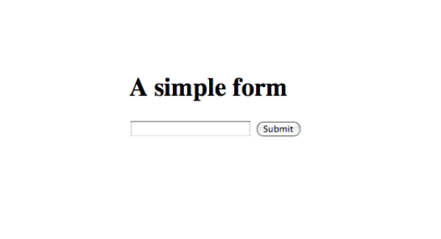
Displayed in HTML

Slide 22
A very simple form
First control element is a text box called “foo”
Second control element is the submit button
Method specifies how the form data is sent (“get” or “post”)
The action URI indicates what CGI script to use on what server for processing
<html>
<head>
<title>A simple form</title>
</head>
<body>
<h1>A simple form</h1>
<form method="post“ action="http://localhost/env.py">
<input type="text" name="foo" />
<input type="submit" />
</form>
</body>
</html>

Slide 23
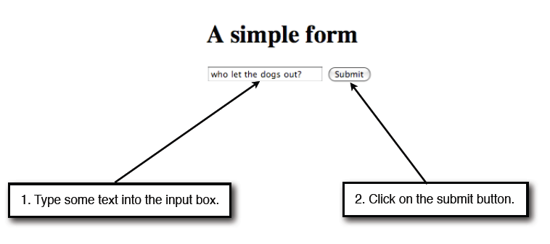
The form in action

Slide 24
env.py
# A Python CGI program which prints out its environment variables,
# and the contents of stdin.
import os
import sys
print 'Content-Type: text/plain'
print
for var in os.environ:
print '%s = %s' % (var, os.environ[var])
print 'stdin = %s' % sys.stdin.read()

Slide 25
Briefly returning to HTTP…
HTTP_REFERER = http://localhost/~bjpop/forms-lecture/simpleform.html
SERVER_SOFTWARE = Apache/2.2.8 (Unix) mod_ssl/2.2.8 OpenSSL/0.9.7l DAV/2
SCRIPT_NAME = /~bjpop/env.py
SERVER_SIGNATURE =
REQUEST_METHOD = POST
SERVER_PROTOCOL = HTTP/1.1
QUERY_STRING =
PATH = /usr/bin:/bin:/usr/sbin:/sbin
CONTENT_LENGTH = 27
HTTP_USER_AGENT = Mozilla/5.0 (Macintosh; U; Intel Mac OS X 10_5_4; en-us) ...
HTTP_CONNECTION = keep-alive
SERVER_NAME = localhost
REMOTE_ADDR = ::1
SERVER_PORT = 80
SERVER_ADDR = ::1
SCRIPT_FILENAME = /Users/bjpop/Sites/env.py
SERVER_ADMIN = you@example.com
HTTP_HOST = localhost
REQUEST_URI = /~astell/foi/mywork/env.py
GATEWAY_INTERFACE = CGI/1.1
REMOTE_PORT = 51901
HTTP_ACCEPT_LANGUAGE = en-us
CONTENT_TYPE = application/x-www-form-urlencoded
HTTP_ACCEPT_ENCODING = gzip, deflate
stdin = foo=who+let+the+dogs+out%3F

Slide 26
A very simple form
<html>
<head>
<title>A simple form</title>
</head>
<body>
<h1>A simple form</h1>
<form method=“get“ action="http://localhost/env.py">
<input type="text" name="foo" />
<input type="submit" />
</form>
</body>
</html>

Slide 27
Output from the env.py script
HTTP_REFERER = http://localhost/~bjpop/forms-lecture/simpleform.html
SERVER_SOFTWARE = Apache/2.2.8 (Unix) mod_ssl/2.2.8 OpenSSL/0.9.7l DAV/2
SCRIPT_NAME = /~bjpop/env.py
SERVER_SIGNATURE =
REQUEST_METHOD = GET
SERVER_PROTOCOL = HTTP/1.1
QUERY_STRING = foo=who+let+the+dogs+out%3F
PATH = /usr/bin:/bin:/usr/sbin:/sbin
CONTENT_LENGTH = 27
HTTP_USER_AGENT = Mozilla/5.0 (Macintosh; U; Intel Mac OS X 10_5_4; en-us) ...
HTTP_CONNECTION = keep-alive
SERVER_NAME = localhost
REMOTE_ADDR = ::1
SERVER_PORT = 80
SERVER_ADDR = ::1
SCRIPT_FILENAME = /Users/bjpop/Sites/env.py
SERVER_ADMIN = you@example.com
HTTP_HOST = localhost
REQUEST_URI = /~astell/foi/mywork/env.py
GATEWAY_INTERFACE = CGI/1.1
REMOTE_PORT = 51901
HTTP_ACCEPT_LANGUAGE = en-us
CONTENT_TYPE = application/x-www-form-urlencoded
HTTP_ACCEPT_ENCODING = gzip, deflate
stdin =

Slide 28
GET versus POST
In general, “get” is recommended only for idempotent requests. A request is idempotent if it returns the same result every time it is run.
An idempotent request does not have “side effects”. That is, it does not change the state of the server. For example, it does not cause a file on the server to be modified.
Why do you think this is a good idea?

Slide 29
foo.py
import cgi
print 'Content-Type: text/html'
print
store = cgi.FieldStorage()
print '<html><head></head><body><h1>'
if 'foo' in store:
print store.getvalue('foo')
print '</h1></body></html>'

Slide 30
A very simple form
<html>
<head>
<title>A simple form</title>
</head>
<body>
<h1>A simple form</h1>
<form method=“get“ action="http://localhost/foo.py">
<input type="text" name="foo" />
<input type="submit" />
</form>
</body>
</html>

Slide 31
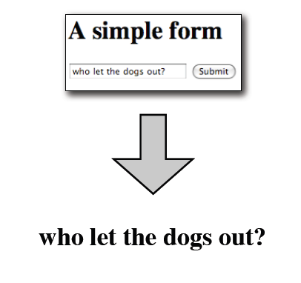
foo.py in action
This is really the HTML:
<html><head></head><body><h1>
who let the dogs out?
</h1></body></html>

Slide 32
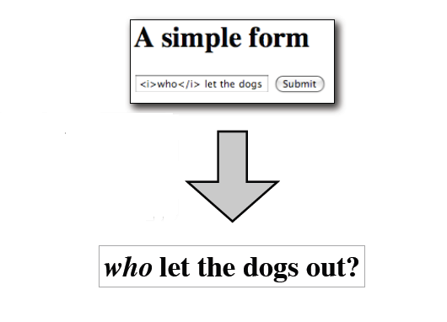
Anyone spot the danger…?

Slide 33
foo.py (safe version)
import cgi
print 'Content-Type: text/html'
print
store = cgi.FieldStorage()
print '<html><head></head><body><h1>'
if 'foo' in store:
print cgi.escape(store.getvalue('foo'))
print '</h1></body></html>'

Slide 34
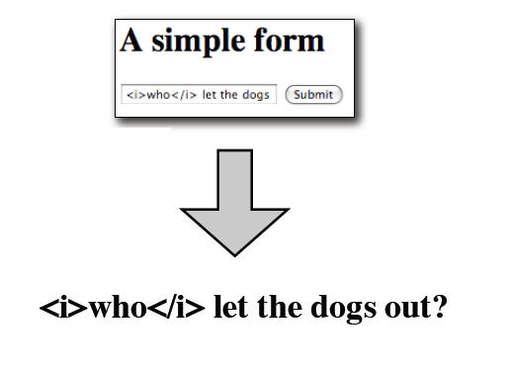
Now it is safe…
This is really the HTML:
<html><head></head><body><h1>
&lt;i&gt;who&lt;/i&gt; let the dogs out?
</h1></body></html>

Slide 35
Input controls
HTML forms provide several input controls, for example:
  text input boxes (single line and multi-line)
  checkboxes
  radio buttons
  submit button
  reset button
  buttons (other than submit and reset)
  menus
  hidden fields
http://www.w3.org/TR/html401/interact/forms.html

Slide 36
A form with a few different controls
<form method="get" action="http://localhost/env.py">
Enter something:
<input type="text" name="mytextbox" value="a default value" />
<br />
<input type="checkbox" name="mycheckbox1" />
<input type="checkbox" name="mycheckbox2" checked="checked" />
<br />
<input type="radio" name="myradio" value="value1" checked="checked" />
<input type="radio" name="myradio" value="value2" />
<input type="radio" name="myradio" value="value3" />
<br />
<input type="submit" />
<input type="reset" />
</form>

Slide 37
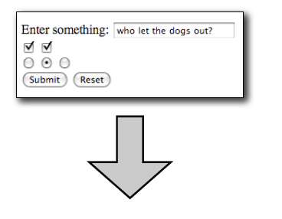
More complicated HTML form (using GET)
QUERY_STRING =
mytextbox=who+let+the+dogs+out%3F&mycheckbox1=on&mycheckbox2=on&myradio=value2

Slide 38
A (slightly) more interesting CGI script
import cgi
print 'Content-Type: text/html'
print
store = cgi.FieldStorage()
print '<html><head></head><body><table border="1">'
print '<tr><th>name</th><th>value</th></tr>'
for var in store:
value = cgi.escape(store.getvalue(var))
print '<tr><td>%s</td><td>%s</td></tr>' % (var, value)
print '</table></body></html>'

Slide 39
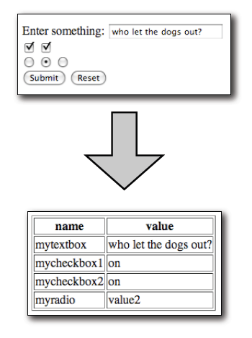
In HTML…

Slide 40
Remarks
A single HTML document can contain multiple forms, and hence multiple submit buttons.
However, forms cannot be nested. That is, one form cannot be inside another.
It is possible to write the CGI script to produce a form as output, and also act as the recipient of the form data (by being the “action” of the form).

Slide 41
Semantic HTML
Accessibility
  Using descriptive tags to aid screen-readers and audio browsers
The dark art of search-engine optimisation (SEO)
  Bumping your site to the top of the Google listing…
“Semantic web”
  All about having descriptive tags in everything so that it can be more efficiently mined
    A controversial idea…

Slide 42


© Copyright The University of Melbourne 2014

