Slide 1
Tools of Analysis
INFO20002: Foundations of Informatics

Slide 2
Analysis - Overview
Visual Analytics vs Numerical Analytics
Univariate, bivariate, and multivariate
Simple summarization/aggregation vs
more complex statistical analysis

Slide 3
Bivariate = Two Variables
Searching for a relationship between two variables (if one exists)
Simplest type of statistics
  Apart from univariate (= one variable!)
Covering the basic principles and characteristics of this analysis

Slide 4

Independent / Dependent variables
In any experiment you have (at least):
  one independent variable
  one dependent variable
  everything else controlled
For instance, to establish the effect of temperature on the rate of plant growth:
  Temperature is the independent variable
  Growth is the dependent variable
    Which could be height, weight, number of fruits, etc

Slide 5
Bivariate analysis of discrete variables: contingency tables
Summarise information about discrete variables using contingency tables:
  “A matrix that shows the frequency distribution of the two variables being correlated”
  Also known as a “cross tabulation”
  Shows the number of observations for each combination of discrete values from two categorical variables.
  Categorical values can be ordinal or nominal
  Continuous values must be made discrete (categorised)

Slide 6
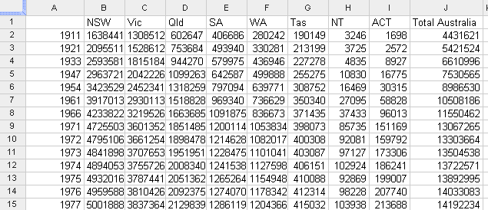
Contingency table example: population count
YEAR VS STATE
cells are count of resident (total population)

Slide 7
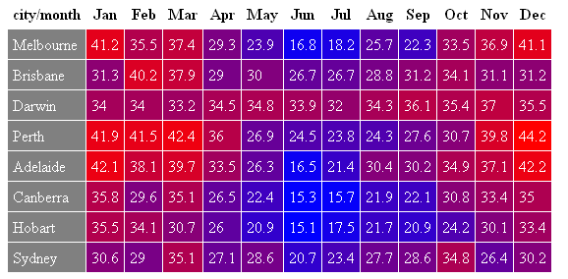
Pivot tables: visualisation of the contingencies
CITY VS MONTH
cells are average of mean max temperature

Slide 8
Pivot tables
Pivot tables allow quick creation of contingencies
Can change the order of variables and see the changes (hence “pivot” due to the rotation of the variables)
Automatically sorts, totals or averages counts within a (tabulated) data-set
Relevant to phase 3 project

Slide 9
Analysing discrete variables: rank correlation
Rank correlation
  Calculates similarities between ranks
“If a university has a higher-ranked football team, then is it likely to have a higher-ranked basketball team?”
Football ranking | University team
1 | Melbourne
2 | Monash
3 | Sydney
4 | New South Wales
5 | Adelaide
6 | Perth
Basketball ranking | University team
1 | Sydney
2 | Melbourne
3 | Monash
4 | New South Wales
5 | Perth
6 | Adelaide

Slide 10
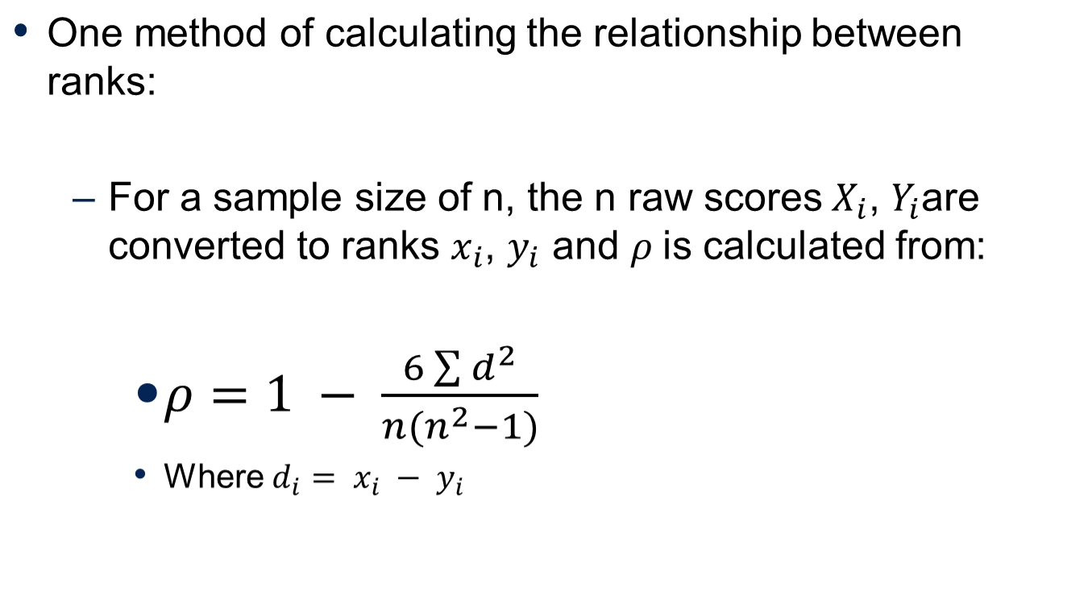
Spearman’s Rank Correlation

Slide 11
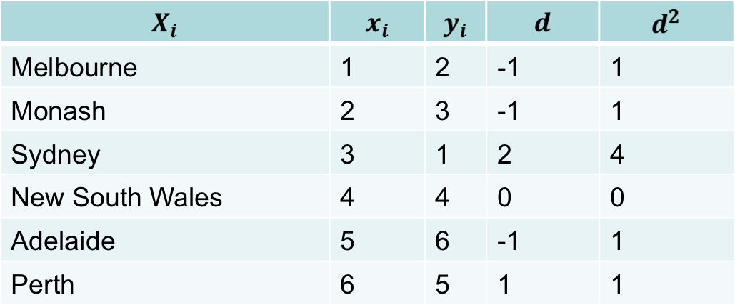
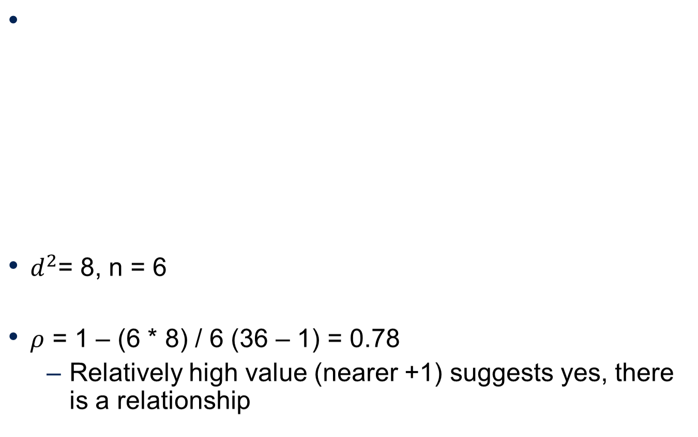
Example: Spearman’s Rank Correlation

Slide 12
Bivariate analysis of continuous variables
Regression
  The concept that in the long-term, extreme measurements of a continuous variable will converge on a single “average” relationship
Pearson correlation coefficient
  The degree of relationship between two continuous variables

Slide 13
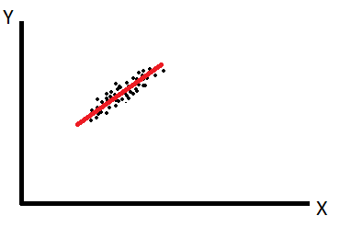
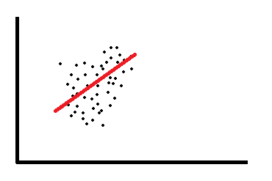

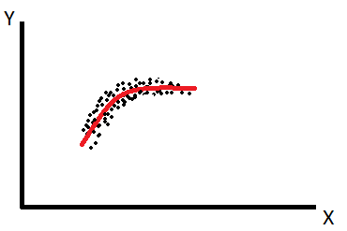
Regression to the mean
The idea is that there is a defined meaning of “normal” of this data-set, and in a good model the data points are never very far from “normal”
  i.e. they “regress to the mean”…

Slide 14
Linear Regression
For instance, the rate of plant growth is the relationship between the independent and dependent variables:
  Growth = [some number] * Temperature
  Where [some number] is the correlation co-efficient
Growth
Rate of growth
Rate of growth
Temperature

Slide 15

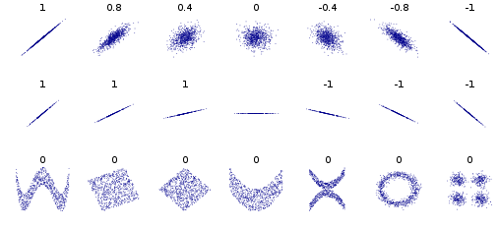
Pearson correlation coefficient
(inverse correlation) -1 <= r <= 1 (positive correlation)
r = 0 (no correlation)

Slide 16


© Copyright The University of Melbourne 2009

