Slide 1

Analysis workshop
INFO20002: Foundations of Informatics
Week 8

Slide 2


Analysis Workshops
Basics of analysis
  Five steps: sourcing, understanding, cleaning, transforming, feature selection
Try applying these techniques to your phase 3 data-set
Descriptive/prescriptive data mining
  BigML
  Google Prediction API

Slide 3
Data analysis – the steps
1. Sourcing
  Find your data…
2. Understanding
  What do the columns and values represent?
  Figure out what story is buried in that data…
3. Cleaning
  Are there errors and is the data valid?
  What was the original data collection purpose?
4. Transformation
  Turn the data into something presentable
5. Feature selection
  Pull out the relevant bits to address your hypothesis

Slide 4

Finding a hypothesis
A “chicken and egg” problem…
You need to look at the data to figure out a question…
Then you need to answer that question using the data…

Slide 5
Step 1: sourcing data
Data-set types:
  Surveys or polls, Experiments, Observational and other studies
Repository types:
  Operational databases, Data warehouses, Historical databases, Purchased data
Data types:
  Any kind of persistent file storage (SQL, CSV, XML, JSON, …)

Slide 6
Step 2: understanding the data
Tables
  Data about “things”
  Column is a variable, row is an observation
Continuous and discrete variables
  Continuous = numbers or anything that can have a range
  Discrete = anything else
  Note: numbers can be discrete too

Slide 7
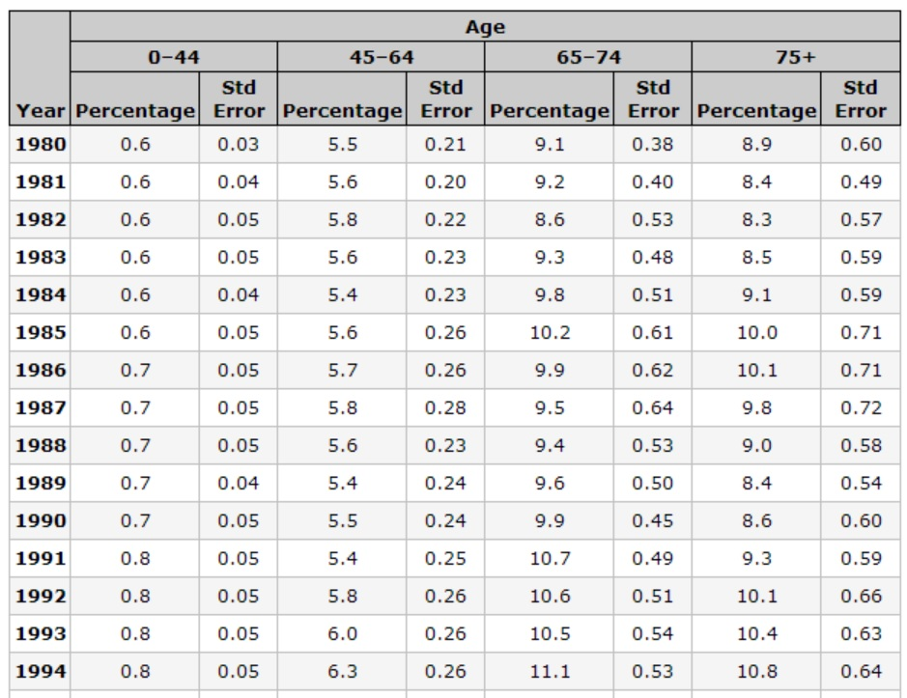
Example – CDC diabetes tables
Continuous variables
Discrete variables

Slide 8
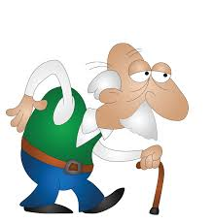
Step 3: cleaning the data
Validation and tidying of the data
Semantic similarities:
  “General Electric Company”
  “General Elec Co.”
  “GE”
  “Gen. Electric Company”
Range problems (or maybe wrong units…)
  Age = 150 years
  Blood pressure = 250 mmHg

Slide 9
Step 4: Transformation
Normalization
  Scale numerical columns so that they can be compared fairly
  e.g. converting absolute numbers to percentages, then scaling
Value mapping
  Convert text data (nominal) to numbers
  e.g. low = 0, medium = 1, high = 2
Discretization
  Convert numerical variables into categorical ones
Aggregation
  Derive a variable that isn’t present from two (or more) that are…

Slide 10

Step 5: Feature Extraction
If your data is way too big… then there will probably be some redundancy
  e.g. measurements in metres and feet
Feature extraction is an algorithm to pull only the information of relevance => Data Mining
This is yet another branch of mathematics in itself…
  Principal component analysis, Non-linear dimensionality reduction, etc.

Slide 11
Data mining - descriptive
Descriptive = grouping things together to get a view of the “data landscape”
Association rule
  Generate rules based on observations of the data-set
Clustering
  Groups data into sets of observations or clusters

Slide 12
Descriptive example – Association Rules
IF a patient is over 70
  AND they have history of liver problems
  AND they have low socio-economic status
    THEN they are 70% likely to be diabetic
Rule is easy to apply to other data points
Rule can be generated by analysing the data-set
Advantages:
  Easy to understand, actionable, good for large data
Disadvantages:
  Categorical only, time-consuming to generate, many rules means priority to be worked out

Slide 13
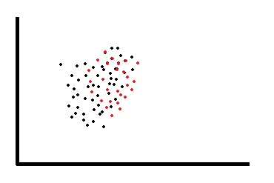
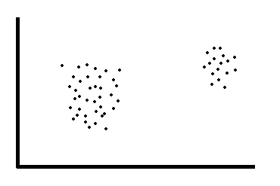
Descriptive example - Clustering
Advantages:
  Flexible, hierarchical approach possible
Disadvantages:
  Subjective interpretations, slow, size limits

Slide 14
Data mining - prescriptive
Prescriptive = using historical patterns to predict what will happen next…
Classification
  Allows observations to be assigned to different categories
Regression
  Mathematical model to predict a continuous response variable

Slide 15

© Copyright The University of Melbourne 2009

