Slide 1
Making sense of data: bivariate analysis
INFO20002: Foundations of Informatics
21st April 2015

Slide 2
Bivariate = Two Variables
Searching for a relationship between two variables (if one exists)
Simplest type of statistics
  Apart from univariate (= one variable!)
Covering the basic principles and characteristics of this analysis

Slide 3

Independent / Dependent variables
In any experiment you have (at least):
  one independent variable
  one dependent variable
  everything else controlled
For instance, to establish the effect of temperature on the rate of plant growth:
  Temperature is the independent variable
  Growth is the dependent variable
    Which could be height, weight, number of fruits, etc

Slide 4
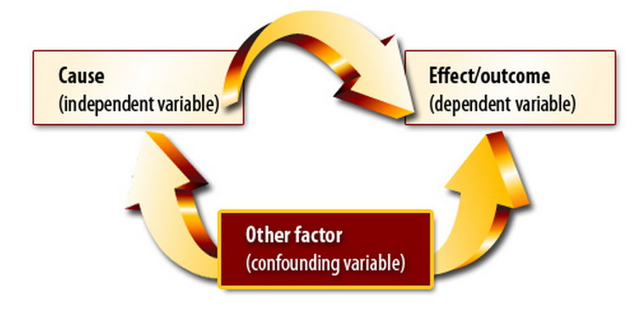
Confounding variables
A confounding variable is one that the researcher has failed to control but which mediates the relationship between independent and dependent.
For example:
  Are people that drink heavily more likely to die younger?
  Over a population sample, the answer is yes.
  But what if people that drink heavily are more likely to smoke/ eat junk food / not exercise?

Slide 5
Discrete vs Continuous
Continuous = numbers or anything that can have a range
  Also called “numerical”
Discrete = anything else
  Also called “categorical”
  But note: numbers can be discrete too

Slide 6
Examples of continuous variables
Numerical measurements:
  Temperature
  Velocity
  Time
  Etc
Anything that can be set down as a range…
1
2
3
4
5
6

Slide 7
Examples of discrete variables
Anything that isn’t a number (“nominal”):
  Colours
  Political party
  Favourite food
  Car models
  Age (as commonly used in polls – e.g. 21-35)
  Etc
But numbers can also be discrete (“ordinal”):
  A set of options (e.g. choose either “1”, “2”, or “3”)

Slide 8
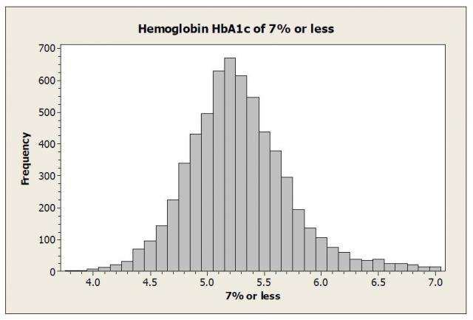
Transforming continuous to discrete
The basic idea:
  Divide the range into intervals that have well-defined boundaries
  Commonly called “binning” into a histogram

Slide 9
Transforming continuous to discrete
There are several strategies for defining what these intervals should be:
  Equal interval
    Intuitively easiest: split up the range equally and see how the data falls into them (previous example)
  Quantile
    Instead of splitting up the range, look at the data and break up the categories so that each one has equal member numbers
  Jenks (Natural Breaks)
    Look at the data and see where the “natural” intervals lie (by measuring the distance from the mean)

Slide 10
Quantile intervals
Seen this in phase 1 of the project:
  “Five key numbers”
Quartile is the most commonly used version of quantile splitting:
  Split into four evenly-populated sections (Q1 – Q4)
  Names are a bit confusing
Quartile name | Alternative name / reference
First quartile (Q1) | Lower Quartile (25th percentile)
Second quartile (Q2) | Median (50th percentile)
Third quartile (Q3) | Upper Quartile (75th percentile)
Interquartile range (IQR) | Q3 – Q1 (difference between upper and lower quartiles)

Slide 11
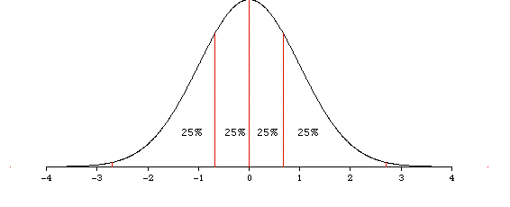
Quartile graph (normal distribution)

Slide 12
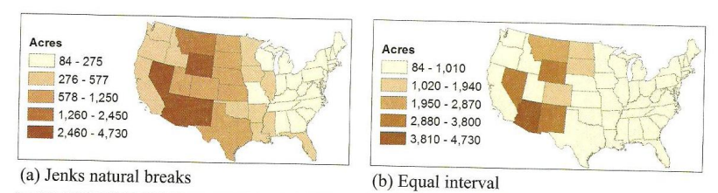
Jenks (natural break)
Jenks natural breaks classification
Cluster a set of values into different classes by reducing the variance within classes and maximizing the variance between classes.

Slide 13
Jenks (natural break)
equal interval (two classes)
jenks natural breaks (two classes)

Slide 14
Jenks (natural break)
Doing the following calculations iteratively:
  Calculate the sum of squared deviations from the array mean (SDAM)
  For each range combination, calculate sum of squared deviations for class means (SDCM_ALL) and find the smallest one
  Finally, calculate a goodness of variance fit (GVF)

Slide 15
Example – Jenks (natural break)
Assume you have four counties with values:
  4, 5, 9, 10
  Mean is 7
SDAM = (4-7)^2 + (5-7)^2 + (9-7)^2 + (10-7)^2 = 9 + 4 + 4 + 9 = 26
[4][5,9,10], SDCM_ALL = (4-4)^2 + (5-8)^2 + (9-8)^2 + (10-8)^2 = 0 + 9 + 1 + 4 = 13
[4,5] [9,10], SDCM_ALL = 1
[4,5,9] [10], SDCM_ALL = 13
GVF = (SDAM – SDCM) / SDAM
  = (26-13) / 26 = 0.5
  = (26 – 1) / 26 = 0.96

Slide 16
Analysing discrete variables: contingency tables
Summarise information about discrete variables using contingency tables:
  “A matrix that shows the frequency distribution of the two variables being correlated”
  Also known as a “cross tabulation”
  Shows the number of observations for each combination of discrete values from two categorical variables.
  Categorical values can be ordinal or nominal
  Continuous values must be made discrete (categorised)

Slide 17
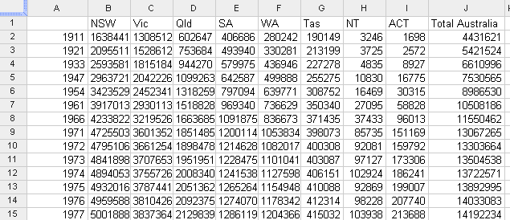
Contingency table example: population count
YEAR VS STATE
cells are count of resident (total population)

Slide 18
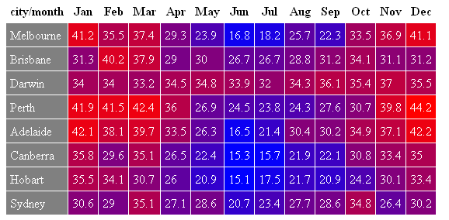
Pivot tables: visualisation of the contingencies
CITY VS MONTH
cells are average of mean max temperature

Slide 19
Pivot tables
Pivot tables allow quick creation of contingencies
Can change the order of variables and see the changes (hence “pivot” due to the rotation of the variables)
Automatically sorts, totals or averages counts within a (tabulated) data-set
Relevant to phase 3 project

Slide 20
Analysing discrete variables: rank correlation
Rank correlation
  Calculates similarities between ranks
“If a university has a higher-ranked football team, then is it likely to have a higher-ranked basketball team?”
Football ranking | University team
1 | Melbourne
2 | Monash
3 | Sydney
4 | New South Wales
5 | Adelaide
6 | Perth
Basketball ranking | University team
1 | Sydney
2 | Melbourne
3 | Monash
4 | New South Wales
5 | Perth
6 | Adelaide

Slide 21
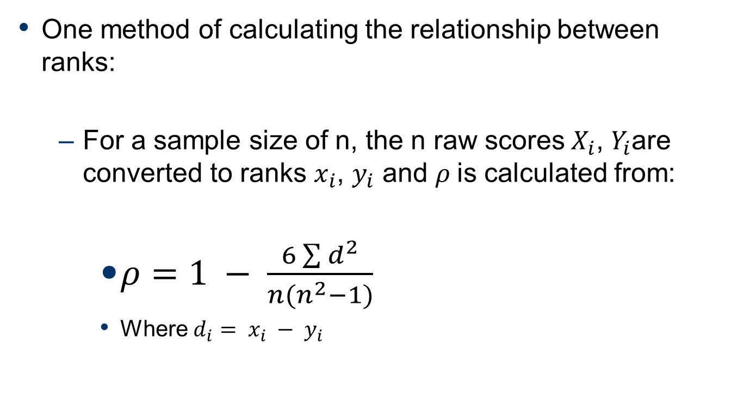
Spearman’s Rank Correlation

Slide 22
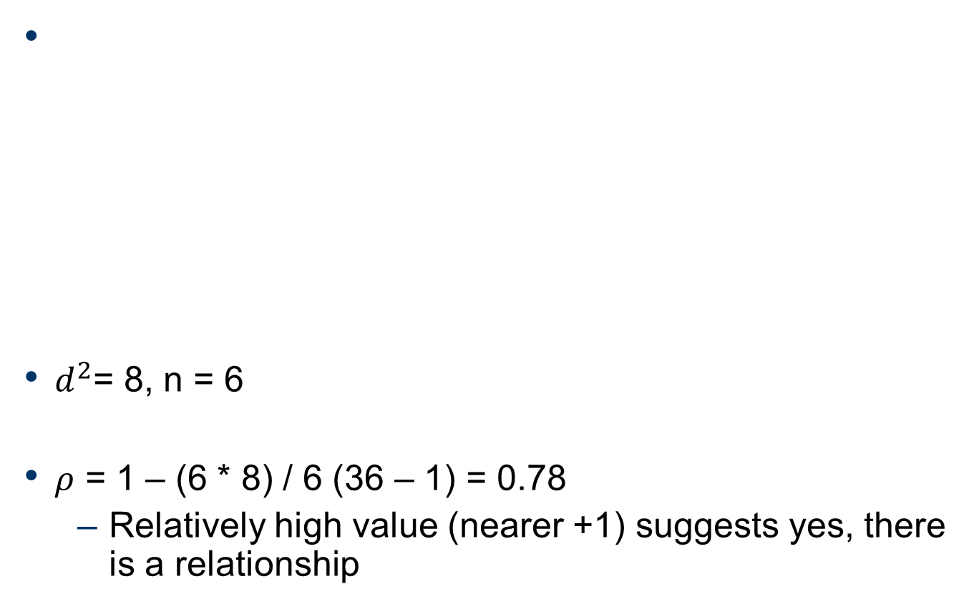
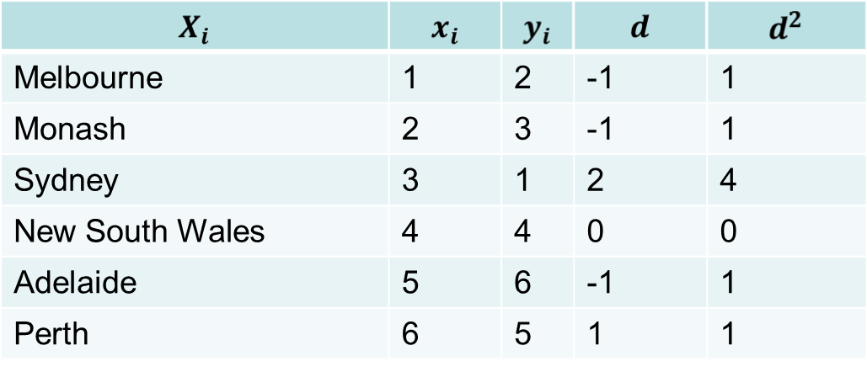
Example: Spearman’s Rank Correlation

Slide 23
Analysing continuous variables
Regression
  The concept that in the long-term, extreme measurements of a continuous variable will converge on a single “average” relationship
Correlation co-efficients
  The degree of relationship between two continuous variables
  From observation to mathematical model, this can be derived

Slide 24
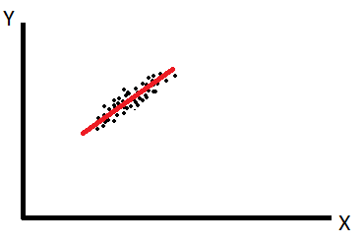
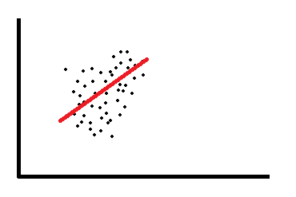

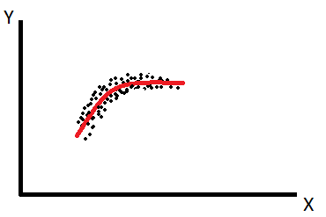
Regression to the mean
The idea is that there is a defined meaning of “normal” of this data-set, and in a good model the data points are never very far from “normal”
  i.e. they “regress to the mean”…

Slide 25
Correlation co-efficients
For instance, the rate of plant growth is the relationship between the independent and dependent variables:
  Growth = [some number] * Temperature
  Where [some number] is the correlation co-efficient
Growth
Rate of growth
Rate of growth
Temperature

Slide 26
Summary
Bivariate = relationship between two variables
  Direct, indirect, independent, confounding
Variable types:
  continuous, discrete
Transforming continuous to discrete:
  Equal interval, quantile, Jenks natural breaks
Discrete: contingency tables / pivot tables
  Quick visualisation of two variables (can be ‘pivoted’)
Discrete: rank correlation
  Metric of relationship between two ranked lists of variables
Continuous: correlation co-efficients
  Metric of the relationship between the two variables

Slide 27


Analysis Workshops
Basics of analysis
  Five steps: sourcing, understanding, cleaning, transforming, feature selection
Try applying these techniques to your phase 3 data-set
Descriptive/prescriptive data mining
  BigML
  Google Prediction API

Slide 28


© Copyright The University of Melbourne 2009

