Slide 1

Spreadsheet Workshop
INFO20002:
Foundation of Informatics
Dept of Computing and Information Systems

Slide 2
Workshop
Phase 2 project specification
Phase 1 project marking feedback
Phase 3 data-sets
  Discussion of domain and data selection
Spreadsheet information (slides)
Spreadsheet workshop exercises

Slide 3
Index, Offset and Match
=INDEX(reference, row, column)
Returns the content of a cell, specified by row and column offset
=OFFSET(cell_reference, offset_rows, offset_columns, [height], [width])
Returns a range reference shifted a specified number of rows and columns from a starting cell reference
=MATCH(search_key, range, search_type) Returns the relative position of an item in a range that matches a specified value

Slide 4
Array Formula
In a formula wrapped inside an =ARRAYFORMULA function, you can pass arrays (ranges) to functions and operators that typically only take non-array arguments. Those functions and operators will be applied to each member of the arrays one at a time. There results of these operation will be presented as a new array.
http://docs.google.com/support/bin/answer.py?hl=en&answer=71291
=ARRAYFORMULA( + )

Slide 5
Filtering and Sorting
=UNIQUE(sourceArray)
Returns only the unique rows in the source array, discarding duplicates, in the order in which those rows first appears.
=FILTER(sourceArray, arrayCondition_1, arrayCondition_2, ..., arrayCondition_30)
Returns a filtered version of the given source array, where only certain rows (columns) have been included. Each condition should be a column (row) of boolean values. Only the rows (columns) from the source array corresponding to the true values of the condition array will be returned. If there are multiple conditions, then all must be true for the corresponding values in the source array to be returned.
=SORT(data, keyColumn_1, ascOrDesc_1, keyColumn_2, ascOrDesc_2, ..., keyColumn_30, ascOrDesc_30)
Returns the rows in the given data range (or array), sorted according to the given key columns. The key column may be part of the data range, or as another column outside the range. If the key column is within the data range, give its index within the range: 1 is the first column of the range, 2 is the second column, etc. You can also specify another column outside the range. Each key column must also be marked to sort either ascending or descending, by adding either TRUE or FALSE after that specifying that key column.

Slide 6
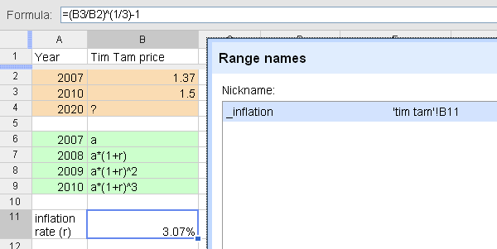
The Basics: Named Range
Define a symbolic name for a particular cell or range of cells
Do not use names that have a potential of conflict with cell references, e.g. A1, ABC123 X
Use underscore to avoid conflict: inflation_

Slide 7
The Basics: Lookup
=VLOOKUP(key_value, range, index, sort_order)
Finds key_value in the first column of range and
returns the value in the matching row and column-index.
key_value: the exact value searched for in the first column of the range.
range: the reference to lookup table, which must include at least two columns.
index: the number of the column in the range that contains the value to be
returned. The first column has the number 1.
sort_order (optional): TRUE or FALSE to indicate whether the first column in the range
is sorted in ascending order. (default=TRUE) This therefore returns an approximate match. If it is FALSE then the function returns an exact match.

