Slide 1
Representing data: JSON
INFO20002: Foundations of Informatics
10th March 2017

Slide 2
XML Recap
eXtensible Markup Language
XML adds meaning to the formatting of other markup languages (like HTML)
XML allows a standard method of data exchange
  Which you can define with a DTD (Document Type Definition)
XML is verbose
XML is a hierarchical method of organising data

Slide 3
Three fundamental differences from other formats (CSV, HTML, etc)
Hierarchical
Extensible
Adds meaning to the text

Slide 4
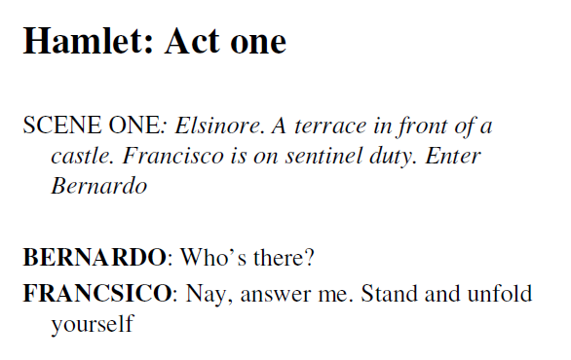
Hamlet in plain-text

Slide 5
Hamlet in XML
<act>
<title> Act One </title>
<scene>
<title> Scene One </title>
<location> Elsinore. A terrace in front of a castle. </location>
<stagedir> Francisco is on sentinel duty. Enter Bernardo </stagedir>
<speech>
<speaker> BERNARDO </speaker>
<line> Who's there? </line>
</speech>
<speech>
<speaker> FRANCISCO </speaker>
<line> Nay, answer me: stand, and unfold yourself. </line>
</speech>
</scene >
</act>

Slide 6
Three fundamental differences from CSV
Hierarchical
  E.g. element “speaker” belongs to element “speech”
Extensible
  E.g. you can define specific tags like “stagedir”
Adds meaning to the text
  E.g. the definition of “speaker” tells us what that text block means

Slide 7
Data Example
Customer
Name: Mr David Lynn
CustID: Cust201
Type: home
Address: 211 Fox Street
Greenville, NH 80021
Phone: (315) 555-1812
E-mail: dlynn@nhs.net

Slide 8
XML Design
<?xml version=“1.0”?>
<customers>
<customer>
<name>David Lynn</name>
<address>211 Fox Street Greenville, NH 80021</address>
<phone>(315) 555-1812</phone>
<email>dlynn@nhs.net</email>
</customer>
</customers>

Slide 9
Document Type Definition (DTD)
DTD is a schema that creates a consistent data structure
A grammar for the application of XML
customers
customer
name
address
phone
email

Slide 10
DTD Elements Rules
Element Type
(#PCDATA) | Parsed character (text) only
(child1, child2, child3, …) | Declare order of child elements
EMPTY | Element must be empty
(child1 | child2 | child3 |…) | Declare choice of child elements
ANY | Any type of content (no restrictions)
Symbol
? | Allow zero or one of the item
+ | Allow one or more of the item
* | Allow zero or more of the item

Slide 11
Document Type Definition (DTD)
<!ELEMENT customers (customer+)>
<!ELEMENT customer (name, address, phone, email)>
<!ELEMENT name (#PCDATA)>
<!ELEMENT address (#PCDATA)>
<!ELEMENT phone (#PCDATA)>
<!ELEMENT email (#PCDATA)>

Slide 12
XML Design
<?xml version=“1.0”?>
<customers>
<customer custID=“001” custType=“home”>
<name>David Lynn</name>
<address>211 Fox Street Greenville, NH 80021</address>
<phone>(315) 555-1812</phone>
<email>dlynn@nhs.net</email>
</customer>
</customers>

Slide 13
DTD Attribute Rules
Attribute Types
CDATA | Character data
(value1| value2 | …) | Allowed values (enumerated list)
ID | Used to create a unique identifier for an attribute
IDREF | Allows an attribute to reference the ID attribute from another element
NMTOKEN | A name token whose value is restricted to a valid XML name
ENTITY | A reference to an external file, usually one containing non-XML data

Slide 14
DTD Attribute Rules
Attribute default
#REQUIRED | The attribute must appear with every occurrence of the element
#IMPLIED | Attribute is optional
“default” | Attribute is optional, but if not specified, XML parser supplies default value
#FIXED “default” | Attribute is optional, but if value is specified it must match the default value

Slide 15
Declaring DTD Attributes
<!ATTLIST element attribute_name attribute_type default>
<!ATTLIST customer custID ID #REQUIRED >
<!ATTLIST customer custType (home|business) #IMPLIED >
<!ATTLIST order orderBy IDREF #REQUIRED>
<!ATTLIST item itemPrice CDATA #REQUIRED >
<!ATTLIST item itemQty CDATA "1">

Slide 16
Running the code in the client’s browser…
IE / Windows
Client 1
HTTP Request
Server
11000110
00111001
HTTP Response
Client 2
HTTP Request
11000110
00111001
HTTP Response
Safari / OSX
Apache / Linux

Slide 17
Browsers and Servers
When running code in the client, an issue that quickly develops is the lack of speed when the server needs to be contacted…
In the early 2000’s, developers tried to solve this by pre-compiling code and sending that to the client browser (Flash or Java applets)…
  This approach lacked flexibility
AJAX (Asynchronous Javascript And XML) and other projects started to use clever caching methods to bring info from the server when needed, but hold it at the client for a certain time…

Slide 18
A slimline information passage…
So we have a situation where information is passing along HTTP connections…
  Quickly
    The data is being processed locally
  Flexibly
    the connection is keeping data that you’re likely to want next (caching)
We need a way to represent data that isn’t as cumbersome as other formats
  such as XML…
And can be easily integrated into the executable environment using a lightweight language
  such as Javascript…

Slide 19
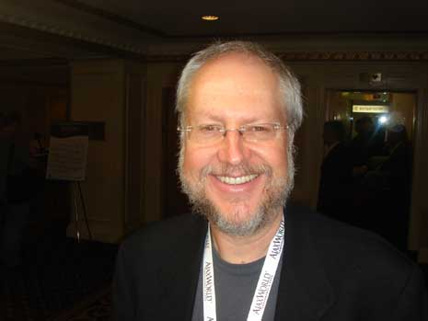

JavaScript Object Notation (JSON)
JSON (www.json.org)
Douglas Crockford (pretty much alone)
  c.f the development of XML by committee
“Javascript: the good parts”
  O’ Reilly, Yahoo Press

Slide 20
Data Example
Customer
Name: Mr David Lynn
CustID: Cust201
Type: home
Address: 211 Fox Street
Greenville, NH 80021
Phone: (315) 555-1812
E-mail: dlynn@nhs.net

Slide 21
XML Representation
<?xml version=“1.0”?>
<customers>
<customer>
<name>David Lynn</name>
<address>211 Fox Street Greenville, NH 80021</address>
<phone>(315) 555-1812</phone>
<email>dlynn@nhs.net</email>
</customer>
</customers>

Slide 22
JSON Example
{
"firstName": “David",
"lastName": “Lynn",
"isAlive": true,
"age": 25,
"height_cm": 167.6,
"address": {
"streetAddress": "211 Fox Street",
"city": “Greenville",
"state": "NH",
"postalCode": “80021“
},

Slide 23
JSON Example
"phoneNumbers": [
{
"type": "home",
"number": “315 555-1812“
},
{
"type": "office",
"number": "646 555-4567“
}
],
“email”: dlynn@nhs.net
}

Slide 24
Diagram of a JSON object
person
firstName
address
city
postalCode
state
phone
age
etc

Slide 25
JSON syntax rules
Data is in name/value pairs
  "firstName":"John“
JSON values
  A number (integer or floating point)
  A string (in double quotes)
  A Boolean (true or false)
  An array (in square brackets)
  An object (in curly braces)
  null

Slide 26
JSON syntax rules
JSON Objects
  {"firstName":"John", "lastName":"Doe"}
JSON Arrays
  "employees":[
  {"firstName":"John", "lastName":"Doe"},
  {"firstName":"Anna", "lastName":"Smith"},
  {"firstName":"Peter", "lastName":"Jones"}
  ]
These objects repeat recursively down a hierarchy as needed.
In terms of syntax that’s pretty much it!

Slide 27
Using JSON (Python)
import json
json.loads(
  '["foo",
    {"bar":
      ["baz", null, 1.0, 2]
    }
  ]')
json.dumps(
  ['foo',
    {'bar':
      ('baz', None, 1.0, 2)
    }
  ]
)
Note: white space and indentation
is for display purposes only!

Slide 28
JSON vs XML
XML has the concept of a schema
  allows formal validation
  makes you consider the data design more closely
  gives you context
    JSON schema does exist but is not formalised
JSON is more streamlined, lightweight and compressed
  Which appeals to programmers looking for speed and efficiency
  Compare the customer information representations between XML and JSON

Slide 29
JSON
JavaScript Object Notation
Lightweight, streamlined, standard method of data exchange
Designed to speed up client/server interactions:
  By running in the client browser
Lacks context and schema definitions

Slide 30


© Copyright The University of Melbourne 2014

