Slide 1
Exam Review
INFO20002: Foundations of Informatics
25th May 2015

Slide 2
Exam Logistic
When?
Where?
120 points (1 point a minute)
n questions, n < 10, many sub-questions
Preparation strategies:
  Start from these slides
  Lectures
  Workshops
  Review again these slides
Exam strategies:
  Don’t write a novel
  Short and sweet
  Speed Reading (and Writing)

Slide 3
Expected Python Skills
Some coding-related questions:
  data processing
  producing HTML
Data Types
Character representation: byte string and Unicode string
Booleans and logic operators
Functions
Selection/control
Iteration/looping
Lists
Dictionary/tuples
NOT examinable:
cgi
lxml

Slide 4
Review Lecture – Subjects
Representing data: XML & JSON
Information, Data & Meaning
Information in Global World
HTML & CSS
Spreadsheets
Visualisation
Analysis
Tools of Analysis
Interactivity
Informatics in Society: Big Data & Health Informatics/Security
Network of Data

Slide 5
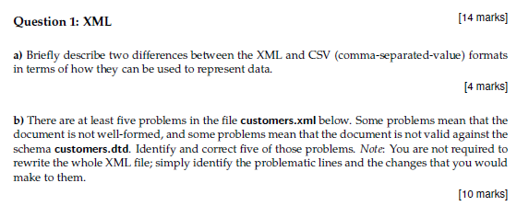
Representing Data – Practice Question

Slide 6
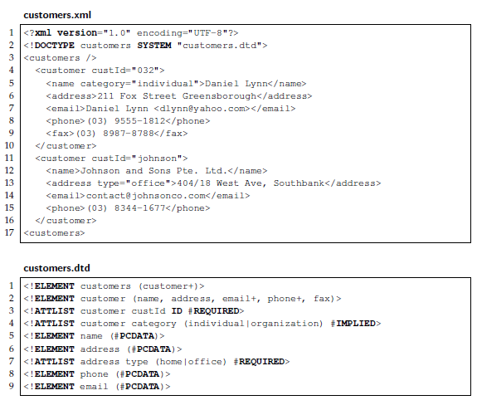
Representing Data – Practice Question

Slide 7
Representing Data
Structure of data
  Hierarchy/Tree (XML)
  Relational (database tables)
  Graph

Slide 8
XML – Summary
eXtensible Markup Language
XML adds meaning to the formatting of other markup languages (like HTML)
XML allows a standard method of data exchange
  Which you can define with a DTD (Document Type Definition)
XML is verbose
XML is a hierarchical method of organising data

Slide 9
JSON – Summary
JavaScript Object Notation
Lightweight, streamlined, standard method of data exchange
Designed to speed up client/server interactions:
  By running in the client browser
Native JavaScript, so can be executed as code
Lacks context and schema definitions
Integral to the Big Data paradigm (NoSQL)

Slide 10

Information Data & Meaning– Practice Questions
Two strings of DNA:
  TTTTAAAATTTTAAAA
  AGGATTCCGGAATTCC
Which one has higher entropy?
Icon, Symbol, or Index?

Slide 11
Information Data & Meaning– Summary
Various levels of Data, Information, Knowledge, Wisdom
Information in context and out of context
Information Entropy
Syntactics, Semantics, and Pragmatics
Semiotic Triangle
Peirce’s Typology of Signs

Slide 12
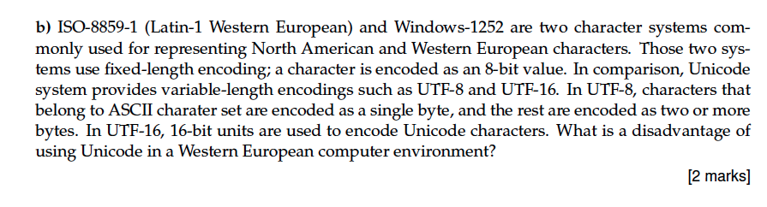
Information in Global World – Practice Questions

Slide 13
Information in Global World – Summary
Issues in i18n/L10n
Physical vs logical representation
i18n in Python
Python encoding() and decoding() functions
Character set and encoding
Unicode

Slide 14


XHTML and CSS
XHTML (XML and HTML)
  Three flavours: strict, transitional, frameset
  Types of markup: structural, stylistic and semantic
  Separate content and presentation
  <div> and <span>
CSS (Cascading Style Sheet)
  Used to give single style type to a site
  Selectors: universal, tag, class, id
  Colours, fonts, positioning, borders, media

Slide 15
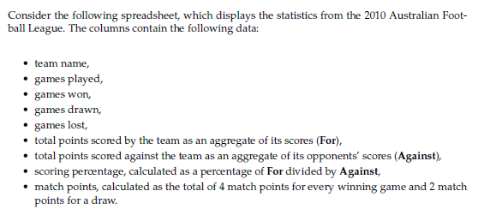
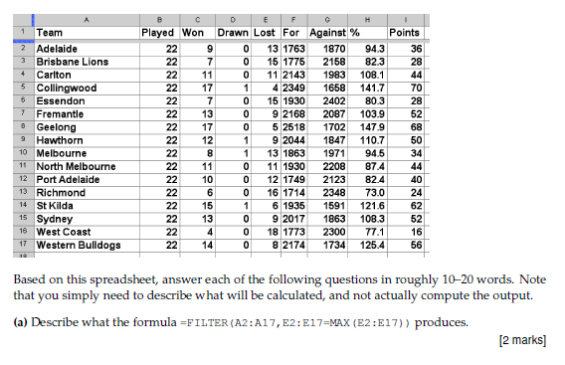
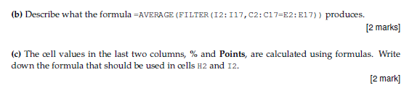
Spreadsheets – Practice Question

Slide 16
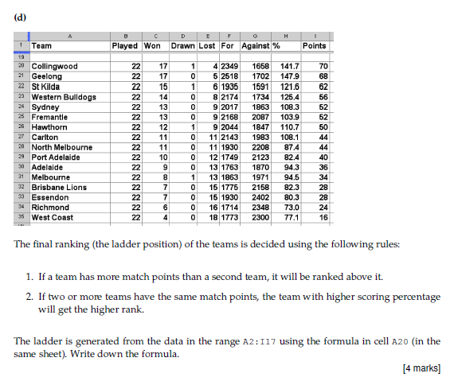
Spreadsheets – Practice Question

Slide 17
Spreadsheets – Summary
Basics: Formulae
Cell References: Absolute and Relative
Conditionals
Aggregate functions
Arrayformula
Filtering and sorting (UNIQUE, SORT, FILTER)
Named ranges
Lookup (Vlookup)
Pivot tables

Slide 18
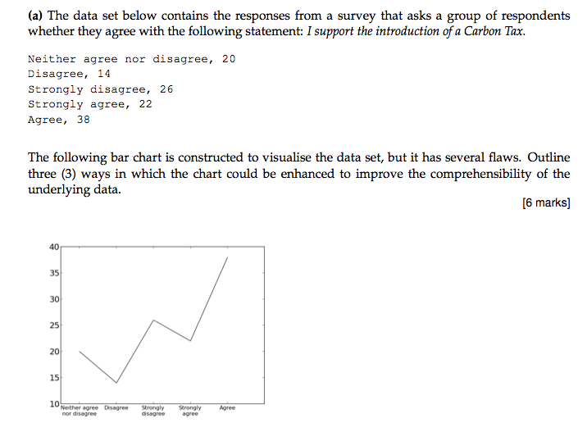
Visualisation – Practice Questions

Slide 19
Visualisation – Summary
Functions of visualisation
Bertin’s semiology
Data variables (nominal, ordinal, continuous)
Visual variables
Various chart types (line, bar, pie)
and the context of their application
Visualisation steps
What is good visualisation

Slide 20
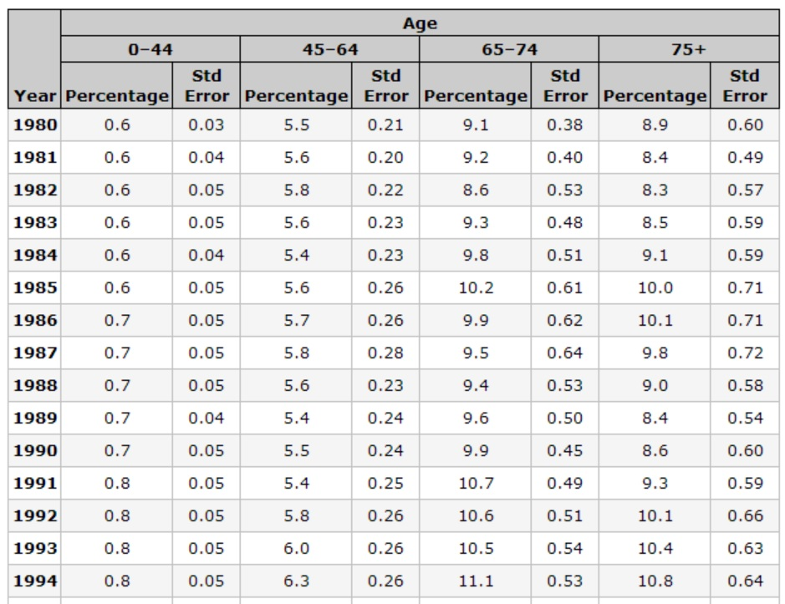
Analysing data – Practice Questions
Which variables are numerical, which are categorical?
How do we transform numerical into categorical?
[5 marks]

Slide 21
Analysing data
Five steps of data analysis
  Sourcing, understanding, cleaning, transformation, feature selection
Numerical and categorical data parameters
Classification
  Association rules
  Clustering
Prediction
  Classification (for prediction)
  Regression

Slide 22
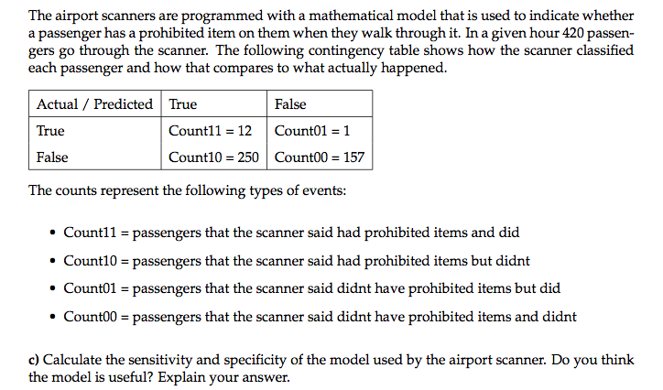
Analysing data – Practice Questions

Slide 23
Analysing data - Summary
Confusion Matrix
Know how to calculate sensitivity and specificity
Understand how this would apply to real life examples of prediction models
  e.g. classifying individual patients in a disease outbreak pattern

Slide 24
Interactivity – Practice Questions
Explain what we mean by “Event-driven programming” [2 marks]
Name two other paradigms that make JavaScript uniquely suited to creating interactive websites and describe each of them [4 marks]
Name one method of viewing debug output when programming JavaScript and write a line of code using that method [2 marks]
Expand the acronym AJAX and briefly describe it’s operation [2 marks]

Slide 25
Interactivity – Summary
Interactive websites use JavaScript
JavaScript is a client-side scripting language
JavaScript allows you to manipulate a web page’s DOM
JavaScript is event-driven (‘onclick’, etc)
JavaScript is invoked using <script> tags and has four main ways of getting debug output

Slide 26
Interactivity – Summary
JavaScript is important for interactivity due to it’s ability to manipulate web-page DOMs and event-driven paradigm
JavaScript is raw and untamed => many libraries exist
JQuery is the most popular of these
AJAX asynchronously allows communication between client and server in the background
HighCharts is a leading interactive charting framework using JavaScript

Slide 27
JavaScript Syntax to remember
Getting debug output to console
  innerHTML
  console.log()
  document.write()
  window.alert()
Selecting elements in a document
  getElementById()
Declaring variables and functions
  var this = that;
Scope (variable visibility)
  JavaScript does not have block scope (Python does)

Slide 28
Big Data / Health Informatics / Security – Practice Question
Social media has the power to harvest a great deal of information about an individual. Describe, using two specific examples, a potential risk of freely giving your personal information to, say, Facebook where this information was also used as authorization to your financial institution. [6 marks]
Name three behaviours that constitute a particular philosophy of security. [3 marks]
How would you implement each of these when creating a secure area online? [3 marks]

Slide 29
Big Data – Summary
Big Data has come about from scientific computing and improving computing technology
Big Data uses distributed computing paradigms (cloud, grid, etc)
Big Data technical detail is about transporting data, consistency, standardisation, volume
Example applications use database technology such as NoSQL (CouchDB, CouchBase, etc)
Big Data examples in society include corporate (Facebook, Google) and government (NSA). All have privacy ramifications on your life

Slide 30
Health Informatics / Security – Summary
Informatics is applied to the clinical domain in two broad categories:
  gathering information (medical record, repositories, biobanks
  Analysis (studies, trials, guideline development)
Security has several layers:
  Physical, infrastructure, application, data
Security design philosophy includes:
  Prevention, detection, reaction
  “AAA” = Authentication, Authorization, Auditing
Data security has the major challenge of statistical inference
To control application security you need a perimeter and a way of sharing secrets

Slide 31
Securing an online area
To secure any online application, you need:
  A way to establish a perimeter (a “gated” community with only one gate)
  A way of sharing secrets

Slide 32
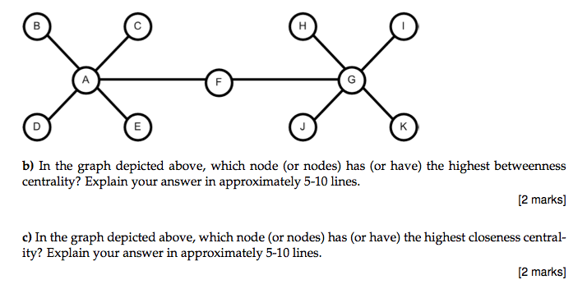
Network of Data – Questions

Slide 33
Network of Data – Summary
Basic Construct of Graph
Various measures of centrality
Calculation of the measures

