Slide 1
Representing data: XML
INFO20002: Foundations of Informatics
16th March 2015

Slide 2
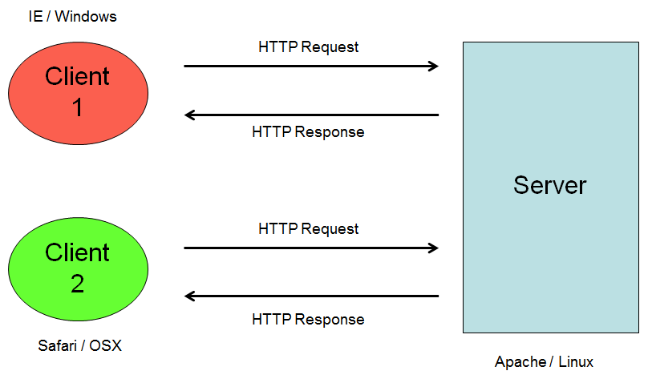
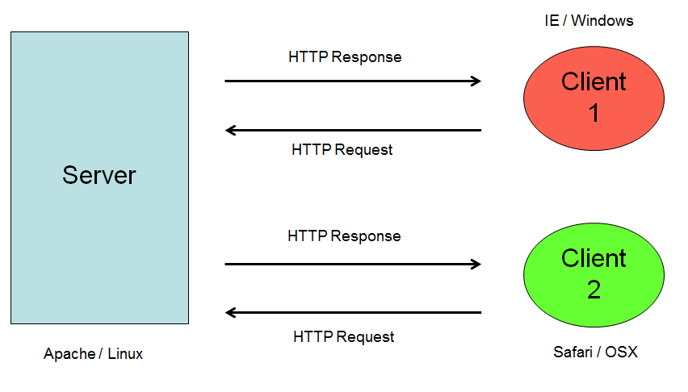
Connecting the Internet…
What is being transmitted?
Server
<!DOCTYPE HTML PUBLIC "-//IETF//DTD HTML 2.0//EN">
<html><head>
<title>302 Found</title>
</head><body>
<h1>Found</h1>
<p>The document has moved <a href="http://www.fairfax.com.au">here</a>.</p>
</body></html>
Client 1
Client 1

Slide 3
Limitations of HTML
HTML was not designed for current web activity
  video, music, ecommerce, PDAs, user-agents
  searching and reusing information
HTML is concerned with formatting not meaning
  it doesn’t matter what it is about, HTML will format it
HTML is not extensible
  can’t be modified to meet specific needs
  browsers have developed their own tags (<bgsound>, <layer>)
HTML can be inconsistently applied
  almost everything is rendered somehow
    e.g. <b>is this acceptable?</i>
HTML usage tends to be inconsistent with the standards

Slide 4
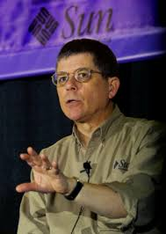

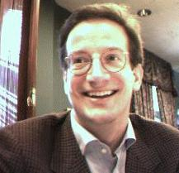
A new standard is born…
Standard Generalized Markup Language (SGML)
  Developed in the 80’s by Internet Pioneers
eXtensible Markup Language (XML)
  Developed in the mid 90’s by committee
“… the major design features were decided in a short burst of work in 1996…”
“… the designers never actually met face-to-face…”
Bosak, Bray, Clark et al

Slide 5




“Transcending politics…”
Bray had links to Netscape
  Microsoft cried foul and had a co-editor appointed
IBM were heavy users of XML
Microsoft “claimed” it…
  … as a response to the ubiquity of Java
But read a Sun Microsystems XML document of the period
  … and you would think it belonged to them…
“Transcends politics through sheer usefulness…”
  “Intro to XML”, Tim Anderson, 2004
  http://www.itwriting.com/xmlintro.php

Slide 6
eXtensible Markup Language
A ‘meta’ mark-up language
  used to create other mark up languages
Extensible
  user defined tags
Separates style and content
Supports internationalisation (Unicode)
Rigorous adherence to rules
Device and system independent
Both humans and machines can read it…

Slide 7
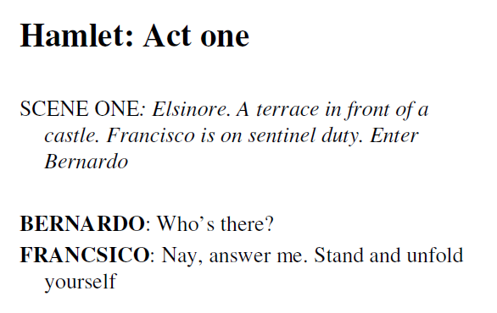
Hamlet in plain-text

Slide 8
Hamlet in HTML
<body>
<h1> Act One </h1>
<p>
<i> Scene One: Elsinore. A terrace in front of a castle.
Francisco is on sentinel duty. Enter Bernardo. </i>
</p>
<p>
<b> BERNARDO: </b> Who's there?
</p>
<p>
<b> FRANCISCO: </b> Nay, answer me: stand, and
unfold yourself
</p>
</body>

Slide 9
Hamlet in XML
<act>
<title> Act One </title>
<scene>
<title> Scene One </title>
<location> Elsinore. A terrace in front of a castle. </location>
<stagedir> Francisco is on sentinel duty. Enter Bernardo </stagedir>
<speech>
<speaker> BERNARDO </speaker>
<line> Who's there? </line>
</speech>
<speech>
<speaker> FRANCISCO </speaker>
<line> Nay, answer me: stand, and unfold yourself. </line>
</speech>
</scene >
</act>

Slide 10
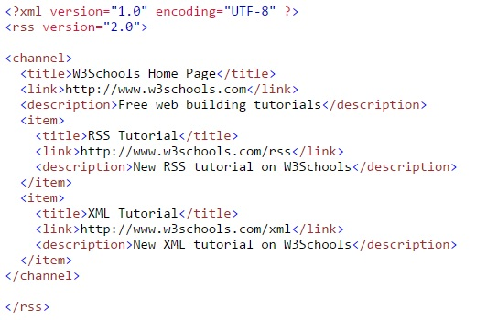
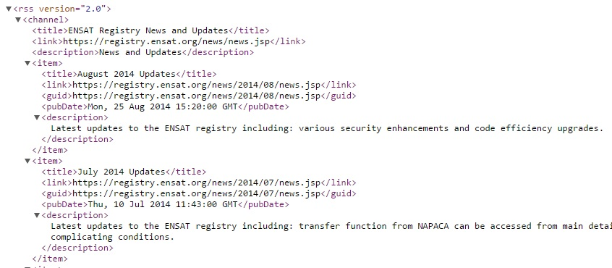
Website examples

Slide 11
XML Syntax Rules
xml files must begin with declaration
  <?xml version=“1.0”?>
xml files must have one single root element
  <catalog>...</catalog>
elements are built with tags, must be properly closed
  opening <firstname> and closing </firstname>
  empty <br />
an element may have one or more attributes, attributes must be in quotes
  <person title="Sir">Tony</person>
  <person title="Mr" sex="M">Ivo</person>

Slide 12
XML Syntax Rules
xml code is case sensitive
  <title> is not the same as as <Title>
elements must be appropriately nested
  <author><firstname>James</firstname></author>
  <author><firstname>James</author> </firstname>
    Wrong…
comments
  <!-- comments do not affect the document,
  it's not part of the data that you want to represent -->

Slide 13
XML Syntax Rules
some characters have special meaning
  < and & are strictly illegal inside an element
    <text>all books & videos are now < AUD 10</text>
      Wrong…
    <text>all books &amp; videos are now &lt; AUD 10</text>
CDATA (character data) section may be used inside XML element to include large blocks of text, which may contain these special characters such as &, >
  <![CDATA [ … … … ] ]>
  <![CDATA [all books & videos are now < AUD 10] ]>

Slide 14
XML Syntax Rules (example)
<?xml version="1.0"?>
<catalog>
  <book isbn="1-23456-789-0">
    <title>Beyond the Clouds</title>
    <author>
      <firstname>Rebecca</firstname>
      <surname>Skye</surname>
      <picture source="rebecca.jpg" />
    </author>
  </book>
  <book isbn="0-98765-432-1">
  <title>The Final Straw</title>
  <author>
    <firstname>James</firstname>
    <surname>Last</surname>
    <picture source="james.jpg" />
  </author>
  </book>
</catalog>
Declaration
One root element
Attributes in quotes
Empty tag
Opening/closing tags
Tags correctly nested
“WELL FORMED”

Slide 15
Data Example
Customer
Customer
Name: Adservices
Name: Mrs Jean Kaufman
Customer
Name: Mr David Lynn
CustID: Cust201
Type: home
Address: 211 Fox Street
Greenville, NH 80021
Phone: (315) 555-1812
E-mail: dlynn@nhs.net

Slide 16
XML Design
<?xml version=“1.0”?>
<customers>
<customer>
<name>David Lynn</name>
<address>211 Fox Street Greenville, NH 80021</address>
<phone>(315) 555-1812</phone>
<email>dlynn@nhs.net</email>
</customer>
</customers>

Slide 17
Document Type Definition (DTD)
<!ELEMENT customers (customer+)>
<!ELEMENT customer (name, address, phone, email)>
<!ELEMENT name (#PCDATA)>
<!ELEMENT address (#PCDATA)>
<!ELEMENT phone (#PCDATA)>
<!ELEMENT email (#PCDATA)>
DTD is a schema that creates a consistent data structure

Slide 18
Diagram of a DTD
customers
customer
name
address
phone
email
orders
order
orderDate
etc

Slide 19
Attribute or Element
DTD designers must choose
Attributes cannot contain elements
  elements can contain other elements
Attributes have no explicit structure
  ‘chapter’ cannot be an attribute of ‘book’
Attributes are used for small, simple, unstructured, “extra”/secondary information
Attributes can be specified only once and in any order
Attributes represent properties of objects
  Elements represent parts of objects

Slide 20
DTD Elements
<!ELEMENT element_name element_type symbol>
<!ELEMENT name (#PCDATA) >
<!ELEMENT order (orderDate, items) >
<!ELEMENT customer (name|company) >
<!ELEMENT order (orderDate, item+) >
<!ELEMENT img EMPTY >
<!ELEMENT customer ((name | company), phone*, email?)>

Slide 21
DTD Elements Rules
Element Type
(#PCDATA) | Parsed character (text) only
(child1, child2, child3, …) | Declare order of child elements
EMPTY | Element must be empty
(child1 | child2 | child3 |…) | Declare choice of child elements
ANY | Any type of content (no restrictions)
Symbol
? | Allow zero or one of the item
+ | Allow one or more of the item
* | Allow zero or more of the item

Slide 22
Mixed Content Model
<!ELEMENT parent (#PCDATA|child1|child2)* >
parent can contain any combination of zero or more #PCDATA, child1, and child2 elements
<!ELEMENT parent (child1|child2)+ >
parent can contain any combination of one or more child1, and child2 elements
Order of the children does not matter in mixed content model.

Slide 23
Declaring DTD Attributes
<!ATTLIST element attribute_name atttibute_type default>
<!ATTLIST customer custID ID #REQUIRED >
<!ATTLIST customer custType (home|business) #IMPLIED >
<!ATTLIST order orderBy IDREF #REQUIRED>
<!ATTLIST item itemPrice CDATA #REQUIRED >
<!ATTLIST item itemQty CDATA "1">

Slide 24
DTD Attribute Rules
Attribute Types
CDATA | Character data
(value1| value2 | …) | Allowed values (enumerated list)
ID | Used to create a unique identifier for an attribute
IDREF | Allows an attribute to reference the ID attribute from another element
NMTOKEN | A name token whose value is restricted to a valid XML name
ENTITY | A reference to an external file, usually one containing non-XML data

Slide 25
DTD Attribute Rules
Attribute default
#REQUIRED | The attribute must appear with every occurrence of the element
#IMPLIED | Attribute is optional
“default” | Attribute is optional, but if not specified, XML parser supplies default value
#FIXED “default” | Attribute is optional, but if value is specified it must match the default value

Slide 26
Entities
Entities are codes that refer to other data or objects
You have already encounter these in HTML
  &amp; used for &
  &lt; used for <
  &quot; used for "
General Entities are content that can be used within an XML document
  PARSED GENERAL ENTITY
    text that can be readily interpreted (or parsed) by an XML reader
  UNPARSED GENERAL ENTITY
    non-textual content (e.g. image) that cannot be interpreted by an XML parser
Entities are declared in the DTD
  <!ENTITY entity “value” >
Entities are used in the XML file
  &entity;
Entities are parsed (or interpreted) by XML readers (often browsers)

Slide 27
Entities (example)
Declared in the DTD:
  <!ENTITY DCT5Z “Digital Camera”>
Written in the XML file:
  <item itemPrice=“599.95”>&DCT5Z;</item>
Interpreted by the browser:
  <item itemPrice=“599.95”>Digital Camera</item>

Slide 28
Namespaces
Namespaces define collections of elements
Namespace declared as an attribute of element
  <customer xmlns:cust="http://mycompany.com/customer">
    "cust" is the prefix
      prefix is any string which is added to elements and attributes to associate them with a particular namespace
    "http://mycompany.com/customer" is the URI
      URI (Uniform Resource Identifier) is a string the uniquely identifies the name of the namespace.
More than one namespaces can be in a single element
Namespaces normally declared in the root element
  available for all children of the root

Slide 29
Namespaces
URI (Uniform Resource Identifier)
  URIs in namespaces look like a web address
    They are not!
  The purpose of URI is to be unique identifies
    URL are often chosen because they tend to 'belong' to the organisation it doesn't necessarily point to a page
Using namespaces
  a qualified name has a namespace prefix
  an unqualified name doesn't

Slide 30
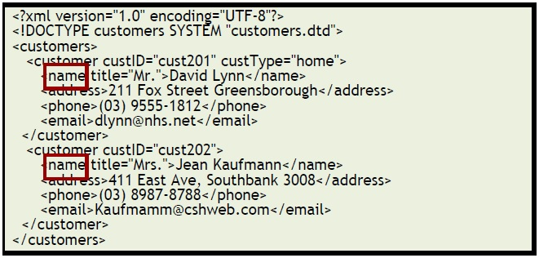
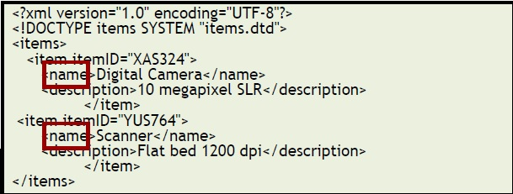
Namespaces (examples)

Slide 31
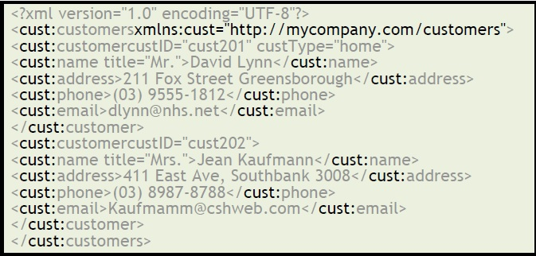
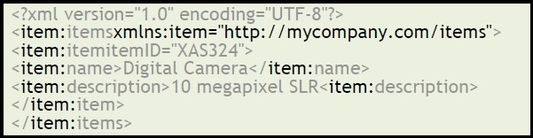
Apply namespace prefix to XML instance

Slide 32
Validation
An XML instance file is valid if it is consistent with a particular Schema
Validation Tools
  local XML editors (XMLWriter, Editix, Liquid XML … )
  online validators: http://validator.w3.org/ or http://www.validome.org/xml/ for files with internal DTDs (or schemas that at publically available
  lxml (python library)
Note: an XML file can be well-formed and NOT valid

Slide 33
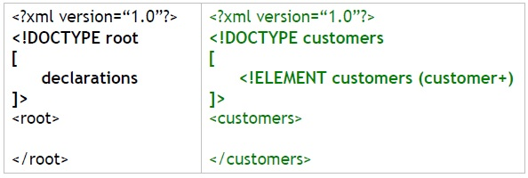
Declaring DTD in XML file
Internal
External
  SYSTEM – specifies location of an external DTD
    <!DOCTYPE root SYSTEM “uri” >
      e.g. <!DOCTYPE customers SYSTEM “customers.dtd” >
  PUBLIC – where DTD appears in publicly available location
    <!DOCTYPE root PUBLIC “id” “uri” >
      e.g. <!DOCTYPE html PUBLIC "-//W3C//DTD XHTML 1.0 Strict//EN“ "http://www.w3.org/TR/xhtml1/DTD/xhtml1-strict.dtd">
Attaching DTD to an XML file does NOT mean that the XML data will be validated. The decision to validate the XML depends on the XML reader.

Slide 34
Using XML (Python)
lxml library is your friend…
  http://lxml.de/
Import the XML file into your program as a tree structure:
import xml.etree.ElementTree as ET
tree = ET.parse(‘yourfile.xml')
root = tree.getroot()
Then loop through root with the various methods available:
for child in root:
print child.tag, child.attrib

Slide 35
Using XML (Programming interfaces)
Document Object Model (DOM)
  Most useful way of parsing XML
  Parsing calls load the document into a tree structure with different nodes that can be navigated by the program
Simple API for XML (SAX)
  Stream-based way of reading XML
  Fast and efficient if you don’t need random-access

Slide 36
Criticisms
XML is verbose and overly complex
  Therefore it has a large overhead
XML is strictly hierarchical
  Therefore some structures are difficult to model
  Such as relational information
    Explore this in more detail in the next lecture
XML is losing ground in recent years because of the above…
  But these approaches ebb and flow with fashion
    We’ll look at another alternative (JSON) tomorrow

Slide 37
Connecting the Internet…
HTTP (carrying an XML payload…)
Server
<?xml version="1.0"?>
<catalog>
<book isbn="1-23456-789-0">
<title>Beyond the Clouds</title>
<author>
<firstname>Rebecca</firstname>
<surname>Skye</surname>
<picture source="rebecca.jpg" />
</author>
</book>
</catalog>
Client 1
Client 1

Slide 38


© Copyright The University of Melbourne 2014

