Slide 1
CSE 433S: Introduction to Computer Security
Block Cipher
Notes:
High level lesson plan
Quizz – 20 mins
What is block cipher
Abstractions
Design principles
DES/AES
One time key, many time key
Modes of operations

Slide 2
Previously in CSE 433 – Classic and Stream Cipher
Caesar Cipher, Substitution Cipher
Frequency attack
Rotor Machine, Egnima Machine
XOR with uniform random variable
Perfect Secrecy - One time pad
Attack on Stream Cipher
Two time pad
Integrity attack

Slide 3
Quiz Questions
Cryptography is all about the algorithm, therefore, as long as we use the right cryptographic tool, and random keys, the system is secure.
What is the key space of substitution cipher for English alphabet, how would you crack this?
What is the intuitive idea / formal definition of Shanon’s idea of perfect secrecy?
What is OTP, what’s its limitation, and what mathematical property gives it perfect secrecy intuitive?
What is the definition of semantic security? Why is it a weaker notion of perfect secrecy?
Can stream cipher have perfect secrecy?
Name two attacks against stream cipher? What can an adversary achieve with these two attacks?

Slide 4
Block ciphers: crypto work horse
n bits
n bits
E, D
PT Block
CT Block
Key
k bits
Canonical examples:
3DES: n= 64 bits, k = 168 bits
AES: n=128 bits, k = 128, 192, 256 bits
Notes:
E and D are encryption algorithms,
Takes a key of k bits.
The unique aspect of block cipher is that it takes n bit block and output an n bit block
The longer the key, presumably the more secure it is going to be

Slide 5
Block Ciphers Built by Iteration
key k
key expansion
k₁
k₂
k₃
k_{n}
m
R(k₁, ⋅)
R(k₂, ⋅)
R(k₃, ⋅)
R(k_{n}, ⋅)
c
R(k,m) is called a round function
for 3DES (n=48), for AES-128 (n=10)
Notes:
The general construction of block cipher is to use something called the key expansion function to expand the key to n round keys,
then the round function is then applied to the message, with the round key

Slide 6
Performance: Crypto++ 5.6.0 [ Wei Dai ]
AMD Opteron, 2.2 GHz ( Linux)
Cipher Block/key size Speed (MB/sec)
RC4 126
Salsa20/12 643
Sosemanuk 727
3DES 64/168 13
AES-128 128/128 109
stream
block
Notes:
Block ciphers are considerably slower than stream cipher
In that case, why not just use all stream cipher, as a matter of fact, as we will show later, there are things we can do with block cipher that is hard to accomplish using stream cipher, such as parallizable. RC4 is sequential.

Slide 7
When and how do we use block ciphers? And how to use it correctly.
Notes:
Now let’s jump out a bit and think about how we can analyze it using abstractions

Slide 8
Pseudo Random Function
Pseudo Random Function (PRF) defined over (K,X,Y):
F: K × X → Y
such that exists “efficient” algorithm to evaluate F(k,x)
Notes:
In order for us to discuss how we can use block cipher correctly, we need to look at the abstraction of this functionality first.
Then we can argue what construction are correct and what construction are incorrect.
An elegant abstraction of block cipher is called the pseudo random function (sometimes called pseudo random permutation)

Slide 9
Pseudo Random Permutation
Pseudo Random Permutation (PRP) defined over (K,X):
E: K × X → X
such that: 1. Exists “efficient” deterministic algorithm to evaluate E(k,x)
2. The function E( k, ⋅ ) is one-to-one
3. Exists “efficient” inversion algorithm D(k,y)
Notes:
PRP on the other hand, maps element back to the same field, therefore we don’t need Y, as in PRF
Since E is one to one, there is also an inversion function, which is often referred to as the decryption function in the context of cryptography, and we want this decryption algorithm to be efficient.
PRP captures accurately and sytatically what a block cipher is

Slide 10
Running example
Example PRPs: 3DES, AES, …
AES: K × X → X where K = X = {0,1}¹²⁸
3DES: K × X → X where X = {0,1}⁶⁴ , K = {0,1}¹⁶⁸
Functionally, any PRP is also a PRF.
A PRP is a PRF where X=Y and is efficiently invertible.
Notes:
It is efficiently invertible

Slide 11
Secure PRFs – Why block ciphers are secure
Let F: K × X → Y be a PRF
Funs[X,Y]: the set of all functions from X to Y
S_{F} = { F(k,⋅) s.t. k ∈ K } ⊆ Funs[X,Y]
Intuition: a PRF is secure if a random function in Funs[X,Y] is indistinguishable from a random function in S_{F}
Funs[X,Y]
S_{F}
Size |Y|^{|X|}
Size |K|
Notes:
We just show that the syntactic format of what a PRF and PRP is, now let’s look at semantically, what it means for PRF and PRP to be secure, and it turns out that it is equivalent to saying how block cipher is secure. And this is the reason why we were looking the abstraction so we can effectively argue if a block cipher is secure or not.
So for 128 bit AES, we are talking about 2^(128*2^128), for AES Sf has the size of 2^128,
More specifically the uniform distribution of SF is indistinguishable from the uniform distribution of Funcs

Slide 12
Secure PRFs
Intuition: a PRF is secure if a random function in Funs[X,Y] is indistinguishable from a random function in SF
f ← Funs[X,Y]
x ∈ X
???
f(x) or F(k,x) ?
k ← K
Notes:
Adversary is trying to distinguish the truly random function from a pseudo random function, we allow the adversary to interact with the box, where he is given either the top cloud with truly random function or the bottom cloud where it is the pseudo random function with key k
Each time the adversary can submit x, we can let her interact with the top one or the bottom one, we say it is secure if the attacker cannot distinguish the two
f is the truly random function

Slide 13
Secure PRPs - secure block cipher
Intuition: a PRP is secure if a random function in Perms[X] is indistinguishable from a random function in SF
π ← Perms[X]
x ∈ X
π(x) or E(k,x) ?
k ← K
???

Slide 14
Let F: K × X → {0,1}¹²⁸ be a secure PRF.
Is the following G a secure PRF?
G(k, x) =
0 ¹²⁸ if x=0
F(k,x) otherwise
No, it is easy to distinguish G from a random function
Yes, an attack on G would also break F
It depends on F
Notes:
All the adversary has to query is to query x=0
Answer is the first one

Slide 15
An easy application: PRF ⇒ PRG
Let F: K × {0,1}^{n} → {0,1}^{n} be a secure PRF.
Then the following G: K → {0,1}^{nt} is a secure PRG:
G(k) = F(k,0) ll F(k,1) ll ⋯ ll F(k,t-1)
Key property: parallelizable
Security from PRF property: F(k, ⋅) indistinguishable from random function f(⋅), therefore the output G(k) is also indistinguishable as well

Slide 16
Block Cipher – Design Principles

Slide 17
General Design Principles
Confusion - Relationship between plain & cipher text is obscured.
Ex. Substitution table
Diffusion – the influence of each plaintext bit is spread over many cipher text (avalanche effect)
Ex permutation, let’s see a brief example
Non-linearity – resistant to linear cryptanalysis
Combine into multiple rounds

Slide 18
The Data Encryption Standard (DES)
Early 1970s: Horst Feistel designs Lucifer at IBM
key-len = 128 bits ; block-len = 128 bits
1973: NBS asks for block cipher proposals. IBM submits variant of Lucifer.
1976: NBS adopts DES as a federal standard
key-len = 56 bits ; block-len = 64 bits
1997: DES broken by exhaustive search
2000: NIST adopts Rijndael as AES to replace DES
Widely deployed in banking (ACH) and commerce
Notes:
Essentially, in the
early 1970s, IBM realized that their customers are demanding some form of
encryption. And so they formed a crypto group, and the head of that group, was
Horst Feistel, who, in the early 70s, designed a cipher called Lucifer.
1970 Gov finds itself buying a lot of commercial off the shelf computer
So in 1973 the National Bureau of Standards as it was called at the time put out a
request for proposals for a block cipher that is going to become a federal
standard.
NBS(National Bureau of Standard)
DES was very successful, In fact, there is a classical
network called the Electronic Clearinghouse, which banks use to clear
checks with one another. DES is used for integrity protection in that network.

Slide 19
DES: core idea – Feistel Network
Given functions f₁, …, f_{d}: {0,1}^{n} ⟶ {0,1}^{n}
Goal: build invertible function F: {0,1}^{2n} ⟶ {0,1}^{2n}
R₀
R₁
R₂
R_{d-1}
R_{d}
n-bits
f₁
f₂
⋯
f_{d}
L₀
L₁
L₂
L_{d-1}
L_{d}
n-bits
⊕
⊕
⊕
input
output
Notes:
Feistel network gets its name from Horst Feistel, the goal of feistel network is to contruct an invertible function using a set of arbitrary functions
f1 to fd. Can anyone tell me why reversible is an important property to have.

Slide 20
R₀
R₁
R₂
R_{d-1}
R_{d}
n-bits
f₁
f₂
⋯
f_{d}
L₀
L₁
L₂
L_{d-1}
L_{d}
n-bits
⊕
⊕
⊕
input
output
Claim: for all f₁, …, f_{d}: {0,1}^{n} ⟶ {0,1}^{n}
Feistel network F: {0,1}^{2n} ⟶ {0,1}^{2n} is invertible
Proof: construct inverse
R_{i-1}
R_{i}
R_{i-1} = L_{i}
L_{i-1} = f_{i}(L_{i}) ⨁ R_{i}
inverse
f_{i}
L_{i-1}
L_{i}
⊕

Slide 21
Decryption circuit
R_{d}
⊕
⊕
⊕
n-bits
R_{d-1}
R_{d-2}
R₁
R₀
⋯
f_{d}
f_{d-1}
f₁
L_{d}
L_{d-1}
L_{d-2}
L₁
L₀
n-bits
Inversion is basically the same circuit, with f₁, …, f_{d} applied in reverse order
General method for building invertible functions (block ciphers) from arbitrary functions.
Used in many block ciphers … but not AES
Notes:
Encryption hardware is the same as decryption hardware, the only difference is that the function are applied in reverse order

Slide 22
“Thm:” (Luby-Rackoff ‘85): Convert PRF to PRP
f: K × {0,1}^{n} ⟶ {0,1}^{n} a secure PRF
⇒ 3-round Feistel F: K³ × {0,1}^{2n} ⟶ {0,1}^{2n} a secure PRP
R₀
R₁
R₂
R₃
f
f
f
L₀
L₁
L₂
L₃
⊕
⊕
⊕
input
output
Notes:
Very important that the keys need to be independent
Why 3 rounds: if you take a look at this closely, you will see that

Slide 23
DES: 16 round Feistel network
f₁, …, f₁₆: {0,1}³² ⟶ {0,1}³² , f_{i}(x) = F( k_{i}, x )
k
key expansion
⋯
k₁
k₂
k₁₆
16 round Feistel network
IP
IP⁻¹
64 bits
64 bits
input
To invert, use keys in reverse order
output
Notes:
All f in the round function are derived from the same function F, where k is the round key

Slide 24
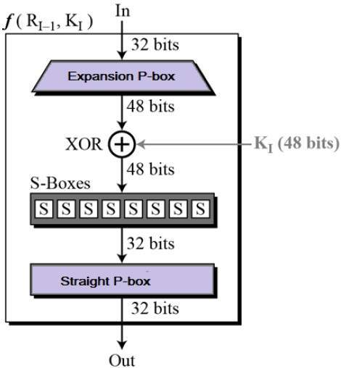
The function F(k_{i}, x)
Notes:
E box: bit 1 → bit 2 and 48, bit 2 → bit 3
P Box: bit 1 → bit 9, bit 2 → bit 15
The key of the slide is to introduce the round function process and also to show that the nonlinear process of using the S-box to translate from 6 bit 4 bit

Slide 25
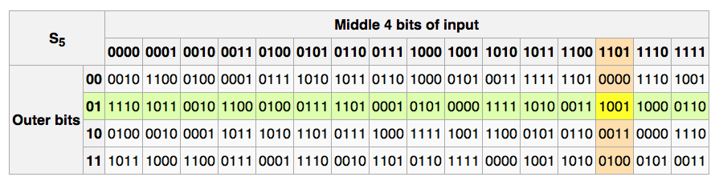
The S-boxes
S_{i}: {0,1}⁶ ⟶ {0,1}⁴

Slide 26
Example: a bad S-box choice
Suppose:
S_{i}(x₁, x₂, …, x₆) = ( x₂⨁x₃, x₁⨁x₄⨁x₅, x₁⨁x₆, x₂⨁x₃⨁x₆ )
or written equivalently: S_{i}(x) = A_{i}⋅x (mod 2)
We say that S_{i} is a linear function.
0 1 1 0 0 0
1 0 0 1 1 0
1 0 0 0 0 1
0 1 1 0 0 1
x₁
x₂
x₃
x₄
x₅
x₆
x₂⨁x₃
x₁⨁x₄⨁x₅
x₁⨁x₆
x₂⨁x₃⨁x₆
.
=
Notes:
We have six bits input, and the output is 6 bits.
Another way to express this is in matrix

Slide 27
Choosing the S-boxes and P-box
Choosing the S-boxes and P-box at random would result in an insecure block cipher (key recovery after ≈2²⁴ outputs) [BS’89]
Several rules used in choice of S and P boxes:
No output bit should be close to a linear func. of the input bits
⋮
Notes:
We want s box to be linear, but often times it is difficult

Slide 28
DES challenge
msg = “The unknown messages is: XXXX … “
CT = c₁ c₂ c₃ c₄
Goal: find k ∈ {0,1}⁵⁶ s.t. DES(k, m_{i}) = c_{i} for i=1,2,3
1997: Internet search -- 3 months
1998: EFF machine (deep crack) -- 3 days (250K $)
1999: combined search -- 22 hours
2006: COPACOBANA (120 FPGAs) -- 7 days (10K $)
⇒ 56-bit ciphers should not be used !!
Notes:
Distributed .net

Slide 29
Strengthening DES against ex. search
Method 1: Triple-DES
Let E : K × M ⟶ M be a block cipher
Define 3E: K³ × M ⟶ M as
For 3DES: key-size = 3×56 = 168 bits. 3×slower than DES.
(simple attack in time ≈2¹¹⁸ )
3E( (k₁,k₂,k₃), m) = E(k₁ D(k_{2 ,}E(k_{3 ,}m)))
Notes:
E(D(E( - it is a hack for backwars compatible

Slide 30
The AES process
1997: NIST publishes request for proposal
1998: 15 submissions. Five claimed attacks.
1999: NIST chooses 5 finalists
2000: NIST chooses Rijndael as AES (designed in Belgium)
Key sizes: 128, 192, 256 bits. Block size: 128 bits

Slide 31
AES is a Subs-Perm network (not Feistel)
k₁
k₂
k_{n}
S₁
S₁
S₁
S₂
S₂
S₂
S₃
S₃
S₃
⋯
⨁
input
⨁
output
⨁
⋯
⋯
⋯
S₈
S₈
S₈
subs.
layer
perm.
layer
inversion
Notes:
Substitution and permutation network

Slide 32
AES-128 schematic
10 rounds
4
ByteSub
ShiftRow
MixColumn
ByteSub
ShiftRow
MixColumn
ByteSub
ShiftRow
input
⋯
4
⨁
⨁
⨁
⨁
k₀
invertible
k₁
k₂
k₉
⨁
k₁₀
key
output
4
key expansion:
16 bytes
16 bytes ⟶176 bytes
4

Slide 33
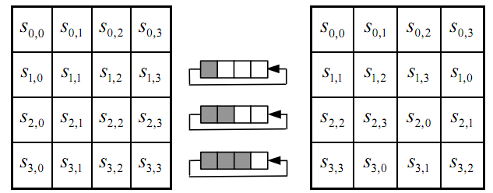
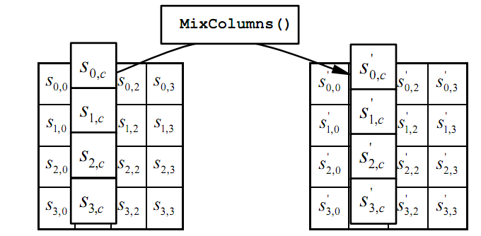
The round function
ByteSub: a 1 byte S-box. 256 byte table [4 x 4 table], input is used as index
ShiftRows:
MixColumns:
Notes:
S-box is easily computable with little code.
The first step basically use the input as row and column index for the s box, and outputs the s box
All three steps can be combined and accelerated with pre-computed tables.

Slide 34
Code size/performance tradeoff
 | Code size | Performance
Pre-compute round functions (24KB or 4KB) | largest | fastest: table lookups and xors
Pre-compute S-box only (256 bytes) | smaller | slower
No pre-computation | smallest | slowest
Notes:
Turns out that s box are precomputable, depending on your trade off on performance, the implementation of AES can be small or large

Slide 35
AES in hardware
AES instructions in Intel Westmere:
aesenc, aesenclast: do one round of AES
128-bit registers: xmm1=state, xmm2=round key
aesenc xmm1, xmm2 ; puts result in xmm1
aeskeygenassist: performs AES key expansion
Claim 14 x speed-up over OpenSSL on same hardware
Similar instructions on AMD Bulldozer
Notes:
To implement AES called aesenc 9 times and then call aesenclast.

Slide 36
Attacks
Best key recovery attack: four times better than ex. search [BKR’11]
Related key attack on AES-256: [BK’09]
Given 2⁹⁹ inp/out pairs from four related keys in AES-256, can recover keys in time ≈ 2⁹⁹
Also many side channel attacks
Notes:
Related keys means hamming distance is very close.

Slide 37
Summary
Design principles of block cipher
Confusion
Diffusion
Non-linear
Multiple rounds
Luby-Rackoff, Feistel Network generating PRP from PRF
Overview of DES, AES
Attacks
Exhaustive search, meet in the middle, linear and differential cryptanalysis, side channel attack

Slide 38
Block Cipher - Modes of Operation

Slide 39
How do we encrypt very long messages, using AES and DES?

Slide 40
Let’s forget about how DES and AES work, but think about a block cipher as any generic PRP

Slide 41
Using PRPs and PRFs
Goal: build “secure” encryption from a secure PRP (e.g. AES).
This segment: one-time keys
Adversary’s power:
Adv sees only one ciphertext (one-time key)
Adversary’s goal:
Learn info about PT from CT (semantic security)
There is also many-time keys (a.k.a chosen-plaintext security)
Notes:
Today: we build ciphers that are semantically secure against one-time use
And ciphers that are semantically secure against many-time use
One time key means adversary will only see one ciphertext encrypted using the same key

Slide 42
Semantic Security Model for one time key (one-time key)
EXP(0):
Chal.
m₀ , m₁ ∈ M : |m₀| = |m₁|
Adv. A
k←K
c ← E(k,m₀)
b’ ∈ {0,1}
one time key ⇒ adversary sees only one ciphertext
Chal.
m₀ , m₁ ∈ M : |m₀| = |m₁|
Adv. A
EXP(1):
k←K
c ← E(k,m₁)
b’ ∈ {0,1}
Adv_{SS}[A,OTP] = | Pr[ EXP(0)=1 ] − Pr[ EXP(1)=1 ] | should be “neg.”

Slide 43
Incorrect use of a PRP
Electronic Code Book (ECB):
Problem:
if m₁=m₂ then c₁=c₂
PT:
m₁
m₂
CT:
c₁
c₂
Notes:
Just to give you a bit of concrete example

Slide 44
Is it secure ?

Slide 45
ECB is not Semantically Secure
ECB is not semantically secure for messages that contain more than one block.
b∈{0,1}
Two blocks
m₀ = “Hello World”
m₁ = “Hello Hello”
Chal.
Adv. A
k←K
(c₁,c₂) ← E(k, m_{b})
If c₁=c₂ output 0, else output 1
Then Adv_{SS} [A, ECB] = 1
Notes:
One way to accomplish this is to use deterministric counter mode, where you generate random number with F(k,0) | F(k,1) …..

Slide 46
Semantic Security for many-time key
Key used more than once
⇒ adv. sees many CTs with same key
Adversary’s power: chosen-plaintext attack (CPA)
Can obtain the encryption of arbitrary messages of his choice (conservative modeling of real life)
Adversary’s goal: Break sematic security
Notes:
For example, alice might send adversary an email. Alice will then encrypt the email to save on disk.

Slide 47
Semantic Security for many-time key (CPA security)
E = (E,D) a cipher defined over (K,M,C). For b=0,1 define EXP(b) as:
Def: E is sem. sec. under CPA if for all “efficient” A: Adv_{CPA} [A,E] = |Pr[EXP(0)=1] – Pr[EXP(1)=1] | is “negligible.”
b
for i=1,…,q:
Chal.
Adv.
k←K
m_{i,0} , m_{i,1} ∈ M : |m_{i,0}| = |m_{i,1}|
c_{i} ← E(k, m_{i,b})
b’ ∈ {0,1}
if adv. wants c = E(k, m) it queries with m_{j,0}= m_{j,1}=m
Notes:
Challenger choose random key K, adversary can query challenger
Adversary can submit the two messages, the adversary then receives either m0 or m1. he need to determine if the ciphertext he received is m0 or m1
In experiment 0, EXP(0), he receives the encryption of m0 and in experiment 1, EXP(0) he receives the encryption of m1
The goal of the adversary is to figure out whether he is in Experiment 0 or experiment 1,
In each round, the adversary can keep on submitting new messages, until he figures out whether he is in Exp(0) or Exp(1)
What the adversary can do is to submit m0 = m1 = m, then he knows the encryption of m

Slide 48
Ciphers insecure under CPA
Suppose E(k,m) always outputs same ciphertext for msg m. Then:
So what? For example, An attacker can learn that two encrypted files are the same, two encrypted packets are the same, etc.
Leads to significant attacks when message space M is small
Chal.
m₀ , m₀ ∈ M
Adv.
c₀ ←E(k, m₀)
k←K
m₀ , m₁ ∈ M
c ← E(k, m_{b})
output 0
if c = c₀
Notes:
Stream ciphers like RC4, DETCTR are not CPA secure
Think about phone where when nobody is talking, it is always the same.

Slide 49
Ciphers insecure under CPA
Suppose E(k,m) always outputs same ciphertext for msg m. Then:
If secret key is to be used multiple times ⇒
given the same plaintext message twice, encryption must produce different outputs.
Chal.
m₀ , m₀ ∈ M
Adv.
c₀ ←E(k, m₀)
k←K
m₀ , m₁ ∈ M
c ← E(k, m_{b})
output 0
if c = c₀
Notes:
Stream ciphers like RC4, DETCTR are not CPA secure

Slide 50
Solution 1: randomized encryption
E(k,m) is a randomized algorithm:
⇒ encrypting same msg twice gives different ciphertexts (whp)
⇒ ciphertext must be longer than plaintext
Roughly speaking: CT-size = PT-size + “# random bits”
enc
m₀
dec
m₀
m₁
m₁
Notes:
Draw picture where two messages map to two disjoint ciphertext clouds. Each cloud maps to original message.
Encrypting same message twice results in different ciphertexts.
One also need to consider the additional overhead. Of using this random number, especially when the size of plaintext is small.

Slide 51
Solution 2: nonce-based Encryption
nonce
Alice
Bob
m, n
E
E(k,m,n)=c
c, n
D
D(k,c,n)=m
k
k
nonce n: a value that changes from msg to msg.
(k,n) pair never used more than once
method 1: nonce is a counter (e.g. packet counter)
used when encryptor keeps state from msg to msg
if decryptor has same state, need not send nonce with CT
method 2: encryptor chooses a random nonce, n ← N
Essentially it is randomized encryption
Notes:
Nounce just has to be a unique value, does not have to be random
File encryption: random nonce, no state from file to file
SSL encrytpion (in order delivery): counter is fine, no need to send nonce to peer.
IP sec (out of order delivery): counter is fine, but need to include nonce in every packet.
Nounce is very nice, because Decryptor does not need to receive the state from the server
Method 2 is particularly useful when you don’t want to maintain this state, in this case, when you pick randomly from a large nounce space, the probability of having using the same nonce is small

Slide 52
CPA security for nonce-based encryption
System should be secure when nonces are chosen adversarially.
Def: nonce-based E is sem. sec. under CPA if for all “efficient” A: Adv_{nCPA} [A,E] = |Pr[EXP(0)=1] – Pr[EXP(1)=1] | is “negligible.”
b
for i=1,…,q:
Chal.
Adv.
n_{i} and m_{i,0} , m_{i,1} : |m_{i,0}| = |m_{i,1}|
k←K
c ← E(k, m_{i,b} , n_{i})
b’ ∈ {0,1}
All nonces {n₁, …, n_{q}} must be distinct.
Notes:
Same as before, but he has the power to give the nonce

Slide 53
Take another step back, and think about how to implement the ideas we talk about, nonce based encryption or randomized encryption

Slide 54
Construction 1: CBC with random IV
Let (E,D) be a PRP. E_{CBC}(k,m): choose random IV∈X and do:
IV
m[0]
m[1]
m[2]
m[3]
⊕
⊕
⊕
⊕
E(k,⋅)
E(k,⋅)
E(k,⋅)
E(k,⋅)
IV
c[0]
c[1]
c[2]
c[3]
ciphertext
Notes:
Cipher block training, IV has to be 16 bytes for AES, it has to be the same size of block size for this particular construction
IV stands for initialization vector, and you can see with the addition of IV, now the ciphertext is much longer
Unlike ECB, same block in different positions gets mapped to different ciphertexts.

Slide 55
Decryption circuit
In symbols: c[0] = E(k, IV⨁m[0] ) ⇒ m[0] = D(k, c[0]) ⨁ IV
IV
c[0]
c[1]
c[2]
c[3]
D(k,⋅)
D(k,⋅)
D(k,⋅)
D(k,⋅)
⊕
⊕
⊕
⊕
m[0]
m[1]
m[2]
m[3]

Slide 56
Warning: an attack on CBC with rand. IV
CBC where attacker can predict the IV is not CPA-secure !!
Suppose given c ⟵ E_{CBC}(k,m) can predict IV for next message
0 ∈ X
Chal.
c₁ ← [ IV₁, E(k, 0⨁IV₁) ]
Adv.
k←K
predict IV
m₀=IV⨁IV₁ , m₁ ≠ m₀
c ← [ IV, E(k, IV₁) ] or
output 0
if c[1] = c₁[1]
c ← [ IV, E(k, m₁⨁IV) ]
Bug in SSL/TLS 1.0: IV for record #i is last CT block of record #(i-1)
Notes:
Recall that the game happens in the following, challenger picks key k from key space K,
Adversary can choose two messages, and deliver that to the challenger,
She would be given back a c, and in order to be semantically secure, his advantage of distinguishing E(m0) and E(m1) should be zero, i.e. he has absolutely no clue if this is encryption of m0 and m1.
When the iv is preditable,
the attacker can first encrypt the next IV1, then we can submit IV xor IV1

Slide 57
An example Crypto API (OpenSSL)
void AES_cbc_encrypt(
const unsigned char *in,
unsigned char *out,
size_t length,
const AES_KEY *key,
unsigned char *ivec, ⟵ user supplies IV
AES_ENCRYPT or AES_DECRYPT);
When nonce is non random need to encrypt it before use

Slide 58
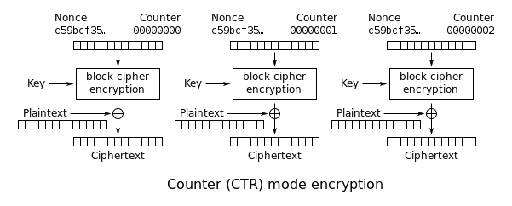
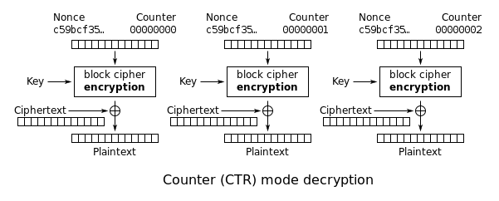
Couter Mode Summary

Slide 59
Comparison: CTR vs. CBC
 | CBC | CTR
uses | PRP | PRF
parallel processing | No | Yes
Security of rand. enc. | q^2 L^2 << |X| | q^2 L << |X|
dummy padding block | Yes | No
1 byte msgs (nonce-based) | 16x expansion | no expansion
(for CBC, dummy padding block can be solved using ciphertext stealing)

Slide 60
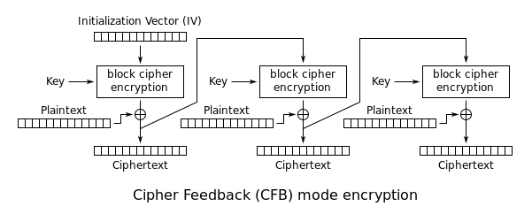
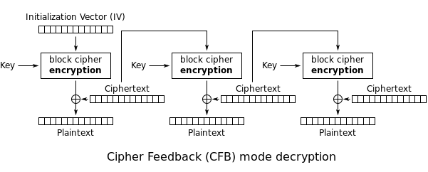
CFB Mode

Slide 61
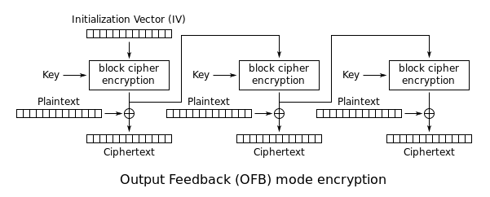
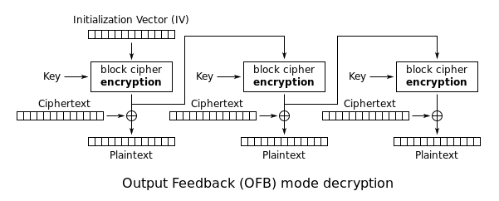
OFB

Slide 62
Summary
Design principles of block cipher
Techniques to prove semantic security of block cipher
Luby-Rackoff, Feistel Network generating PRP from PRF
One time key vs Many time key
Ciphertext only attack vs Chosen-plaintext attack
Randomized encryption vs counter-based encryption
Modes of operations – CBC, CTR, OFB, CFB
Padding, Predictable IV
For many time keys, randomized CBC or CTR is semantically secure

