Slide 1
Advice for Machine learning

Slide 2
PCD : dimension reduction
Virtualization

Slide 3
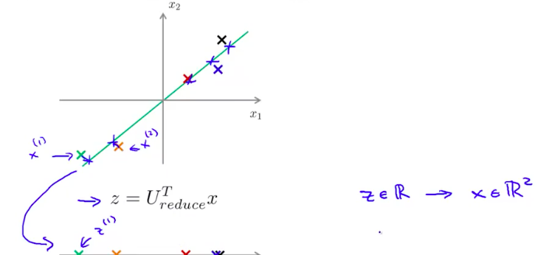
From 2-D to 1-D

Slide 4
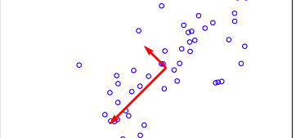
U1
U2

Slide 5
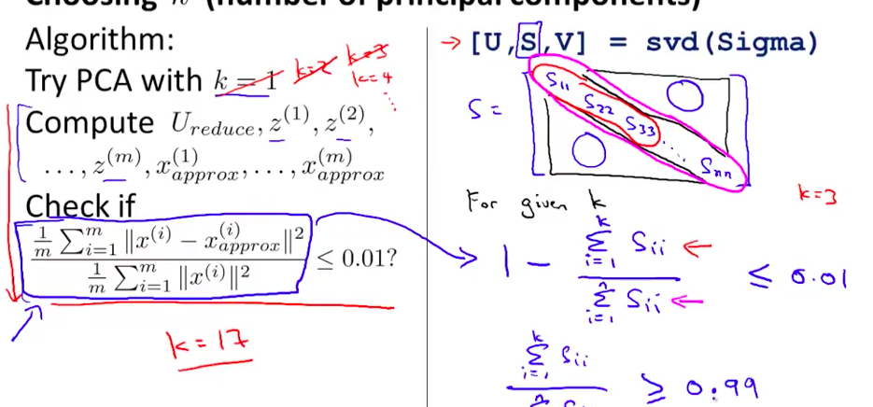
SVD

Slide 6
def PCD(self,X):
m,n = X.shape
U = np.zeros(n)
S = np.zeros(n)
sigma = (1.0/m)*(X.T).dot(X)
U,S,Vh = linalg.svd(sigma)
S = linalg.diagsvd(S,len(S),len(S))

Slide 7
def projectData(self,X,U,K):
Z = np.zeros((X.shape[0],K))
U_reduce = U[:,:K]
Z = X.dot(U_reduce)

Slide 8
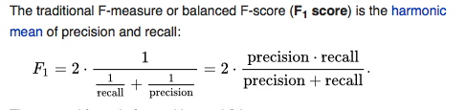
Method to judge algrothms

Slide 9
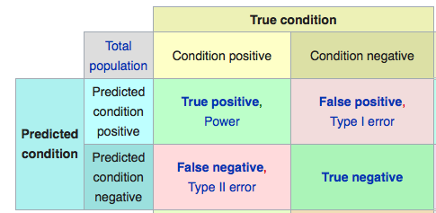
Precise = true positive /predicted condition positive
Recall = true positive /condition positive

Slide 10
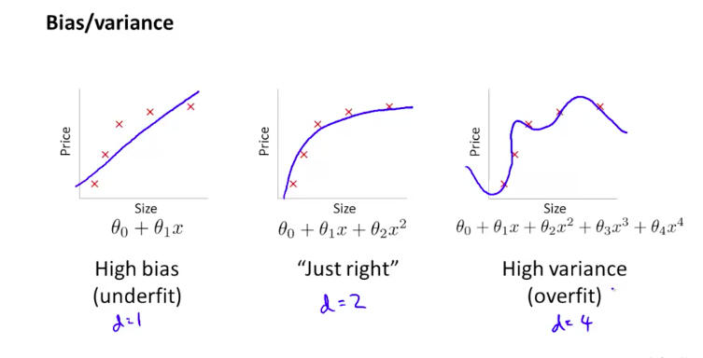
Bias vs Variance
Bias: underfitting
Variance : overfitting

Slide 11
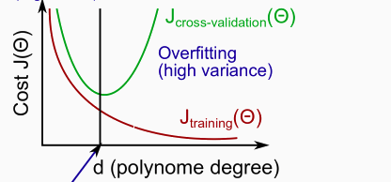
How to judge Bias VS Variance

Slide 12
How to reduce bias and variance
Reduce bias : add more parameters, layers
Reduce variance: add more data, regularization .

Slide 13
algorithm
ADM
Monte
Mini-batch

