Slide 1
Benchmarking Protein Structure Relaxation on BM5.5: AMBER vs Rosetta
Systematic comparison of relaxation protocols
across 257 protein-protein docking targets
257 targets · 110K+ measurements · 2 independent pipelines
Meiler Lab · Vanderbilt University
March 2026

Slide 2
Study Overview
Question: How do relaxation protocols affect predicted protein structures?
Prediction Methods:
AlphaFold2 (relaxed + unrelaxed outputs)
Boltz-1 (diffusion-based structure prediction)
Relaxation Methods:
AMBER (energy minimization, built into AF2)
Rosetta (6 protocols: 3 sampling × 2 energy functions)
Evaluation:
Global accuracy: TM-score, RMSD vs crystal
Local geometry: MolProbity (clashscore, rotamers, Ramachandran)

Slide 3
BM5.5 Benchmark Dataset
Dataset Scale:
257 protein-protein docking targets
605 chains, 122,966 residues
2 independent pipelines (Blue + Green)
Data Collected:
Pre-relaxation TM/RMSD: 12,065 measurements
MolProbity validation: 13,344 measurements
Rosetta TM-score: 257 targets (45K+ rows)
Rosetta MolProbity: 257 targets (56K+ rows)
Rosetta Protocol Matrix:
6 input types × 6 protocols × 5 replicates = 180 runs/target

Slide 4
Analysis Pipeline
Phase 1: Pre-relaxation accuracy (TM-score, RMSD)
→ AF2 vs Boltz-1 baseline comparison
Phase 2: Rosetta relaxation effect on TM-score
→ 6 protocols × 6 sources × 5 replicates
Phase 3: AMBER effect on MolProbity
→ 257 targets, both pipelines
Phase 4: Rosetta effect on MolProbity
→ The critical comparison: does Rosetta add value?
Phase 5: Statistical analysis
→ Wilcoxon, Friedman, Cliff's delta, Blue-Green reproducibility

Slide 5
AF2 vs Boltz-1 Comparison
Metric AF2 (relaxed) Boltz-1 Winner
─────────────────────────────────────────────────
TM-score 0.943 0.939 AF2 (54%)
Clashscore 2.82 15.09 AF2 (5× better)
Rama Favored % 96.99 98.38 Boltz
Rotamer Outliers % 0.89 0.23 Boltz (4× fewer)
MolProbity Score 0.70 1.16 AF2
After AMBER:
MP Score 0.70 0.45 AMBER(Boltz) wins!
Nuance: Boltz has better backbone but worse clashes.
AMBER fixes the clashes → AMBER(Boltz) = best local geometry.

Slide 6
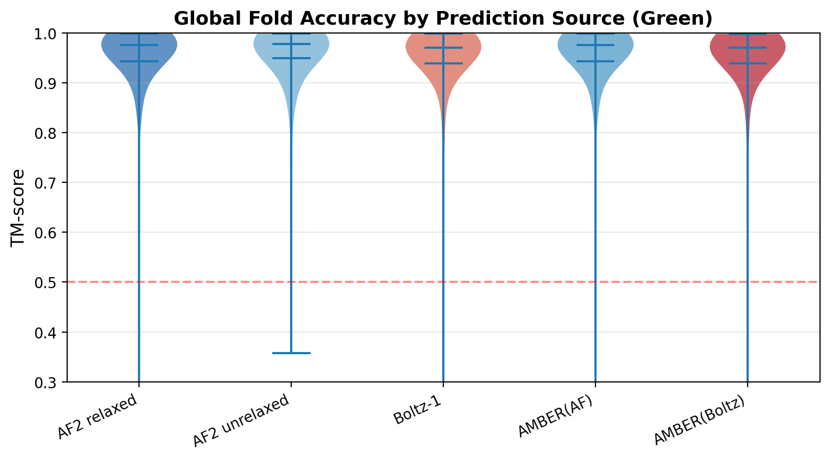
Global Fold Accuracy (Green)
Key Findings:
AF2 wins on TM-score (54% of targets)
AMBER has negligible effect on TM (d = -0.01)
3 catastrophic failures (TM < 0.5): all methods fail
High reproducibility: Blue-Green r = 0.997

Slide 7
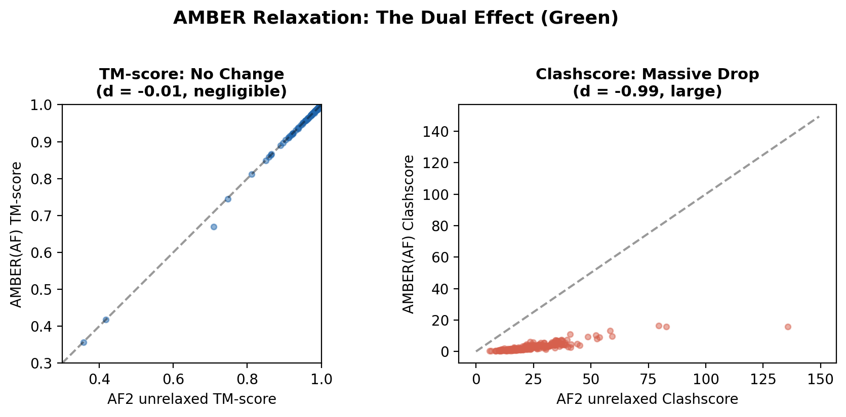
AMBER: The Dual Effect (Green)
AMBER simultaneously:
Has zero effect on fold accuracy
(TM d = -0.01, negligible)
Has massive effect on local geometry
(Clash d = -0.99, large)
This is a free lunch:
257/257 AF targets improved (100%)
256/257 Boltz targets improved (99.6%)

Slide 8
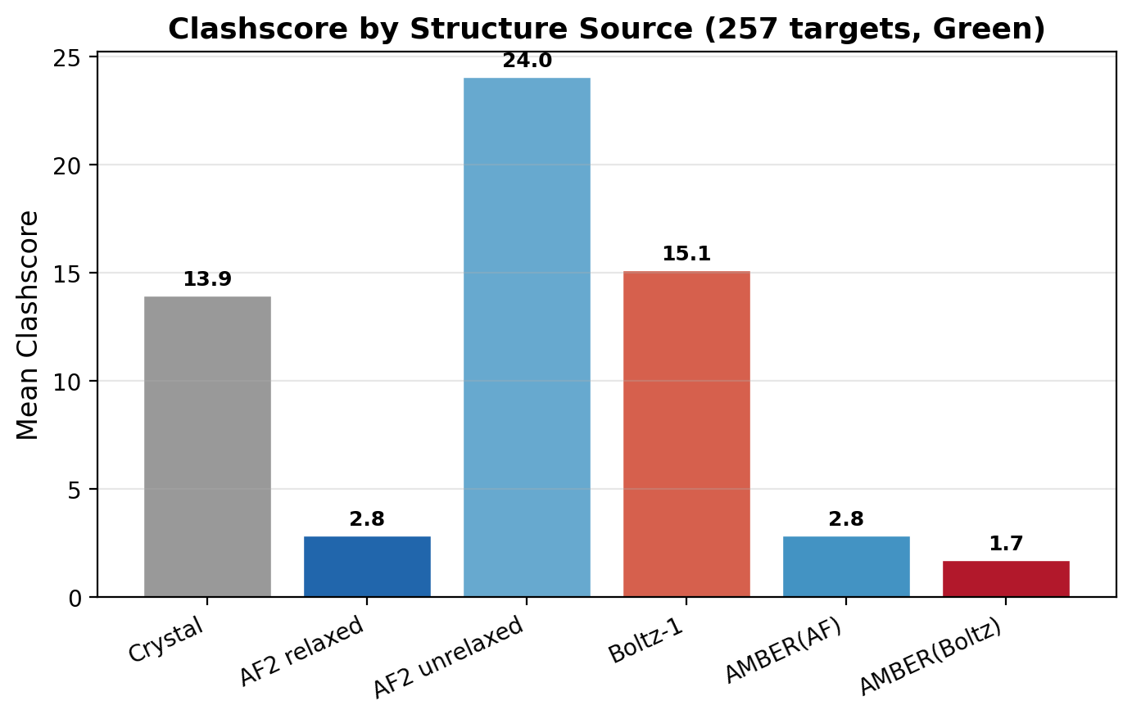
Crystal Structures Have the Worst MolProbity (Green)
Source Clash Rota% MP
──────────────────────────
Crystal 13.85 6.15 1.81
AF relaxed 2.82 0.89 0.70
AMBER(Boltz) 1.60 0.36 0.45
Crystal: 5× worse clashscore
7× more rota outliers
Predictions are computationally
idealized; crystal captures real
experimental constraints.

Slide 9
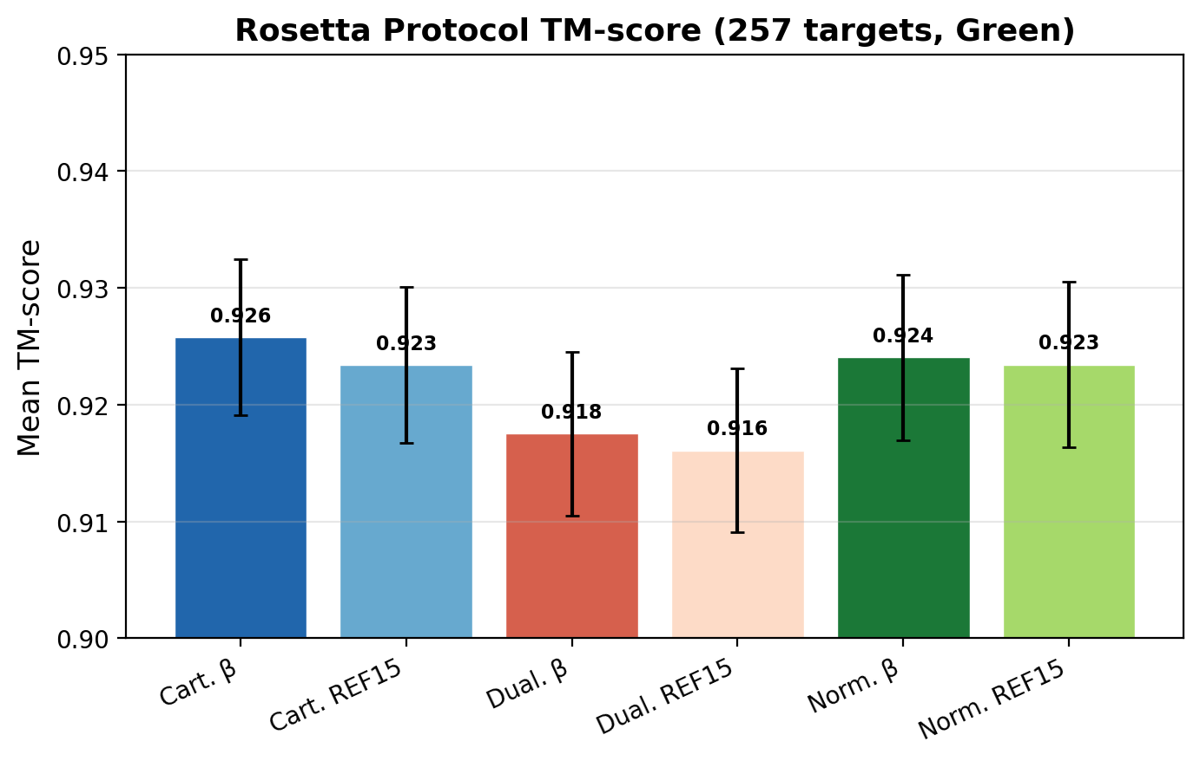
Rosetta Relaxation: TM-score Impact (Green)
All 6 protocols degrade TM-score:
ΔTM ≈ -0.019 (d = -0.36, medium)
2/110 targets improved
p < 1e-17
Protocol ranking:
Cart. β ≈ Norm. β (top tier)
Dual. protocols (bottom tier)
Blue-Green agreement: r = 0.99
5 replicates: 94% with σ < 0.01

Slide 10
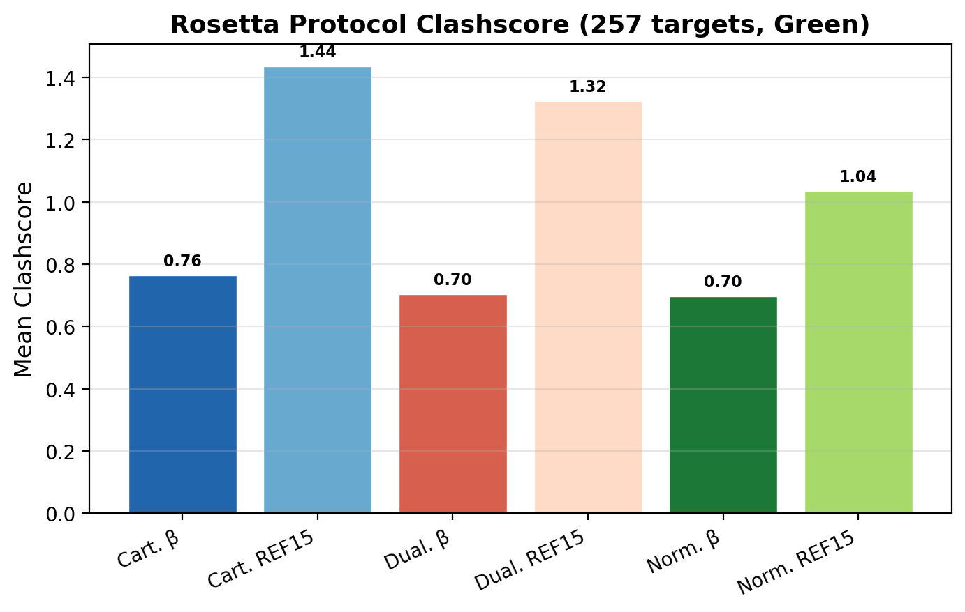
Rosetta MolProbity: The Key Finding (Green)
Rosetta dramatically improves
local geometry:
AF unr → Rosetta:
Clash: 22.9 → 1.0 (96% drop)
Boltz → Rosetta:
Clash: 12.5 → 0.9 (93% drop)
Rota outliers: 0.8% → 0.02%
Beta energy function is key:
β: 0.65-0.69 vs REF15: 1.0-1.4
Beta protocols win 96% of targets

Slide 11
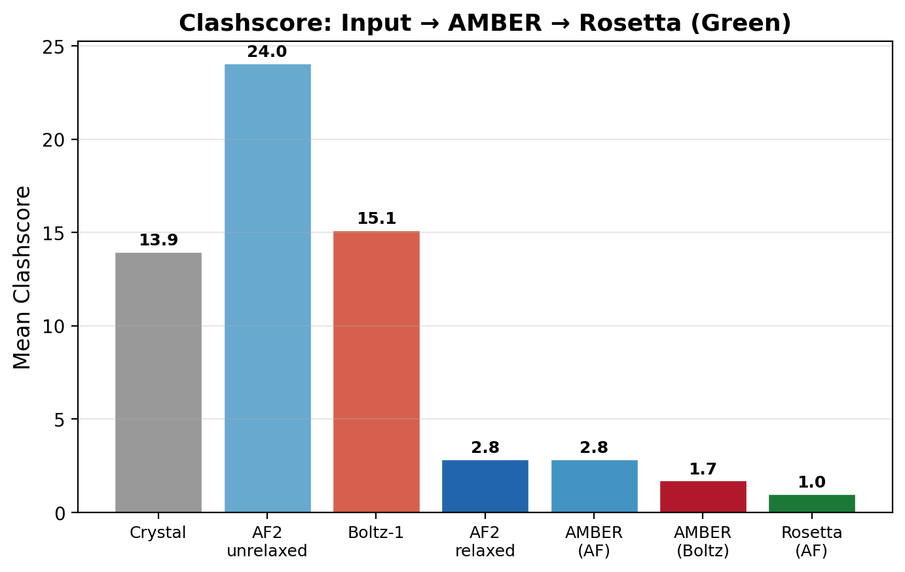
AMBER vs Rosetta: Direct Comparison (Green)
Rosetta beats AMBER (n=100):
Clashscore:
AMBER: 2.74 → Rosetta: 0.98
(64% better)
MP Score:
AMBER: 0.68 → Rosetta: 0.30
(56% better)
Rota Outliers:
AMBER: 0.86% → Rosetta: 0.02%
(virtually eliminated)

Slide 12
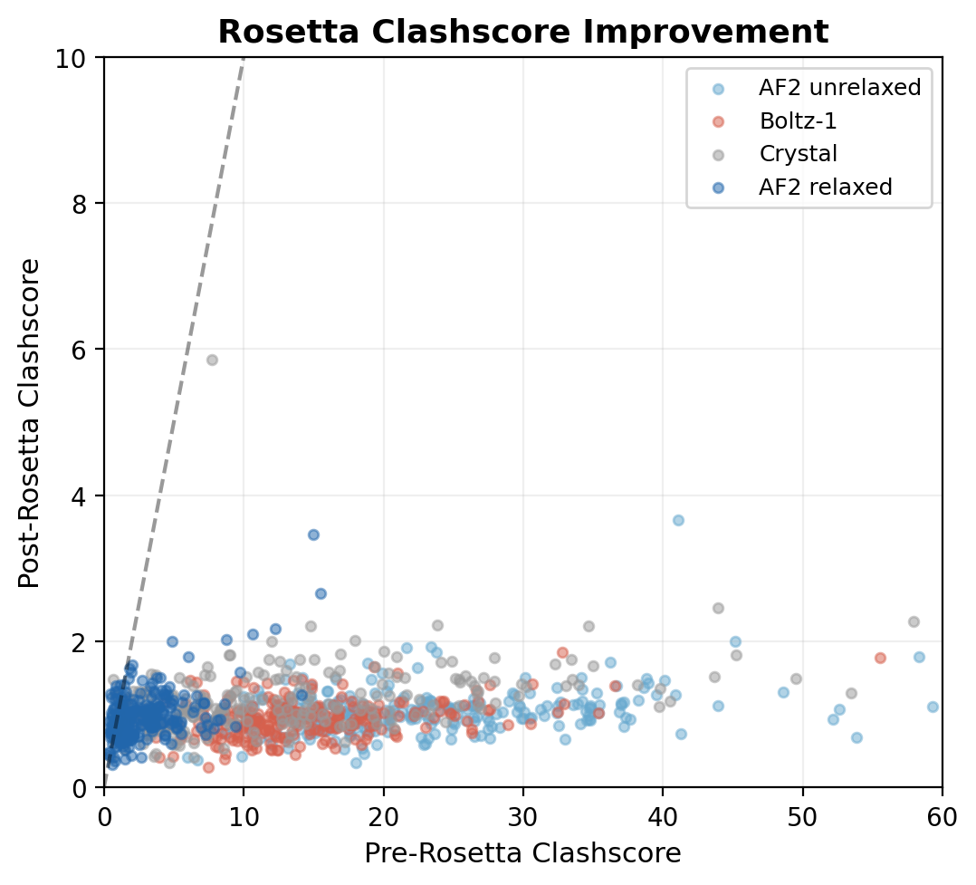
Rosetta Eliminates Steric Clashes (Green)
Every point below the
diagonal = improvement
All input types collapse
to clashscore ≈ 0.7-1.0
regardless of starting
clashscore (2-50+)
Rosetta energy function
naturally eliminates
steric clashes during
structure optimization.

Slide 13
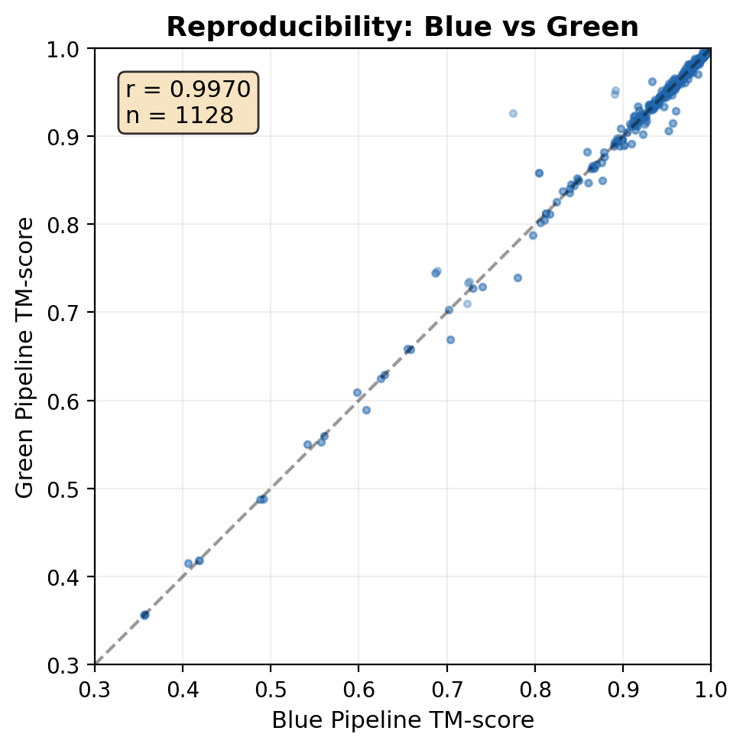
Reproducibility: Blue-Green Agreement
Two independent implementations
of the same protocol:
Metric Pearson r
───────────────────────
Pre-Rosetta TM 0.997
Pre-Rosetta RMSD 0.994
Rosetta TM 0.988-0.992
Clashscore 0.867-0.991
MP Score 0.941-0.984
The protocol specification
is unambiguous and results
are not implementation artifacts.

Slide 14
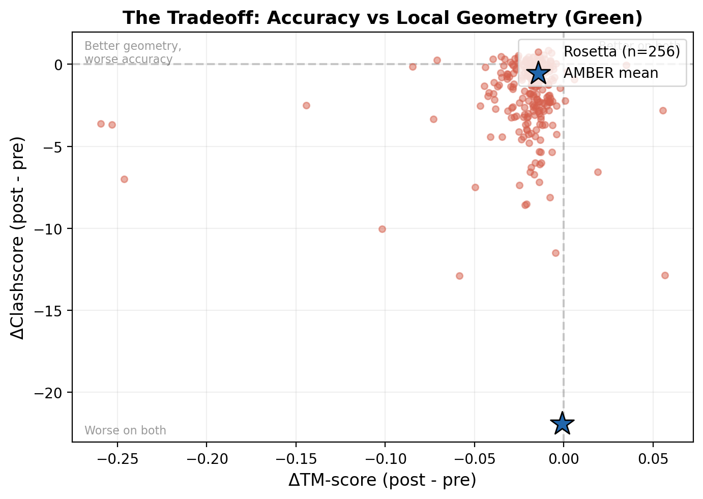
The Tradeoff: Accuracy vs Geometry (Green)
Each point = one target
AMBER (star):
TM: no change
Clash: big improvement
→ Free lunch
Rosetta (circles):
TM: small cost (~0.02)
Clash: even bigger gain
→ Worth it for docking,
MD, drug design

Slide 15
Conclusions
1. AMBER relaxation is a free lunch
→ Zero TM-score cost, massive MolProbity gain (d = -0.99)
→ Should be standard practice for ALL predictions
2. Rosetta relaxation improves MolProbity MORE than AMBER
→ Clashscore: 0.98 vs 2.74 (64% better than AMBER)
→ But at a TM-score cost of ~0.02
3. Beta energy function is the critical differentiator
→ β protocols: 0.65-0.69 clashscore vs REF15: 1.0-1.4
→ Recommended: cartesian_beta (best TM + near-best MP)
4. Crystal structures have worst local geometry
→ 5× worse clashscore than predictions
→ Expected: predictions are computationally idealized
5. Everything reproduces (Blue-Green r > 0.98)

Slide 16
Future Directions
Immediate:
Complete Rosetta processing (204/257 Blue, 257/257 Green done)
Final statistical analysis with full dataset
Manuscript preparation
Extensions:
Impact on downstream docking performance (HADDOCK, ClusPro)
Interface-specific relaxation effects
Newer prediction methods (AF3, Boltz-2, Chai-1)
Per-residue quality analysis at binding interfaces
Code & Data:
github.com/dreamlessx/Protein_Relax_Pipeline
Full analysis pipeline reproducible from raw PDBs
Questions?

