Slide 1

FLASK
Group E: Martin Alexander B00884229
Mingyuan Chen B01655222
Bangzhao Wang B01656211
Xinyi Lu B01657382

Slide 2
行业PPT模板http://www.1ppt.com/hangye/
1
Background
2
MVC&MTV Architecture
CONTENT
3
Jinja
4
Flask-SQLAlchemy

Slide 3
PART 01
Background

Slide 4
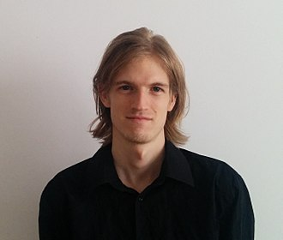
1
Background
Armin Ronacher
From April fools’ joke to a famous python framework
Notes:
creator of the Flask web framework for Python
In the first time, Flask is just a joke from Armin in April fools’day. He just simply packaged existing tools, like werkzeug and jinja and upload them online.
werkzeug is a packages including the funtions such as request, response or cookie， which we need in web development.
And jinja is a system for template. We have some data, how can we show them to users, jinja will help us build such a structure.
What make Armin suprised is many people like the package he uploaded. So he chose to make it become a real web framework. And that is flask.

Slide 5
The flexibility of Flask
Werkzeug
Jinja2
Flask
SQLalchemy
admin
....
Notes:
Compared with another famous python framework: Django, flask is small, and it is like a core with basic funtions. If you need any other functions, install the packages, for example, if you need something about database, install flask-SQLalchemy, or if you want to build a something for administrators, flask-admin can help you. Flask will be extended again and again with the development of project. It’s so flexible, That’s the advantage of flask. Also, it’s the disadvantage of flask. Yes, we can add the packages we like, But we don't know if these packages can work together or if they will conflict with each other. No one help us test it in advance. This is the reason why flask is not suitable for developing a epic website.

Slide 6

Other advatages
Open Source. In developer community, many people like flask are developing new tools for it and solving some problems.
Easy to Use: Flask is friendly to the beginner, it’s not so complex.
Notes:
Flask is open source, So more people can help the development of flask, also, You can get more help in the community.
It’s easy use and friendly to the beginner. it’s lightweight, it doesn't have many conplex rules for people who start to learn it. Also, with the help of virtual environment of python, it't not so hard for us to build the environment.

Slide 7
big company using Flask
Samsung
Netflix
Uber
a tech giant headquartered in Seoul, South Korea
a subscription-based online streaming platform that provides a large library of movies, TV shows, and documentaries.
a ride-sharing application that allows its users to book transportation services or food delivery.
Notes:
Companies using Flask
Samsung: They use Flask to provide their customers with a seamless UI for easy access to information about their products. Netflix: They use Flask within their source code for an easy-to-access API that handles large amounts of data and traffic.
Uber: It uses Flask for its rideshare Marketplace to facilitate dynamic pricing, intelligent matching of highly-rated drivers with highly-rated passengers, and smart supply positioning.

Slide 8
PART 02
Model-view-controller (MVC) & Model-template-view (MTV) Architecture

Slide 9
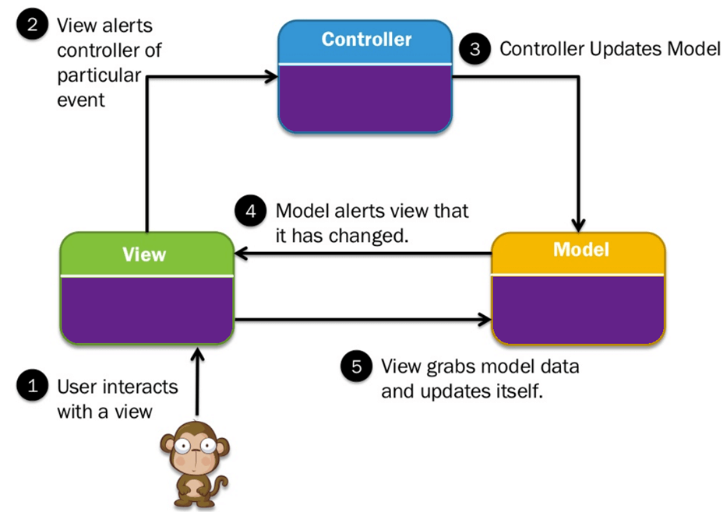
The Model-view-controller (MVC) architecture
2
Each of these components is designed to manage a specific development aspect of an application. MVC separates the business/domain logic i.e., the algorithm that defines the way a database and the end-user application exchange data between each other, and presentation layer.
Microframeworks
Flask is a microframework, and so by default does not contain built-in support for any architectural pattern.
A microframework is a type of web framework designed with simplicity and flexibility in mind and provides only the most basic tools and components required for developing web applications. However, Flask does have extension support, allowing developers to choose their own tools and libraries that can implement various application features.
The Model-view-controller (MVC) architecture
MVC, or Model-View-Controller is a software architectural pattern in which an application is divided into three main logical components:
• Model
• View
• Controller

Slide 10
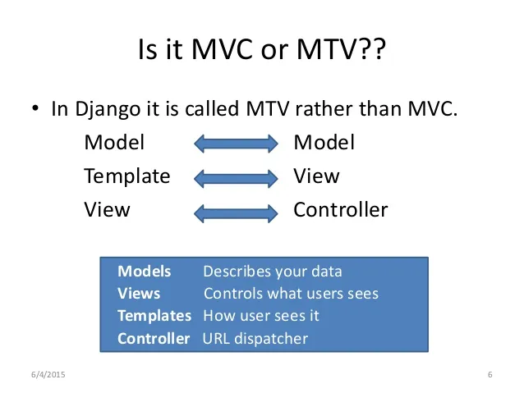
Model-template-view (MTV) architecture
2
The MTV, or Model-Template-View, architecture is a slight variation of MVC architecture introduced by another Python-based web development framework, called Django, which programmers who use Flask have chosen to adopt. A basic comparison between MVC and MTV is shown on the left.
This is a very simplified comparison, as the “controller” in MVC does not directly translate to the “view” in MTV. They have slightly different functions.

Slide 11
Model-template-view (MTV) architecture
2
In Django’s MTV model, the "View" is responsible for handling the business logic of the application, handling incoming HTTP requests, and describes the data that gets presented to the user. In MVC, this role is often associated with the “Controller”.
The creators of Django wanted to emphasize the idea that views should contain the business logic and control the flow of the application. By naming this component the "View," Django aimed to make it clear that it describes which data you see, not how you see it.
The "Template" is responsible for handling the presentation logic in the framework and controls how data should be presented to the user.
Naming it the "Template" emphasizes that it deals with the presentation and layout aspects of the application's UI, even though it performs the role typically associated with the “View” in MVC.

Slide 12
PART 03
jinja

Slide 13
3
Jinja
Template
Jinja
Templates are widely used in Python web development. They can effectively separate business logic and page logic, making the code more readable and easier to understand and maintain.
Simply put, a template is a file that contains placeholder variables to represent dynamic parts. The template file is returned to the user after dynamic assignment. It can be understood as rendering.
However, the template functions that come with Python are extremely limited. If we want to use control statements, expressions, inheritance and other functions in the template, we cannot achieve it.
Jinja is a modern and designer-friendly templating language for Python, modelled after Django’s templates. It is fast, widely used and secure with the optional sandboxed template execution environment
It's called Jinja because the Japanese shrine (Jinja) is the English word temple, and the English word for template is template, and the two are pronounced very similarly
Jinja2 is a template language, but similar to Python, more in line with Python syntax, but not exactly the same. The Jinja2 language is indented, unlike pure python.

Slide 14
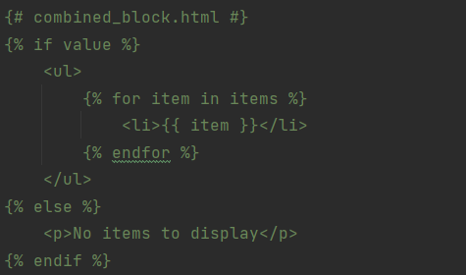
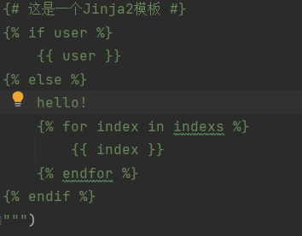
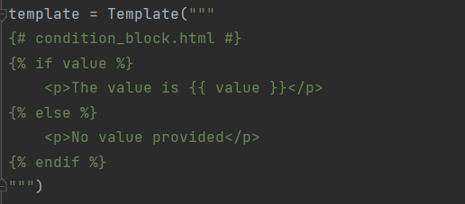
3
Jinja2
Multi-line code block:
Notes:
Those code is a simple example of a Jinja2 template that contains conditional statements. In Jinja2, we can use wrap code blocks and use add comments. This makes it possible to create multi-line blocks of code, for example: ‘{%%}’’{# #}’. In Jinja2 templates, such a syntax allows us to create more complex template structures, and you can insert variables, logic, and control structures as needed. Multi-line code blocks play an important role in Jinja2 templates. They enable developers to include more complex logic and structure in templates.

Slide 15
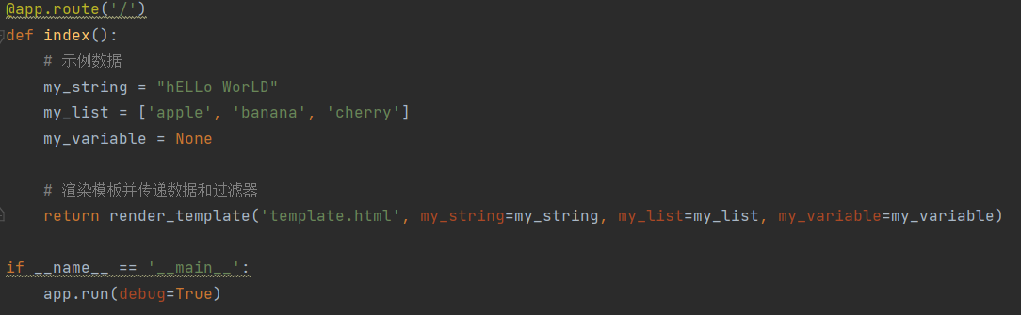
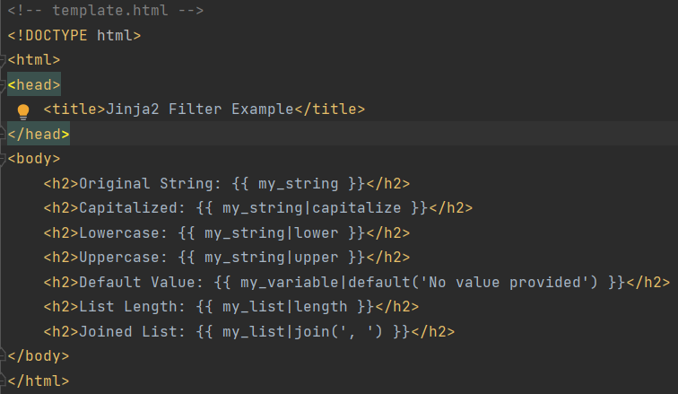
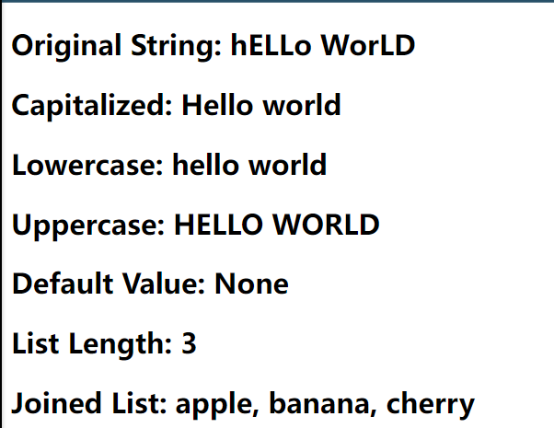
3
Jinja2
Filter:
Notes:
Filters in Jinja2 are used to transform or manipulate variables. They can be applied to variables in templates to modify how they are displayed. In this code example, the render_template function is used to render the template.html template, In this code example, the render_template function is used to render the template.html template, passing in some variables.

Slide 16
PART 04
Flask-SQL Alchemy

Slide 17



Introduction
4
Flask-SQLAlchemy
1
SQLAlchemy is a powerful Python SQL package that allows users to perform a variety of database operations
With Flask-SQLAlchemy, users can define models as Python classes corresponding to database tables, which makes working with databases very intuitive.
2
Flask-SQLAlchemy is a Flask extension that provides the ability to use SQLAlchemy in Flask applications。
It supports a wide range of relational databases, provides ORM (Object-Relational Mapping) functionality.
3

Slide 18
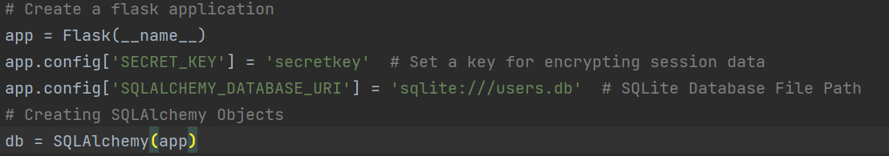
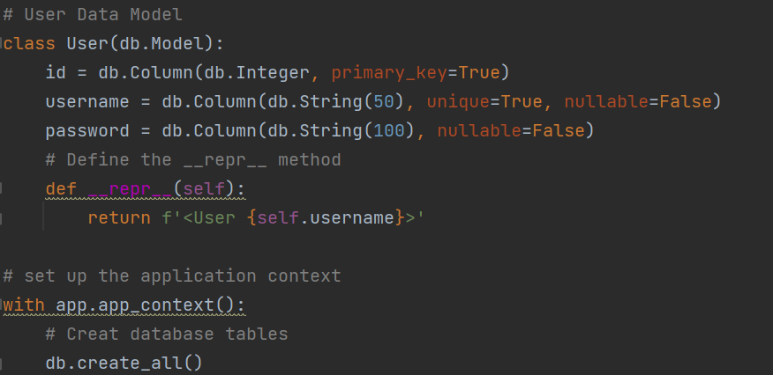
4
Simple Application
Basic CURD
Import the necessary modules:
Create Flask application and set up some configuration :
Define user data model :
Notes:
So here we use a simple login and register page to introduce the basic steps to use Flask-SQLAlchemy. First, we need to import the necessary modules: import Flask, SQLAlchemy, and related modules.
Then we need to create flask application and set up some configuration:
- Set the application's SECRET_KEY, it is used for encrypting session data to insure security.
- we use SQLALCHEMY_DATABASE_URI to specify the path to the SQLite database file.
- create a SQLAlchemy instance and associate it with the flask application to handle database operations.
After that we define user data model:
We use db.Model to create a User data model for mapping to the User table in the database

Slide 19
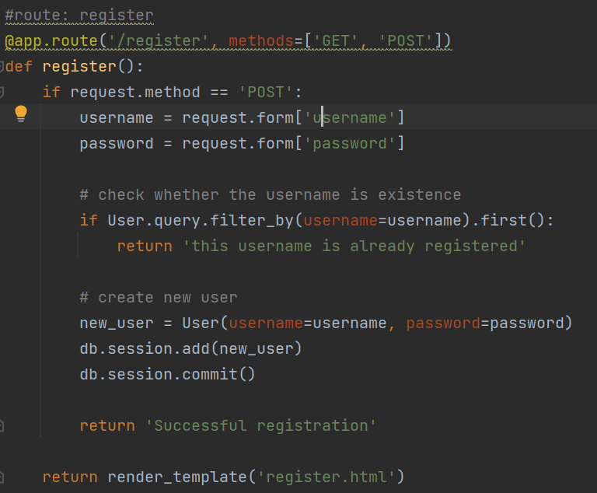
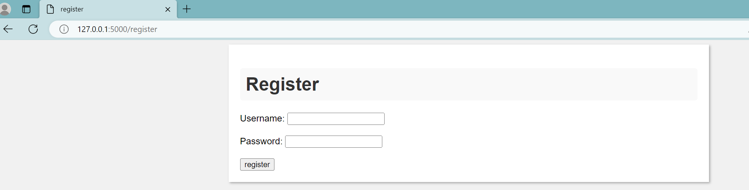
4
Simple Application
Basic CURD
Define the route and perform database operations:
Create a user:
Input the username and password to register a new user.
(main code)
Notes:
This route used to handle the user registration, it checks if the username already exist in the database when a POST request is made. If the username do not exist, a new user is created with the provided username and password.
input the username and password and click register, a new user will be created.

Slide 20
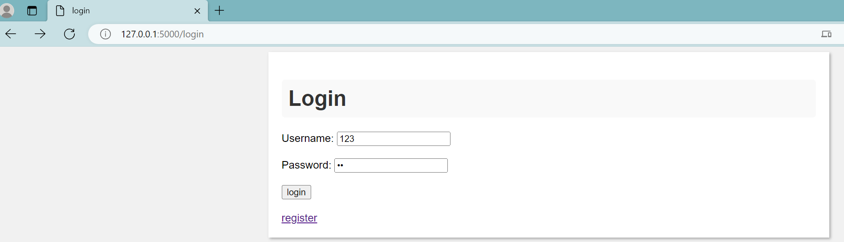
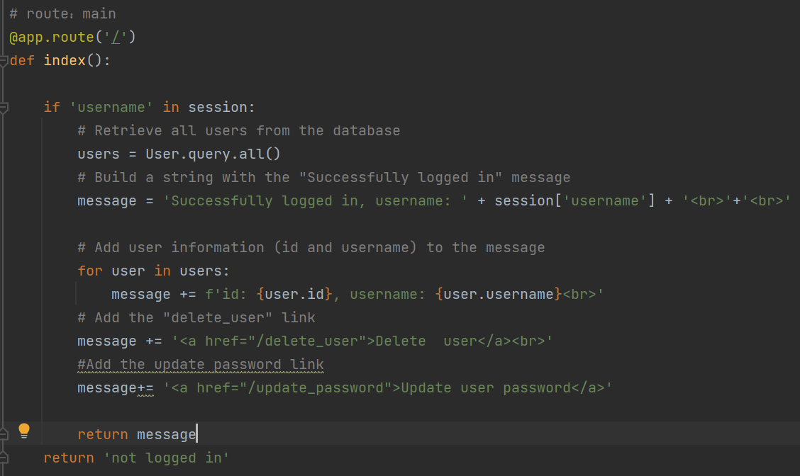
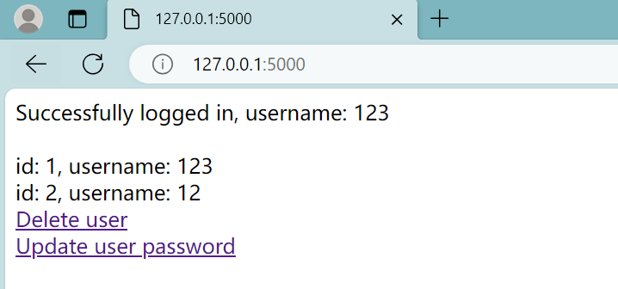
4
Simple Application
Basic CURD
Define the route and perform database operations:
Login and see all the user:
(main code)
Notes:
It is the mian route of the application, user can accessed this page when navigate to the root URL("/"). It checks whether the user is logged in by verifying the existence of the 'username' in the session.If logged in, it retrieves all users from the database and displays a list of user IDs and usernames. It also provides two links: "Delete User" and "Update User Password."
when successful login,you can see all the user in the page

Slide 21
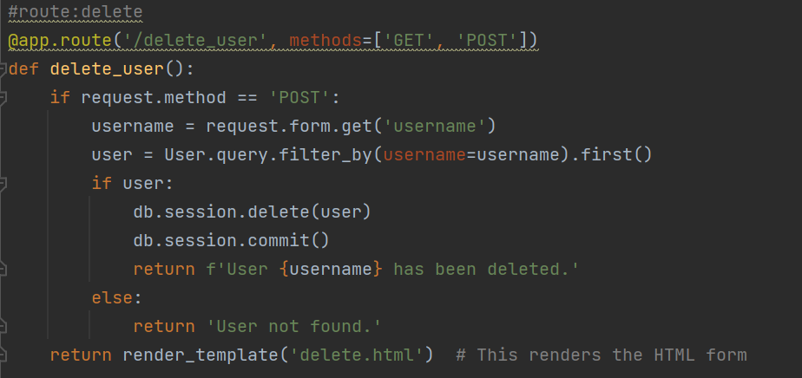
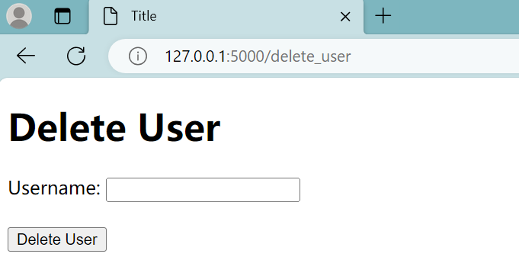
4
Simple Application
Basic CURD
Define the route and perform database operations:
Delete a user:
Enter the username of the user you want to delete
(main code)
Notes:
This route allows users to delete other users.If a POST request is made , it will delete a user based on the provided username.It checks if the user exists, deletes the user's record from the database, and commits the change. Then a success or failure message is displayed.

Slide 22
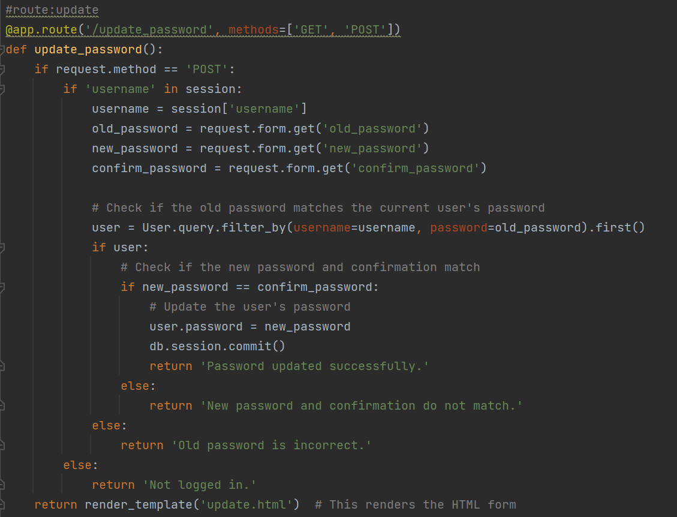
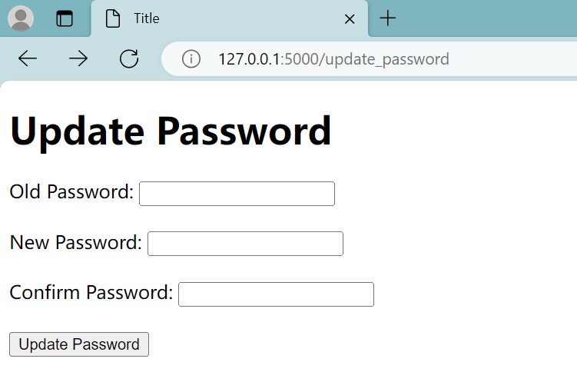
4
Simple Application
Basic CURD
Define the route and perform database operations:
Update the user password:
Notes:
This route allows users to change their password.If a POST request is made, it checks if the user is logged in. It verifies the old password, checks if the new password and confirmation match, and updates the password if everything is valid.

Slide 23
PART 05
Reference

Slide 24

5
Reference
Flask Documentation (Version 3.0.x). Available at: https://flask.palletsprojects.com/en/3.0.x/
"Flask (web framework)" on Wikipedia. Available at: https://en.wikipedia.org/wiki/Flask_(web_framework)
Flask-SQLAlchemy Documentation (Version 3.1.x). Available at: https://flask-sqlalchemy.palletsprojects.com/en/3.1.x/
Grinberg, M. (n.d.). "The Flask Mega-Tutorial Part IV: Database." Available at: https://blog.miguelgrinberg.com/post/the-flask-mega-tutorial-part-iv-database
5. “Templating with Jinja2 in Flask” – GeeksforGeeks. Available at: https://www.geeksforgeeks.org/templating-with-jinja2-in-flask/
6. "MVC Tutorial" - Guru99. Available at: https://www.guru99.com/mvc-tutorial.html
7. “Companies using Flask” at: https://careerkarma.com/blog/companies-that-use-flask/
8. About Armin Ronacher at: https://en.wikipedia.org/wiki/Armin_Ronacher

Slide 25

Thank you

