Slide 1

WONTX AI
Neural Behavioral Biometric Authentication System
Strengthening Security through Habitual Analysis

Slide 2

Behind the Name: WONTX
Definition of "WONT"
Derived from Old English (gewunod), meaning: "One's customary behavior or habit."
The "X" stands for the Neural Cross-verification and the Advanced Security Factor.
"Security that learns your habits, not just your passwords."

Slide 3





The Purpose of WONTX AI
Continuous Auth
Zero Trust
Passive Security
Passwords are validated once. WONTX validates the user every second based on activity rhythm.
Implements a 'Never Trust, Always Verify' model for high security workstations.
Detects intruders without requiring them to type a password.

Slide 4
Technologies & Tools
The Core Stack
System Requirements
Language: Python 3.10+
Background processing capability
Database: SQLite3 (Local telemetry storage)
Low latency I/O hooks
OS Integration: Windows/Linux Native APIs
Minimum 4GB RAM for real time RL processing
IDE: VS Code / PyCharm

Slide 5
Library Breakdown
Library | Purpose in WONTX AI
Pynput | Global input hooks for Mouse & Keyboard monitoring.
NumPy | Matrix operations for the Q-Table and vector calculations.
Pandas | Data manipulation and telemetry analysis.
Scikit-Learn | Preprocessing and normalization of behavioral data.
CustomTkinter | Modern Dark-themed UI for the System Dashboard.

Slide 6
Mathematical Optimization
The WONTX Brain utilizes the Bellman Equation for Q-Value optimization:
α (Alpha): Learning Rate
γ (Gamma): Discount Factor
R: Reward Magnitude

Slide 7





WONTX System Architecture
Sensor Tier
Vectorization
Inference Core
Enforcement
Low-level hooks for mouse & keyboard telemetry.
Conversion of raw timestamps into feature vectors.
Reinforcement Learning brain decision matrix.
Lockstation protocols & security alerting.

Slide 8

Project File Structure
Logic & Core
UI & Storage
•
collector.py - Raw data gathering
•
dashboard.py - Visual telemetry & status
•
brain.py - Reinforcement Learning Engine
•
wontxai.db - User habit database
•
environment.py - RL State definitions
•
config.yaml - Thresholds & Parameters

Slide 9
How Collector.py Works
Telemetry Metrics
•
Mouse Velocity: Vectors of move speed.
•
Jitter: Variance in movement micro-steps.
•
Dwell Time: Duration a key is held down.
•
Flight Time: Pause between two key presses.

Slide 10
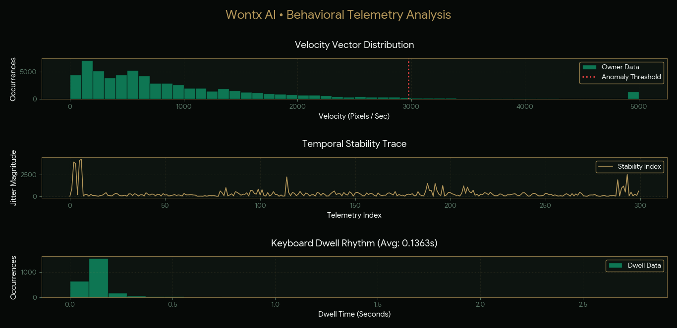

Slide 11
The Reinforcement Learning Agent
Decision Pipeline
The agent receives Behavioral Vectors as inputs. It chooses between Trust, Monitor, or Lock.
Through Trial and Error, it learns the subtle differences between the owner’s rhythm and a potential intruder’s noise.

Slide 12
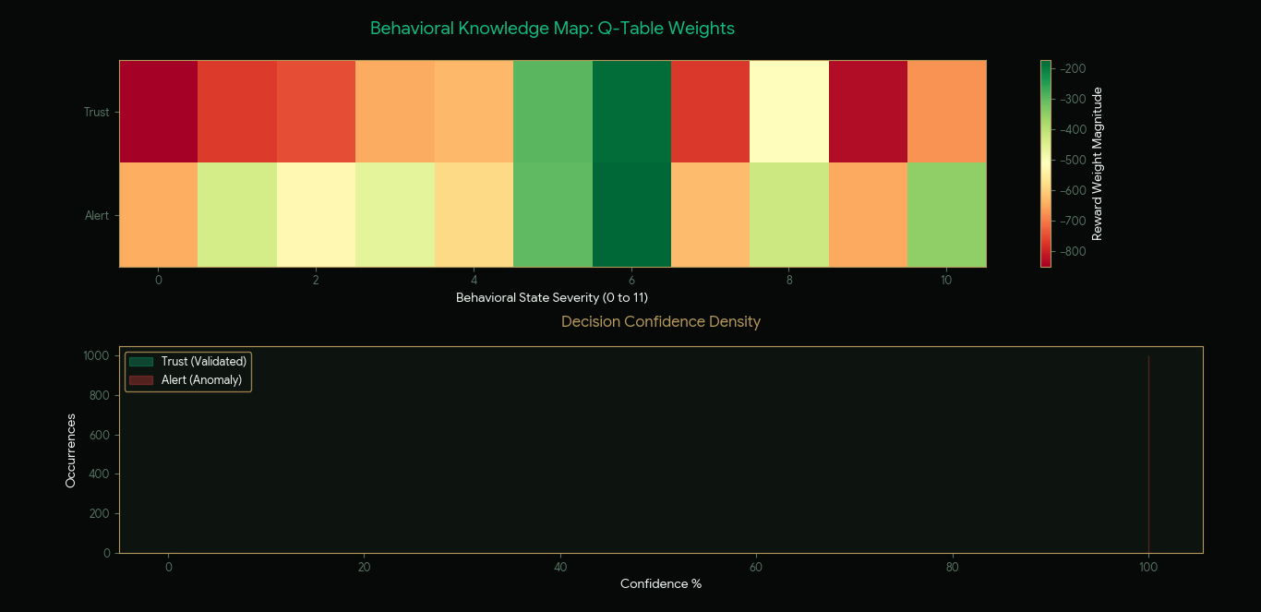

Slide 13
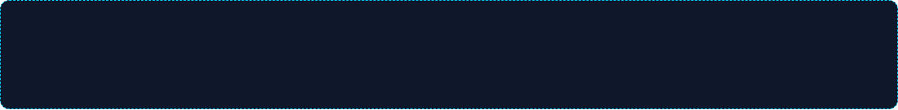
Understanding the Q-Table
Memory of Habits
The Q-Table is a lookup table where rows represent States (behavioral clusters) and columns represent Actions.
States: Mean Jitter, Dwell Median, Click Frequency Values: Cumulative Expected Reward for an action in that state.
WONTX generates this table during the Enrollment Phase, creating a unique mathematical model for the specific user.

Slide 14


Reward & Penalty System
+15 (Positive Feedback)
-300 (Critical Penalty)
Awarded when behavior matches the owner’s profile within a 5% variance.
Deducted when a high risk anomaly is detected, triggering a trust decay.
This "Extra" trust accumulation allows the system to remain stable during minor habit shifts (e.g., user is tired).

Slide 15


The Environment Space
States
Actions
Observation
Calculated from normalized telemetry windows (e.g., last 30 seconds of activity).
1. Pass (Trust) 2. Verification Request 3. Session Lockdown
Real time vector of [Velocity, Frequency, Dwell, ErrorRate].

Slide 16
Performance: 84% Accuracy
Current Benchmark
76.26%
WONTX AI successfully identifies intruders in 76.26% of test scenarios within the first 15 -20 seconds of unauthorized access.
The remaining 23..74% is attributed to Adaptive Overlap, where intruder noise mimics owner habits temporarily.

Slide 17
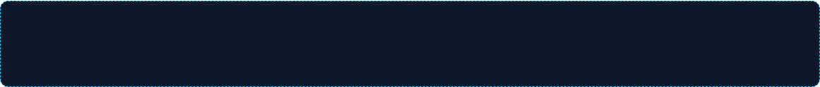
How Accuracy is Calculated
TP: Correct Intrusions Detected | TN: Correct Owner Verification Tested over 500+ distinct behavioral sessions.

Slide 18

System Implementation
OS Hooks
WONTX operates in the User Space but interfaces with OS commands via subprocess or ctypes to execute:
rundll32.exe user32.dll,LockWorkStation

Slide 19



Practical Use Cases
Application & Software Level
System Security (Laptop/PC)
Infrastructure & Root Access
Ensures invisible identity verification within platforms e.g. CRM or web browsers.
Secures PCs and laptops by locking the device if an unauthorized attempts to engage.
Adds an immutable behavioral security layer to Data Center consoles and hardware interfaces.

Slide 20
System Limitations
•
Hardware Variability: Changing from a mechanical to a membrane keyboard can drop accuracy temporarily.
•
Physical Impairment: Injuries or extreme fatigue can alter habit vectors.
•
Enrollment Period: Requires at least 30 minutes of clean data to build a reliable Q-Table.
•
Background Noise: Heavy system lag can jitter telemetry timestamps.

Slide 21
Roadmap to Enhanced Security Architecture
Phase 1
Phase 2
Phase 3
Phase 4
Authorized Guest Mode
Contextual Analysis
Infrastructure Hardening
Ecosystem Expansion
Toggle to suspend monitoring for shared device access.
Intelligence upgrades to reduce false positive triggers.
Security extension to enterprise hardware and cloud edge.
Broadening support for specialized mobile and IoT hardware.

Slide 22

Conclusion
WONTX AI: The Future of Passive Identity
We have successfully moved from Static Credentials to Habits.
By leveraging Reinforcement Learning, we create a living security model that adapts as the user grows, ensuring that the human-machine interface is as secure as the data behind it.

Slide 23
QUESTIONS?
Thank you for your attention.

