Slide 1

Understanding the SIMD Efficiency of Graph Traversal on GPU
Yichao Cheng, Hong An, Zhitao Chen, Feng Li, Zhaohui Wang, Xia Jiang and Yi Peng
University of Science and Technology of China

Slide 2

Breadth-first Search (BFS)
Source
A
C
1
1
A
C
D
E
F
2
E
2
F
2
D
G
H
I
3
3
H
I
4
G
Notes:
The problem of breadth first search (B-F-S) is very simple .You have an unweighted graph. You pick up a source vertex.
(click)
And you want to label all of the other vertices with their distances from the source vertex.

Slide 3
Breadth-first Search (BFS)
BFS_Iteration:
for u ∈ Current Frontier
for v ∈ u’ s neighbors do
if v has not been labeled
label v
put v in Next Frontier
B
A
C
E
F
D
H
I
G
Notes:
Actually, the process of breath-first search can be viewed as iterations over two vertex-frontiers:
In each iteration, vertices in the current frontier are being labeled. And all their unlabeled neighbors are appended to the next frontier.
(click)
(click)
This process repeats until the current frontier is empty

Slide 4
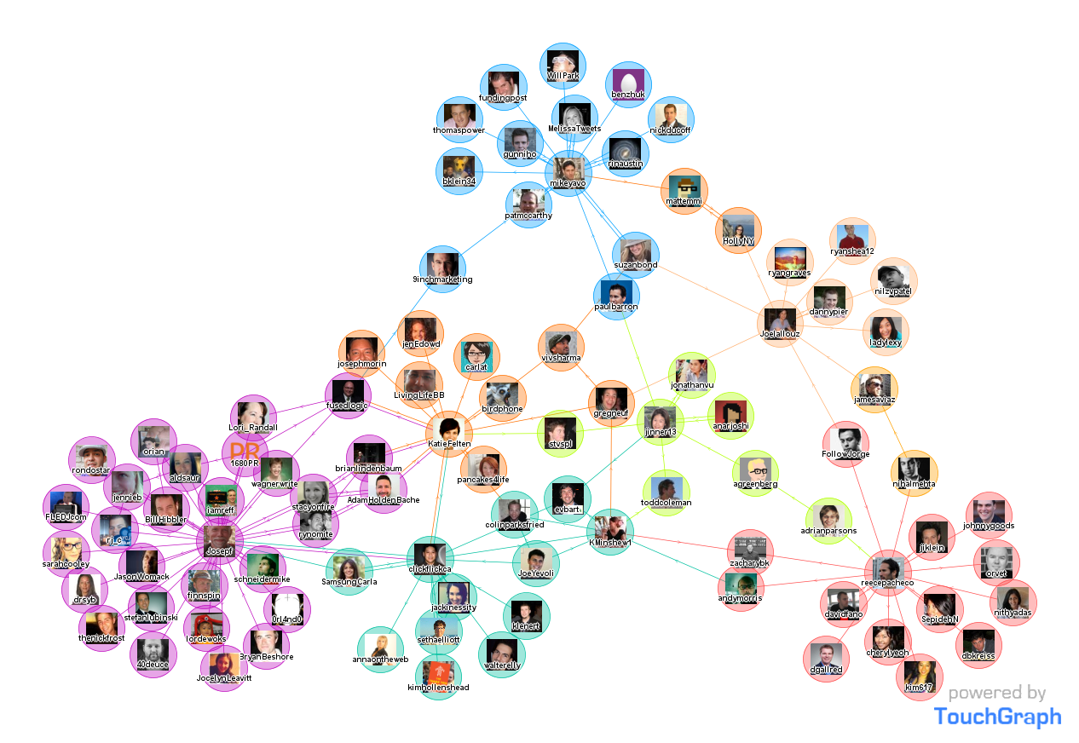
Application of BFS
Many datasets in real world are represented by graph
VLSI circuits
Social relationship
Road connections
Primitive for building complex algorithms
Path-finding
Belief propagation
Points-to Analysis (PTA)
Notes:
Although breadth-search is a really simple problem. But it’s a very important study for a bunch of reasons.
The first reason is that a lot of large-scale datasets in real world are represented by graph:
such as VLSI circuits, social relationship, and road connections.
BFS also serves as a primitive [‘primetive] for solving other complex graph problems.
For example, path-finding, belief propagation and points-to analysis [e‘nai le sis]

Slide 5
The Problem
I
GPU relies on high SIMD lanes occupancy to boost performance
100% efficiency is achieved only if all SIMD lanes fall in the same path
Do_something_common();
If (thread_id > 5) {
do_something_red();
} else {
do something_blue();
}
100% utilization
Notes:
Modern GPU exaggerates its performance by executing massive threads in a Sim-dee way. So a high Sim-dee lanes occupancy is critical to its performance.
But 100% efficiency is achieved only if all Sim-dee lanes fall in the same path.
Say we have a piece of code like this. If there’s no branch. All threads within a warp can do the same thing at the same time
(click)
So the utilization rate is 100%.

Slide 6
The Problem
I
GPU relies on high SIMD lanes occupancy to boost performance
100% efficiency is achieved only if all SIMD lanes fall in the same path
Do_something_common();
If (thread_id > 5) {
do_something_red();
} else {
do something_blue();
}
37.5% utilization
Notes:
But when there is a branch. the code can not be executed in parallel [pere low].
(click)
One branch has to be executed serially after the other, which will keep the SIMD utilization at low level

Slide 7
The Problem
I
GPU relies on high SIMD lanes occupancy to boost performance
100% efficiency is achieved only if all SIMD lanes fall in the same path
Do_something_common();
If (thread_id > 5) {
do_something_red();
} else {
do something_blue();
}
62.5% utilization
Notes:
The other path
(click)

Slide 8
Traditional Implementation
The # of sub-iterations depends on the size of u ’s adjacent list
GPU_BFS_Iteration
u = C[tid]
for v ∈ u’ s neighbors do
end for
task 1 = 4 sub-iterations
task 2 = 2 sub-iterations
…
Notes:
The traditional BFS iteration assigns each vertex within the current frontier with one thread. This is native for GPU’s programming model.
For example, we calculate thee offset by thread id, and fetch the corresponding data from thee array，and operating on them.
However this is not suitable for GPU architecture. Because for each thread, the number of sub-iterations depends on the size of its adjacent-list [a jason t]. Since different vertex has different number of neighbors, the workload is pretty imbalanced. All right?

Slide 9
Visualizing the Irregularity
Highly skewed
outlier exists
distributed
between a wide rage
irregular but concentrate
vertex range < 8
Notes:
The question is how imbalanced it is? Here, we use boxplot to visualize thee irregularity of fifteen real-world graphs.
We can see that some graphs have a tight range of vertex-degree. And some graphs are irregular but concentrate, because most vertices still have close outdegree. And in some graphs, vertex degree distributes *evenly* between a wide range. And in those highly irregular graphs, some *outliers* exist. For example, some vertices can have more than ten thousand neighbors.
* In each boxplot, the two horizontal lines represent the greatest and the least degree. The top and the bottom of the box denote the first and the third quartile. Finally, the diagonal [dy a gnal] cross in the box stands for the median.

Slide 10
Alternative Way
I
Assign each task with a warp of threads
Vectorize the sub-iterations!
So, what’s the relationship between graph topology and SIMD efficiency?
Notes:
To alliviate the work-imbalance problem, thee alternative way is to assign each task with a warp of threads
(click)
*However*, the Sim-dee lanes cab still be wasted when the average out-degree is much smaller than the warp size.
(click)
This observation leads us to ask the question: what’s the relationship between graph topology and Sim-dee efficiency?
*And* what’s the trade-off between the two mapping strategies.

Slide 11
Topology and Utilization
Assign each vertex with a group of threads
Thread
Warp
Group
task 1 = 2 sub-iterations
task 2 = 1 sub-iteration
Notes:
We present a model to answer the question. First, we assign each vertex with a group of threads, instead of a single thread, or a warp of threads.
In each BFS iteration, each thread group processes [prao ce cess] its task in a *logical* Sim-dee window.
In this example,the logical Sim-dee window size is two, and thread group 1 requires 2 sub-iterations to finish its task and thread group 2 requires one sub-iteration.

Slide 12
Topology and Utilization
Divide the SIMD underutilization into two parts
InteR-group Underutilization (U_{R})
IntrA-group Underutilization (U_{A})
SIMD Window
Notes:
And then we can divide the Sim-dee underutiliztion into two parts,
(click)
Thee intra-group underutiliztion is represented by the wasted slots inside the logical Sim-dee windows. They are underutilized because the vertex degree is not *always divisible* [di visi able] by group size.
(click)
Thee inter-group underutiliztion is represented by the wasted slots between the logical Sim-dee windows. They are caused by the workload imbalance among different thread groups.
(click)

Slide 13
Conclusions From the Model
U_{R} is induced by the heterogeneity of workloads
Affected by the graph topology
U_{R} is sensitive to the group size (S)
Large logical SIMD window can narrow the gap
When S = 32, U_{R} = 0
U_{A} is determined by the intrinsic irregularity of vertex degree
It can be limited by shrink the S
When S = 1, U_{A} = 0
U_{R} and U_{A} can convert to each other
Notes:
Here we just present the conclusions coming from the model. Please refer to our paper for the formalization [formal i zation] of the model, which is actually not that interesting. : )
We discovered that thee inter-group underutilization is induced by the heterogeneity of workloads，which is *affected* by the graph topology. And thee inter-group underutilization is very sensitive to the group size. Intuitively, using a larger logical Sim-dee window can narrow the gap among tasks. When the group size is thirty-two, which is the warp size, thee inter-group underutilization is zero, because the warp is occupied by one task.
And thee intra-group underutilization is determined by thee *intrinsic* [`in tran sic] irregularity of vertex degree. And it can be limited by shrinking group size. When the group size is one, it is eliminated entirely.
And these two kinds of Sim-dee underutilization can convert to each other when different group size is selected.

Slide 14
Comparing Different Mapping Strategies
Scalability
good
Expansion
Rate (ME/s)
poor
low
high
Notes:
We first compare the performance for mapping strategies using different group size across all the datasets. We concentrate on the workload imbalance problem in expansion phase of BFS. And we benchmark thee expansion rate in millions of edges per second.
The results can be divided intro four categories. The datasets in the left bottom corner has low expansion rate and poor scalability. They are poorly suited for any GPU implementation. This is because those graphs have low average out-degree, concurrency grows very slowly. So there isn’t sufficient amount of work to saturate the hardware in most BFS iterations.
The graphs in the bottom center have considerable expansion rate due to their rich concurrency. However their performance still does not scale with the group size. On the other hand, The datasets in he top center has better scalability,
The datasets in the top right corner not only have high expansion rate, but also scale well with group size.

Slide 15
Evaluating the SIMD Efficiency
Metrics derived from the model:
UR = inter-group underutilization
UA = intra-group underutilization
ME = mapping efficiency
UR + UA + ME = 100%
Captures utilization trend with increasing S
Notes:
We then derive three metrics from the model for quantifying the Sim-dee efficiency：UR and UA denotes thee inter and intra-group underutilization, and ME stands for mapping efficiency. ME is complementary to the other two metrics.
We calculate these metrics online by simulating the Sim-dee windows operations on the vertex-frontier during BFS.
They can help us to capture the utilization trend with increasing group size.

Slide 16
Explaining the Result
Scalability
good
alleviate the UR，
introducing minor UA
Expansion
Rate (ME/s)
poor
low
high
Notes:
For some graphs, increasing group size can effectively *alleviate* thee inter-group underutilization with introducing *minor* intra-group underutilization, thus improving the mapping efficiency. This explains why these datasets have excellent scalability.

Slide 17
Explaining the Result
Scalability
good
ME in a high level (~80%)
Expansion
Rate (ME/s)
poor
low
high
Notes:
*While* the Sim-dee utilization for some datasets does not present an ascending [a sending] trend, the mapping efficiency *still* maintains at a high level (about eighty per cent). So the performance for these datasets scales with the group size too.

Slide 18
Explaining the Result
outweighed by the fast-growing UA
Scalability
good
Expansion
Rate (ME/s)
poor
low
high
Notes:
But for some datasets, the benefits of reducing inter-group undertutilization are soon *outweighed* by the fast-growing intra-group underutilization.

Slide 19
Explaining the Result
do little help to UR but lead to severe UA
Scalability
good
Expansion
Rate (ME/s)
poor
low
high
Notes:
The worse case is, increasing group size *not only* can do little help to thee inter-group underutilization but also lead to *severe* intra-group underutilization. All these datasets correspond to the categories that have poor scalability

Slide 20
Conclusion
Study the link between graph topo & hardware util
Present a model for analyzing the components of SIMD underutilization
Discover that the SIMD are wasted due to:
Develop 3 metrics for quantifying SIMD efficiency
Provide a foundation for developing techniques of static analysis and runtime optimization
imbalance of vertex degree distribution
heterogeneity of each vertex degree
Notes:
Thee optimal mapping granularity in graph traversal depends on thee input graph and must be tuned manually. And we attempt to understand the link between graph topology and hardware utilization.
We present a model for analyzing the components of Sim-dee underutilization. Based on that model, we discover that the Sim-dee lanes are wasted either due to thee imbalance of vertex degree distribution, or to the heterogeneity of each vertex degree.
(click)
We also develop 3 metrics for quantifying sim-dee efficiency
We hope our method can provide foundations for developing techniques of static analysis and runtime optimization.

Slide 21
Q&A
Notes:
Thank you very much. I am prepared to answer any questions.
Yeah. It is good question.
Please refer to our paper for the details.

