Slide 1
MACS 30123 · FINAL PROJECT · 2026
Mapping the Discursive Battle
Over AI on Hacker News
60 months · 411K comments · doomer vs accelerationist framings
411K
60
4
4
comments
months 2020–24
stance classifiers
aggregation backends
Cynthia Wu · University of Chicago · github.com/macs30123-s26/final-project-final-project

Slide 2
THE RESEARCH QUESTION
Did doomer vs accelerationist framing of AI
shift around three pivotal events?
· Hacker News as an elite technical public sphere — narratives show up here before mainstream media.
· 60 months · 411K comments · doomer / accelerationist / neutral stance per comment.
· Interrupted time series at ChatGPT (2022-11-30), with pulse dummies at GPT-4 and the OpenAI board crisis.
THE METHODOLOGICAL POINT
Single-classifier discourse analysis is fragile. A defensible answer requires running the same panel under multiple independent measurement instruments and seeing where they agree or disagree.
Research question
2 / 8

Slide 3
SCALE, THREE WAYS
Why this is a scalable-computing problem
Corpus scale
Per-doc classification × 4
Aggregation × 4 backends
1,260
411K × 4
60-month panel
1,260 partitioned shards across 60 months · year × keyword family × query
411K comments scored by four independent stance instruments — CPU + GPU.
Same 1,260 inference parquets reduced under serial pandas, Dask local, Dask multi-node, PySpark.
Why scalable computing
3 / 8

Slide 4
ARCHITECTURE
Pipeline — 6 stages, partitioned files, re-run any branch
①
Collect
②
Clean + 4 classifiers
③
Aggregate × 4 backends
AWS EC2 + S3
+ local parallel
Midway Slurm
CPU + GPU array
Midway
pandas / Dask / Spark
④
ITS + atlas + topics
⑤
Gold-set validation
⑥
Public dashboards
Midway Slurm
statsmodels / BERTopic
Midway Slurm
200-row hand audit
AWS S3
static website
Everything after Stage ① runs on Midway Slurm — CPU arrays, GPU, Dask multi-node, PySpark.
Pipeline
4 / 8

Slide 5
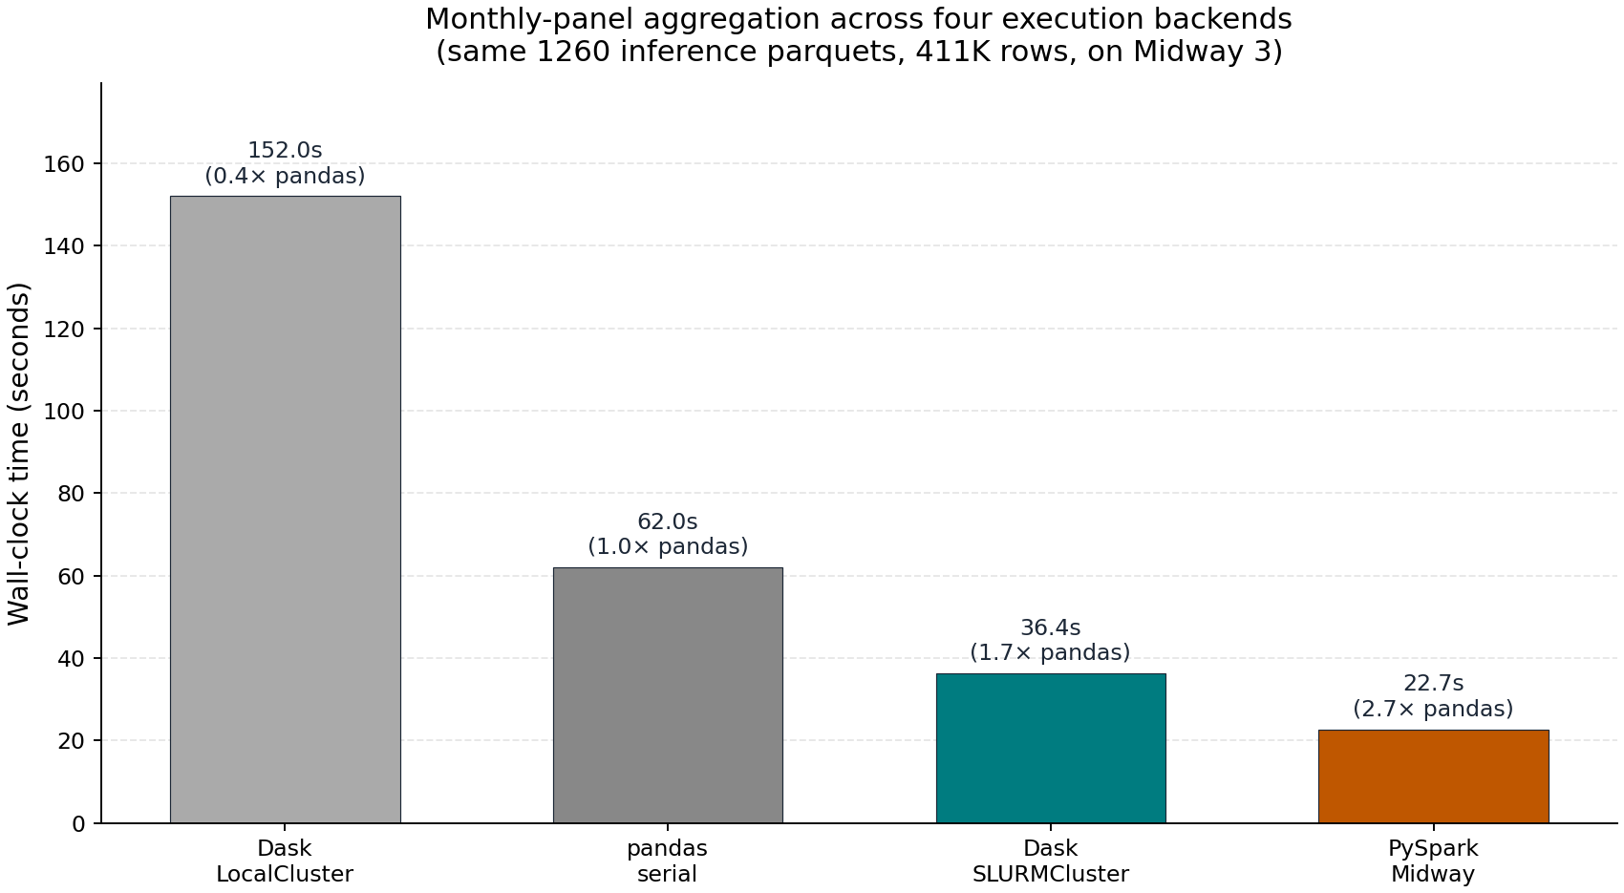
BACKEND BENCHMARK
Four aggregation backends, same 1,260 parquets
PySpark 23 s — Dask multi-node 36 s — pandas 62 s — Dask local 152 s. Distributed isn’t automatically faster.
Backend benchmark
5 / 8

Slide 6
CROSS-METHOD ITS
7 of 8 headline coefficients disagree across 4 classifiers
7 / 8
ONE DIRECTION SURVIVES EVERY METHOD
Board-crisis doomer pulse
headline coefficients
fail the agreement criterion
+0.012 to +0.131 across TF-IDF, zero-shot gated, and zero-shot ungated — every method finds a rise in doomer share after the OpenAI board episode.
3 SIGN FLIPS
doomer × ChatGPT level · accel × board crisis · accel × GPT-4
Cross-method ITS
6 / 8

Slide 7
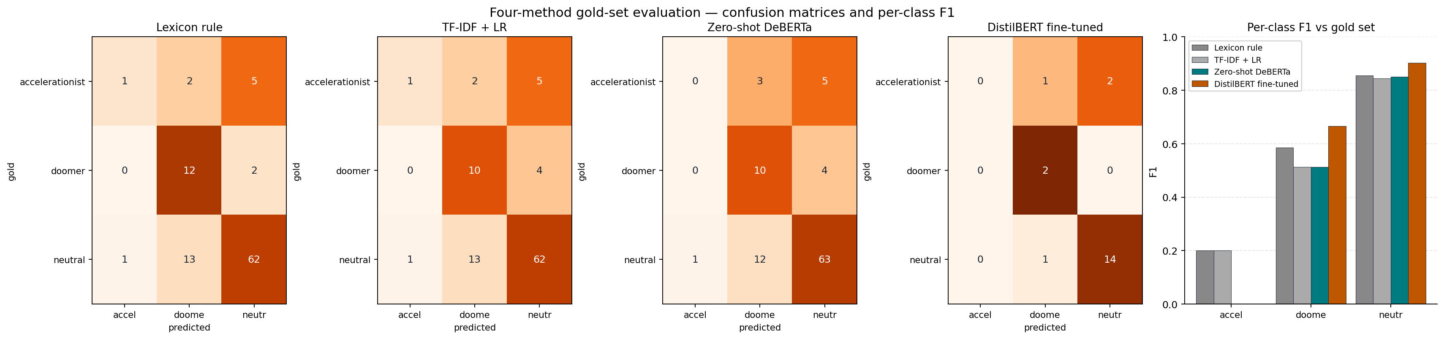
VALIDATION
Gold-set vs human judgement — bounding the instrument
51 %
LEXICON PRECISION FLOOR
98.3 %
EMBEDDING RECALL CEILING
of 200 hand-labelled rows are wrong_other — retrieved by the lexicon but not actually about AI.
MiniLM cosine-similarity cross-check — the lexicon over-retrieves but rarely under-retrieves.
Gold-set validation
7 / 8

Slide 8
WHAT THE PIPELINE BUYS YOU
A 60-month panel of HN AI discourse,
cross-checked under multiple instruments.
4 stance classifiers
4 aggregation backends
3 collection venues
lexicon · TF-IDF + LR · zero-shot DeBERTa · DistilBERT fine-tune
pandas · Dask local · Dask multi-node · PySpark
Local parallel · AWS EC2 + S3 · Google BigQuery
LIVE DASHBOARDS
hn-ai-discourse-public-2026.s3-website-us-east-1.amazonaws.com
Contribution
8 / 8

