Slide 1
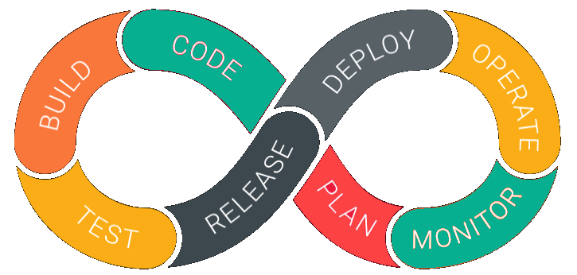
DevOps

Slide 2
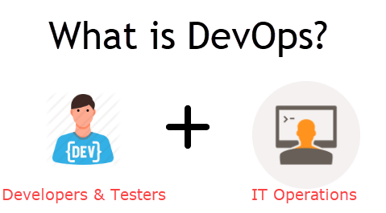
DevOps is a Methodology which promotes collaboration between Development and Operations Team to deploy code to production faster in an automated & repeatable way. The word 'DevOps' is a combination of two words 'development' and 'operations.’
In simple words, DevOps can be defined as an alignment of development and IT operations with better communication and collaboration.

Slide 3
Why is DevOps is Needed?
Before DevOps, the development and operation team worked in complete isolation.
Testing and Deployment were isolated activities done after design-build. Hence they consumed more time than actual build cycles.
Without using DevOps, team members are spending a large amount of their time in testing, deploying, and designing instead of building the project.
Manual code deployment leads to human errors in production
Coding & operation teams have their separate timelines and are not in synch causing further delays.
There is a demand to increase the rate of software delivery by business stakeholders. As per Forrester Consulting Study, Only 17% of teams can use delivery software fast enough. This proves the pain point.

Slide 4
DevOps Lifecycle
1. Development
In this DevOps stage the development of software takes place constantly. In this phase, the entire development process is separated into small development cycles. This benefits DevOps team to speed up software development and delivery process.
2. Testing
QA team use tools like Selenium to identify and fix bugs in the new piece of code.
3. Integration
In this stage, new functionality is integrated with the prevailing code, and testing takes place. Continuous development is only possible due to continuous integration and testing.
4. Deployment
In this phase, the deployment process takes place continuously. It is performed in such a manner that any changes made any time in the code, should not affect the functioning of high traffic website.
5. Monitoring
In this phase, operation team will take care of the inappropriate system behavior or bugs which are found in production.

Slide 5
DevOps Automation Tools
Infrastructure Automation
Configuration Management
Deployment Automation
Performance Management
Log Management
Monitoring.

Slide 6
DevOps Automation Tools
Infrastructure Automation
Amazon Web Services (AWS): Being cloud service you do not need to be physically present in the data center. Also, they are easy to scale on-demand. There are no up-front hardware costs. It can be configured to provision more servers based on traffic automatically.
Configuration Management
Chef: It is a useful DevOps tool for achieving speed, scale, and consistency. It can be used to ease out complex tasks and perform configuration management. With this tool, DevOps team can avoid making changes across ten thousand servers. Instead, they need to make changes in one place which is automatically reflected in other servers.
Deployment Automation
Jenkins: This tool facilitates continuous integration and testing. It helps to integrate project changes more easily by quickly finding issues as soon as a built is deployed.

Slide 7
DevOps Automation Tools
Log Management
Splunk: This is a tool solves the issues like aggregating, storing, and analyzing all logs in one place.
Performance Management
App Dynamic: It is DevOps tool which offers real-time performance monitoring. The data collected by this tool helps developers to debug when issues occur.
Monitoring
Nagios: It is also important to make sure people are notified when infrastructure and related services go down. Nagios is one such tool for this purpose which helps DevOps teams to find and correct problems.

Slide 8
Future of DevOps
They are lots of Change likely to happens in the DevOps world some most prominent are:
Organizations are shifting in their needs to weeks and months instead of years.
We will see soon that DevOps engineers have more access and control of the end user than any other person in the enterprise.
DevOps is becoming a valued skill for IT people. For example, a survey conducted by Linux hiring found that 25% of respondent's job seeker is DevOps expertise.
DevOps and continuous delivery are here to stay. Therefore companies need to change as they have no choice but to evolve. However, the mainstreaming the notion of DevOps will take 5 to 10 years.

Slide 9
Summary
DevOps is a culture which promotes collaboration between Development and Operations Team to deploy code to production faster in an automated & repeatable way
Before DevOps operation and Development team working in completed isolation.
Manual code deployment leads to human errors in production
In the Old process, Operations team has no clue on the progress of the Development team. So, operations team developed a IT infrastructure purchase and monitoring plan as per their understanding.
In the DevOps process operation team fully aware of the progress of developer. The purchase and monitoring planning is accurate.
DevOps offers Maintainability, Predictability, Greater quality cost efficiency and time to market.
Agile process focuses on functional and non-functional readiness while DevOps focuses on that IT infrastructure aspects.
DevOps life cycle includes Development, Testing, Integration, Deployment, and Monitoring.
DevOps engineer will work with development team staff to tackle the coding and scripting needs.

Slide 10
Demo
How to upload code onto github repository | How to push code from local repo to remote repo.
CI/CD setup pre-requisites for Simple pipeline
Linux basic commands for AWS & DevOps Engineers
Jenkins Installation and Configuration
Jenkins Master Slave Configuration
Jenkins plugins installations
TomCat Server Installation and Configuration
Running a simple Devops project using Git,Jenkins and TomCat Server
Running a simple Devops project using Git,Jenkins ,Ansible and TomCat Server
Running a simple Devops project using Git,Jenkins ,Docker
Introduction to AWS CodeCommit | Setup CodeCommit | Create a Repo | Upload code to Codecommit
How to Migrate Github repository to AWS CodeCommit

Slide 11
Git Hub Demo
git config --global user.name "harjit Singh Pahwa"
git config --global user.email "harjeet.pahwa@gmail.com"
git clone "https://github.com/yankils/task.git"
git checkout -b newbranch--new branch creation
git log -p filename -----to see changes in file
git log
git status
git add "filename" / git add . or git add *
git commit -m "commit info"
git push origin branchnebranch:master

Slide 12
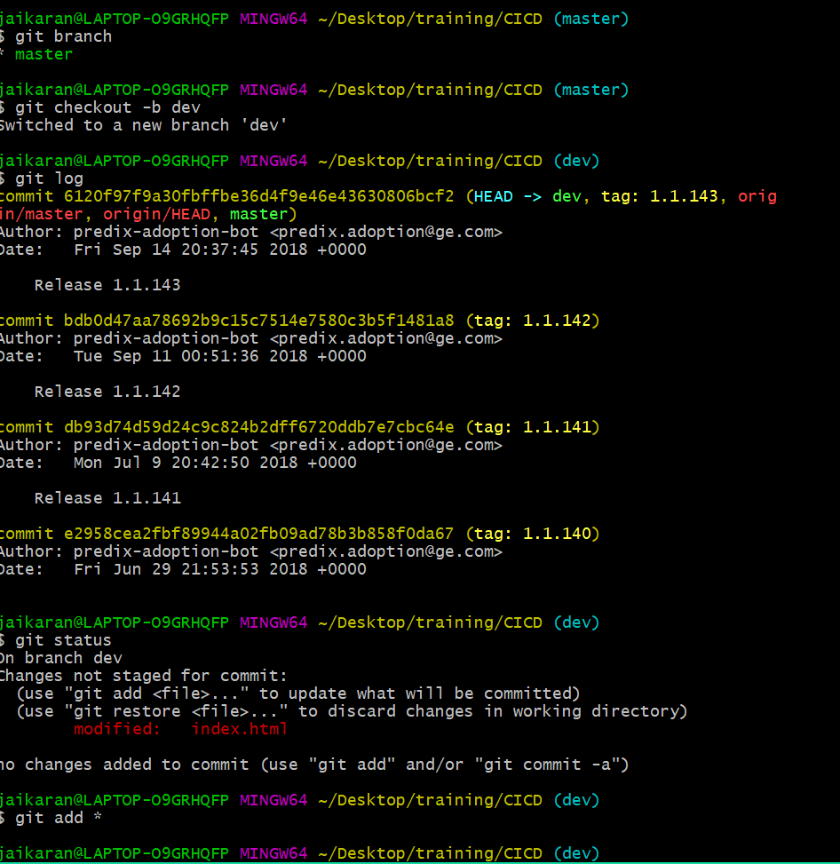
Git basics

Slide 13
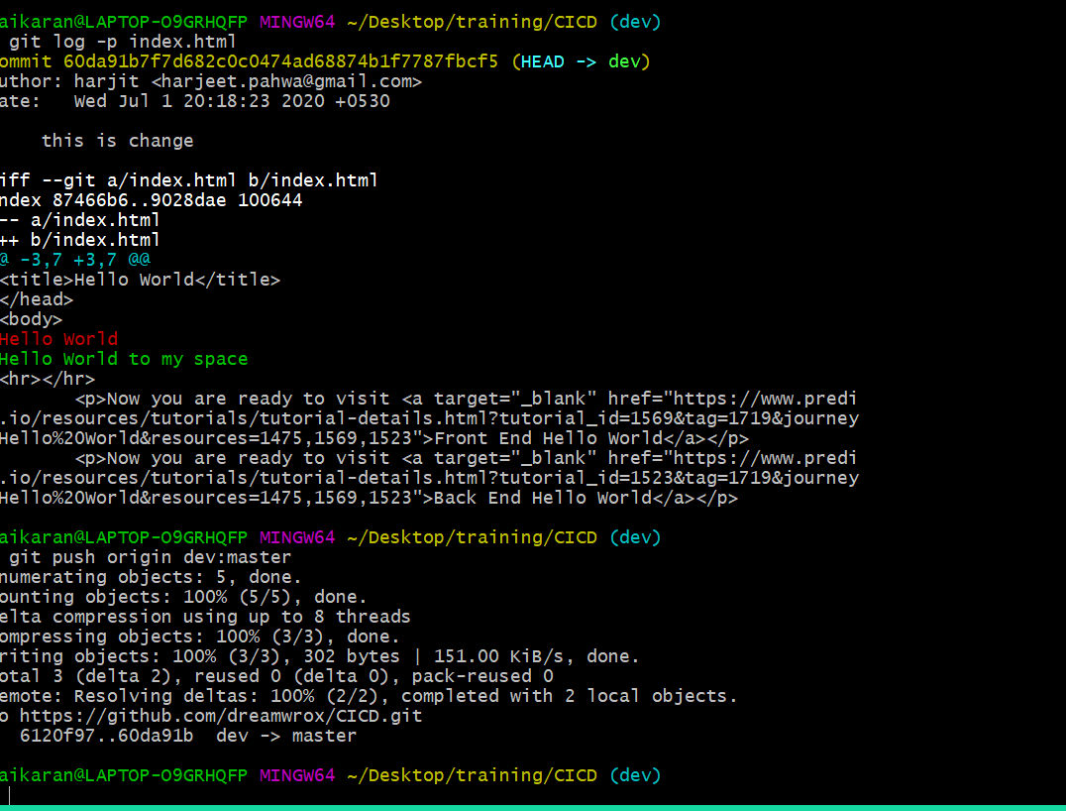
Git basics

Slide 14
Thank You
QA

