Slide 1
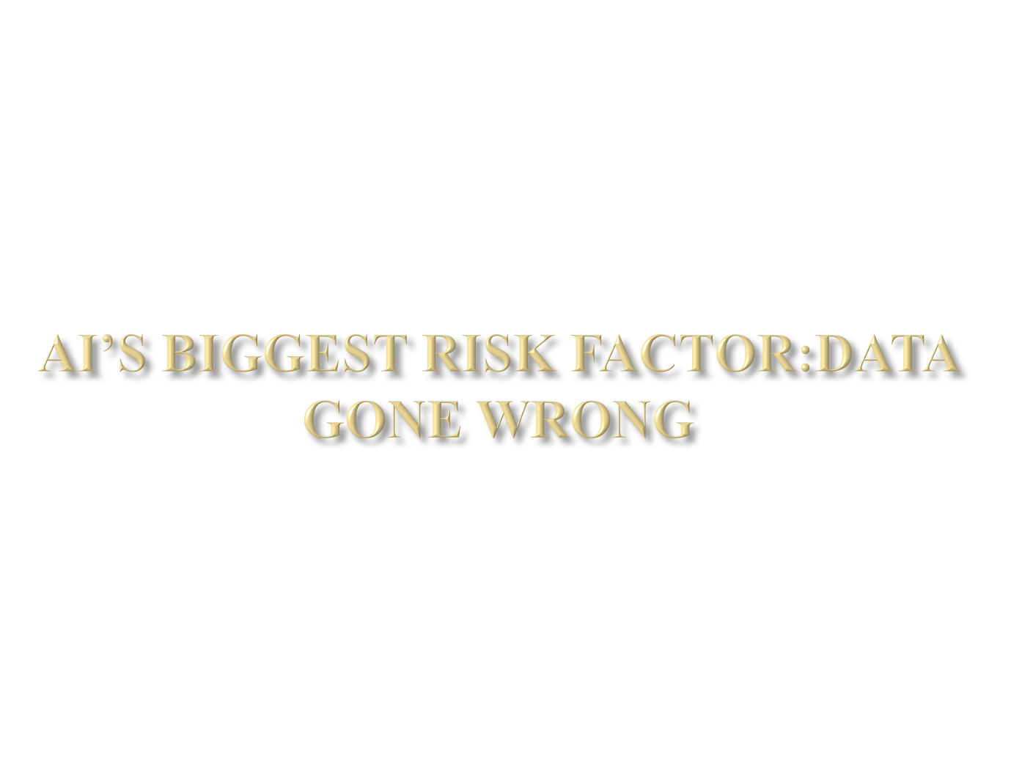

Slide 2

Artificial Intelligence is a technology that focuses on making intelligent machines that can assist and automate process.
AI tries to make software think like how a human brain thinks, with the help of algorithms.
Some of the activities computer with AI are designed for include:
Speech recognition
Learning
Planning
Problem solving

Slide 3

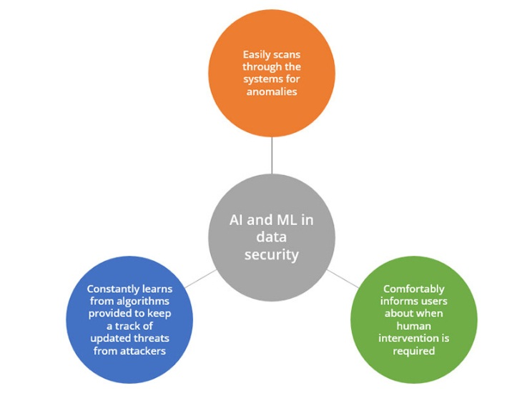

Slide 4

Data cleaning
  Fill in missing values, smooth noisy data, identify or remove outliers and noisy data, and resolve inconsistencies
Data integration
  Integration of multiple databases, or files
Data transformation
  Normalization and aggregation
Data reduction
  Obtains reduced representation in volume but produces the same or similar analytical results
Data discretization
for numerical data.

Slide 5

In Real world data tend to be incomplete, noisy, inconsistent.
Data cleaning attempts (or Data Cleaning task includes)
  To Fill in missing values,
  smooth noisy data while identify outliers or remove outliers, and
  Correct inconsistencies data

Slide 6

Data is not always available:
  E.g., many tuple have no recorded value for several attributes, such as customer income in sales data
  missing
  data
Age | Income | Team | Gender
23 | 24000 | Red socks | M
25 | ? | Yankees | M
34 | 12000 | ? | F

Slide 7

1. Ignore the tuple: This method is not very effective, unless the tuple contains several attributes with missing values. It is especially poor when the percentage of missing values per attribute varies considerably.
2. Fill in the missing value manually: In general, this approach is time-consuming and may not be feasible given a large data set with many missing values.

Slide 8

3. Use a global constant to fill in the missing value: Replace all missing attribute values by the same constant, such as a label like “Unknown” or -. If missing values are replaced by, say, “Unknown,” then the mining program may mistakenly think that they form an interesting concept, since they all have a value in common-that of “Unknown.”
4. Use the attribute mean to fill in the missing value: For example, suppose that the average income of All Electronics customer is $28,000. Use this value to replace the missing value for income.

Slide 9

5. Use the attribute mean for all samples belonging to the same class as the given tuple:
For example, if customers are classified according to credit risk, replace the missing value with the average income value for customers in the same credit risk category as that of the given tuple.
6. Use the most probable value to fill in the missing value:
This may be determined with regression, inference-based tools using a Bayesian formalism, or decision tree induction. For example, using the other customer attributes in your data set, you may construct a decision tree to predict the missing values for income.

Slide 10

Q: What is noise?
A: Random error in a measured variable.
Incorrect attribute values may be due to
  faulty data collection instruments
  data entry problems
  data transmission problems
  technology limitation
  inconsistency in naming convention

Slide 11

Data Smoothing Techniques are
Binning
Regression
Clustering
Binning :
Binning methods smooth a sorted data value by consulting its “neighborhood”, that is, the values around it.
The sorted values are distributed into a number of “buckets”, or bins. Because binning methods consult the neighborhood of values.
And they perform local smoothing.

Slide 12
Types of binning:
Equal width partitioning
Equal depth partitioning
Ways of binning:
Smoothing by bin means
Smoothing by bin medians
Smoothing by bin boundaries
In smoothing by bin means, each value in a bin is replaced by the mean value of the bin. For example, the mean of the values 4, 8, and 15 in Bin 1 is 9. Therefore, each original value in this bin is replaced by the value 9.
Similarly, smoothing by bin medians can be employed, in which each bin value is replaced by the bin median.
In smoothing by bin boundaries, the minimum and maximum values in a given bin are identified as the bin boundaries. Each bin value is then replaced by the closest boundary value. In general, the larger the width, the greater the effect of the smoothing. Alternatively, bins may be equiwidth, where the interval range of values in each bin is constant.

Slide 13

* Sorted data for price (in dollars): 4, 8, 9, 15, 21, 21, 24, 25, 26, 28, 29, 34
  * Partition into (equi-depth) bins:
  - Bin 1: 4, 8, 9, 15
  - Bin 2: 21, 21, 24, 25
  - Bin 3: 26, 28, 29, 34
  * Smoothing by bin means:
  - Bin 1: 9, 9, 9, 9
  - Bin 2: 23, 23, 23, 23
  - Bin 3: 29, 29, 29, 29
  * Smoothing by bin boundaries: [4,15],[21,25],[26,34]
  - Bin 1: 4, 4, 4, 15
  - Bin 2: 21, 21, 25, 25
  - Bin 3: 26, 26, 26, 34

Slide 14

Regression: Data can be smoothed by fitting the data to a function, such as with regression.
Types of regression:
Linear regression
Multi linear regression
Linear regression involves finding the “best” line to fit two variables, so that one variable can be used to predict the other.
Multiple linear regression is an extension of linear regression, where more than two variables are involved and the data are fit to multidimensional surface.

Slide 15
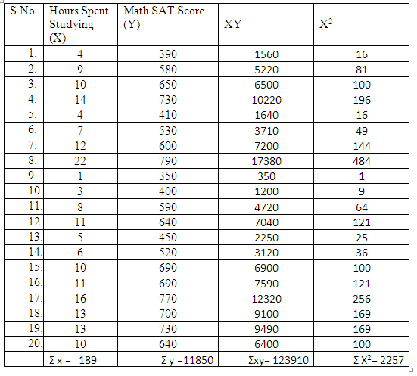


Slide 16

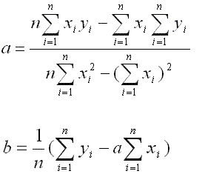
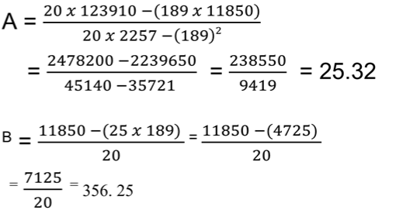

Slide 17
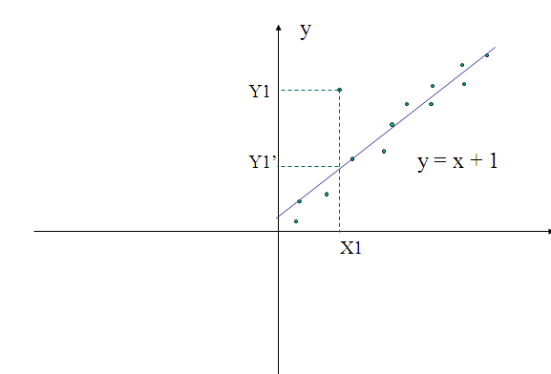
We will get
A=25
B= 356
Y= Ax+b
Y = 25 x + 356

Slide 18

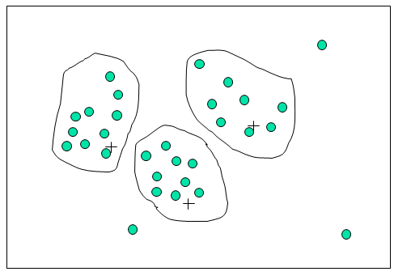
Clustering: Outliers may be detected by clustering, where similar values are organized into groups, or “clusters.” Intuitively, values that fall outside of the set of clusters may be considered outliers

Slide 19

Inconsistance data:
Some data inconsistencies may be corrected manually using external references.
For example, errors made at data entry may be corrected by performing a paper trace.
Inconsistance
data
Age | Income | Team | Gender
23 | 24000 | Red socks | M
32 | 2 | Yankees | M
25 | 20000 | Yankees | F

