Slide 1
User
Name
Email
Password
Models
Country
Name
ISOcode
Zoom
Votes
Points
Month
Country [Ref]
User [Ref]

Slide 2
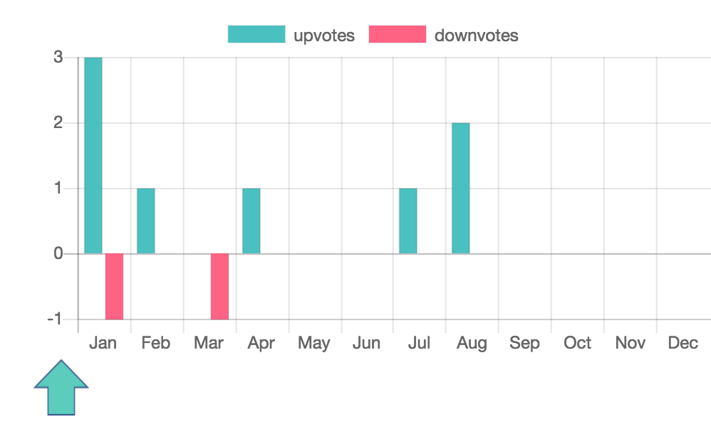
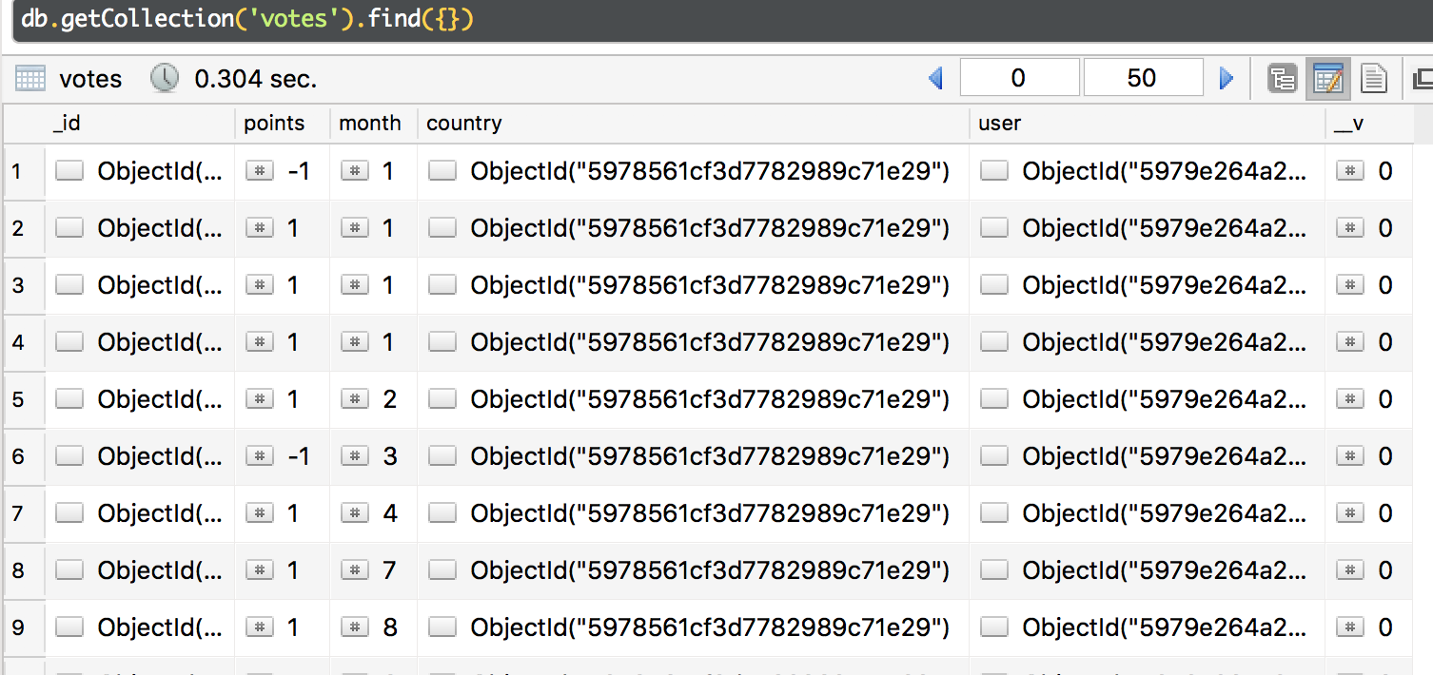
Front End
Back End

Slide 3
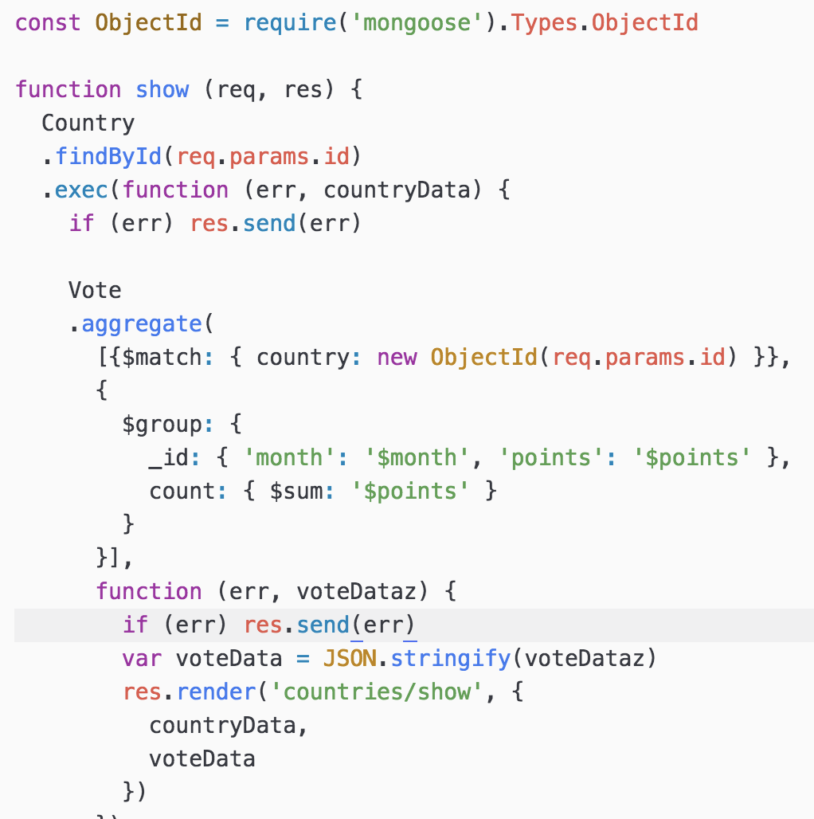
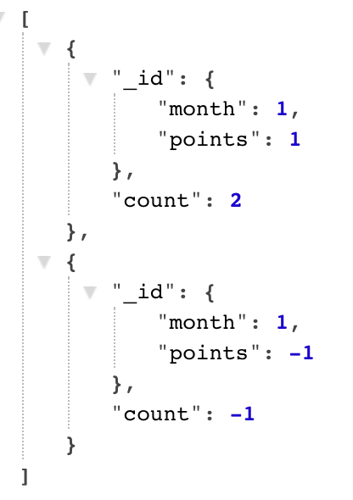
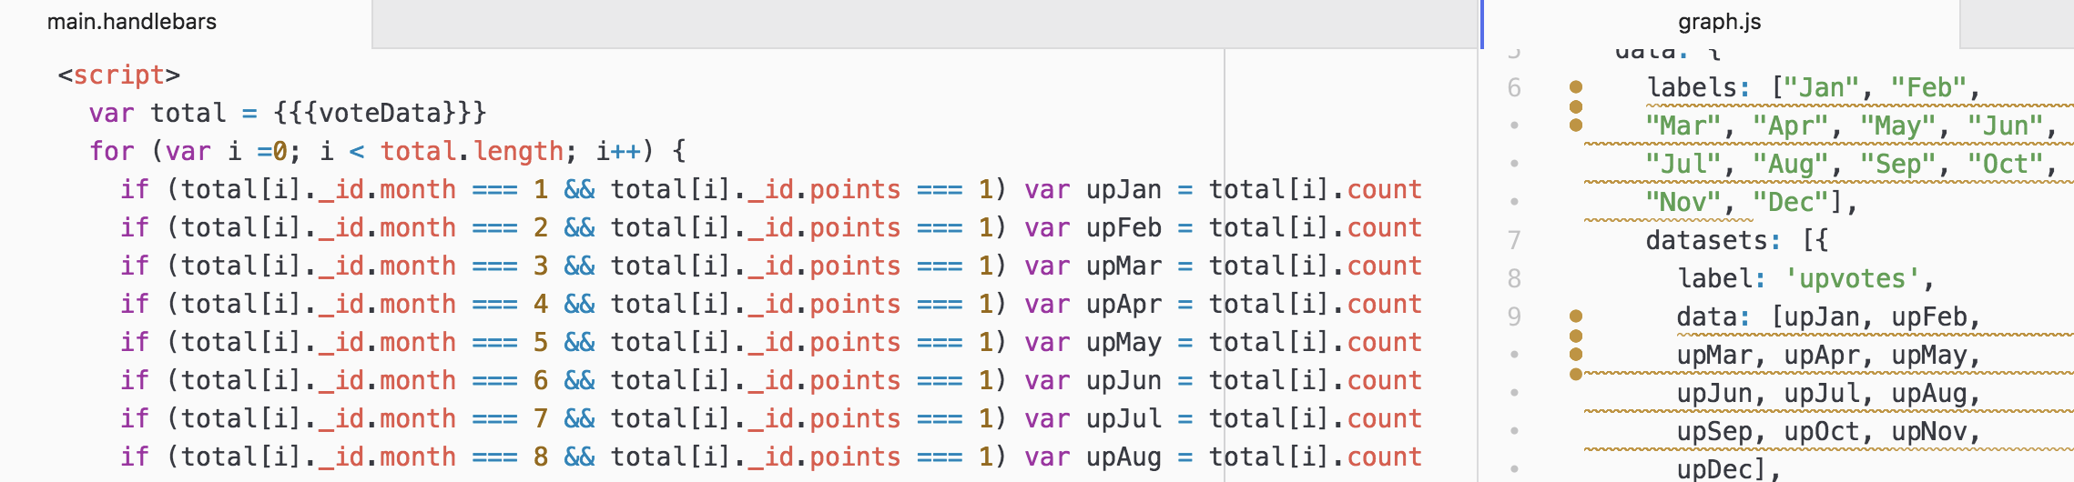
Front End
Back end

