Slide 1
Using Data Mining to Stop Spam in Minecraft
Daniel Gysi
CIS-241
“There will be no Minecraft in this course”

Slide 2
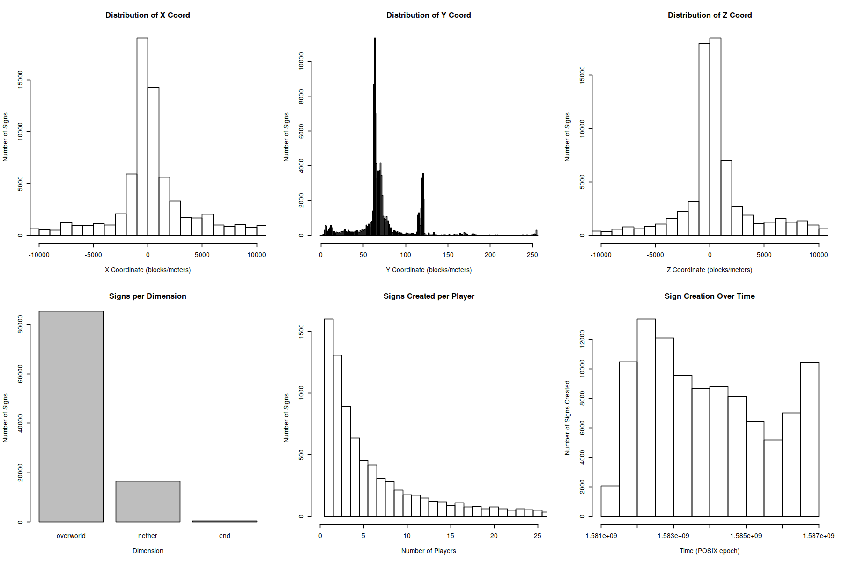
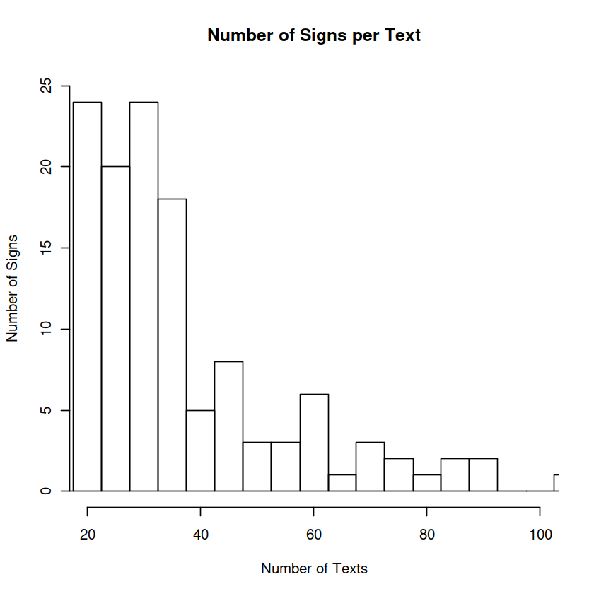
Our Data
Server logs from a Minecraft anarchy server run from February to April 2020
The sign data frame:
Who placed the sign
X,Y,Z coordinate and dimension where it was placed
Text on the sign

Slide 3
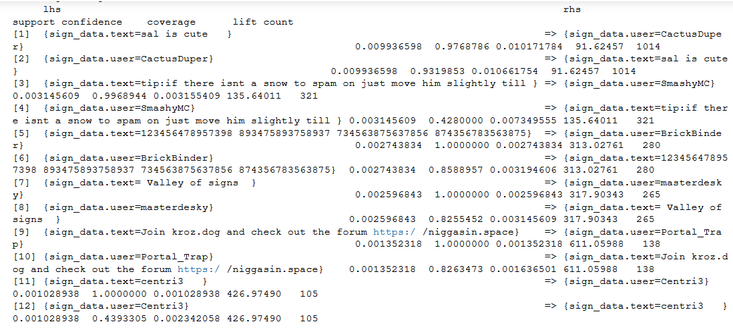
Our Methods
Association Rule Mining
We create association rules on the sign text and the user who placed that sign
The rules with high support indicate spam

Slide 4
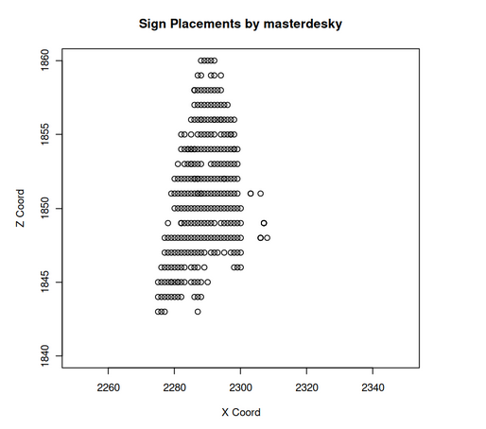
Our Motivation
Sign spam is a bigger problem than one might expect
Storing sign data takes significantly more space than normal blocks
A lot of signs in a small area can cause exploits including duplication glitches
Server operators need to be able to locate areas where this has occurred

