Slide 1
TAXI TRIP TIME PREDICTION FOR PORTO, PORTUGAL
GROUP H
- Sonam Rathod
- Dimple Pinnam
- Alex Borrelli
- Vignesh Gopalakrishna

Slide 2
Techniques used for Regression
Build a predictive framework that is able to infer the trip time of taxi rides in Porto, Portugal
Random Forest
GradientBoost
Linear Regression
Polynomial Regression
SVM
KNN
Techniques Not Covered in the Course
GradientBoost

Slide 3
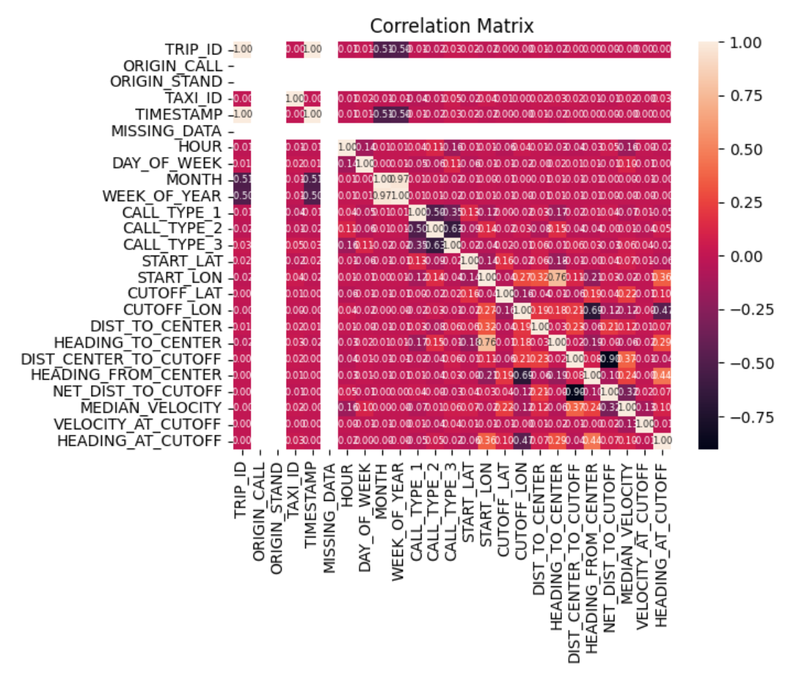
Data Pre-processing & Feature Engineering
Taxi Trip Dataset :
Drop Duplicate data
Convert the Unix timestamps to human-readable dates
Extract Spatial Features from POLYLINE
Compute Haversine Distance
Calculate bearing distance
Process Categorical Features
One hot encoding
Handle invalid trips

Slide 4
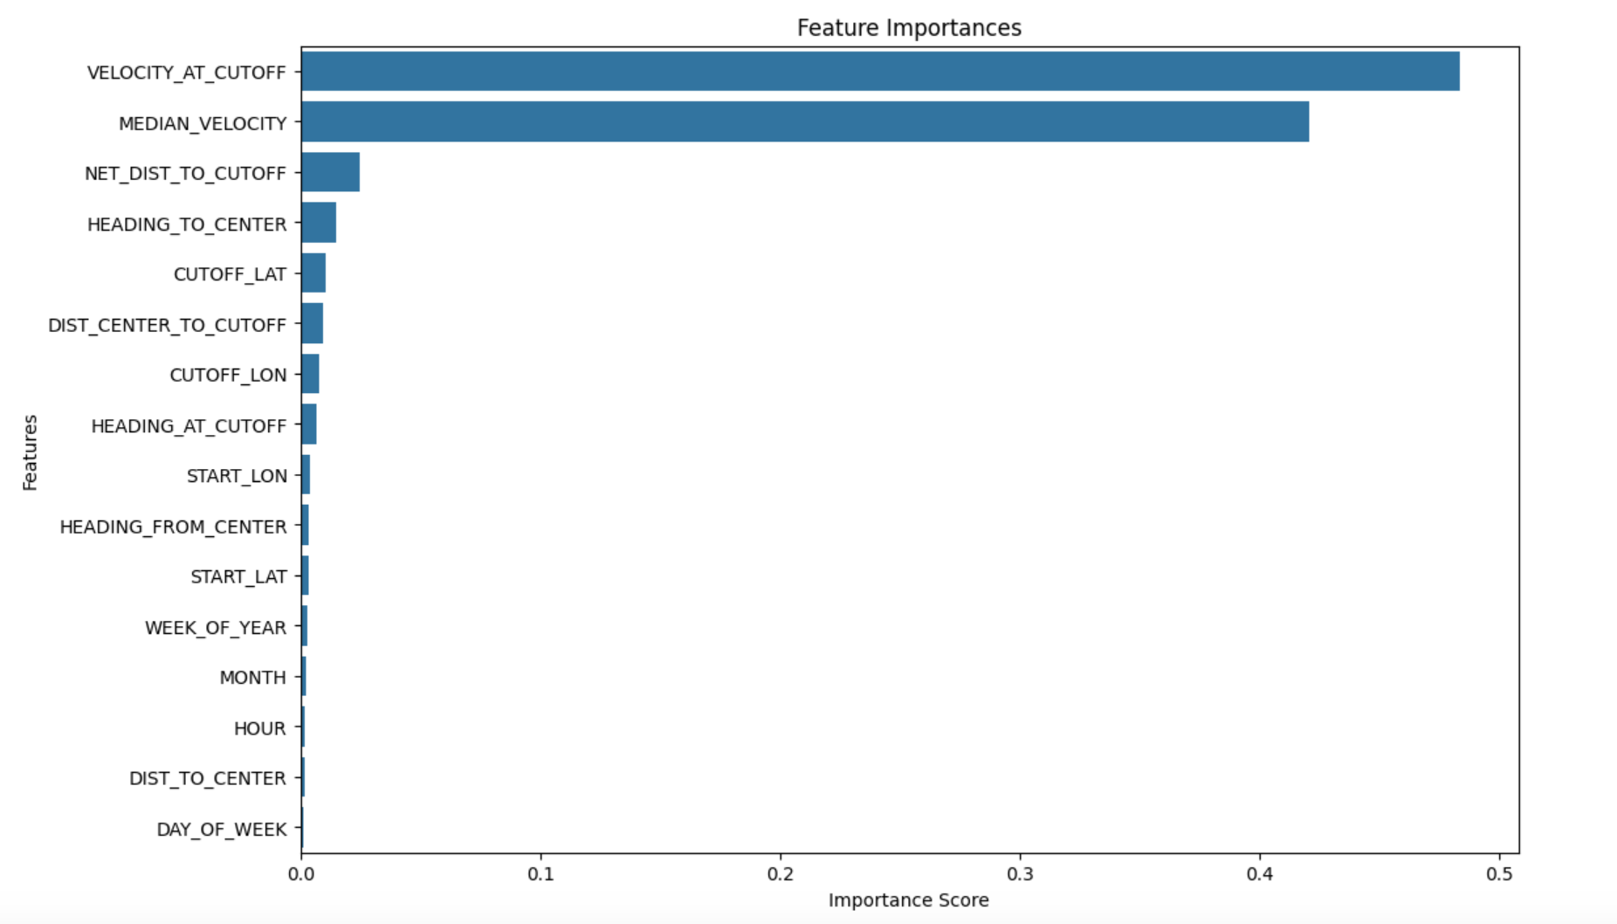
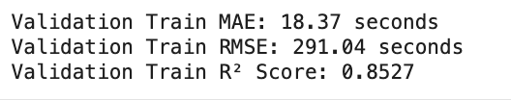
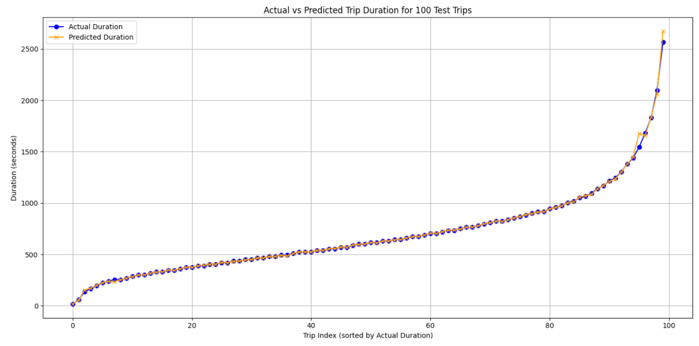
Random Forest
Good for capturing non-linear relationships and works well without much tuning.

Slide 5
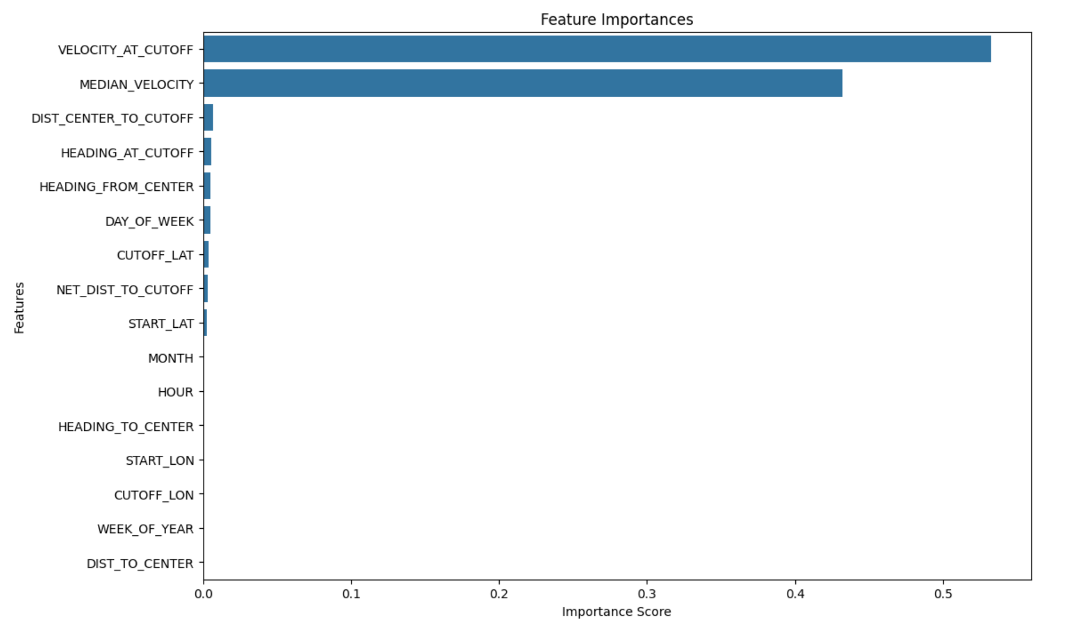
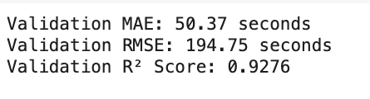
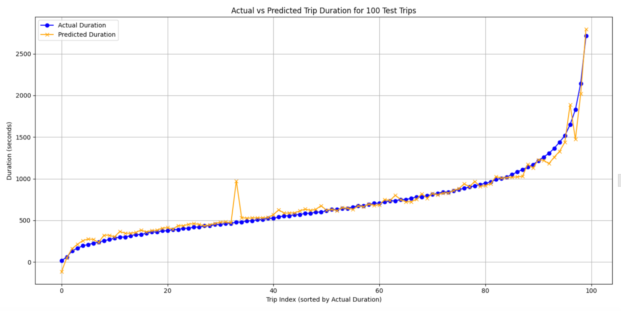
Gradient Boosting
Works well with tabular data and often provide higher performance compared to Random Forests

Slide 6
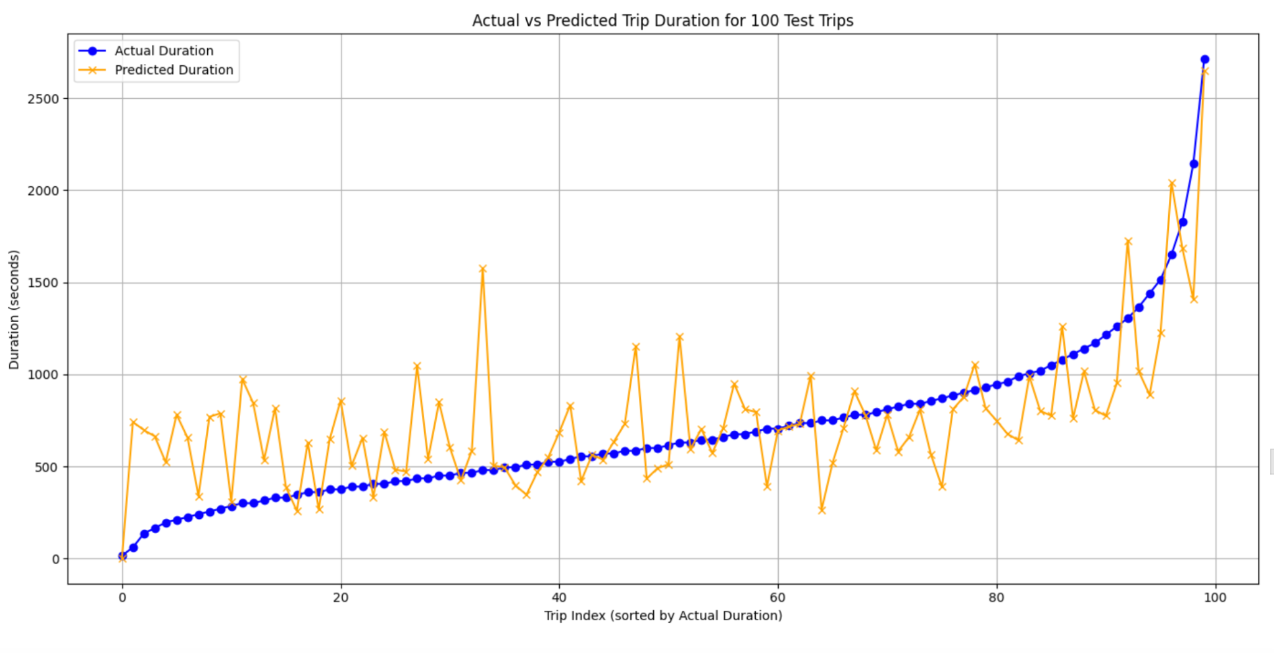
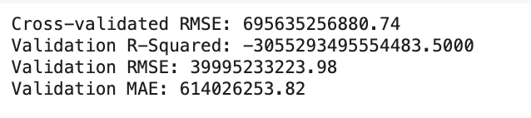
Linear Regression with Splines
A good baseline for a quick evaluation. Splines allow for modeling non-linear relationships by fitting piecewise linear regressions.

Slide 7
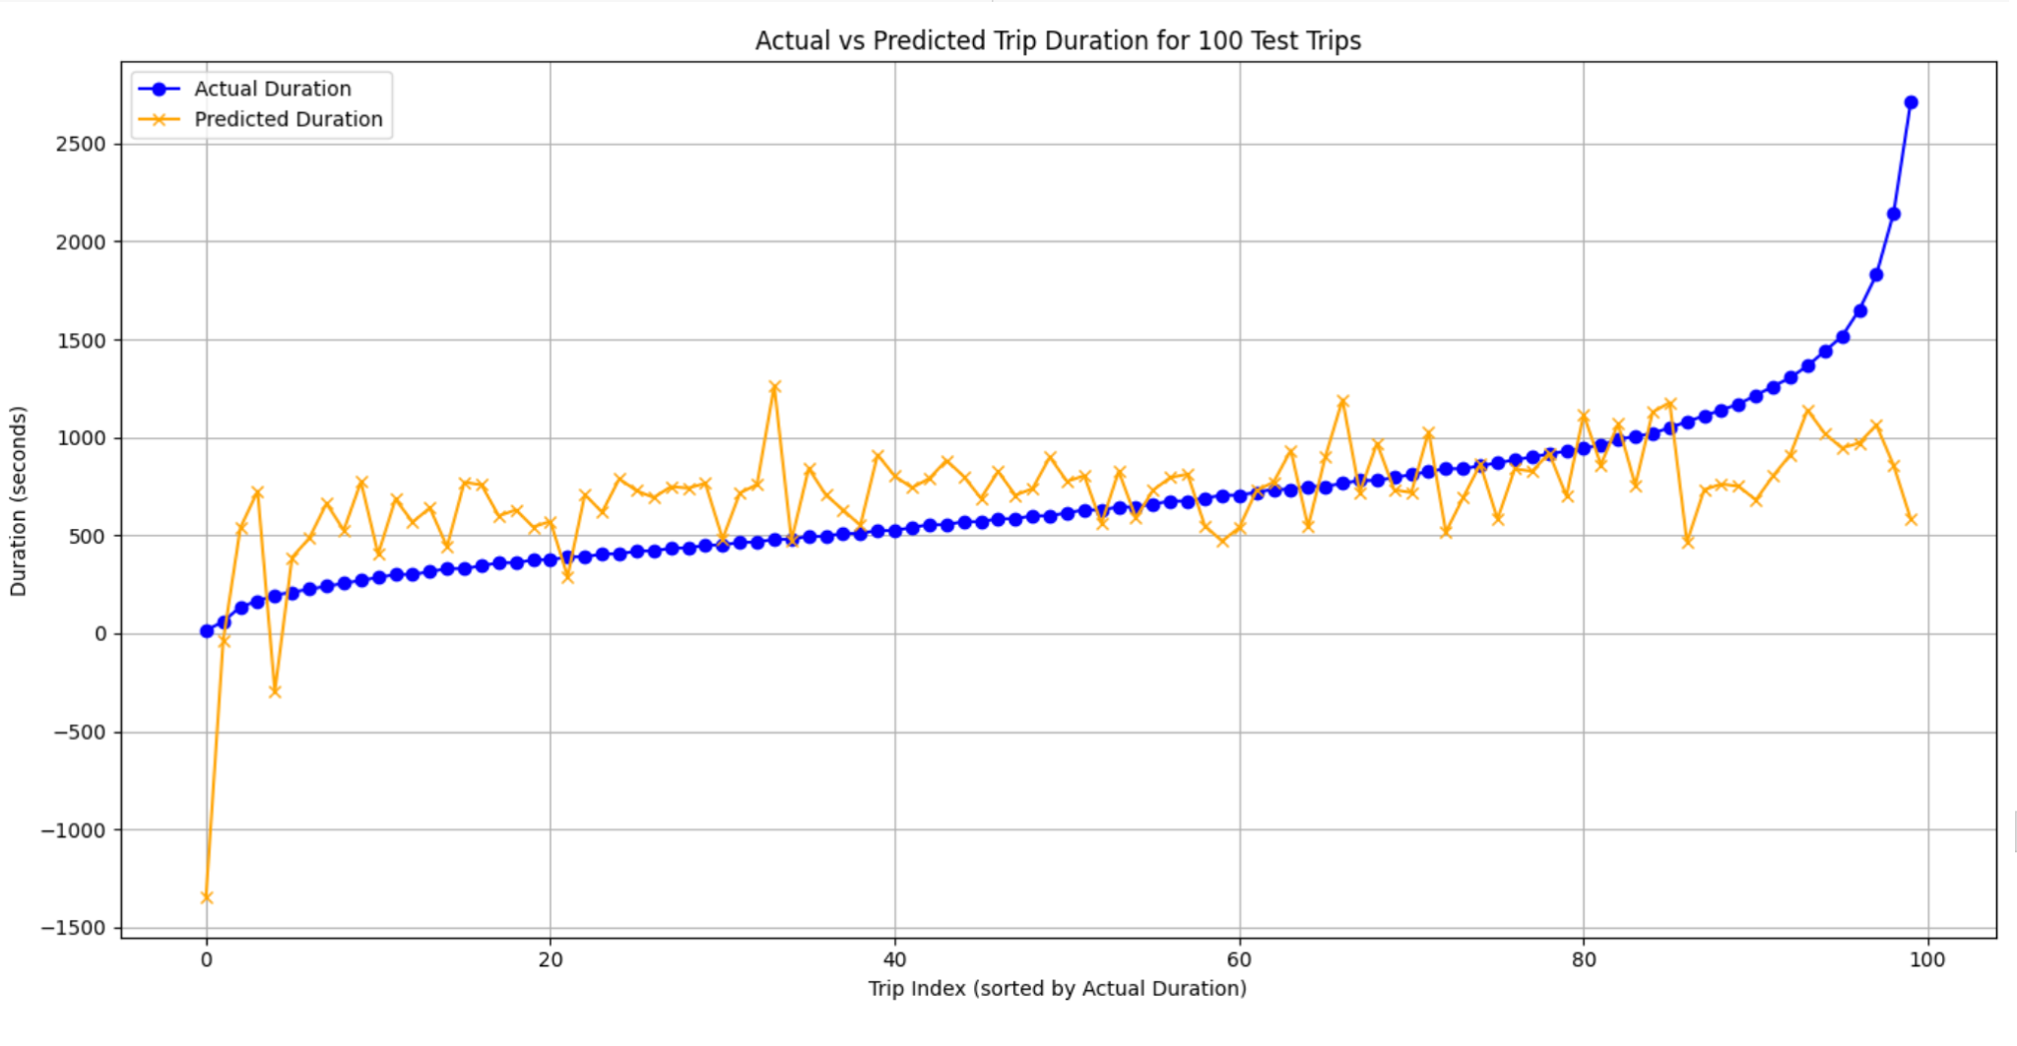
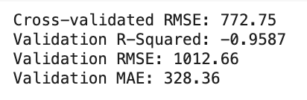
Polynomial Regression
Adds flexibility by fitting higher-degree polynomials. However, it can lead to overfitting for higher degrees, so evaluate the performance carefully.

Slide 8
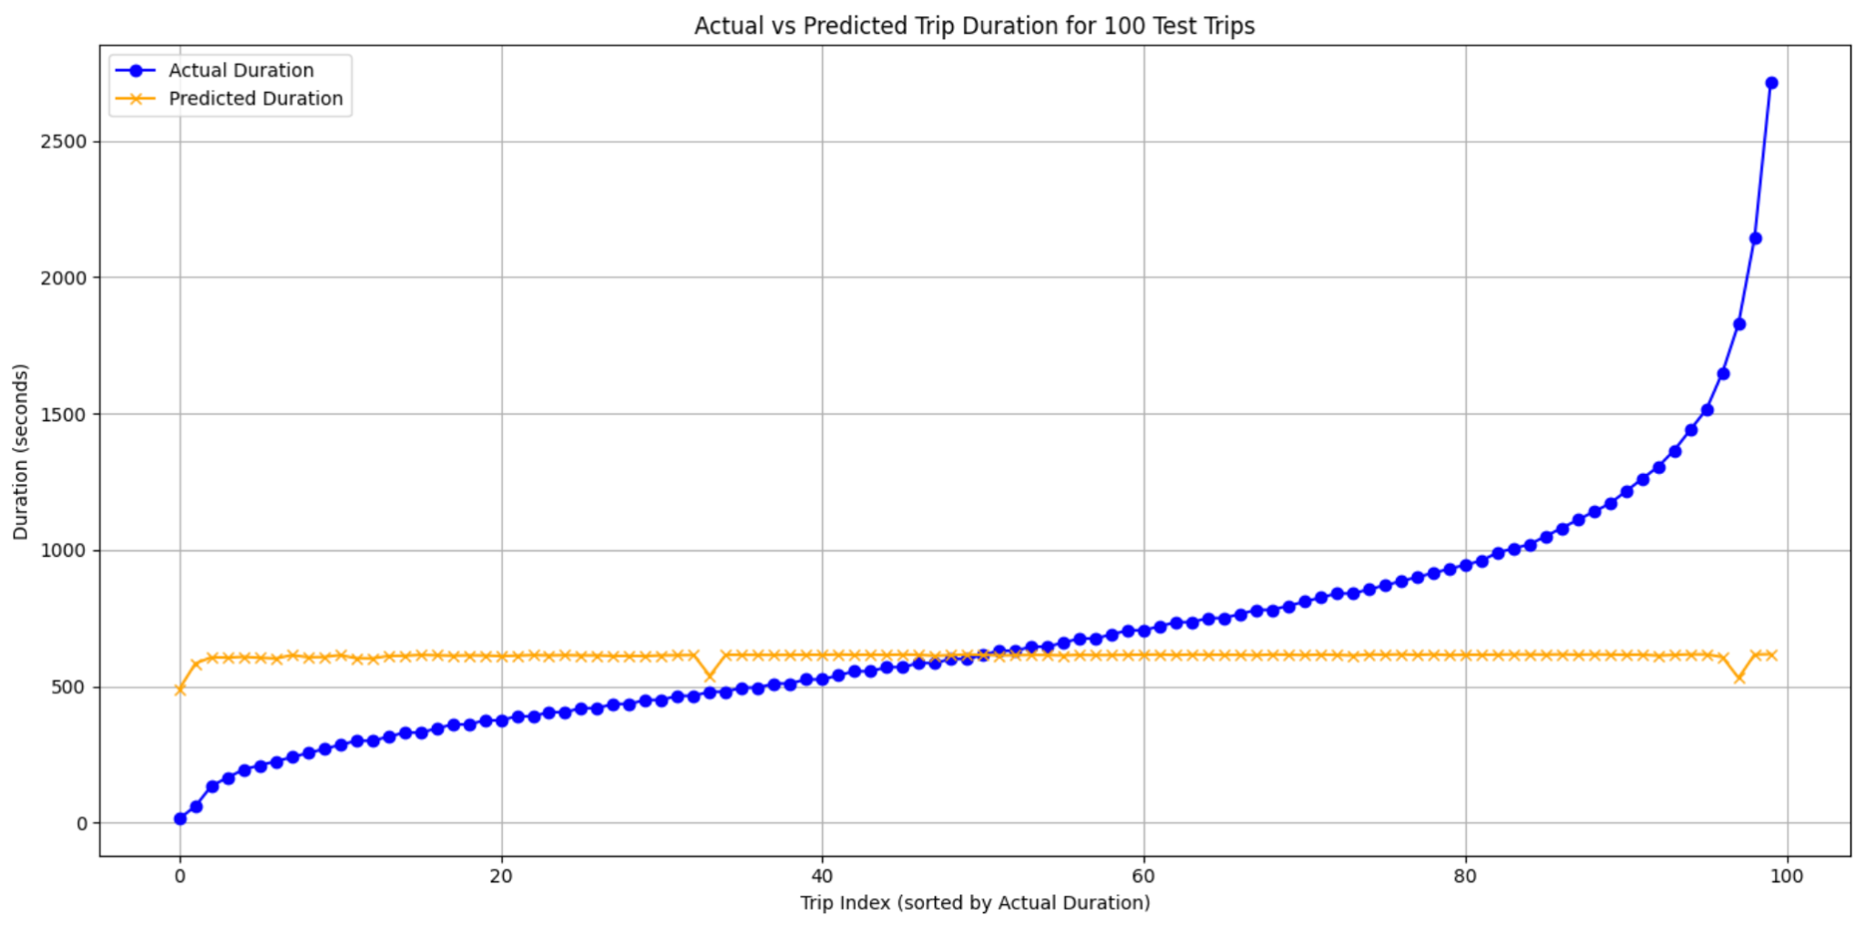
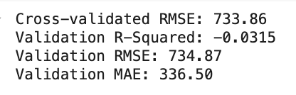
Support Vector Machine (SVM)
Can be effective for smaller datasets or datasets where there is a clear margin of separation between points, but it may struggle with large datasets.

Slide 9
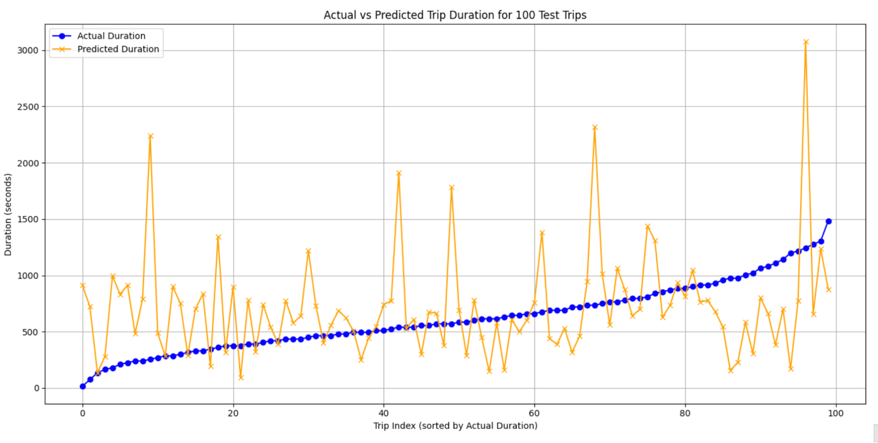
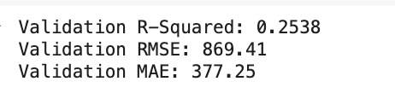
K Nearest Neighbor (KNN)
Simple and intuitive to implement. Non-parametric (makes no assumptions about the underlying data distribution)

Slide 10
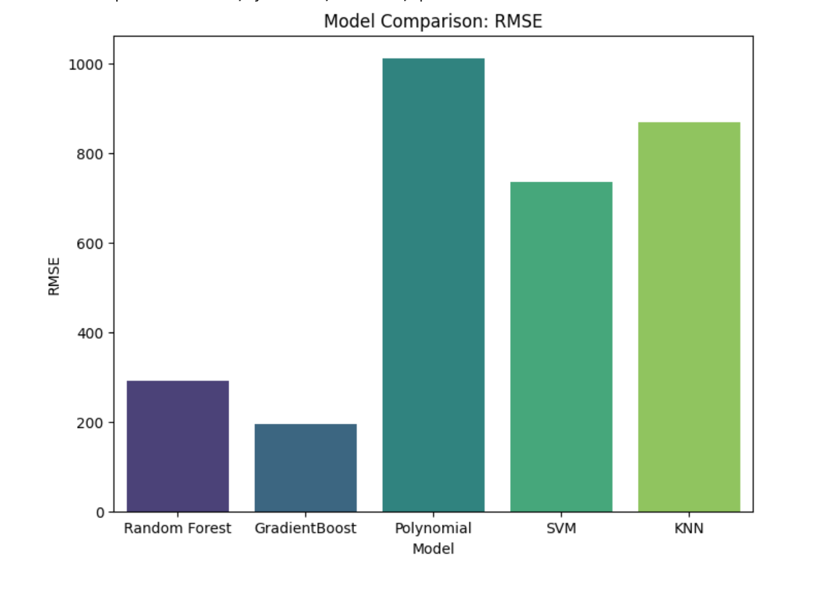
Model Comparisons based on RMSE

Slide 11
Contributions
Data Preprocessing and Feature Engineering - Sonam, Dimple and Alex
Models
RandomForest, Gradient Boost - Sonam
Linear Regression w/Splines, Polynomial Regression - Dimple
KNN - Alex
SVM - Vignesh
Model Evaluation - Sonam, Dimple, Alex and Vignesh
Model Comparison - Sonam, Dimple, and Alex
Prediction Excel - Alex

