Slide 1
Compile safe code with Visitor pattern
DESIGN PATTERNS .NET
CONFIDENTIAL | © 2025 EPAM Systems, Inc.

Slide 2

About me
Lead Software Engineer with 7 years of experience
My core skills:
.NET, C#, LINQ, Dancing
My focus areas:
High loaded fault-tolerant systems, responsible client applications
Microservices architecture, RESTful, RPC
FP, OOP, Design Patterns, Tea Ceremonies
Team management, leadership and project success
My EPAM level activities:
Mentor, Students Lector, Technical Interviewer
Dmitrii Bessonov

Slide 3
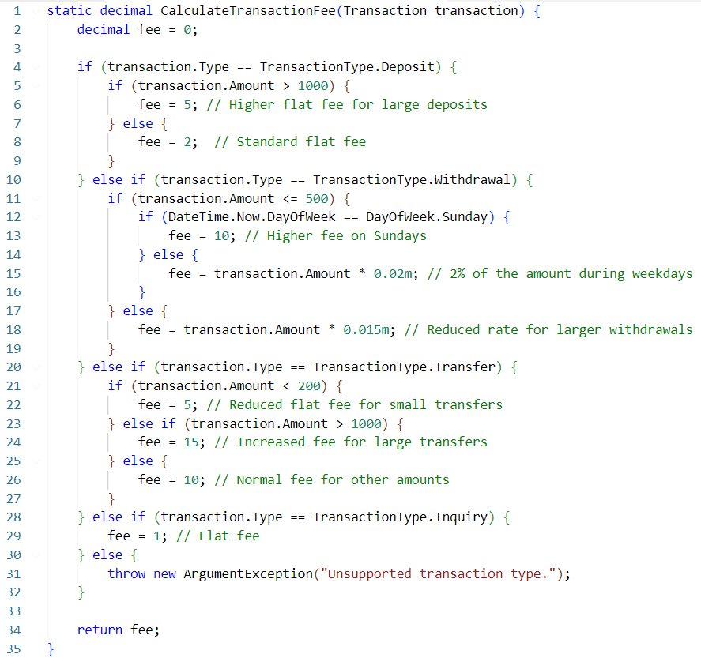
THE PROBLEM
"Compile safe code"
Code that can be successfully compiled without errors, adhering to programming language rules.
It prioritizes catching errors during compilation rather than runtime, enhancing early error detection.
Compile-safe practices lead to more secure and reliable software.

Slide 4
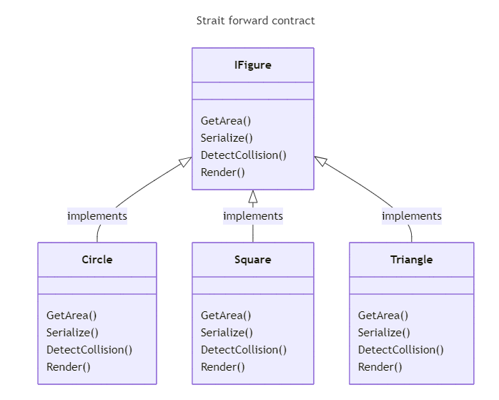

Slide 5
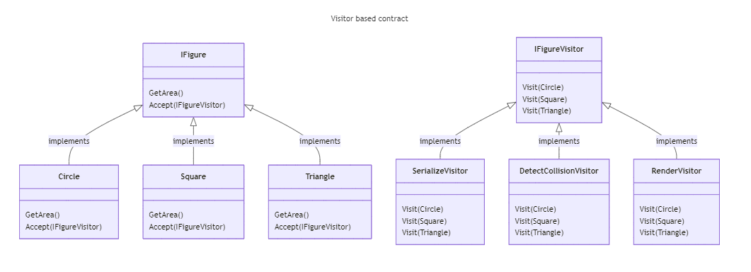

Slide 6
Visitor pattern
Materials
Refactoring guru: Visitor and Double Dispatch
Youtube: Visitor Design Pattern Is Giving Way To Pattern Matching Expressions!

Slide 7

REFACTORING STORY DEMO
https://git.epam.com/gedotnet/design-patterns/visitor
Basic implementation
Switch to pattern matching
Switch to Visitor pattern
Extend implementation
- Visitor with state
- Visitor with currying
- Universal visitor
Compare with switch
Production examples
Homework

Slide 8
SOLUTION
Mindset
Recommendations
Think of avoiding nested IF-ELSE conditions
Think of handle all possible cases (even if they unlikely)
Apply functional programming concepts to achieve compile safety
Declare the contract of what your code can do
Follow SOLID principles

Slide 9
Q&A

Slide 10
THANK YOU!

