Slide 1
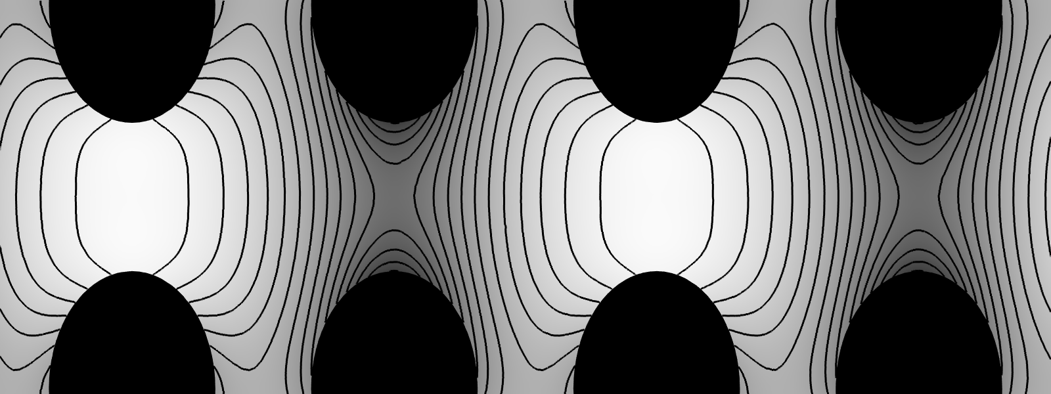
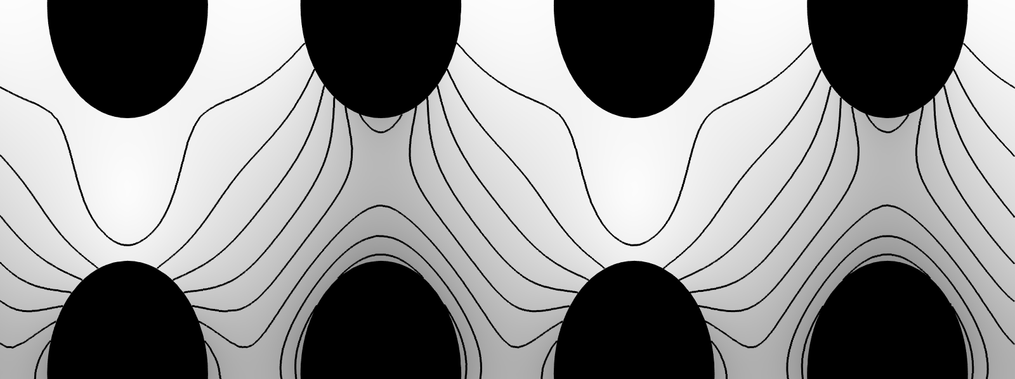
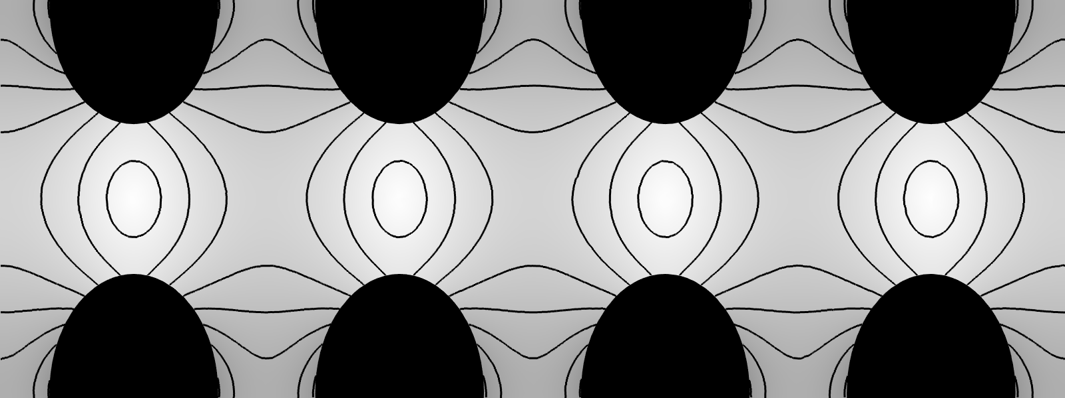
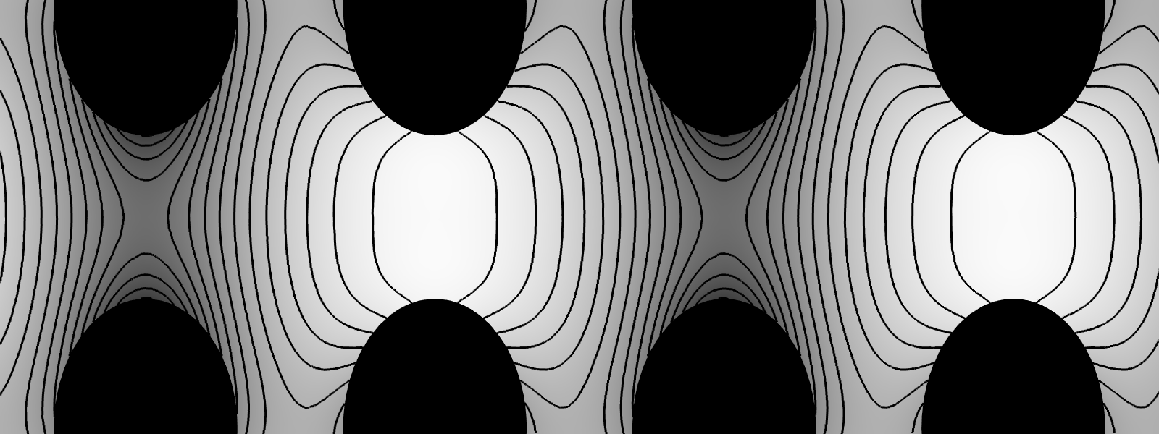
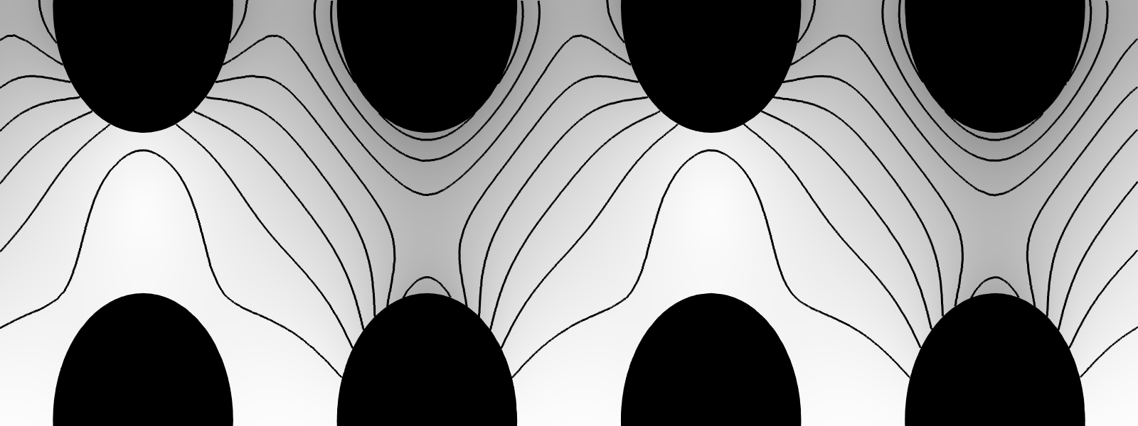
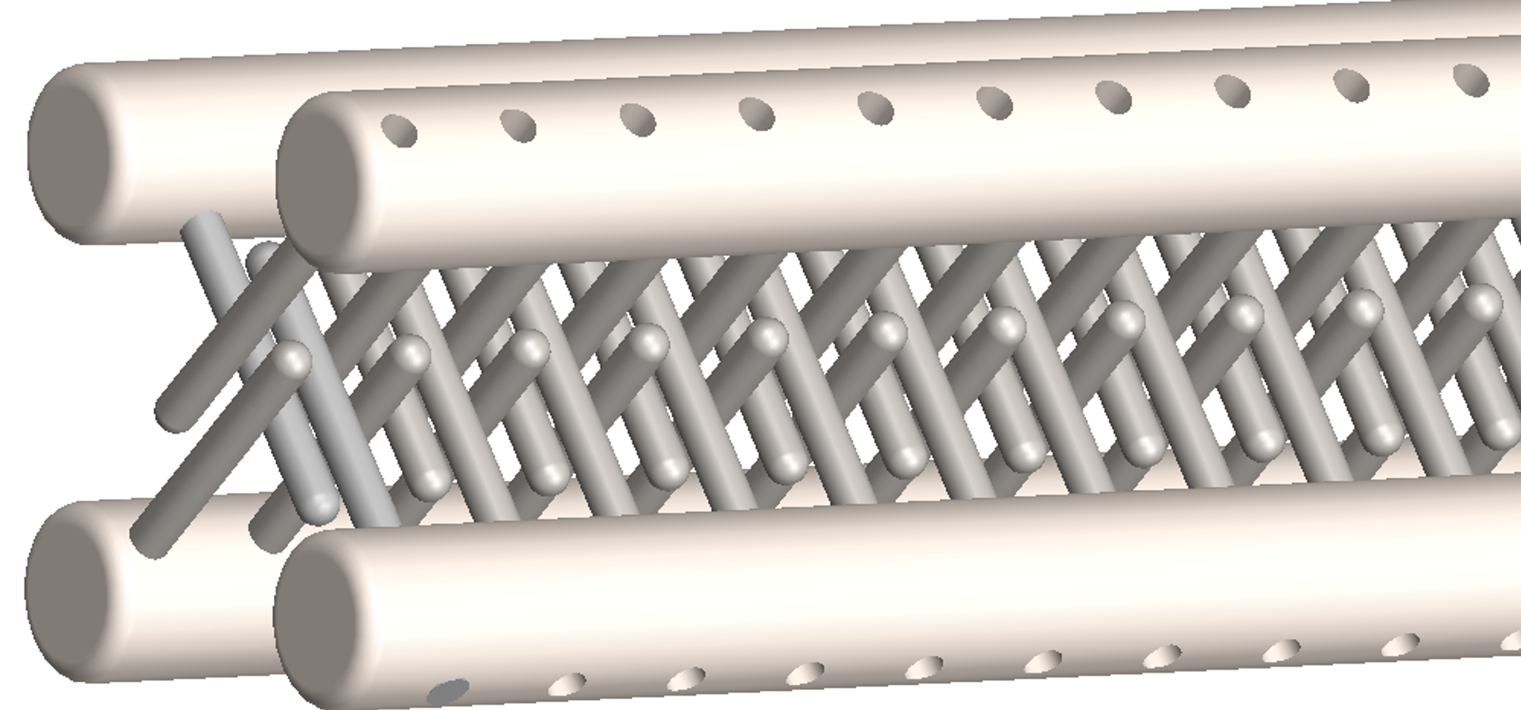
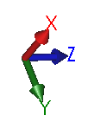
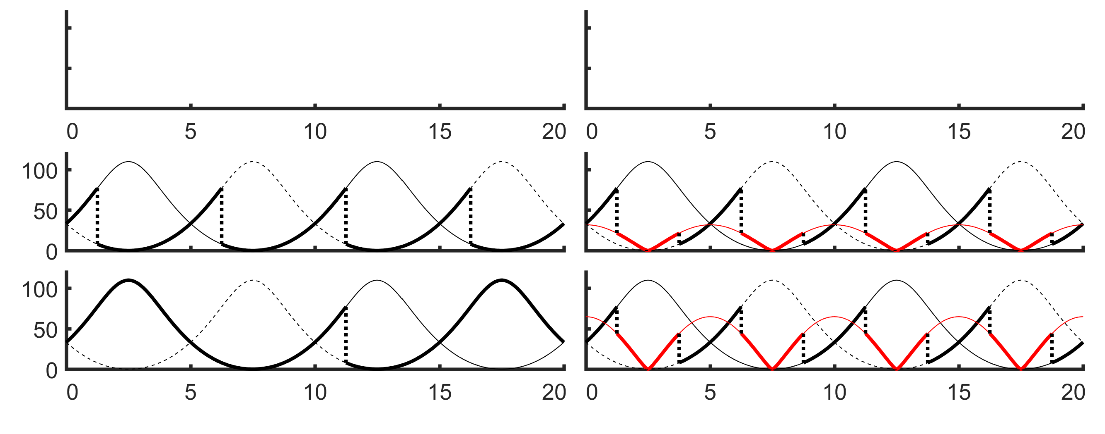
4
+
+
+
+
140
2
A
B
D
120
0
-2
100
Distance from Z-axis (mm)
+
+
—
—
—
—
-4
80
E-Field Norm |E| (kV/cm)
4
+
+
+
+
60
2
A'
C
X
40
0
Z
-2
20
—
—
Y
-4
0
0
5
10
15
20
0
5
10
15
20
S=1
F
SF
A
100
A
A’
A
A'
A
A'
|E| (kV/cm)
A'
50
A
A’
A
A’
B
B’
C
C’
D
D
D
D
BCD
0
Active
0
5
10
15
20
0
5
10
15
20
0
5
10
15
20
Z-axis (mm)
Z-axis (mm)
Z- axis (mm)

