Slide 1
Realizing VSF Mode
Alternatives within reach?

Slide 2
Alternative to VSF Mode: VSF2
Use +-+- instead of gg+- to avoid needing a 3 output switch:
VSF
D
A
D
A′
D
A
D
A′
VSF2
D
E
D
E
D
E
D
E
A | +-gg
D | ++gg
E | +-+-
VSF2.5
D
A
D
E
D
A
D
E

Slide 3
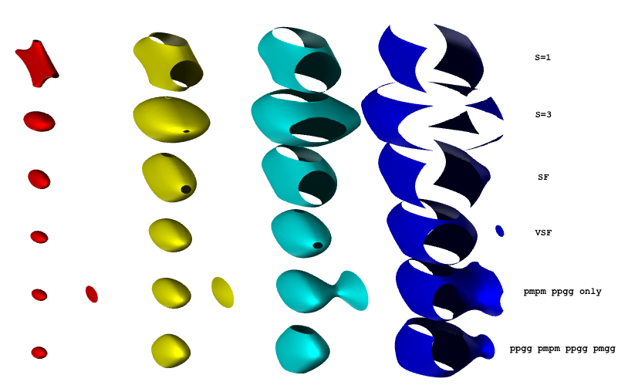
Alternative to VSF Mode: VSF2
Can look at the trap figure:
(VSF2)
(VSF2.5)

Slide 4
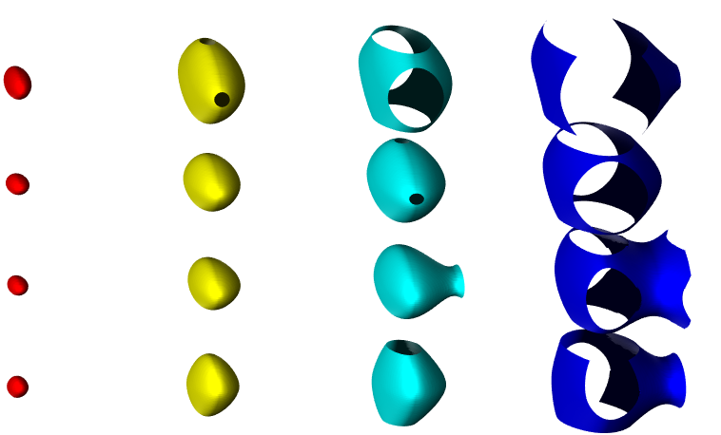
Alternative to VSF Mode: VSF2
Can look at the trap figure:
SF
VSF
VSF2
VSF2.5
$∴$SF < VSF2 ~ VSF2.5 < VSF

Slide 5
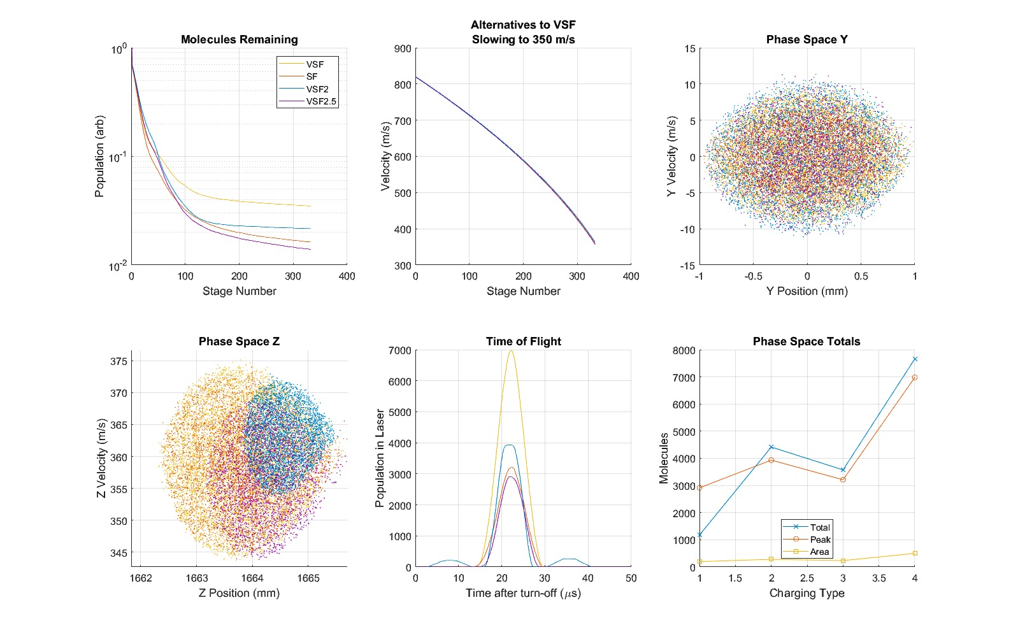
Alternative to VSF Mode: VSF2
We need simulation to see how close VSF2, VSF2.5 come to VSF:

Slide 7
Alternative to VSF Mode: VSF2
We need simulation to see how close VSF2, VSF2.5 come to VSF.
Conclusion:
VSF2.5 < SF < VSF2 < VSF
VSF2 only 25% better than SF.
Why? Maybe the asymmetry of VSF2.5 increases ergodicity, more molecules escape than in SF, VSF.

Slide 8
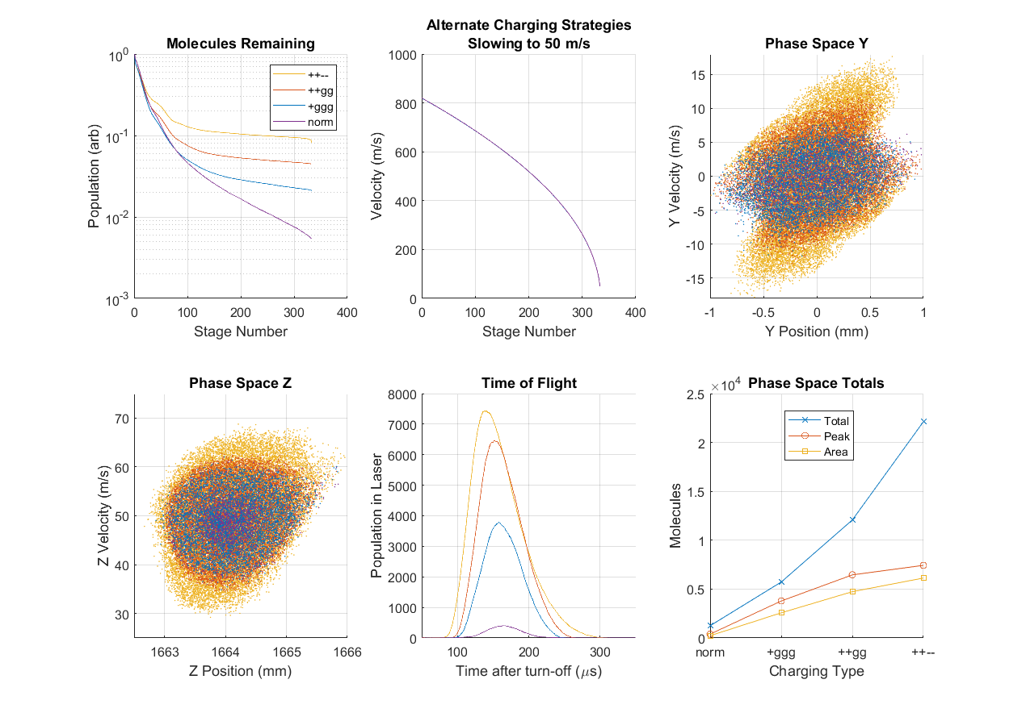
What about XSF?
Use ++-- instead of ++gg for even better focusing.
By simulation, wider phase space but not more density:

Slide 10
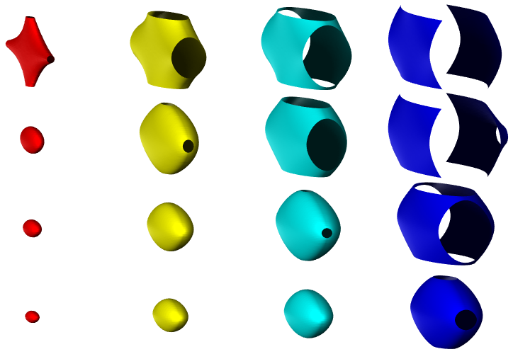
What about XSF?
But the effective moving trap looks incredible:
S=1
SF
VSF
XSF
10 50 100 200 (mK)

Slide 11
What about XSF?
Why the discrepancy?
Low final speed. The XSF effective trap has a higher frequency, and thus requires more frequent focusing events to be realized.
If we compare at higher final speed:

Slide 12
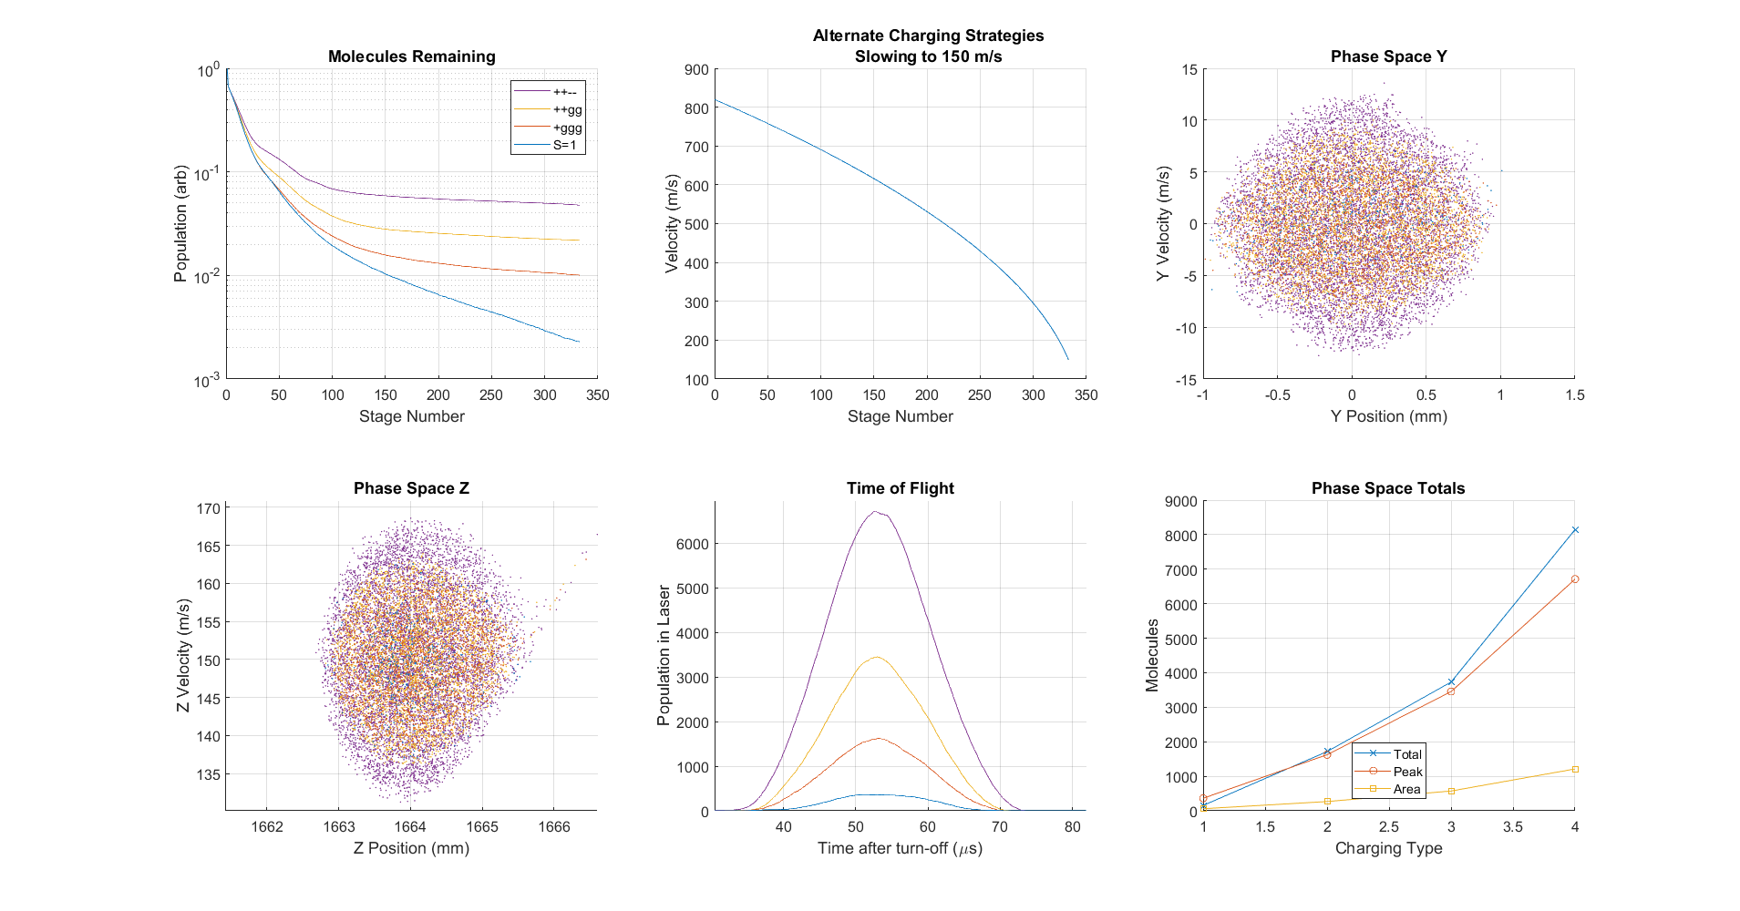

Slide 13
What about XSF?
Why the discrepancy?
Low final speed. The XSF effective trap has a higher frequency, and thus requires more frequent focusing events to be realized.
If we compare at higher final speed:
Now the transverse phase space looks more respectable.
The gain shows no sudden dip near the end.
We do need low speeds for trapping, but we should simulate trap-loading to decide, not simply ignore XSF because the phase space looks ugly.
Also, XSF2:

Slide 14
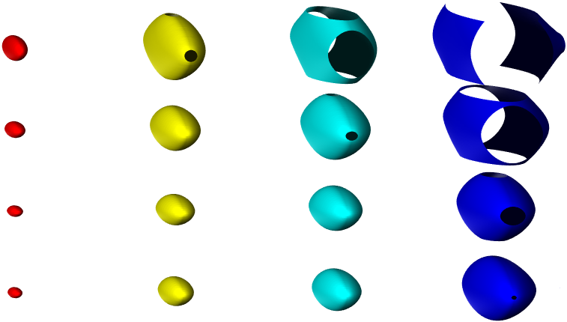
XSF2
Like VSF2, we switch between only two states, ++-- and +-+-.
Can be achieved with two 30 kV push-pull switches.
Or a 30 and a 20, running at +/-15kV and +/-10kV, which we have now
Unlike VSF2, it actually surpasses XSF slightly:
SF
VSF
VVSF
XSF2

Slide 15
XSF2
Like VSF2, we switch between only two states, ++-- and +-+-.
Can be achieved with two 30 kV push-pull switches.
Or a 30 and a 20, which we have now (!)
Unlike VSF2, it actually surpasses XSF slightly:
Why? ++-- fields are strong enough to slow on their own, +-gg not needed.

Slide 16
XSF2
Corroborate with Simulation:

Slide 17
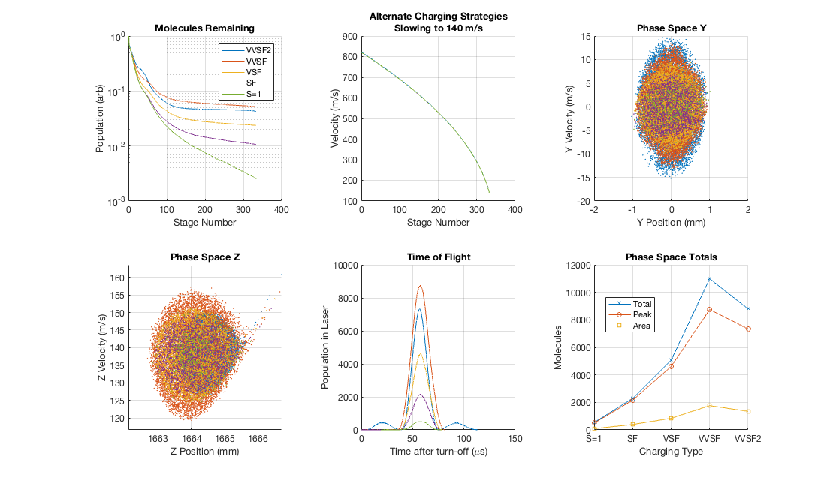
XSF XSF2

Slide 18
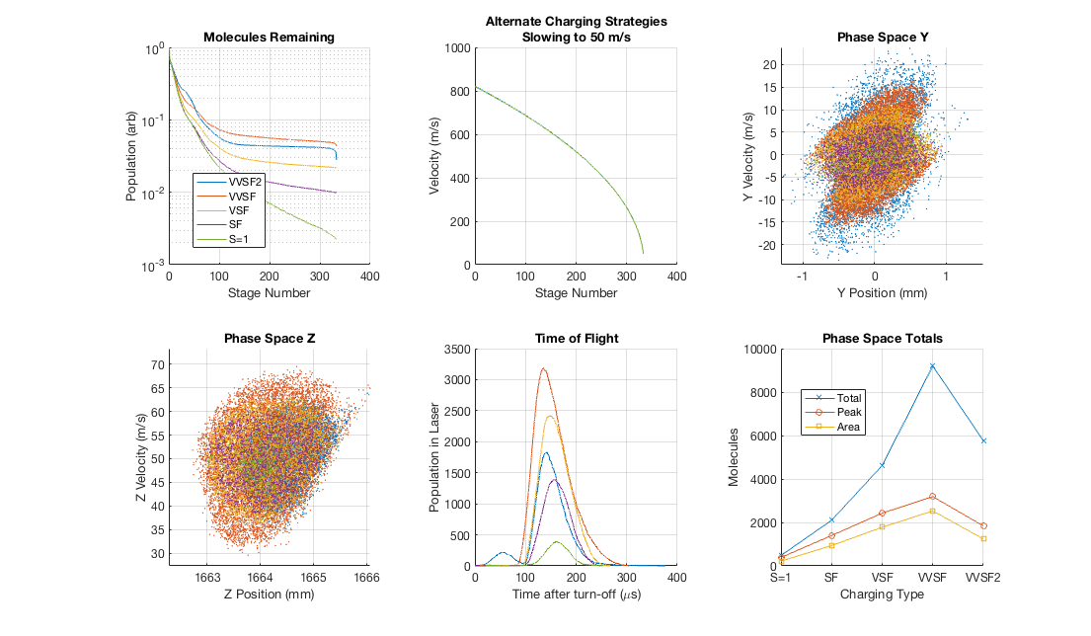
XSF XSF2

Slide 19
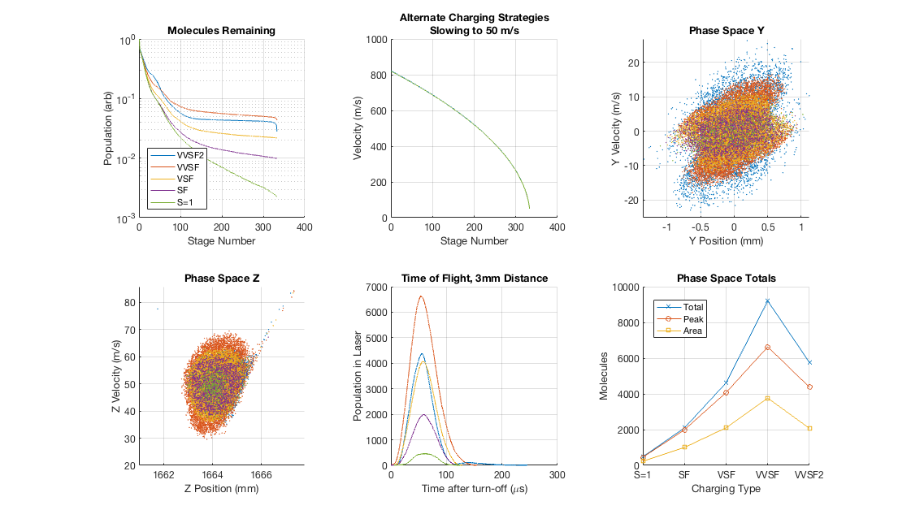
XSF XSF2

Slide 20
XSF2
Corroborate with Simulation:
Slightly worse than XSF, due to reduced Z-PSD.
Stronger negative effect at the lowest speeds for XSF2 than XSF.
Behaves worse than VSF with 8mm free flight to laser.
Not necessarily worse for trap loading.
A hybrid setup for the last few stages?
Could avoid defocusing +-+- configuration.
Maybe ++-- is overfocusing at the lowest speeds.

Slide 21
Alternative to VSF Mode: VSF2
BUT!
Running XSF/XSF2 puts full voltage across adjacent pin pairs.
Maybe we can condition for this configuration…
Configuration +-+-
-
+
-
+
+
-
+
-

Slide 22
Conditioning for XSF2 (+-+-/++--)
Surface Quality:
Best side of pins are pointing towards each other.
Worst parts are pointed away.
Sides of pins are somewhere in between.
Spacing:
Some inaccuracies in pin-pair spacing. Some may be as close as 1.5 mm to one another.
Overlap:
Much smaller than normal configuration, by more than an order.
We could just try it.

Slide 23
Electronic Requirements
To understand charge transfer we need a capacitance matrix:
Experiment (LCR SR720 Probe): COMSOL Simulation:
(pF) | Rod 1 | Rod 2 | Rod 3 | Rod 4 | GND
Rod 1 | 206 | -56 | -64.5 | -62 | -33
Rod 2 | -56 | 208 | -65 | -63 | -37
Rod 3 | -64.5 | -65 | 210 | -57 | -33.5
Rod 4 | -62 | -63 | -57 | 206 | -33.5
GND | -33 | -37 | -33.5 | -33.5 | 140
(pF) | Rod 1 | Rod 2 | Rod 3 | Rod 4 | GND
Rod 1 | 199 | -43 | -55 | -55 | -46
Rod 2 | -43 | 199 | -55 | -55 | -46
Rod 3 | -55 | -55 | 199 | -43 | -46
Rod 4 | -55 | -55 | -43 | 199 | -46
GND | -46 | -46 | -46 | -46 | 184

Slide 24
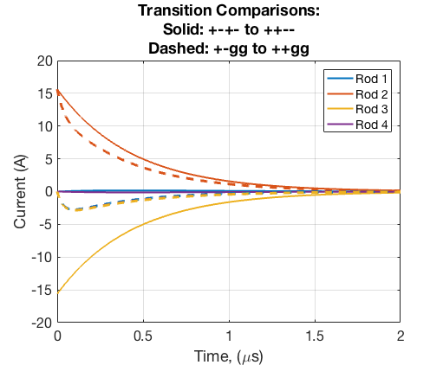
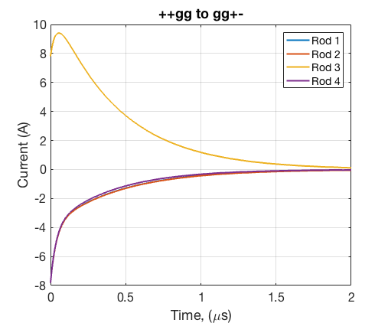
Electronic Requirements
Using Capacitance Matrix, we can solve current during edges:

Slide 25
Electronic Requirements
Next we can check power dissipated in the switches.
Assume R_on = 100 Ohms for now.
We can check the instantaneous power
Energy per switch
Continuous power at 10 Hz

Slide 26
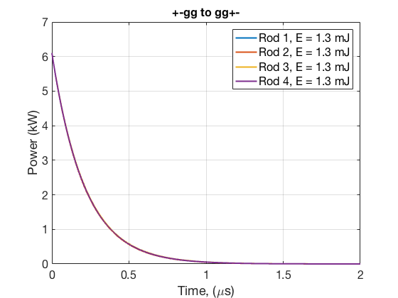
Electronic Requirements
( S = 1 )
1.3 * 167 = 217 mJ / rod
2.2 W continuous @ 10 Hz
 | Energy (mJ) | Power (W)
Rod 1 | 220 | 2.2
Rod 2 | 220 | 2.2
Rod 3 | 220 | 2.2
Rod 4 | 220 | 2.2

Slide 27
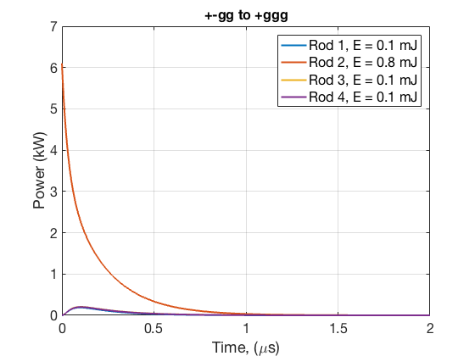
Electronic Requirements
( SF )
Now we consider various different transitions during the SF sequence.

Slide 28
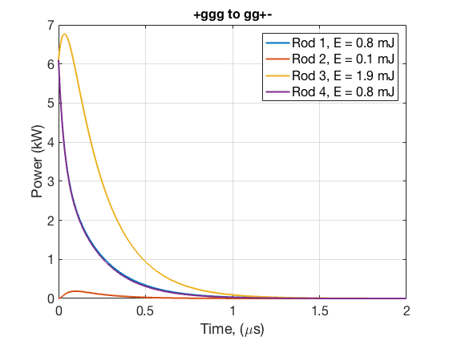
Electronic Requirements
( SF )
Now we consider various different transitions during the SF sequence.

Slide 29
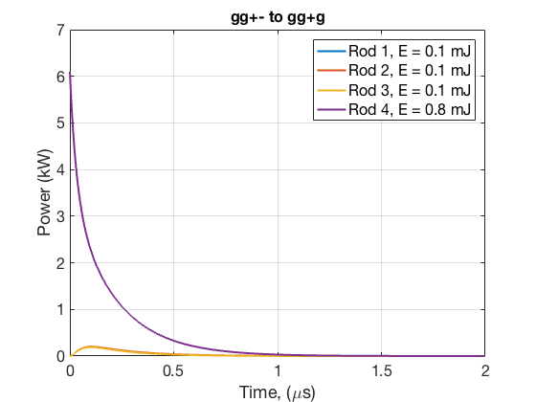
Electronic Requirements
( SF )
Now we consider various different transitions during the SF sequence.

Slide 30
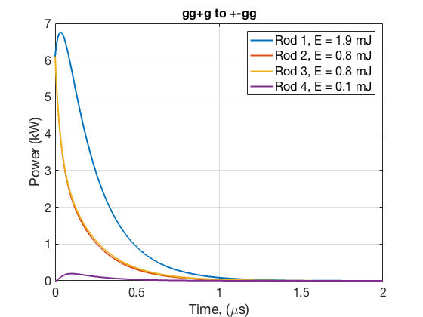
Electronic Requirements
( SF )
Now we consider various different transitions during the SF sequence.
 | Energy (mJ) | Power (W)
Rod 1 | 200 | 2.0
Rod 2 | 200 | 2.0
Rod 3 | 200 | 2.0
Rod 4 | 200 | 2.0

Slide 31
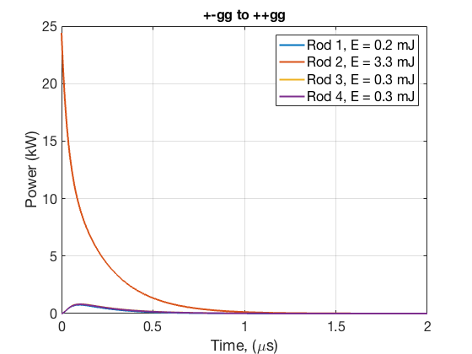
Electronic Requirements
( VSF )

Slide 32
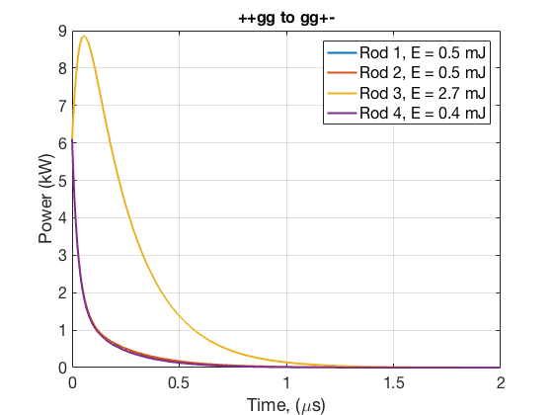
Electronic Requirements
( VSF )
 | Energy (mJ) | Power (W)
Rod 1 | 120 | 1.2
Rod 2 | 640 | 6.4
Rod 3 | 500 | 5.0
Rod 4 | 120 | 1.2

Slide 33
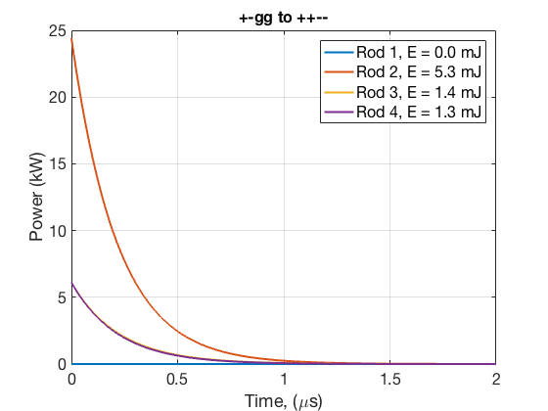
Electronic Requirements
( XSF )

Slide 34
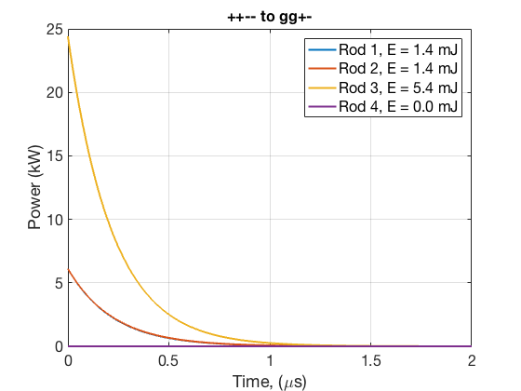
Electronic Requirements
( XSF )
 | Energy (mJ) | Power (W)
Rod 1 | 230 | 2.3
Rod 2 | 1120 | 11.2
Rod 3 | 1140 | 11.4
Rod 4 | 220 | 2.2

Slide 35
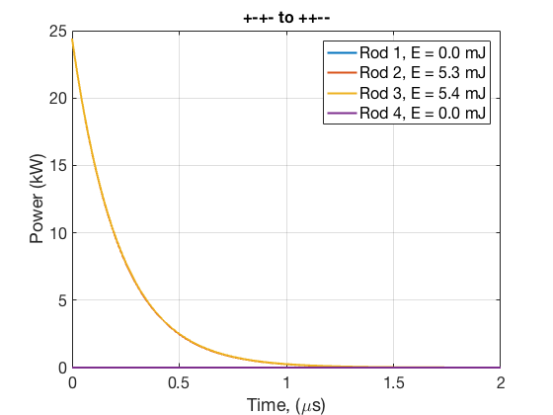
Electronic Requirements
( XSF2 )
 | Energy (mJ) | Power (W)
Rod 1 | 0 | 0
Rod 2 | 1770 | 18
Rod 3 | 1800 | 18
Rod 4 | 0 | 0

Slide 36
Electronic Requirements
Still need to add in contribution from natural capacitances.
Need to check Behlke details- R_{ON} may be even higher.

