Slide 1
Configuration A
Configuration B
+
+
+
+
-
-
+
+
Configuration C
Configuration D
+
+
-
-
S = 1
A
A′
A
A′
SF
C
A
C′
A′
D
A
D′
A′
VSF
B
A
B
A′
B
A
B
A′

Slide 2
Configuration A
Configuration B
+
+
+
+
-
-
+
+
Configuration C
Configuration D
+
+
-
-
S = 1
A
A′
A
A′
SF
C
C′
D
D′
SS
B
B
B
B
VSF
B
A A′
B
A A′
B
A A′
B
A A′

Slide 3
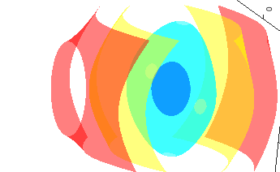
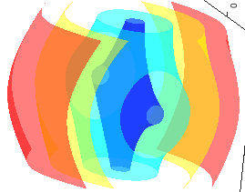
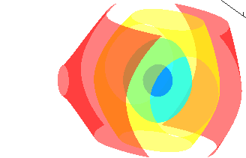
Configuration A
+
+
-
-
Configuration B
+
+
Configuration C
S = 1
A
A′
A
A′
-
-
Configuration D
SF
B
A
B′
A′
C
A
C′
A′
+
+
+
+
VSF
D
A
D
A′
D
A
D
A′

Slide 4
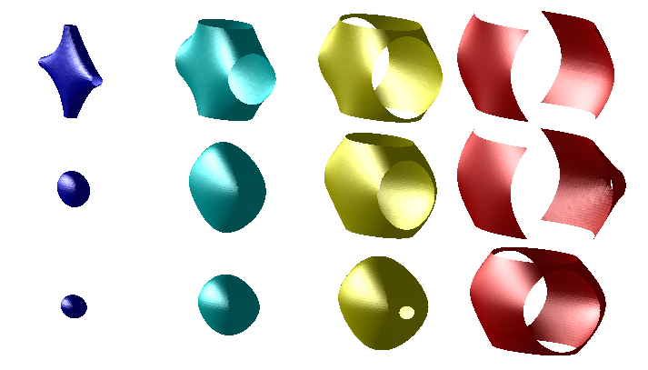
Configuration A
Deceleration Sequences
+
+
S = 1
A
A′
A
A′
-
-
SF
B
A
B′
A′
C
A
C′
A′
Configuration B
+
+
VSF
D
A
D
A′
D
A
D
A′
Configuration C
Contours of Effective Trap
S = 1
-
-
SF
Configuration D
y
+
+
x
VSF
z
+
+
10 mK
50 mK
100 mK
200 mK

