Slide 1
Configuration A
Configuration B
+
+
+
+
-
-
+
+
Configuration C
Configuration D
+
+
-
-
S = 1
A
A′
A
A′
SF
C
A
C′
A′
D
A
D′
A′
VSF
B
A
B
A′
B
A
B
A′

Slide 2
Configuration A
Configuration B
+
+
+
+
-
-
+
+
Configuration C
Configuration D
+
+
-
-
S = 1
A
A′
A
A′
SF
C
C′
D
D′
SS
B
B
B
B
VSF
B
A A′
B
A A′
B
A A′
B
A A′

Slide 3
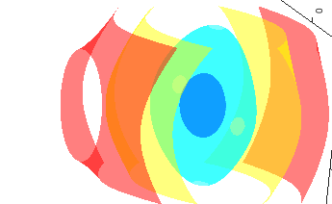
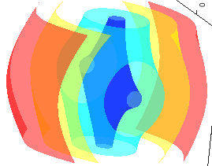
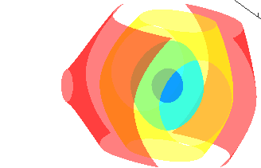
Configuration A
+
+
-
-
Configuration B
+
+
Configuration C
S = 1
A
A′
A
A′
-
-
Configuration D
SF
B
A
B′
A′
C
A
C′
A′
+
+
+
+
VSF
D
A
D
A′
D
A
D
A′

Slide 4
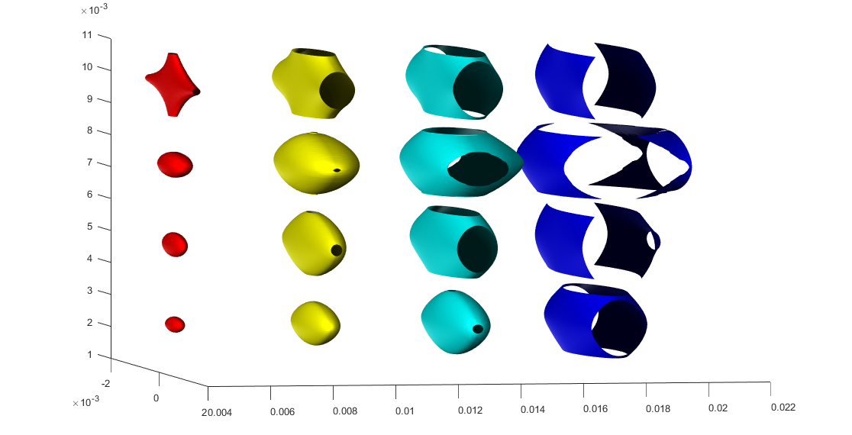
Configuration A
Operation Modes
+
+
S = 1
A
A′
A
A′
-
-
S = 3
A
A′
Configuration B
SF
B
A
B′
A′
C
A
C′
A′
+
+
D
A
D
A′
D
A
D
A′
VSF
Moving Trap Contours
Configuration C
S = 1
-
-
S = 3
SF
Configuration D
+
+
VSF
y
+
+
x
z
10
50
mK
100
200

