Slide 1
Nonadiabatic Decelerator Transitions
Parity Flips Suppressed by Λ,
but how about m=3/2 to m=1/2 ?

Slide 2
Background
Hinds checks during switching
PRA 81,033414(2010) Nonadiabatic transitions in Stark Decelerator
Meijer observes flips on chip decelerator
PRA 83,033413(2011) Suppression of nonadiabatic losses from chip-based microtraps
Tim checks on axis during switching, following Hinds.

Slide 3
OH Stark Effect

Slide 4
In – Flight Hops
Minimum E-field when flying between de-energized stage. How small?

Slide 5
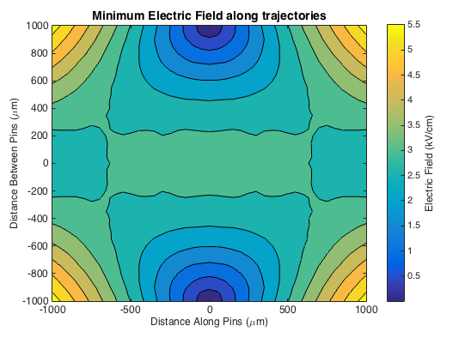
In – Flight Hops

Slide 6
In – Flight Hops
Minimum E-field when flying between de-energized stage. How small?
How about the corresponding Energy Gap?

Slide 7
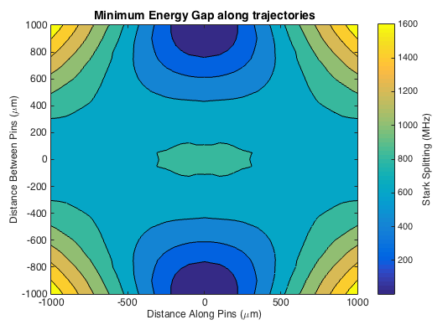
In – Flight Hops

Slide 8
In – Flight Hops
Minimum E-field when flying between de-energized stage. How small?
How about the corresponding Energy Gap?
Approximation from L-Z Formula:
Gap = 100 MHz,
dH/dx = 100 kV/cm/5mm = 10 GHz /mm
v = 750000mm/s (Neon)
LZ ~ (100 MHz )^2 / (10 GHz * 1 MHz) ~ 1

Slide 9
Calculate Schrodinger Equation
Propagate state according to ihdy/dt = Hy beginning far from the gap, at varying distance from central axis:

Slide 10
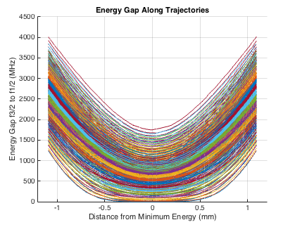
Calculate Schrodinger Equation
Propagate state according to ihdy/dt = Hy beginning far from the gap, at varying distance from central axis:

Slide 11
Calculate Schrodinger Equation
Propagate state according to ihdy/dt = Hy beginning far from the gap, at varying distance from central axis.
State Probability over the worst case trajectory which just grazes the pin:

Slide 12
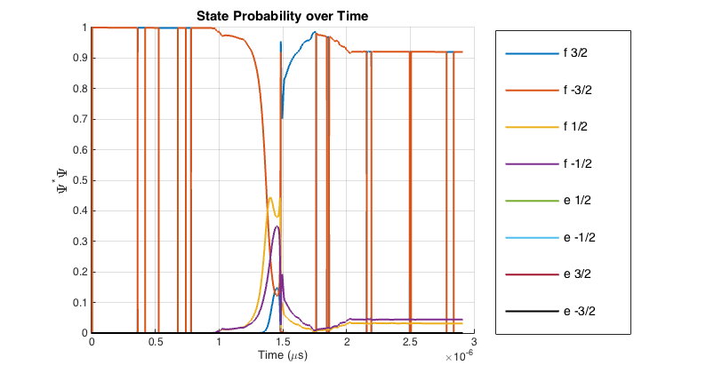
Calculate Schrodinger Equation

Slide 13
Calculate Schrodinger Equation
Propagate state according to ihdy/dt = Hy beginning far from the gap, at varying distance from central axis.
State Probability over the worst case trajectory which just grazes the pin.
Full map, after an hour on 32 cores:

Slide 14
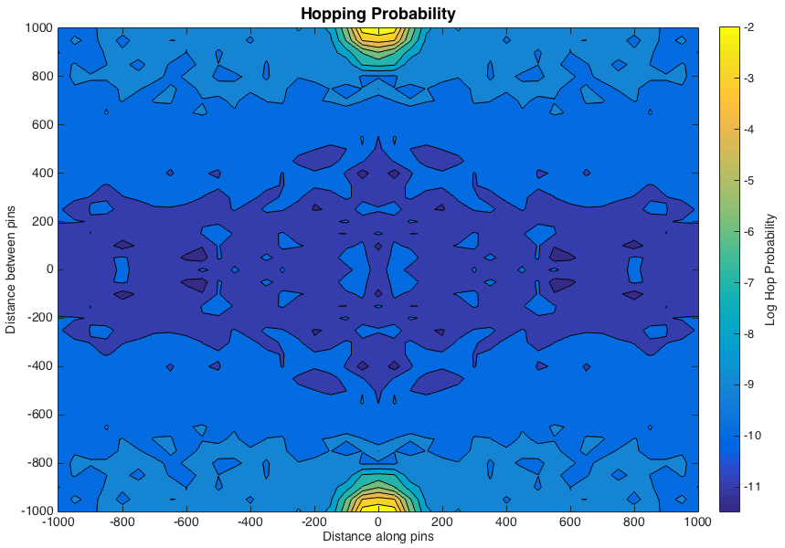

Slide 15
In-Flight Hops
Some molecules do hop.
Just looking at the area in this plane…
3*2*80*20/4e6~0.5% loss in our new Neon decelerator.
maybe only 0.1% in the old machine.

Slide 16
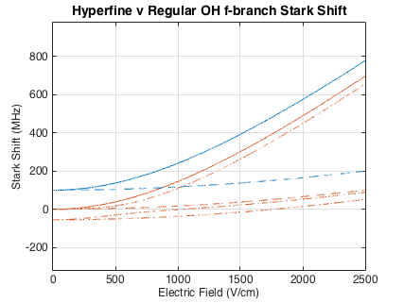
The End?
Hyperfine Correction:
Below 500 V/cm, half of OH has a quarter the gap.
So… I don’t feel like solving the schrodinger equation with the hyperfine hamiltonian, but probably a factor of two enhancement or so…
A 1% loss effect.

Slide 17
The End?
Hyperfine Correction: Factor of 2
Loss during switching?
Not on axis.
How about off axis?

